Slide 1


MARINE TECHNIQUES
Field | Marine Techniques
Chapter | DC Installations on boats
Subtitle | Battery Charges
Number | DLP-MT61-PP1-BatteryCharger

Slide 2
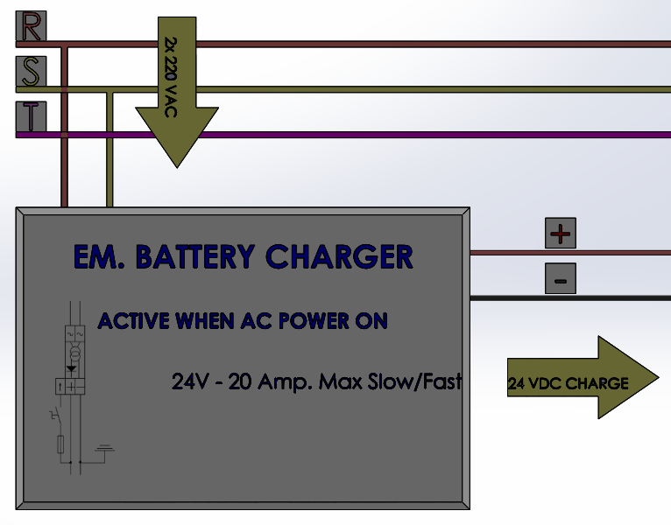
BATTERY CHARGER
A battery is a reversible device. It can give in energy to the consumers at different rates and must be recharged as continuously as possible to keep a zero balance.
A battery charger generates the energy needed by the battery. The charger must be powerful enough to replace the consumed energy in an automatic way. The energy transfer has to be efficient and safe.
Next

Slide 3
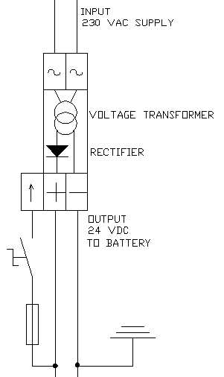
BATTERY CHARGER BASICS
The input comes from the AC line.
The electric power is given at a voltage (e.g. 230 VAC) and
and intensity (e.g. 2 Amps).
The voltage is reduced to an adequate level, say 24 VDC.
At this stage the voltage is converted into Direct Current by means of a diode bridge.
On the last stage the power is given in to the battery at an adequate level of intensity. A control device is needed. Sometimes it is just a diode.
Next

Slide 4
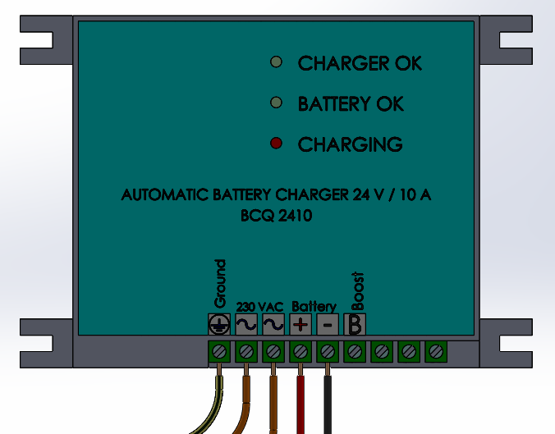
BATTERY CHARGER BASICS
Realistic view of a battery charger.
Inside this box the hardware is assembled: the voltage transformer, the diode bridge and the control unit.
On the exterior, there are a number of connection terminals and some leds indicating the charger mode.
Simple to connect. Two terminals for the AC supply and other two for the battery
Next

Slide 5
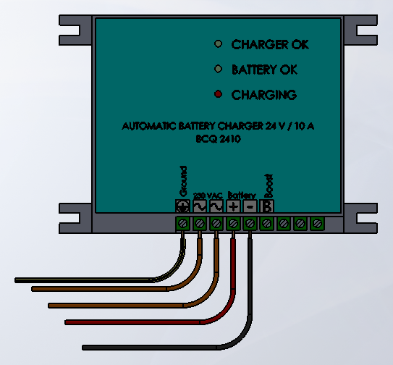
BATTERY CHARGER ADVANCED
This is a commercial battery charger.
Checking its correct operation is quite easy. It is just necessary to follow a number of steps.
On the lower part of the charger there are the AC and battery connectors.
On the front panel there are three leds that help check a correct running.
Next

Slide 6
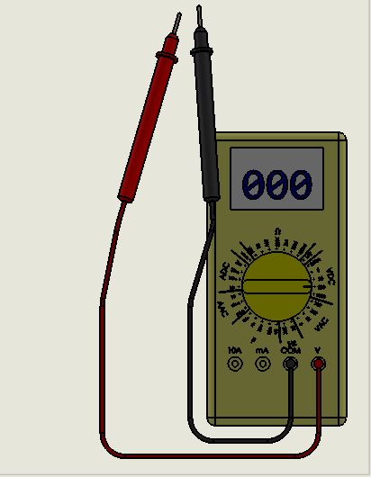
BATTERY CHARGER ADVANCED
This is a electric tester.
Now is set on VDC 200 V scale
The test cables are inserted into the V socket (red one) and into the COM socket (black one)
The first measure to be checked is the AC voltage, so the selector is to set on VAC 700V scale.
Next

Slide 7
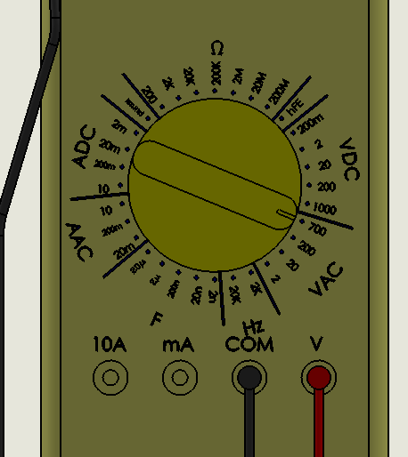
BATTERY CHARGER ADVANCED
The electric tester is now set on VAC 700 V scale.
The black cable must be connected onto one of the AC terminals. Whatever, as this is AC.
The red cable will touch the other AC terminals so a Voltage measure is read on the display.
Next

Slide 8
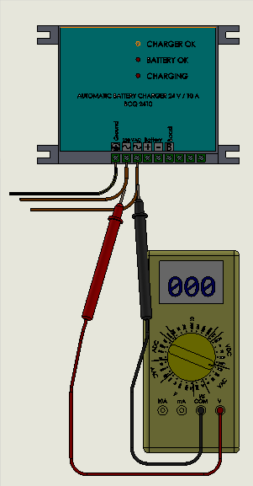
BATTERY CHARGER ADVANCED
The electric tester is is ready but test tips are not touching the terminals AC on the charger.
On the charger only the CHARGER OK led is green
Now, to check the AC supply test tips are put in contact with AC terminals.
Next

Slide 9
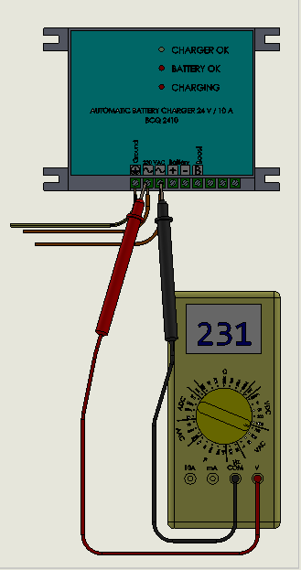
BATTERY CHARGER ADVANCED
The reading is 231 VAC.
The CHARGER OK green led is ON.
The conclusion is that the AC supply is OK and the CHARGER is AC powered.
Now is time to check the DC terminals or BATTERY terminals.
Next

Slide 10
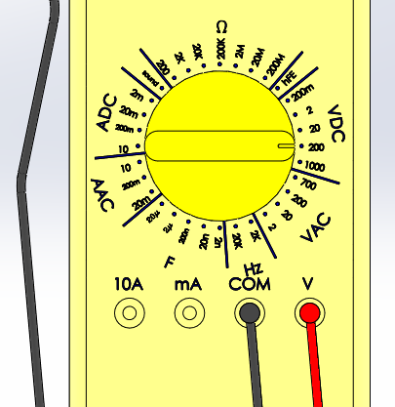
BATTERY CHARGER ADVANCED
The electric tester is now set on VDC 200 V scale.
The black cable must be connected onto negative DC terminals.
The red cable will touch the positive DC terminals so a voltage measure is read on the display.
Next

Slide 11
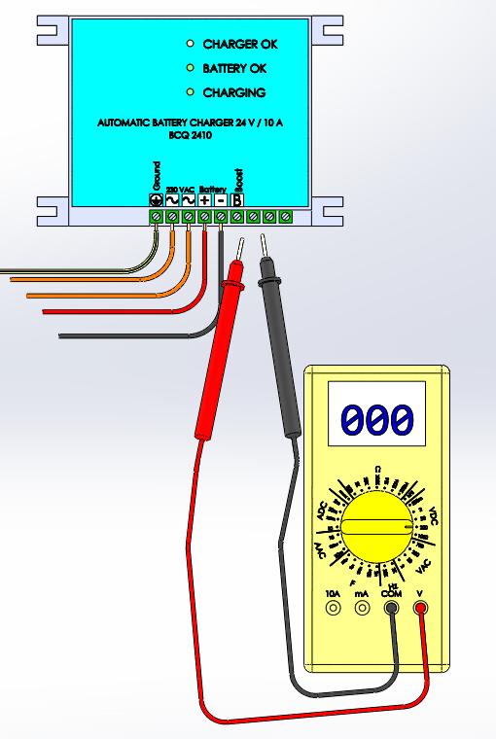
BATTERY CHARGER ADVANCED
The electric tester is is ready but test tips are not touching the terminals DC on the charger.
Now, to check the DC supply test tips are put in contact with DC terminals.
Next

Slide 12
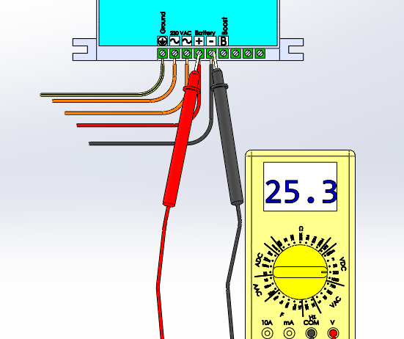
BATTERY CHARGER ADVANCED
The reading is 25.3 VDC.
The conclusion is that both the AC supply and the DC charge circuit are OK.
Back to 1st

