Slide 1


MARINE TECHNIQUES
Field | Marine Techniques
Chapter | DC Installations on boats
Subtitle | Maintenance of DC generation systems and power batteries
Number | DLP-MT58-V-2_2-InfoPhaseAnalyticalPhase

Slide 2
MAINTENANCE OF BATTERIES
Voltage
When battery is charged voltage must be nominal + 10%
Charging
Test battery voltage when no charging and when charging, a voltage increase must be significant.
Liquid level
Level in the cells must keep electrode plates perfecly submerged.
Refill water
When liquid level is to be raised distilled water will be used.
Liquid density
Liquid density is about 1.3 when charged and about 1.1 when discharged..

Slide 3
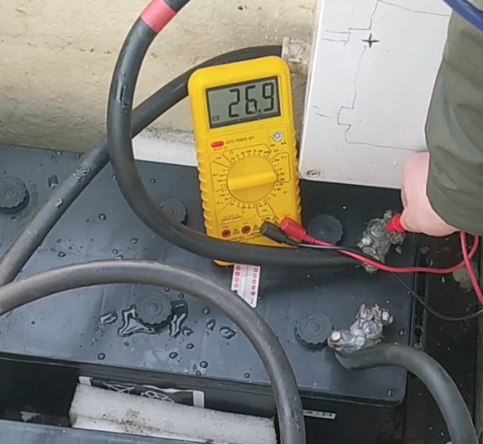
MAINTENANCE OF BATTERIES
Voltage
When battery is charged voltage must be nominal + 10%

Slide 4
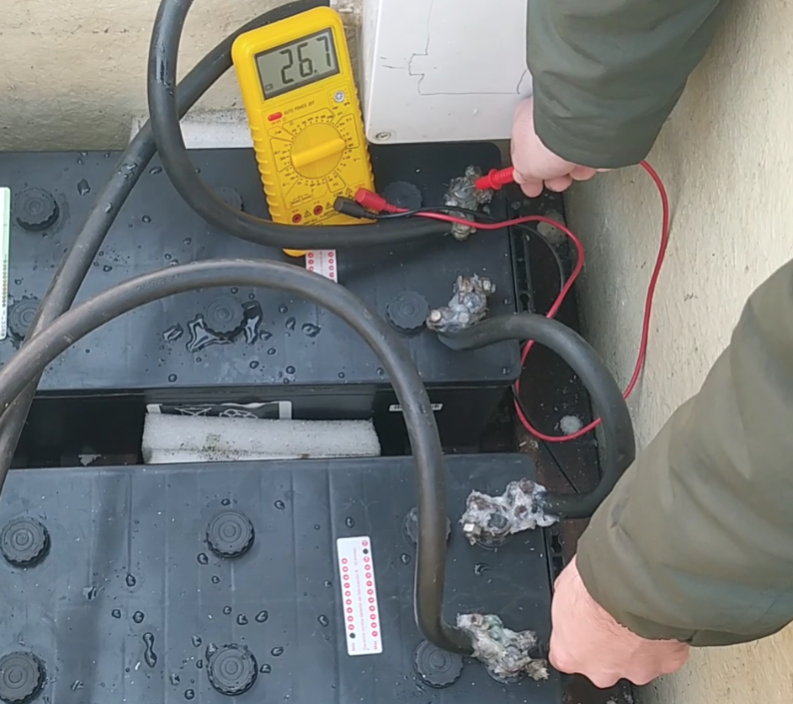
MAINTENANCE OF BATTERIES
Charging
Test battery voltage when no charging and when charging, a voltage increase must be significant.

Slide 5
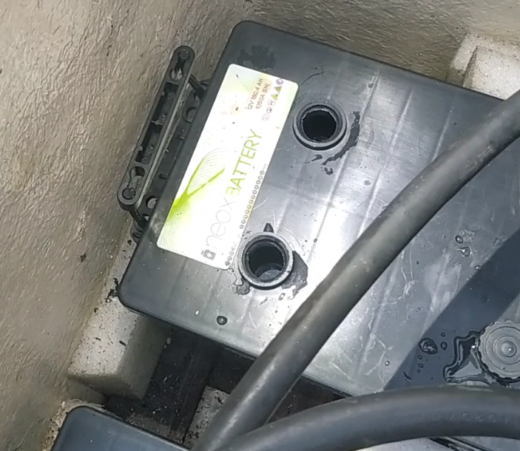
MAINTENANCE OF BATTERIES
Liquid level
Level in the cells must keep electrode plates perfecly submerged.

Slide 6
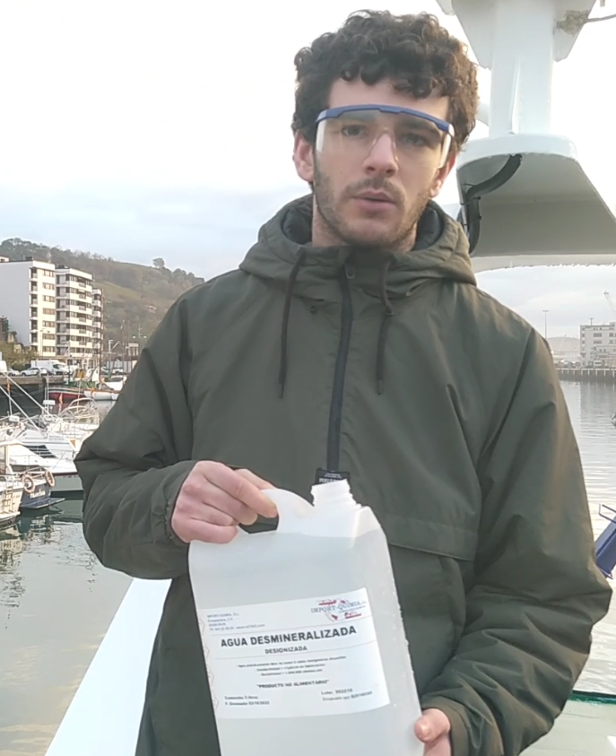
MAINTENANCE OF BATTERIES
Refill water
When liquid level is to be raised distilled water will be used.

Slide 7
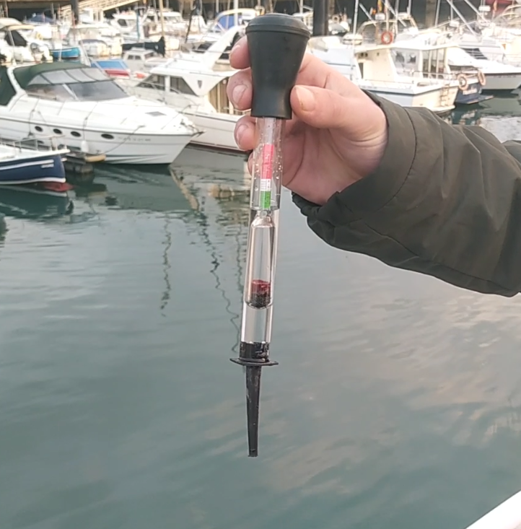
MAINTENANCE OF BATTERIES
Liquid density
Liquid density is about 1.3 when charged and about 1.1 when discharged..

