Slide 1


Field | Marine Technics
Chapter | Communications
Subtitle | Navtex

Slide 2
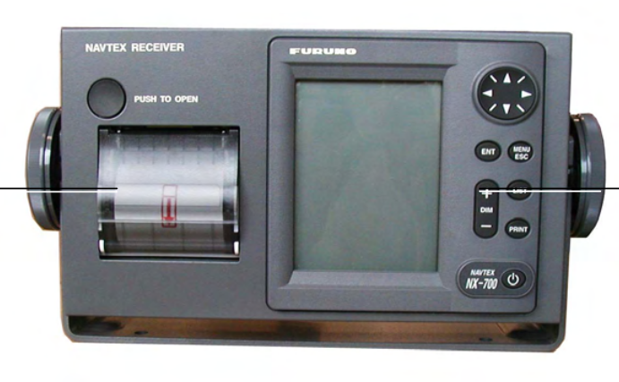
NAVTEX

Slide 3
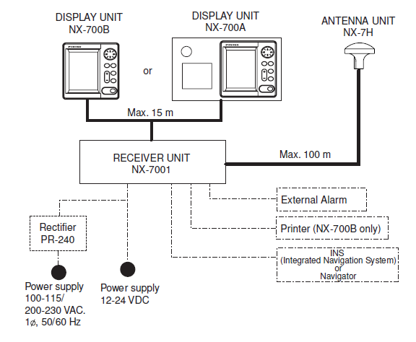
NAVTEX

Slide 4
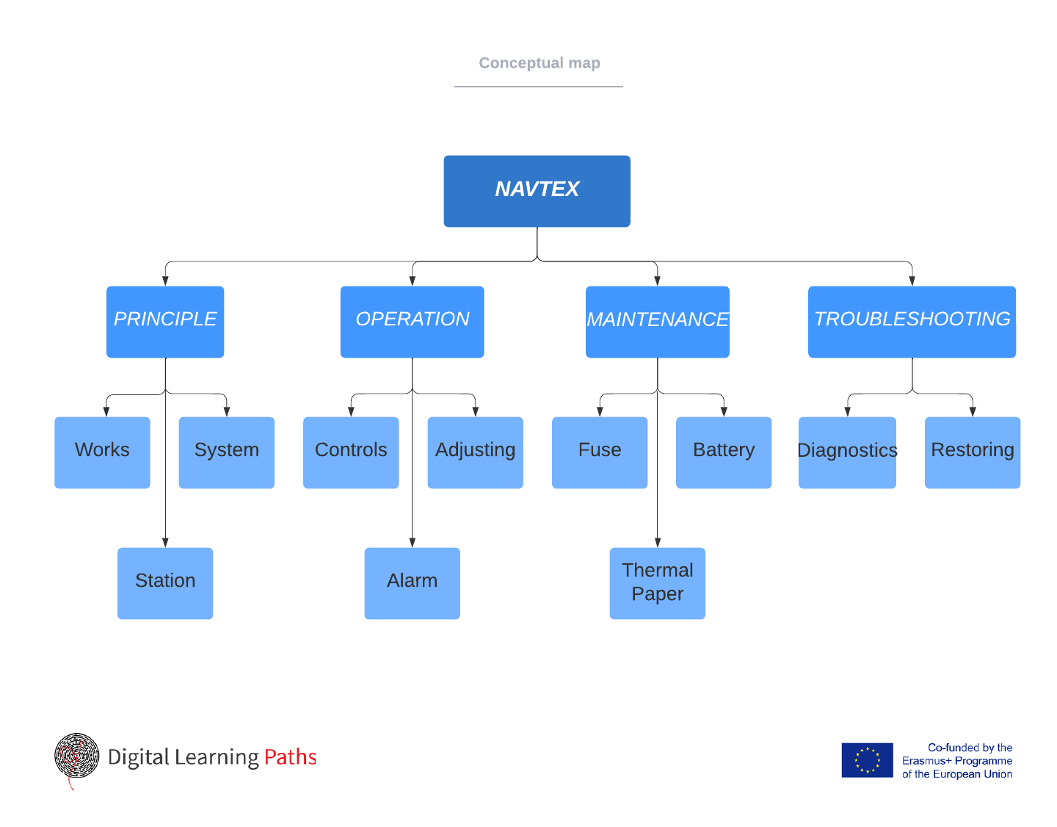

Slide 5
PRINCIPLE OF SYSTEM
How NAVTEX Works
NAVTEX System Operation
NAVTEX Message Format
NAVTEX Station Map & List

Slide 6
How NAVTEX Works
NAVTEX System Operation
NAVTEX is an acronym meaning Navigational Telex, and as its name shows, it is a kind of narrow band radio teletype system for ending (by frequency shift keying) text messages expressed in a 7-unit code.
For navigation purposes, the world is divided into 21 areas (called Navareas).
Each Navtex station has an identification code, from “A” to “Z”. The frequency assigned to Navtex are 518 kHz and another (490 or 4209.5 kHz), and many stations exist in the same service coverage.
• The transmission schedule is determined so that two or more stations having a common service area may not overlap in time.
• Each station transmits with minimum required power to cover its service area (200 to 400 nautical miles nominal).

Slide 7
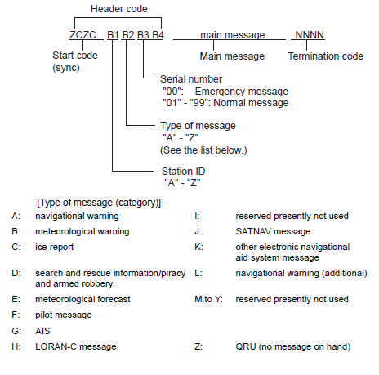
NAVTEX Message Format
The first five characters are always “ZCZC_“ and common to all messages. This part is used for message synchronization. The latter four characters are designed as B1, B2, B3 and B4 indicate origin, category and serial number of the message.
Character B1 is the identification letter of the Navtex station “A” thru “Z”.
Character B2 indicates the type of message. “A” thru “Z”, as listed below.
Character B3 and B4 indicate the serial number of the message.

Slide 8
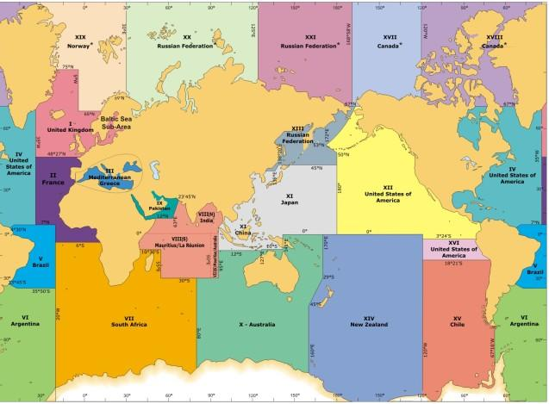
Croatia | Split | 43º30’N | 016º29’E | 518 | 85 | Q | 0240,0640,1040,1440,1840,2240
Spain | Valencia | 38º43’N | 000º19’ E | 518 | 300 | x | 0350,0750,1150,1550,1950,2350
NAVTEX Station
Map & List

Slide 9
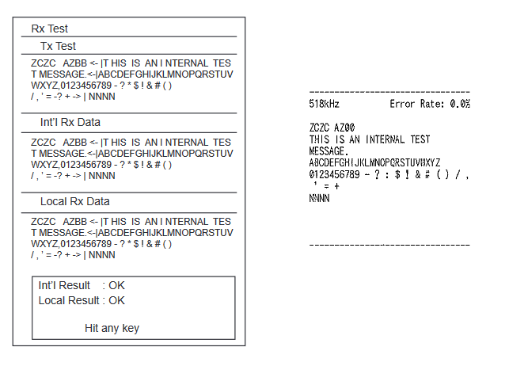
WEEKLY TEST

