Slide 1


Field | Mechanics
Chapter | Strength of materials
Subtitle | Resilience - Study of a spring

Slide 2
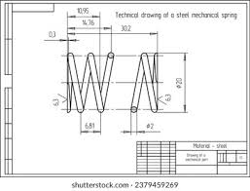
Resilience refers to the ability of a material to absorb energy when it is deformed elastically and then release that energy upon unloading.
Resilience is a crucial concept in understanding how materials respond to applied forces.
Resilience occurs in mechanical springs due to the elastic properties of the materials from which the springs are made.
https://www.shutterstock.com/search/mechanical-spring

Slide 3
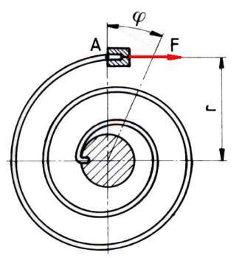
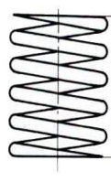
Flexion springs are loaded to the bend and torsion springs are loaded to the twist.
F
f
Flexion springs Torsion springs
F [N] - force
M [Nm] - moment (M=F·r)
f [m] - deflection - spring deformation
φ [rad] - angle of rotation angular deformation of the spring

Slide 4
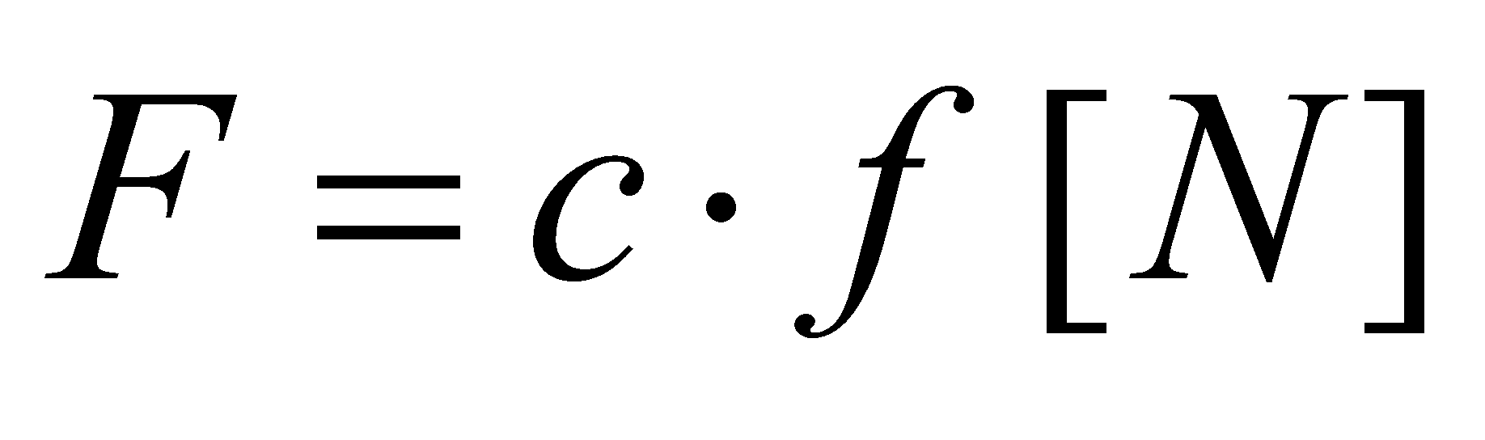
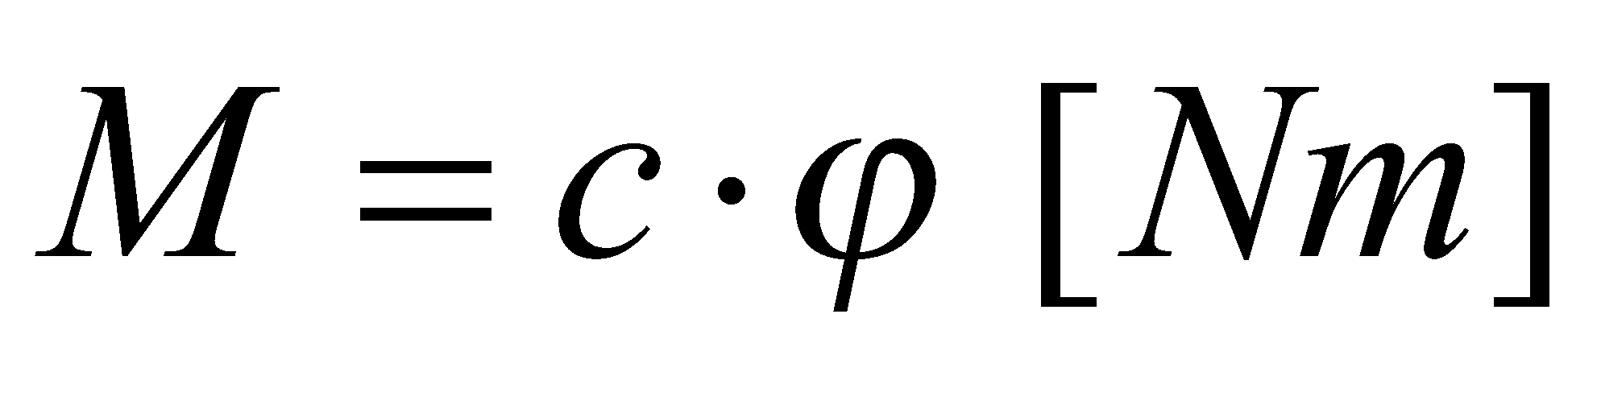
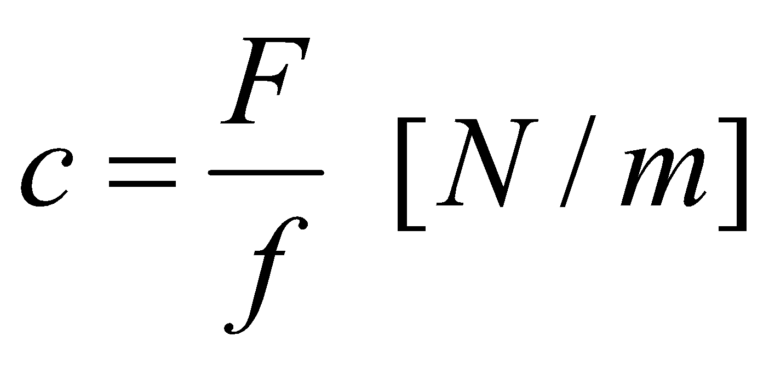
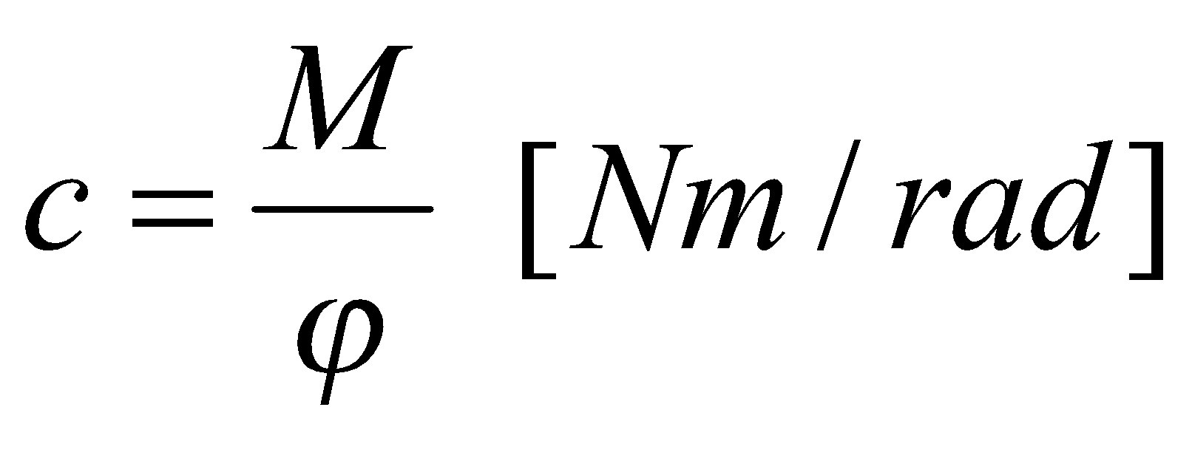
F
f
Flexion springs Torsion springs
F [N] - force
M [Nm] - moment (M=F·r)
f [m] - deflection - spring deformation
φ [rad] - angle of rotation angular deformation of the spring
c - static characteristic of the spring

Slide 5
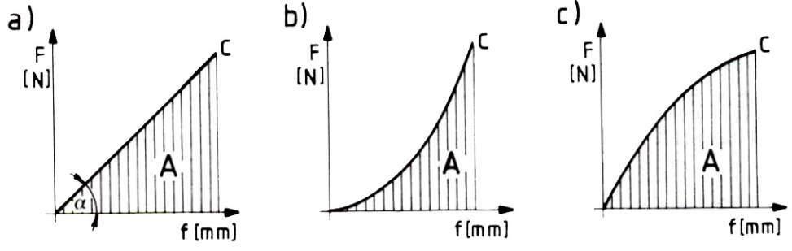
Linear Progressive Degressive
characteristics characteristics characteristics

Slide 6
Why resilience happens in mechanical springs?
Elasticity of Materials:
Springs are typically made from materials with high elasticity, such as various alloys of steel. Elasticity is the ability of a material to deform under stress and return to its original shape when the stress is removed.
Hooke's Law:
Hooke's Law describes the relationship between the force applied to a spring and the resulting deformation. According to Hooke's Law, the force required to deform a spring is directly proportional to the displacement of the spring from its equilibrium or rest position.

Slide 7
Energy Storage in Deformation:
When an external force is applied to a mechanical spring, it deforms elastically in response to that force. This deformation involves stretching or compressing the spring's material.
As the material deforms, it stores potential energy in the form of strain energy. This stored energy is a result of the work done in deforming the material elastically.
Recovery of Energy:
Once the external force is removed, the spring returns to its original shape, releasing the stored energy. This ability to recover and release the stored energy is a manifestation of the resilience of the material.

Slide 8
Repeated Cyclical Behavior:
Mechanical springs are designed to undergo repeated cycles of deformation and recovery. This cyclical behavior is essential in applications where the spring needs to absorb and release energy repeatedly without permanent deformation.

Slide 9
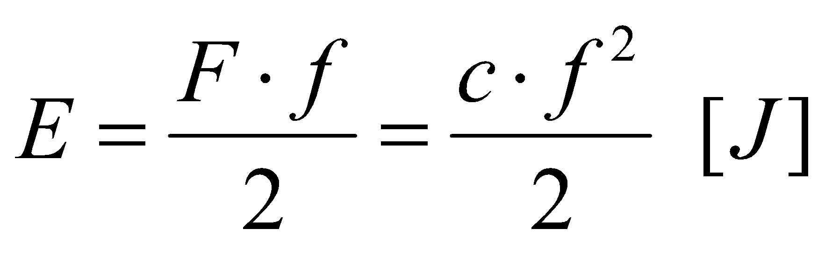
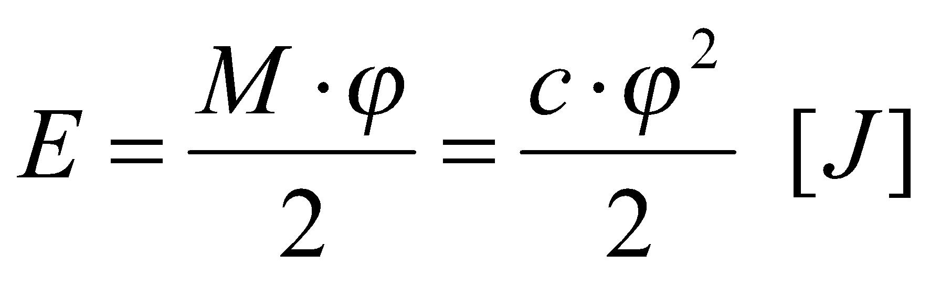
Two main types - Modulus of resilience and Modulus of toughness.
Modulus of resilience measures the elastic energy storage capacity, while Modulus of toughness measures both elastic and plastic energy storage. By returning the spring to its original dimensions and shape, the accumulated energy is also returned.
- Flexion springs
- Torsion springs

Slide 10
Resilience, in materials science, refers to the ability of a material to absorb energy when deformed elastically and then release that energy upon unloading. It is specifically associated with elastic deformation, which means that the material returns to its original shape once the applied force is removed.
Describing resilience as a crucial concept underscores its fundamental role in understanding how materials behave under mechanical loads. Materials with good resilience can absorb energy when subjected to forces, store that energy in the form of elastic deformation, and then release the stored energy when the force is removed. This property is crucial in various engineering applications.

Slide 11
Reference list
[1] Kulišić, Boris, 2007, Tehnička mehanika - nauka o čvrstoći s vježbama, Element, Zagreb
[2] Kulišić, Boris, 2000, Tehnička mehanika - statika s vježbama, Element, Zagreb
[3] Špiranec, Vladimir, 2004, Tehnička mehanika - statika - otpornost - gibanje - mehanizmi, Školska knjiga, Zagreb
[4] Šutalo V., Maković B., Pasanović B., 2007, Tehnička mehanika 1, Neodidacta d.o.o., Zagreb
[5] Šutalo V., Maković B., Pasanović B., 2007, Osnove tehničke mehanike, Neodidacta d.o.o., Zagreb
[6] The science of springs and how they work, from https://lesjoforssprings.com/insights/the-science-of-springs/, 10.01.2024.

