Slide 1


Field | Mechanics
Chapter | Strength of materials
Subtitle | Density of materials

Slide 2

The density of a material is defined as material mass per unit volume and designated by the symbol ρ. The SI unit of density is kg/m³. Density is an important characteristic property of a material and varies with temperature and pressure.
density of a material
m - mass of a material
V - volume of a material

Slide 3
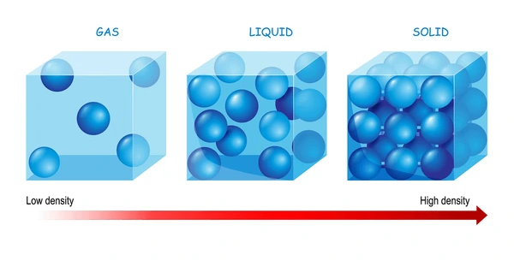
Density depends on temperature and pressure. It also depends on the way atoms stack together in solids. Some elements have many allotropes or forms. For example, graphite and diamond are both solid forms of pure carbon, but they have different densities and other properties.
Density and states of matter
https://www.shutterstock.com/search/density-liquid

Slide 4
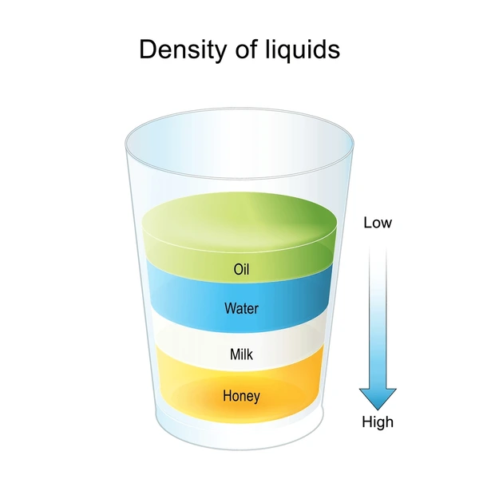
Generally, gases are less dense than liquids, which are less dense than solids. However, there are many exceptions. For example, ice (a solid) is less dense than water (a liquid).
A few gases are heavier than liquids. For example, water is lighter than tungsten hexafluoride gas.
Density of liquids
https://www.shutterstock.com/search/density-liquid

Slide 5
The relationship between material density and strength is complex, with various factors influencing the mechanical behavior of materials. A thorough understanding of these principles is essential for designing robust and efficient structures.
Generally, as the density of a material increases, its strength also tends to increase, given other factors remain constant. Higher density implies stronger intermolecular forces, leading to improved resistance against deformation and failure. In metals, higher density often correlates with stronger metallic bonds, enhancing tensile strength and durability. The density of composite materials, which are composed of different components, can be tailored to achieve a balance between strength and weight.

Slide 6
Reference list
[1] Kulišić, Boris, 2007, Tehnička mehanika - nauka o čvrstoći s vježbama, Element, Zagreb
[2] Kulišić, Boris, 2000, Tehnička mehanika - statika s vježbama, Element, Zagreb
[3] Špiranec, Vladimir, 2004, Tehnička mehanika - statika - otpornost - gibanje - mehanizmi, Školska knjiga, Zagreb
[4] Šutalo V., Maković B., Pasanović B., 2007, Tehnička mehanika 1, Neodidacta d.o.o., Zagreb
[5] Šutalo V., Maković B., Pasanović B., 2007, Osnove tehničke mehanike, Neodidacta d.o.o., Zagreb
[6] Density of Materials, from https://amesweb.info/Materials/Density-Materials.aspx, 20.12.2023.
[7] Density of Common Engineering Materials, from https://www.engineersedge.com/materials/density_of_common_engineering_materials__15896.htm, 20.12.2023.
[8] Density liquid, from https://www.shutterstock.com/search/density-liquid, 21.12.2023.

