Slide 1


Field | Mechanics
Chapter | Strength of materials
Subtitle | Buckling in general

Slide 2
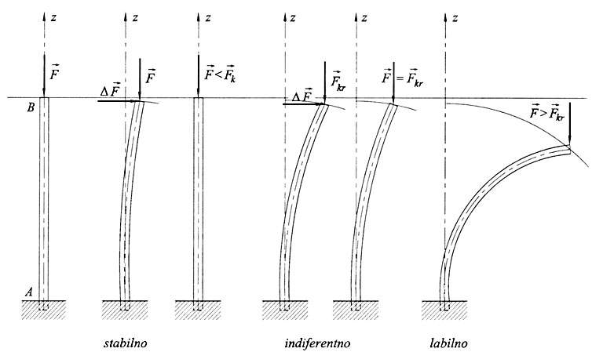
Buckling stress is considered in the case of an axially loaded rod. If the rod has a relatively small cross-sectional area compared to its length, then buckling occurs. If the rod is ideally flat, homogeneous, and centrally loaded, it experiences only compressive stress and retains a flat shape. If a small lateral force ΔF is applied, buckling of the rod occurs.

Slide 3
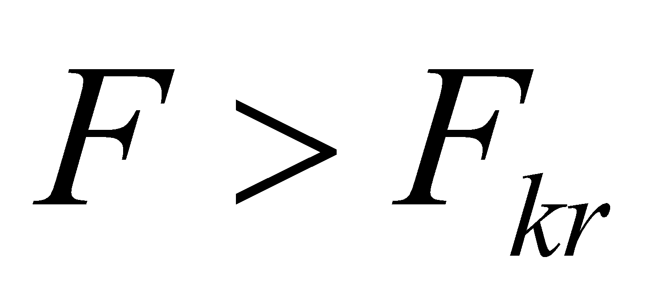
Under real conditions, the rod is never perfectly flat, homogeneous, or centrally loaded, so there is no need for a lateral force ΔF for buckling to occur. Buckling always occurs when the compressive force exceeds a critical value.

Slide 4
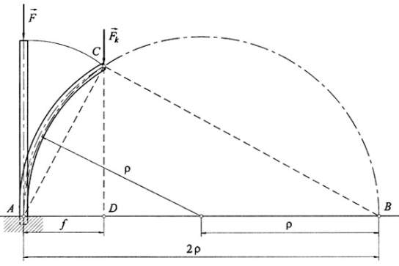
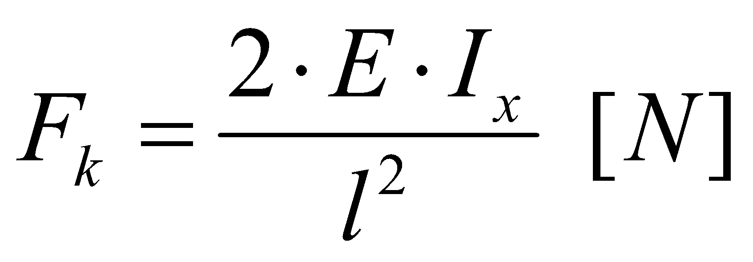
E [MPa] - modulus of elasticity
Ix [mm⁴] - axial moment of inertia
l [mm] - the length of the rod
The ideal shape of the elastic line is in the form of a circular radius. In reality, the elastic line takes the form of a cosine curve,
and the actual critical force is calculated according to Euler's equations.

Slide 5
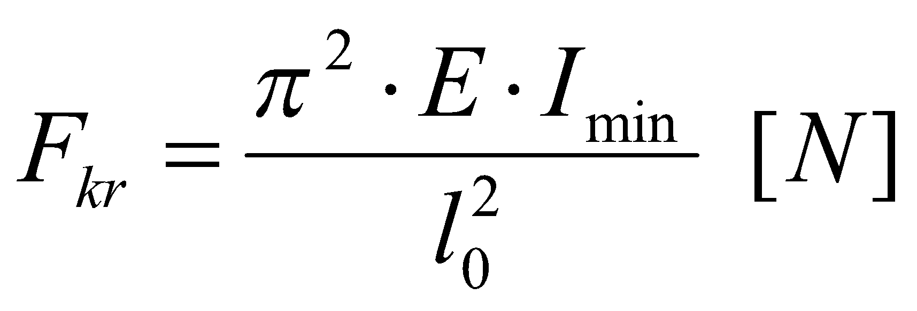
Euler's equations for critical forces
E [MPa] - modulus of elasticity
Imin [mm⁴] - minimal axial moment of inertia
l0 [mm] - reduced rod length; a distance
between the transition points of
elastic lines which depends on the
method of fixing the rod
Buckling is always done around the axis for which the moment of inertia is the smallest.

Slide 6
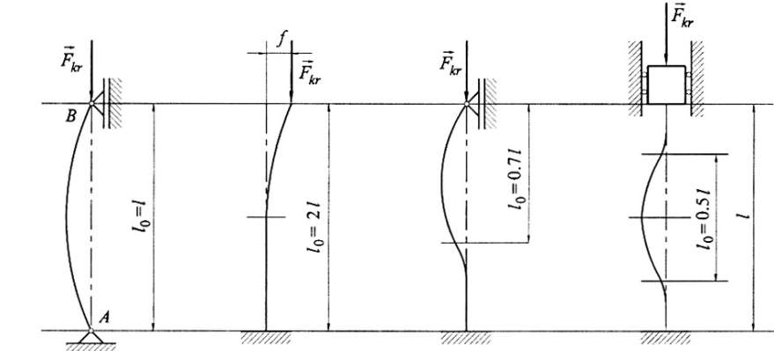
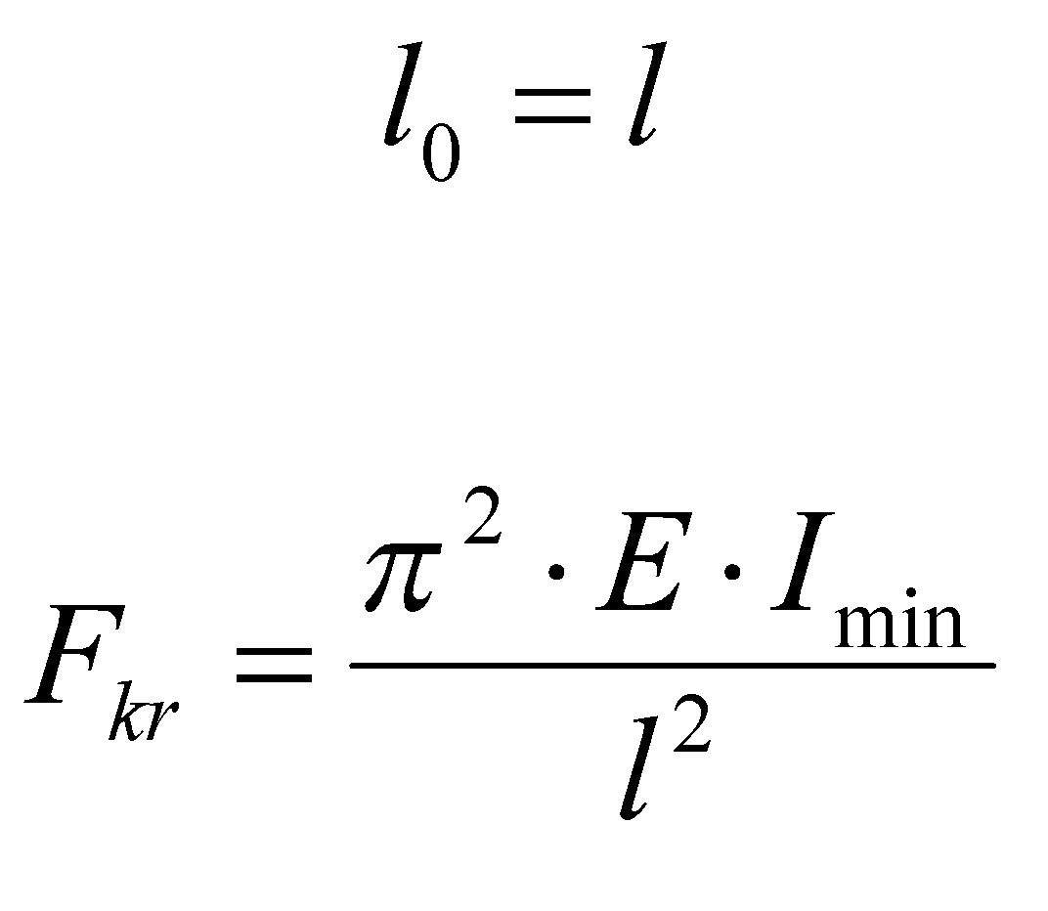
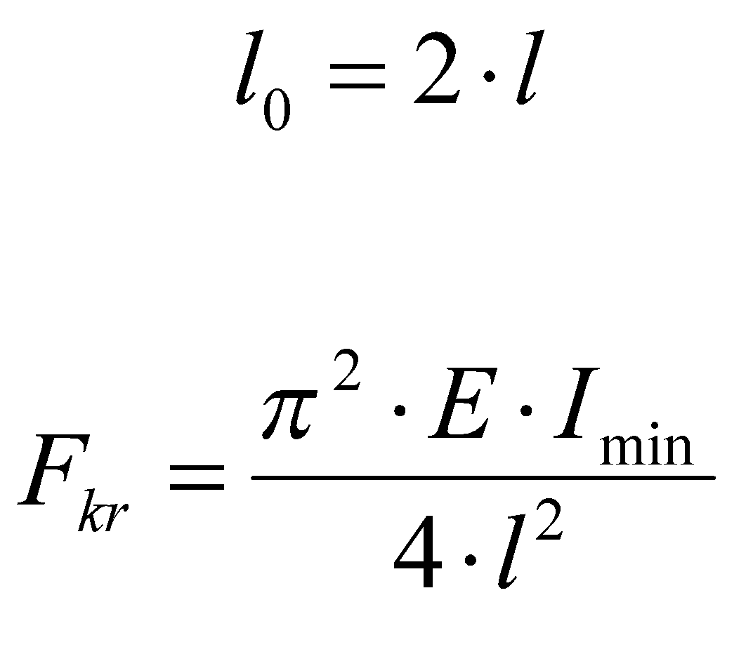
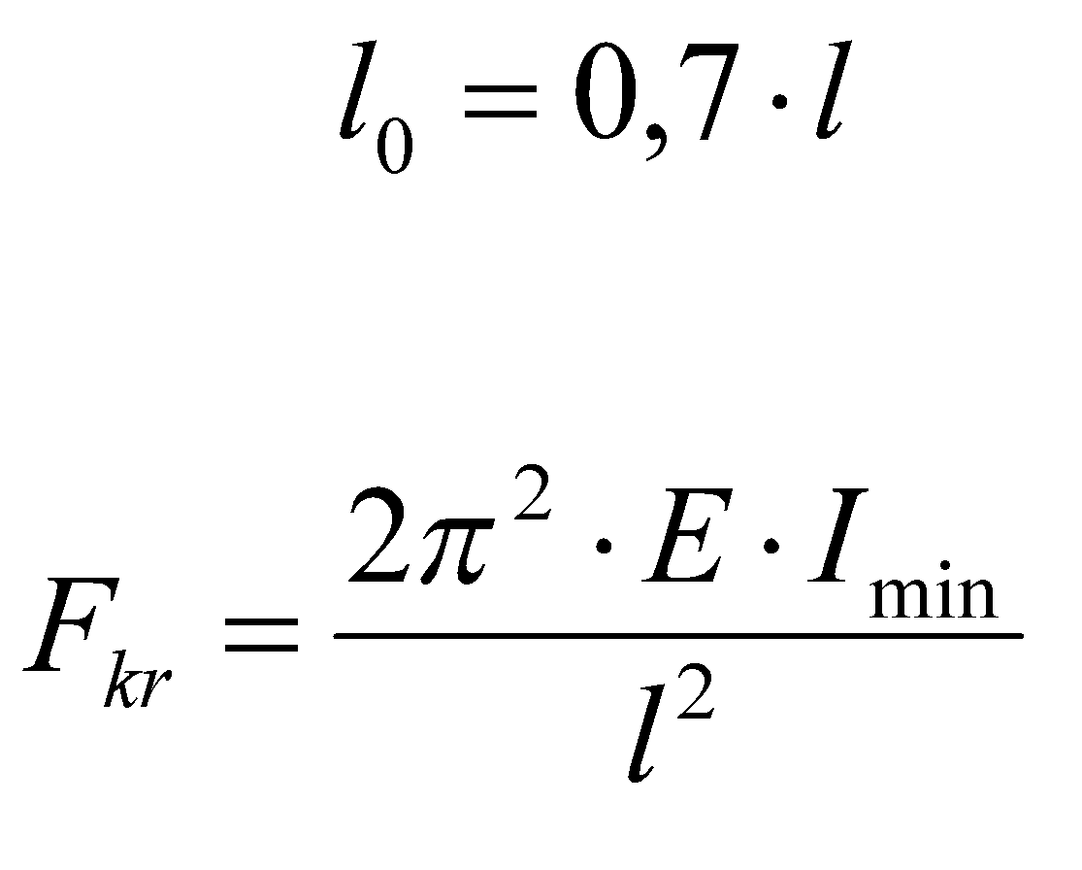
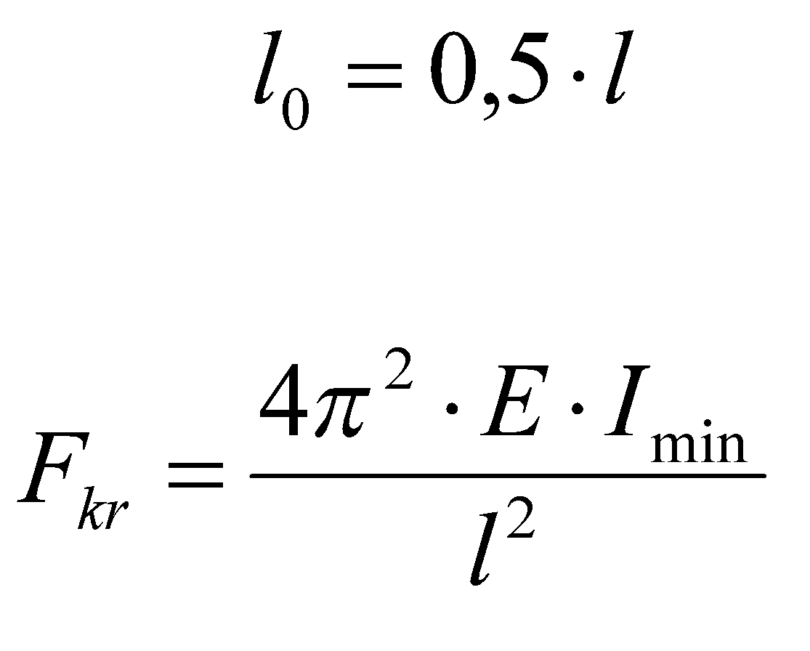

Slide 7
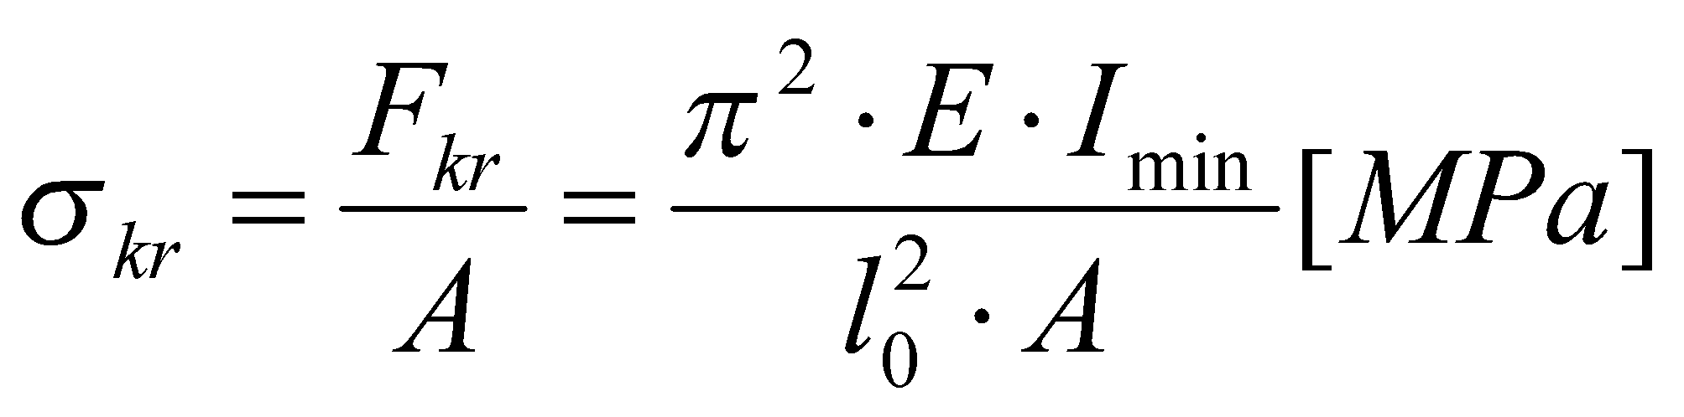
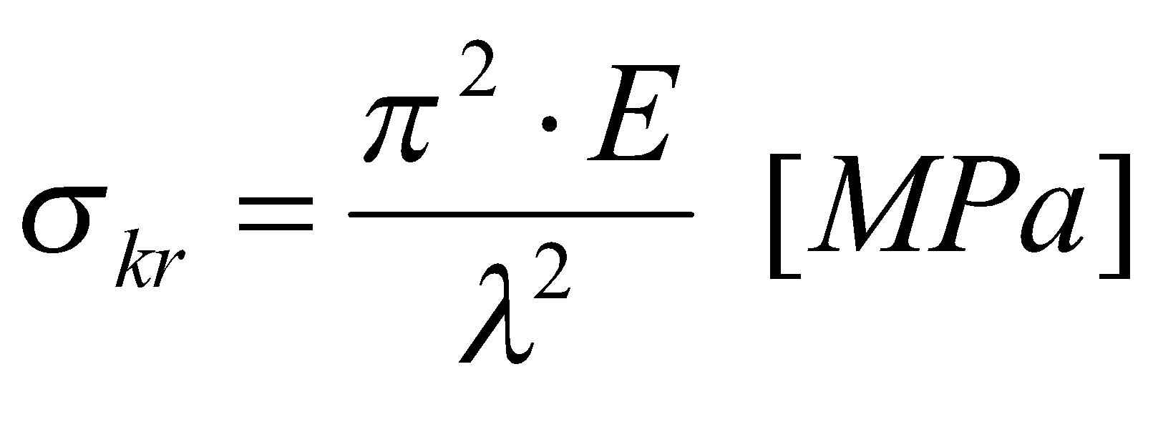
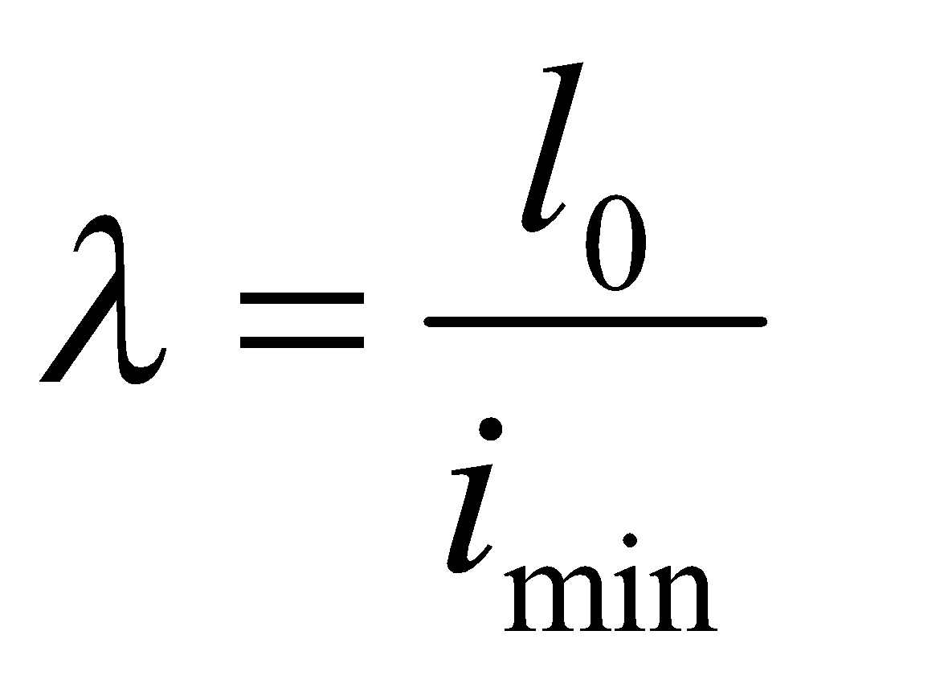
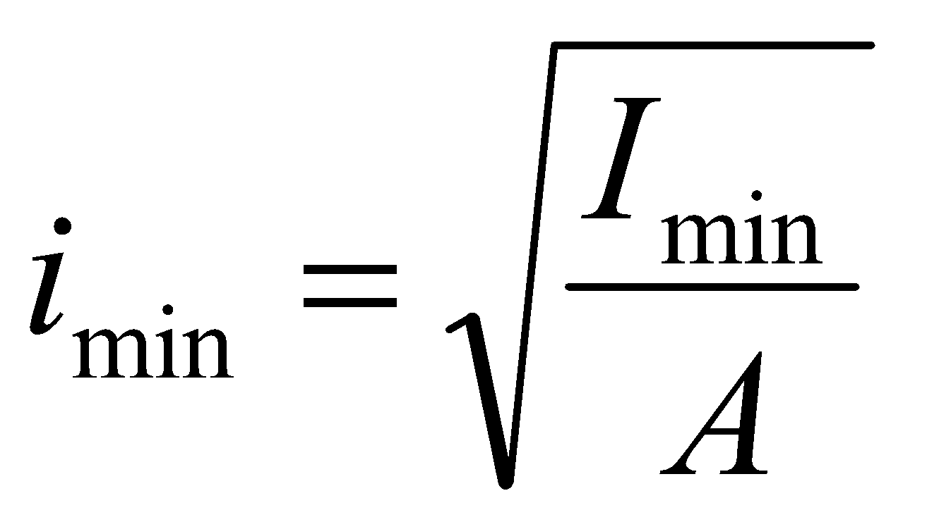
The critical stress is calculated from the critical Euler force.
A [mm²] - cross-sectional area of ​​the
rod
λ - rod slenderness
imin [mm] - minimum radius of inertia
Imin [mm⁴] - minimal axial moment of
inertia
l0 [mm] - reduced rod length

Slide 8
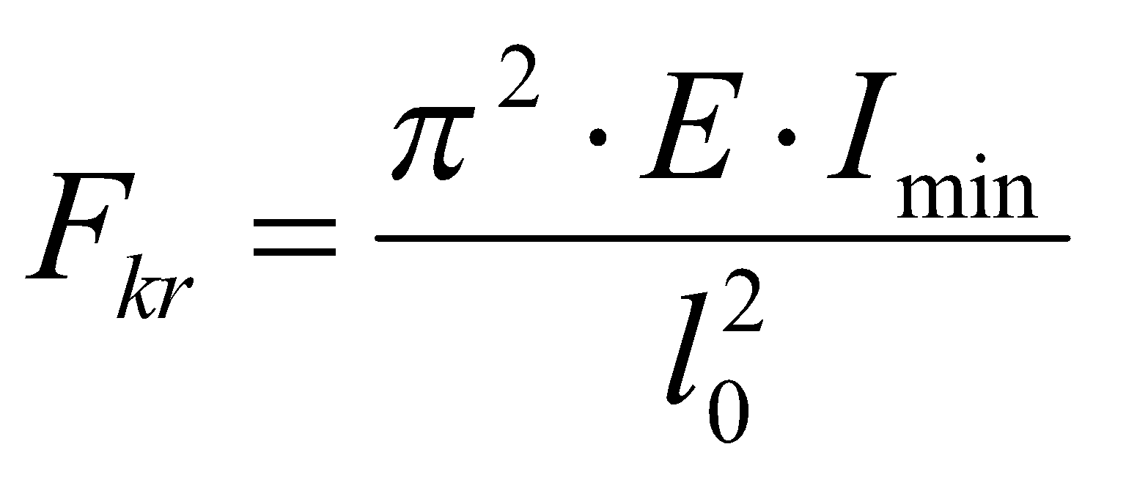
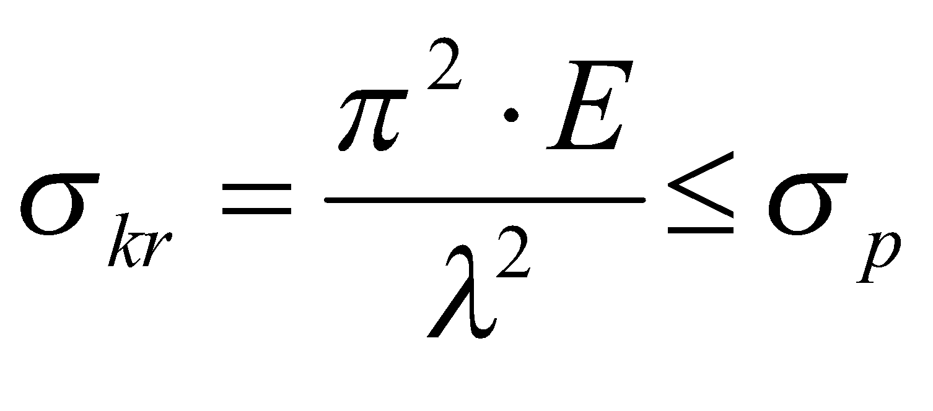
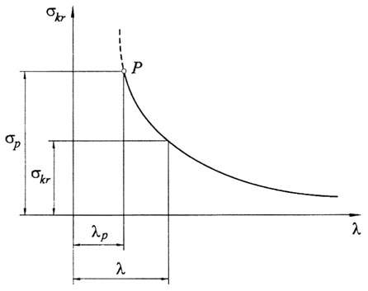
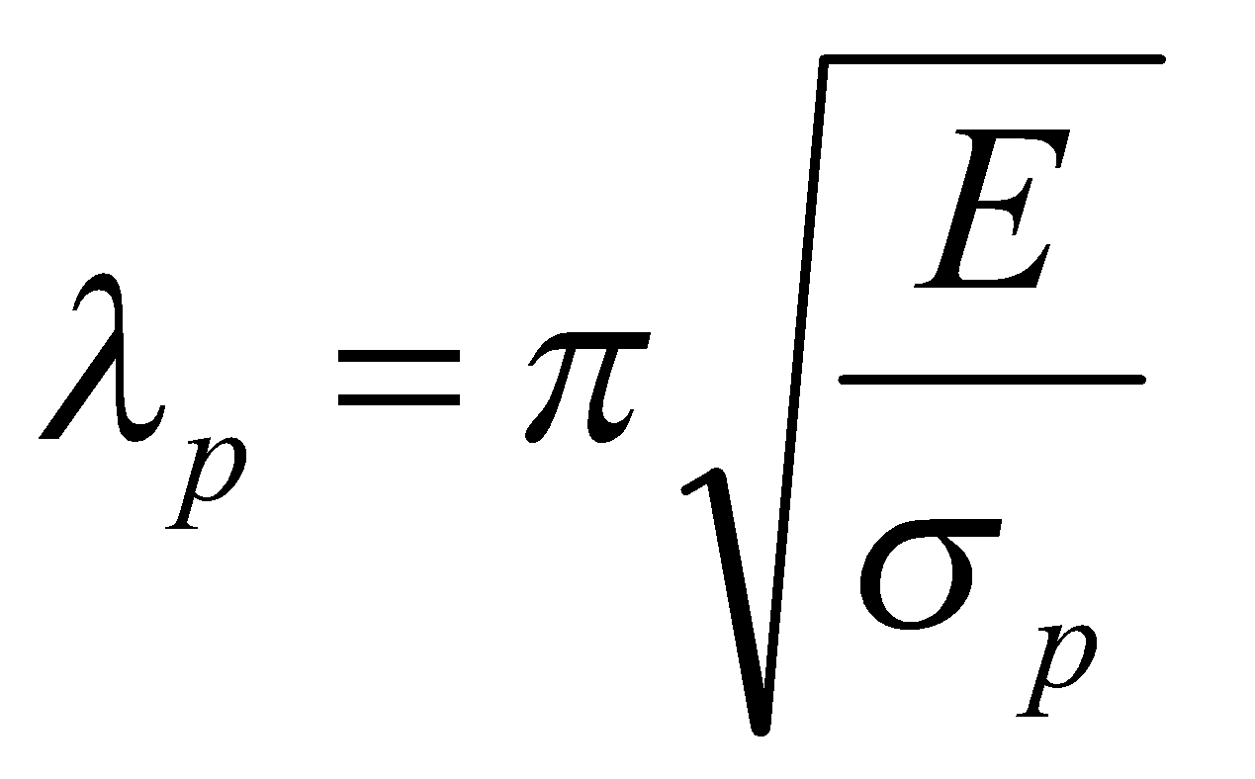
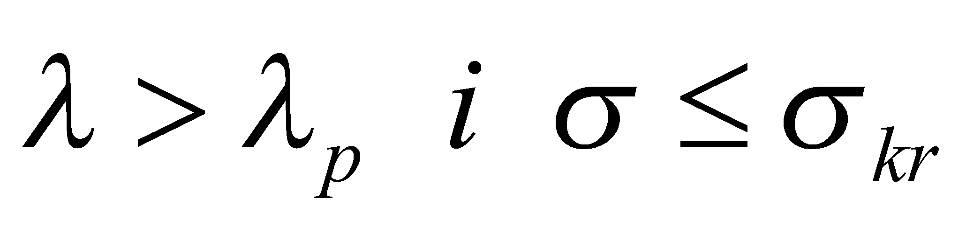
Euler's equations for critical force and critical stress contain the modulus of elasticity (E) which is constant, so they are valid only in the area of ​​proportionality.
For stress at the boundary proportionality applies limit slenderness λ_{p}.
Euler's equations therefore
valid only in the area:

Slide 9
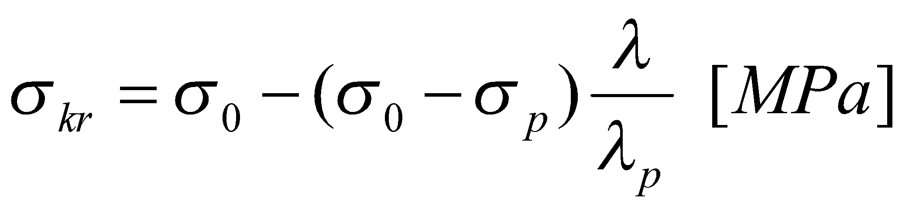
When the slenderness of the rod is greater than the limit (λ>λp), buckling takes place in an inelastic state (plastic) area where Euler's equations do not apply.
In this case, Tetmayer's expressions are used.
λ - rod slenderness
λ_{p} - limitary rod slenderness
σ₀ [MPa] - characteristic stress
obtained by extension of a
Tetmayer's direction
σ_{p} [MPa] - limit of proportionality

Slide 10
Reference list
[1] Kulišić, Boris, 2007, Tehnička mehanika - nauka o čvrstoći s vježbama, Element, Zagreb
[2] Kulišić, Boris, 2000, Tehnička mehanika - statika s vježbama, Element, Zagreb
[3] Špiranec, Vladimir, 2004, Tehnička mehanika - statika - otpornost - gibanje - mehanizmi, Školska knjiga, Zagreb
[4] Šutalo V., Maković B., Pasanović B., 2007, Tehnička mehanika 1, Neodidacta d.o.o., Zagreb
[5] Šutalo V., Maković B., Pasanović B., 2007, Osnove tehničke mehanike, Neodidacta d.o.o., Zagreb

