Slide 1


Field | CNC turning and milling
Chapter | Turning
Subtitle | Exercise 2

Slide 2
Exercise 2
Video of CNC lathe simulation in Mastercam.
Operations used in this exercise are:
- Lathe face turning
- Lathe rough turning
- Lathe fine turning
- Stock flip
- Lathe grooving
- Lathe thread
‹#›

Slide 3
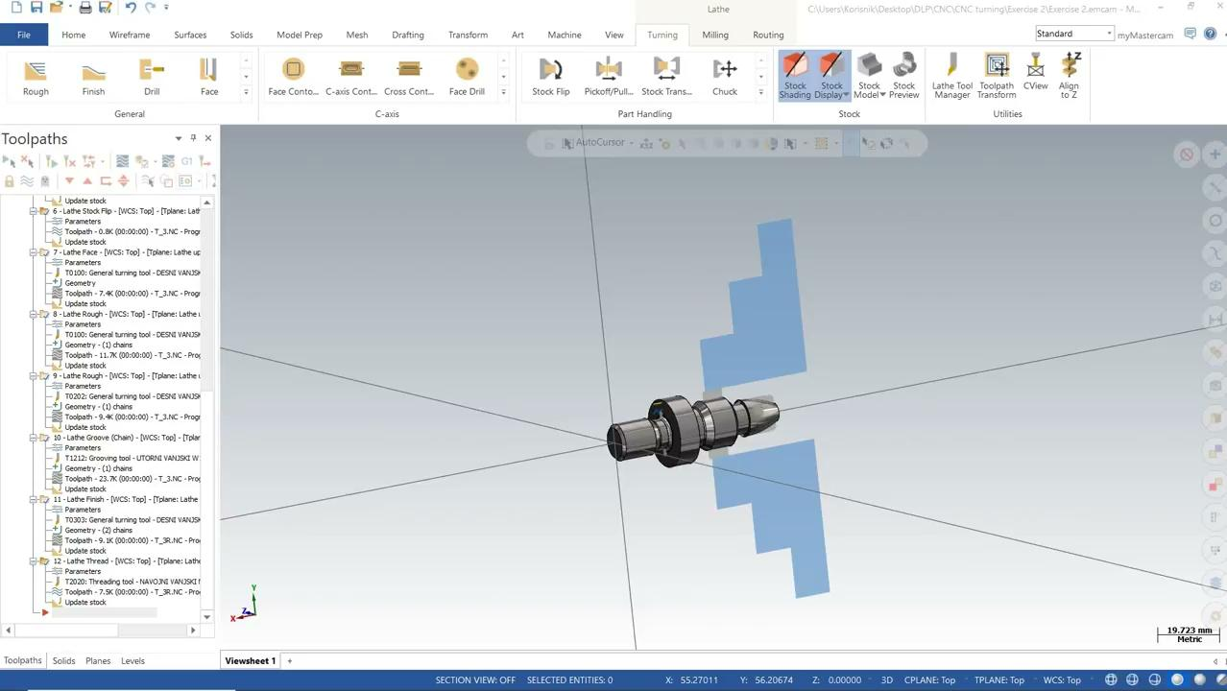
Watch the video of CNC lathe simulation
‹#›

