Slide 1


Field | CNC turning and milling
Chapter | Milling
Subtitle | Exercise 1

Slide 2
Exercise 1
Video of CNC milling simulation in Mastercam.
Operations used in this exercise are:
- Face milling
- 2D high speed milling
- Contour milling
- Chamfer milling
- Drill
- Counterbore
‹#›

Slide 3
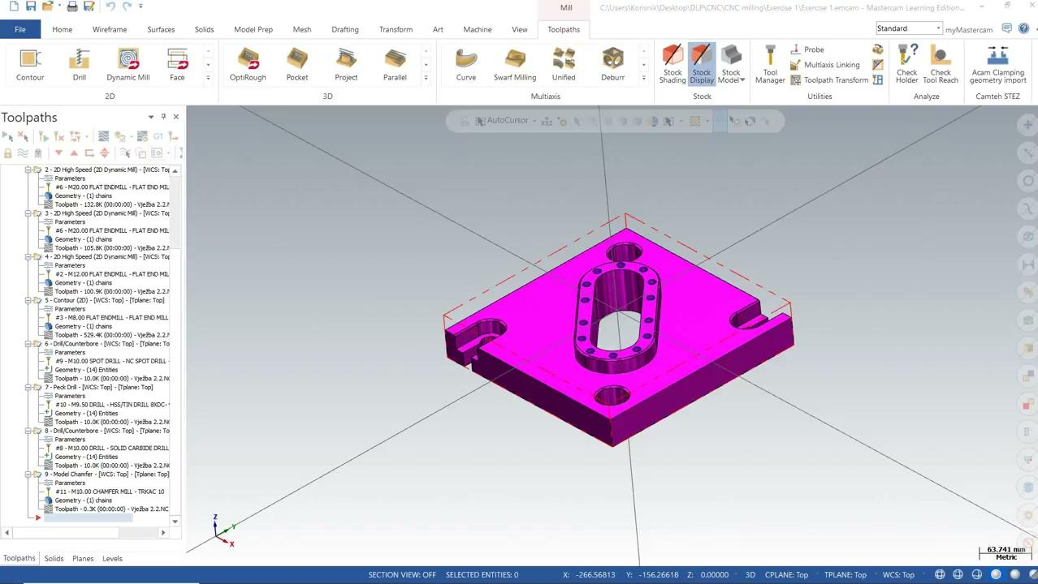
Watch the video of CNC milling simulation
‹#›

