Slide 1


Field | Mechanics
Chapter | Power transmission
Subtitle | Belt transmission

Slide 2
Why choose belt drive?
For the larger distance between shafts
For more elastic and flexible transmission
Easy to install and maintain
More economical way to transmit force and rotary motion
What else?

Slide 3
How the transmission of force and rotary motion is obtained?
By friction
Are there any the disadvantages of a belt drive?
Slippage (transmission of smaller forces)
Wearing out and deterioration of the belt
Increased space requirements

Slide 4
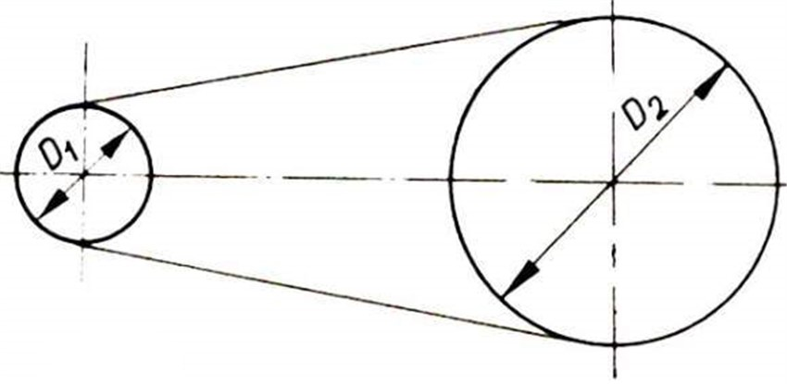
F
M
F
Driving pulley
Belt
Driven pulley

Slide 5
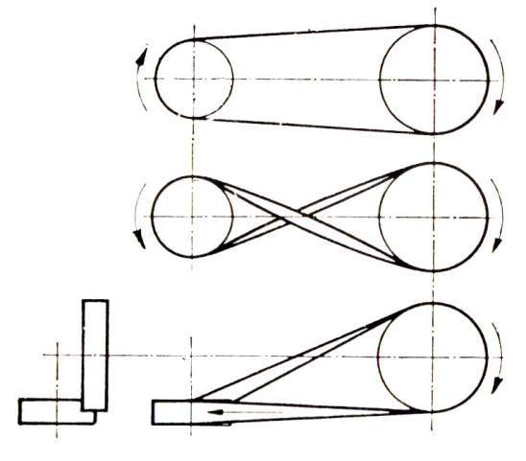
Types of belt drives
Open belt drive
Cross belt drive
Quarter turn belt drive

Slide 6
Preload tension
The weight of the belt itself while in horizontal position
Elastic deformation of the belt
Tightening the belt by moving the driving pulley with the idler pulley
Tensioner pulley
Self-tightening device
Circumferential gear force

Slide 7
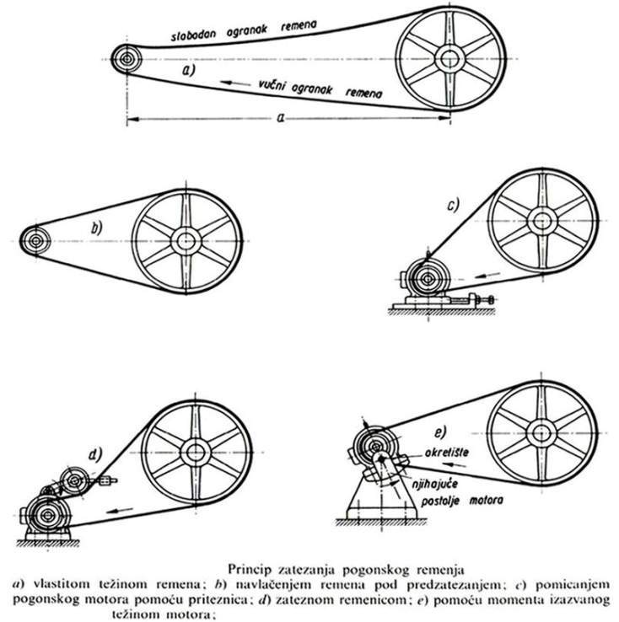
The principles of tightening the drive belts
a) The weight of the belt; b) By pulling the belt under pretensioning c) Tightening the belt by moving the driving pulley with the idler pulley; d) Tensioner pulley; e) Moment caused by the weight of the engine
Notes:
Necessary to find a new illustration (for a and e)
c) Motor slide base???
e) Pivoting motor base???

Slide 8

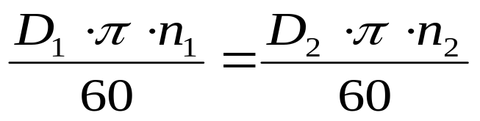

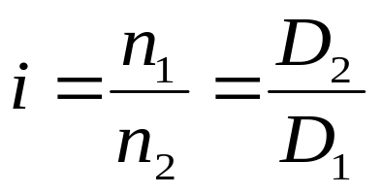
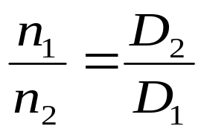
F
M
F

Slide 9
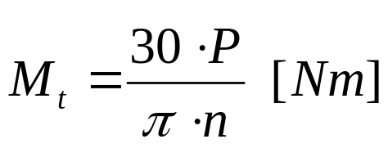
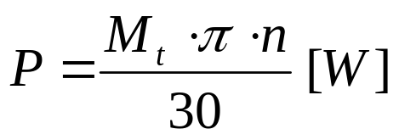

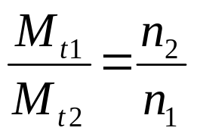
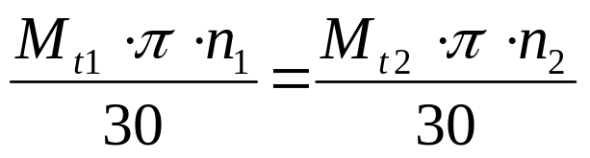
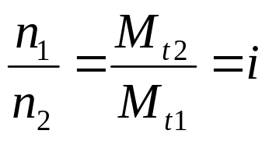

For a normal drive without slipping:

Slide 10

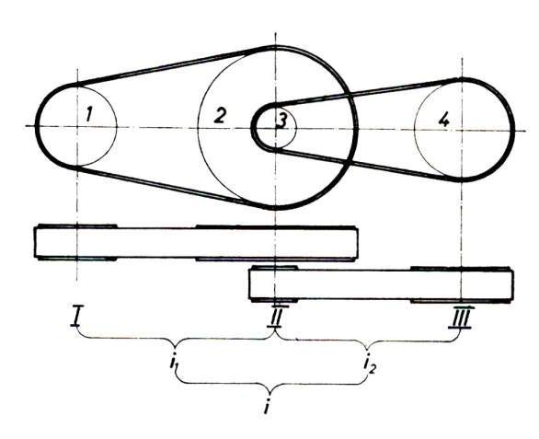
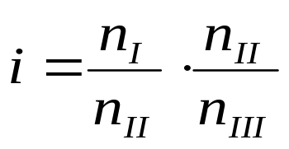
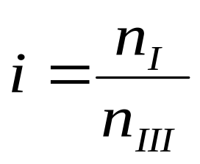
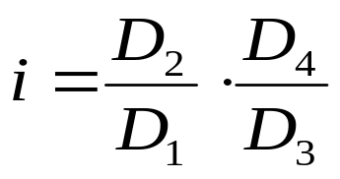

Slide 11
The importance of transmission ratio
i > 1 - reducer; decrease of the number of revolutions; increase of the torque
(n₁>n₂; D₁<D₂)
2
1
i < 1 - multiplier; increase of the number of revolutions; decrease of the torque
(n₁<n₂; D₁>D₂)
1
2
i = 1 - no change of number of revolutions nor the torque
(n₁=n₂; D₁=D₂)
1
2

Slide 12




Practical example
1. An engine with a 700 rpm belt drive transmits the power from the shaft of 100mm in diameter to another shaft on which there is a pulley of 400mm in diameter. What is the rotation speed of another pulley?
n1=700 rpm
d1= 100mm =0,1m
d2= 400mm= 0,4m
Required: n2= ?
Answer:
$$d_{1}∙n_{1}=d_{2}∙n_{2}$$
$$n_{2}=\frac{d_{1}∙n_{2}}{d_{2}}$$
$$n_{2}=\frac{0,1∙700}{0,4}$$
$$n_{2}=175okr/min$$

Slide 13
Reference list
[1] E. Hercigonja, Eduard, 2005, Strojni elementi 1, Školska knjiga, Zagreb​
​
[2] E. Hercigonja, Eduard, 2005, Strojni elementi 2, Školska knjiga, Zagreb​

