Slide 1
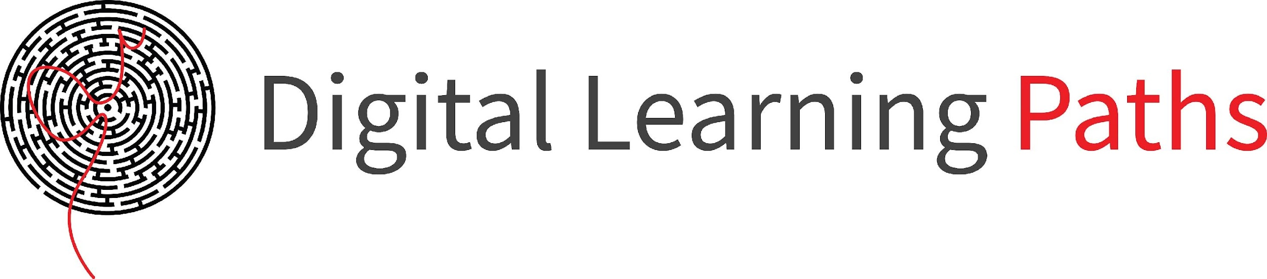

Field | Mechanics
Chapter | Strength of materials
Subtitle | Torsion example

Slide 2
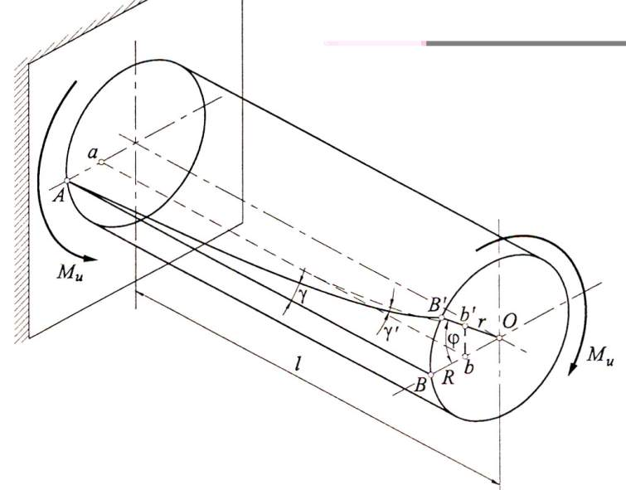
Torsion is a moment that twists a structure. Unlike axial loads which produce a uniform, or average, stress over the cross-section of the object, a torsion creates a distribution of stress over the cross-section. When torsion is applied to the structure, it will twist along the long axis of the rod and its cross section remains circular.
a

Slide 3
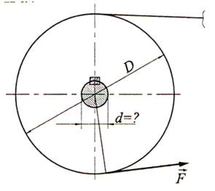
Practical example
Determine the diameter of the shaft through which the power is transmitted belt transmission if the diameter of the pulley is 300 mm,
the force in the working arm is 6 kN, and the permissible stress is 12 MPa.
D = 300 mm
F = 6 kN
τ_{tdop} = 12 MPa

Slide 4
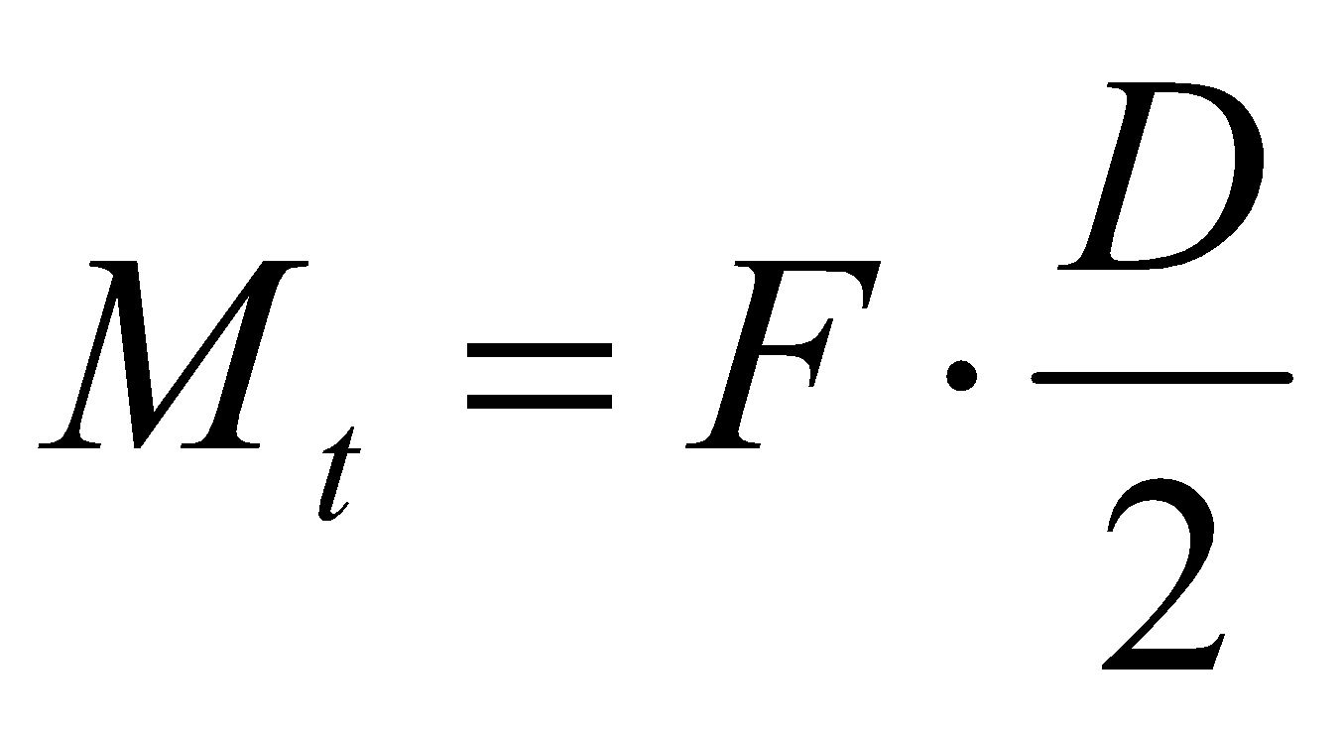
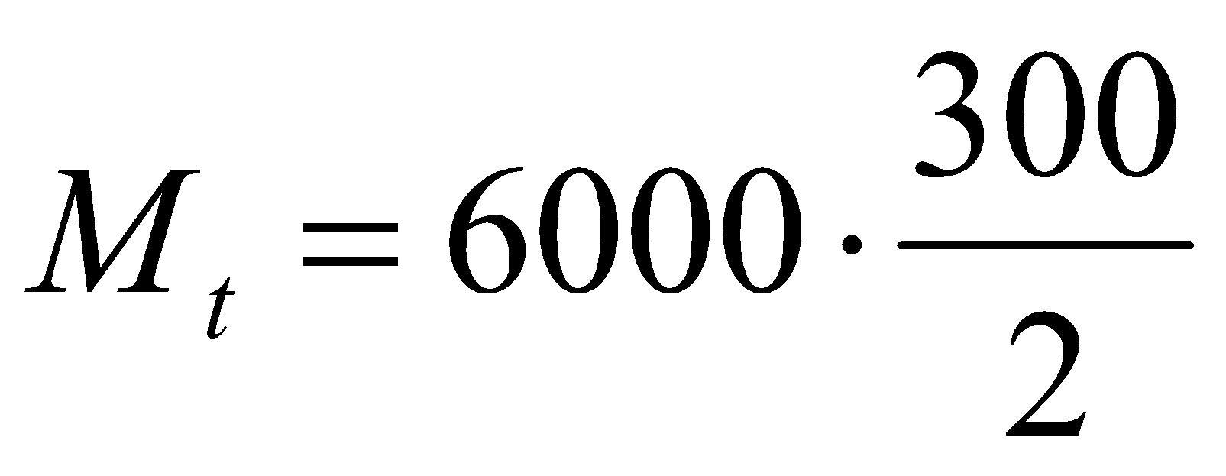
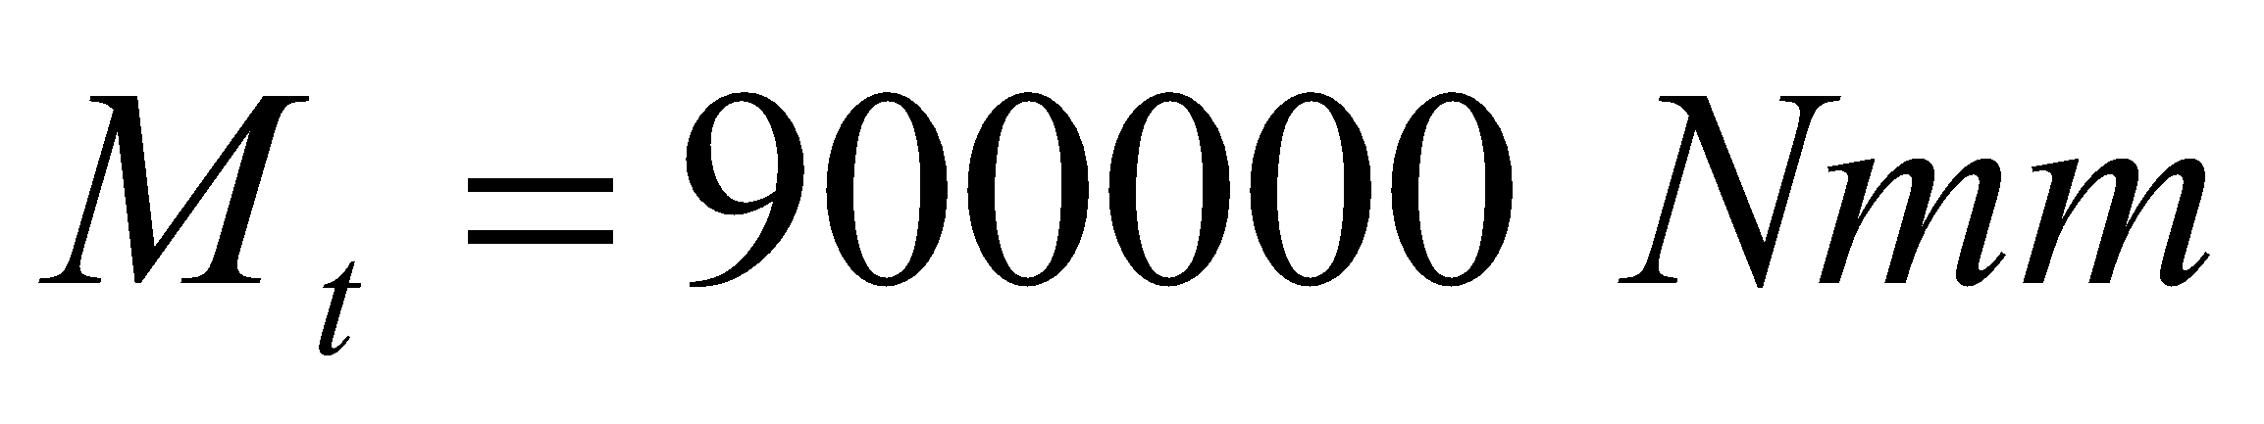
Torsional moment

Slide 5
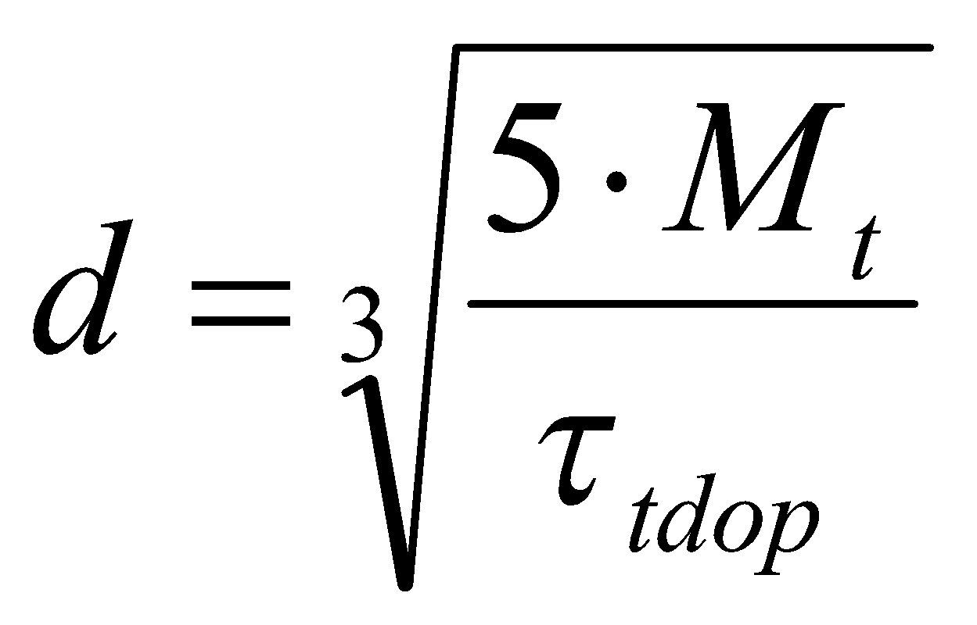
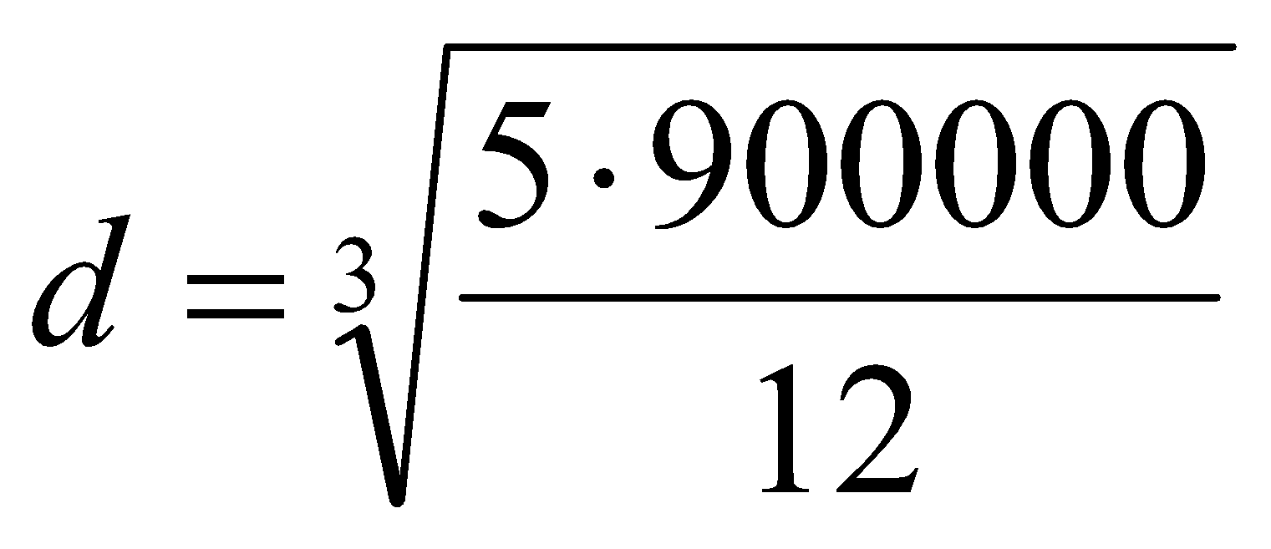
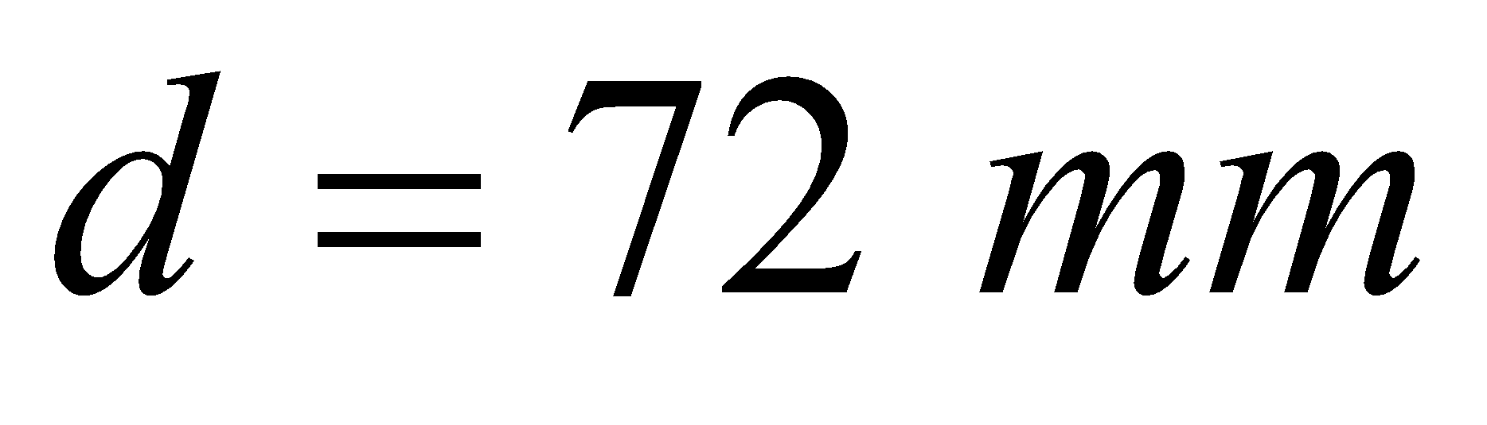
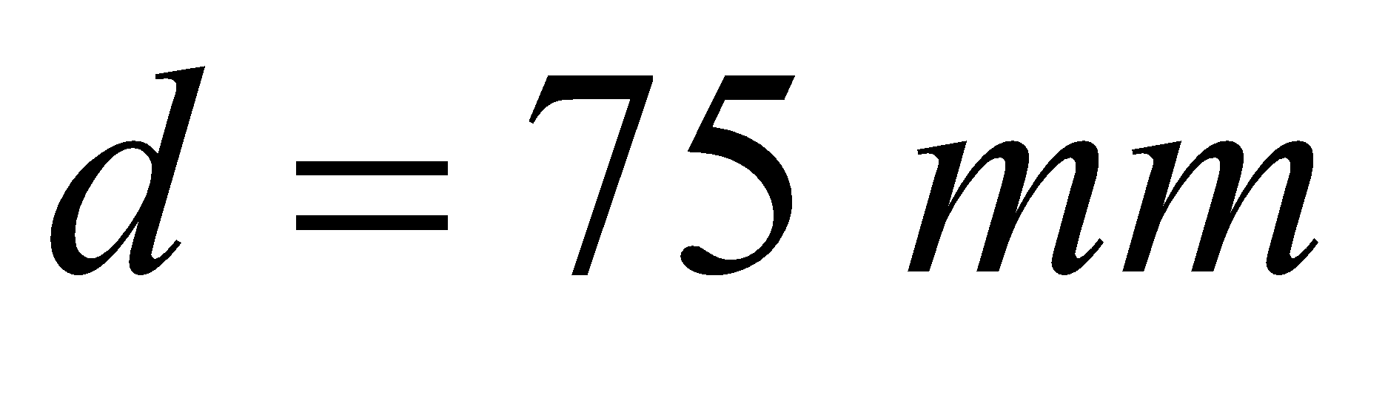
Shaft diameter

Slide 6
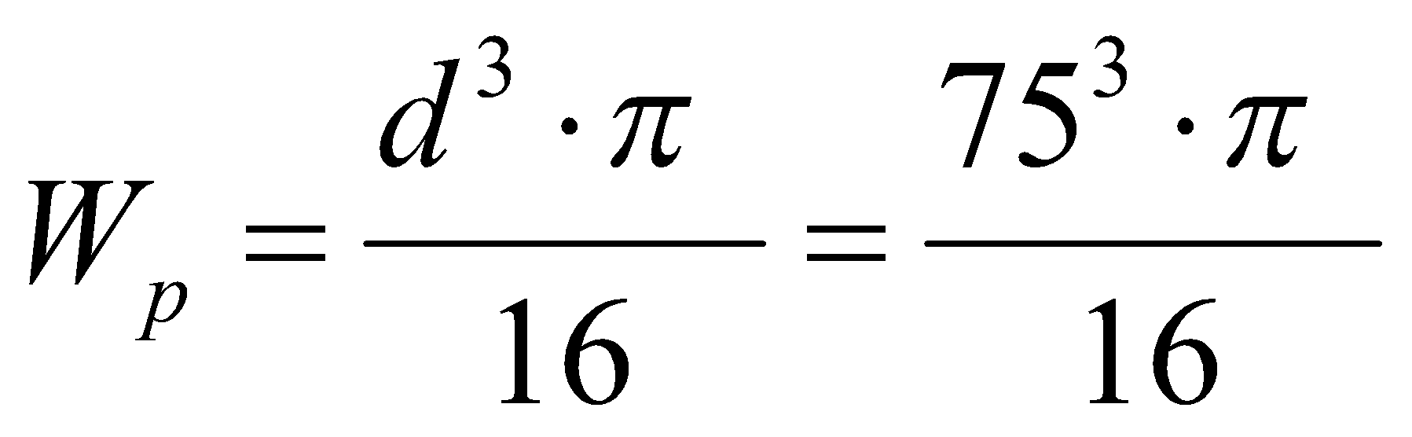
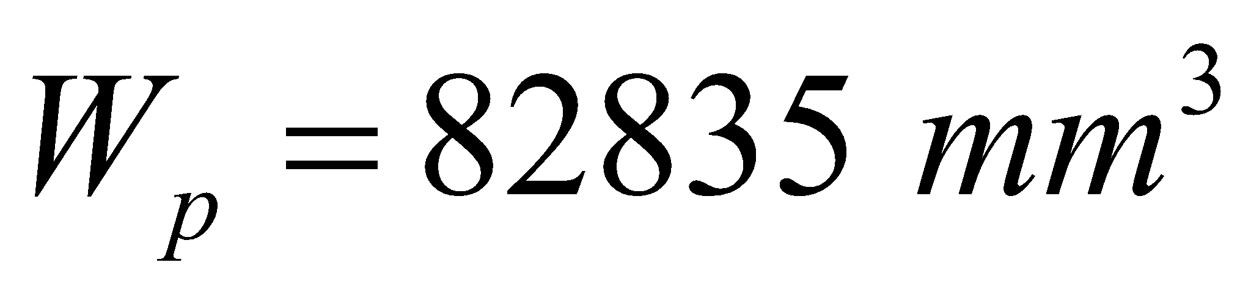
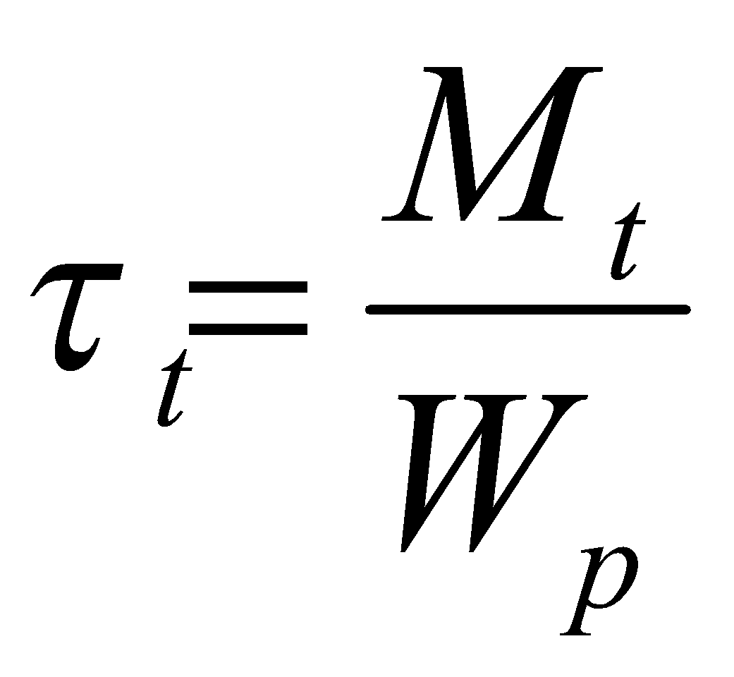
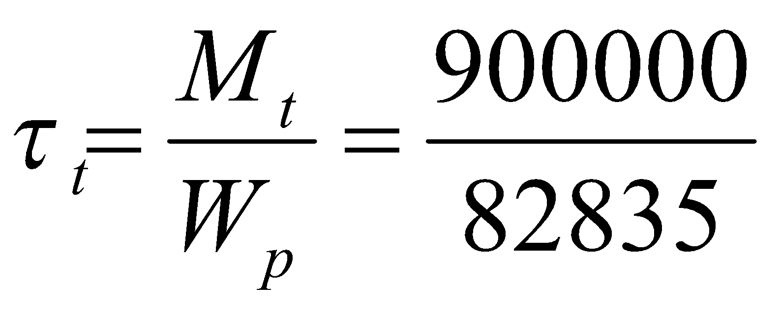
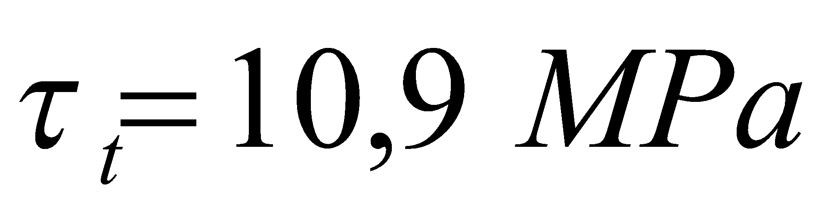
Real torsion stress

Slide 7
Reference list
[1] Kulišić, Boris, 2007, Tehnička mehanika - nauka o čvrstoći s vježbama, Element, Zagreb
[2] Špiranec, Vladimir, 2004, Tehnička mehanika - statika - otpornost - gibanje - mehanizmi, Školska knjiga, Zagreb
[3] Šutalo V., Maković B., Pasanović B., 2007, Tehnička mehanika 1, Neodidacta d.o.o., Zagreb
[4] Šutalo V., Maković B., Pasanović B., 2007, Osnove tehničke mehanike, Neodidacta d.o.o., Zagreb
[5] Mechanics of Slender Structures, from https://www.bu.edu/moss/mechanics-of-materials-bending-normal-stress/, 24.8.2022.
[6] Strength of Materials, from https://mechanicalc.com/reference/strength-of-materials, 25.8.2022.
[7] Strength of Materials, from https://sites.google.com/site/mechanicalstuff4u/contents-of-m/strength-of-materials, 27.8.2022.
[8] Bending and torsion, from https://me-engg-education.blogspot.com/2018/02/bending-and-torsion.html, 29.8.2022.

