Slide 1


Field | Mechanics
Chapter | Statics
Subtitle | Addition of vectors

Slide 2
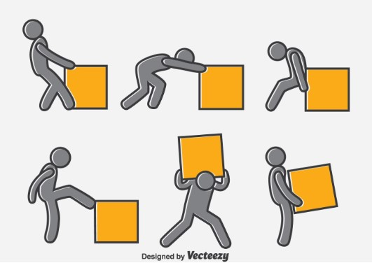
How to add vectors?

Slide 3

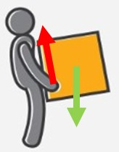
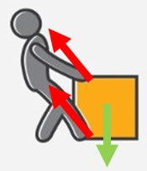
Addition of vectors depends on direction
Same direction
Different direction

Slide 4

Addition of vectors – same direction – graphical
p
Fs
Sum

Slide 5
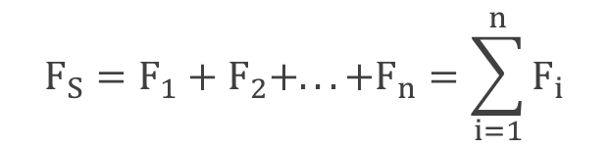
Addition of vectors – same direction – analytical
+
F1 = +
F2 = +
F3 = +
F4 = -
Fs = F1 + F2 + F3 + (-F4)
-
+
-

Slide 6
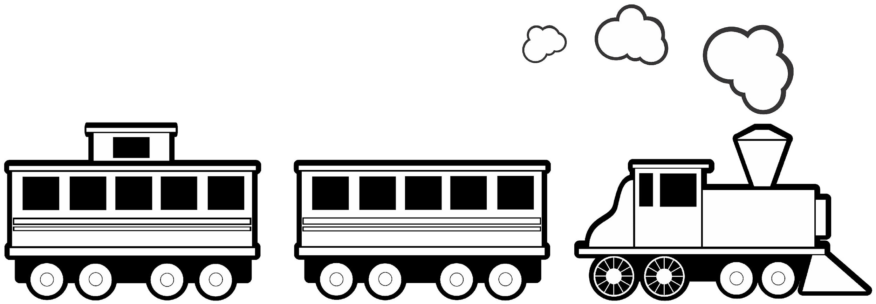
Practical example
Analytically and graphically add train force if wagons have the force of 2000N and locomotive has the force of 5kN.
F1 = F2 = 2000N
F3 = 5kN = 5000N
Fs = F1 + F2 + F3 = 2000 + 2000 + 5000 = 9000N

Slide 7

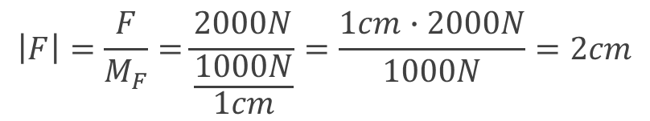
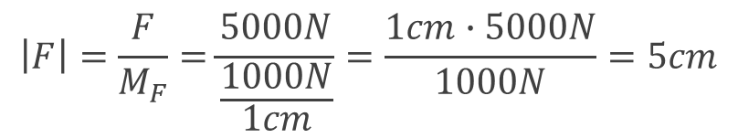
F1
F2
F3
Fs

Slide 8
Addition of vectors – different direction – graphical
Triangle law
Two vectors
Parallelogram law
Three and more vectors
Vectors polygon

Slide 9

Addition of two vectors – triangle law
F
F
Fs

Slide 10

Addition of two vectors – parallelogram law
F
Fs
F

Slide 11

Addition of three and more vectors – vectors polygon
F
F
F
Fs

Slide 12
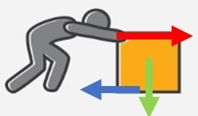

Practical example
Graphically add forces as shown in the picture if blue force is 100N, green 200N and red is 500N.
F1 = 1cm
F2 = 2cm
F3 = 5cm
F1
F1 = 100N
F2 = 200N
F3 = 500N
Fs
F2
F3

Slide 13
Addition of vectors – different direction – analytical
Law of cosines
Law of sines
Law of vector components

Slide 14
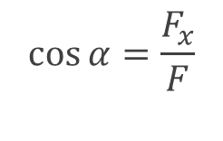

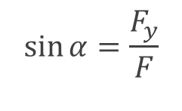

Addition of vectors – different directions – analytical
Every vector that doesn’t lie along the x or y axes needs to be written as a vector component along the x and y axes. With that rule, we put vectors in the same direction.
x component of vector along the x-axis
y
Fy
F
y component of vector along the y-axis
α=45°
Fx
x

Slide 15
Practical example
Graphically add forces as shown in the picture if blue force is 100N, green 200N, and red is 500N.
F1 = 1cm
F2 = 2cm
F3 = 5cm
F1
F1 = 100N
F2 = 200N
F3 = 500N
Fs
F2
F3

Slide 16
Reference list
[1] Kulišić, Boris, 2007, Tehnička mehanika - nauka o čvrstoći s vježbama, Element, Zagreb​
​
[2] Špiranec, Vladimir, 2004, Tehnička mehanika - statika - otpornost - gibanje - mehanizmi, Školska knjiga, Zagreb​
​
[3] Šutalo V., Maković B., Pasanović B., 2007, Tehnička mehanika 1, Neodidacta d.o.o., Zagreb​
​
[4] Šutalo V., Maković B., Pasanović B., 2007, Osnove tehničke mehanike, Neodidacta d.o.o., Zagreb​
​
[5] https://www.cannypic.com/free-vector/man-pushing-box-vector-396689, 2.3.2022.​
​
[6] http://clipart-library.com/clipart/piq8oxXdT.htm, 5.3.2022. ​

