Slide 1
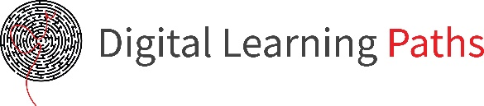

Field | Mechanics
Chapter | Strength of materials
Subtitle | Girder/ Bearer

Slide 2
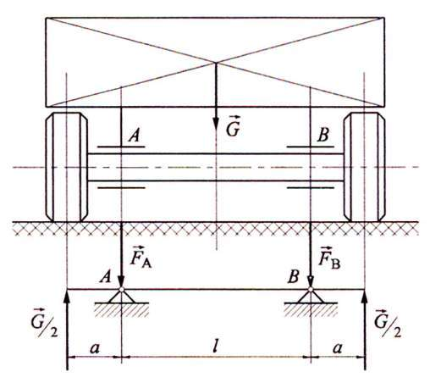
Full flat girders
The girder is part of construction that receives and carries a load.
The girder rests on another structure or the base via supports.
Axis of a vehicle used as the girder.
G - load
A and B - supports (bearings)
Notes:
‹#›
2 sata, 1.primjer u pg krivo teziste plohe

Slide 3
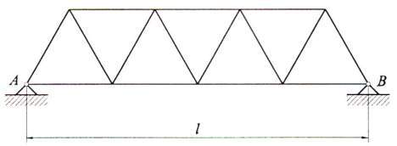
Girders can be:
a) spatial – forces on the girder act in different planes
b) flat – forces act in a single plain
Types of girders by design:
a) full
b) lattice

Slide 4
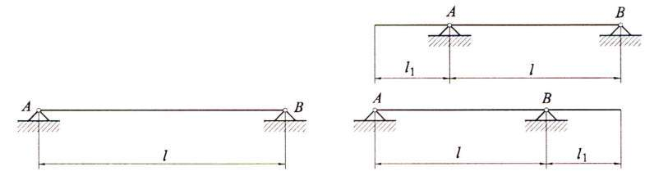
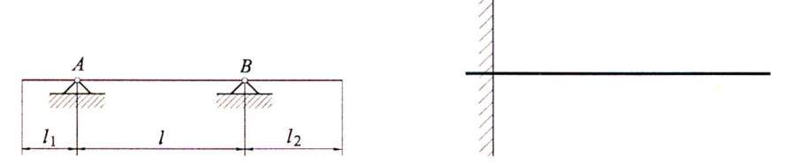
Types of supports
Types of full flat girders by shape:
a) girder with 2 supports
b) girder with 2 supports and 1 pass
c) girder with 2 supports and
2 passes
d) clamped girder

Slide 5
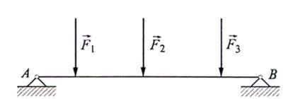
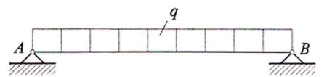
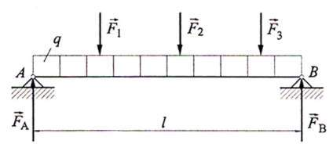
Types of supports
Types of full flat girders by load:
a) Girder loaded with individual forces
b) Girder loaded with uniform load q[N/m]
c) Girder with combined load

Slide 6
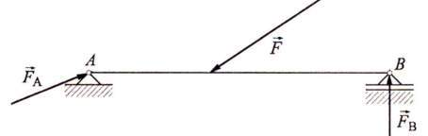
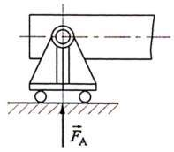
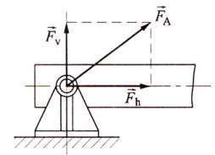
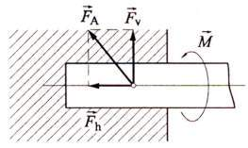
Types of supports
Movable support- has two degrees of freedom of movement.
The reaction in this support is always perpendicular to the direction of possible displacement regardless of the direction of action of external force.
Immovable support- has one degree of freedom of movement. It is firmly attached to the base. The direction of reaction in support can be in any direction.
Pinched support – doesn’t allow any movement.
Reaction in the support is clamping force and moment.

Slide 7
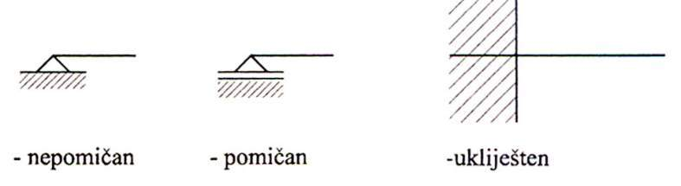
Types of supports
Schematic representation of supports
immovable
movable
pinched
Girders can be:
Statically determined- can be solved using analytical equilibrium conditions.
The total number of unknown reactions in supports is a maximum of 3.
Statically undetermined- can’t be solved using analytical equilibrium conditions.
The total number of reactions is greater than 3.

Slide 8
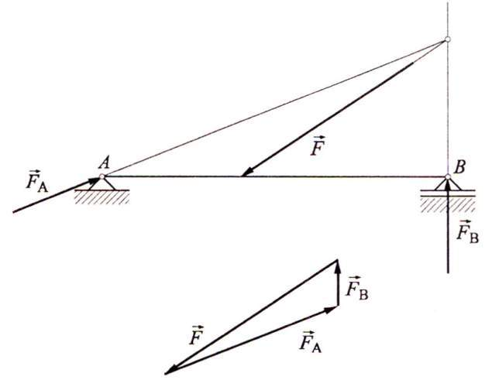
Types of supports
An example of a simple girder loaded with angled force.
Support A
- immovable, reaction is angled. Calculated from equilibrium conditions of 3 forces.
Support B
- movable, reaction is perpendicular to the base.

Slide 9
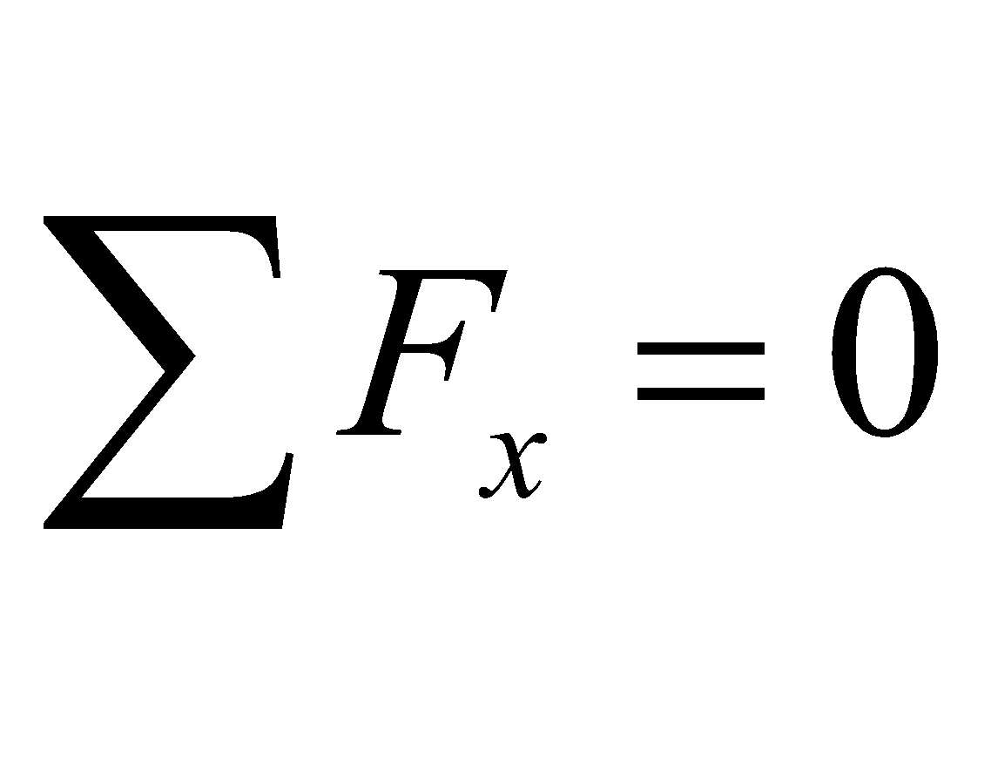
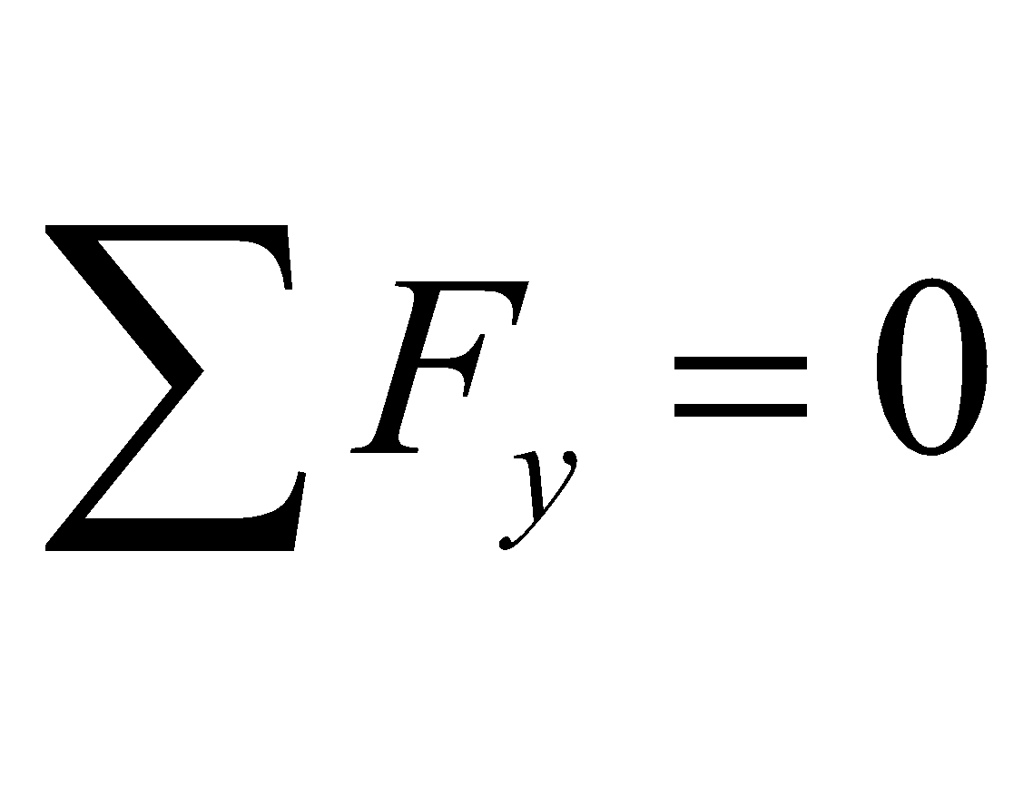
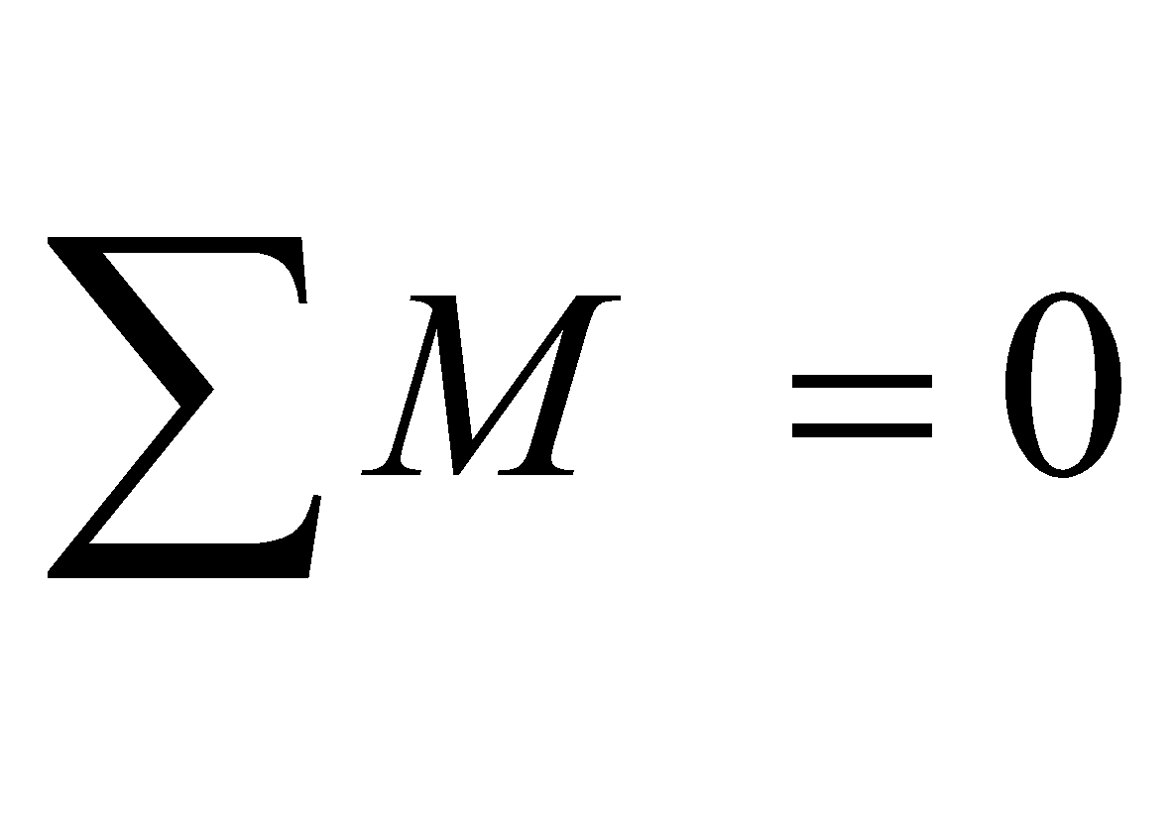
Solving girders
The goal of solving the girder is to determine its dimensions.
In order to be able to dimension the girder we must first determine:
a) Reactions in supports
b) Maximum bending moment
c) Transverse forces
d) Longitudinal forces
Girders are solved graphically and analytically.
Graphical solving requires:
a) Bending moment diagram
b) Transverse forces diagram
c) Longitudinal forces diagram
Analytical solution of girder is done using analytical equilibrium conditions:
1.
2.
3.

Slide 10
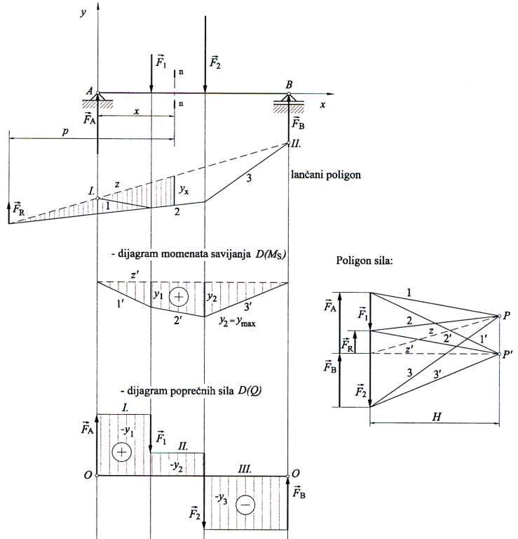
Example of girder solved by graphycal procedure

Slide 11
Reference list
[1] Kulišić, Boris, 2007, Tehnička mehanika - nauka o čvrstoći s vježbama, Element, Zagreb
[2] Kulišić, Boris, 2000, Tehnička mehanika - statika s vježbama, Element, Zagreb
[3] Špiranec, Vladimir, 2004, Tehnička mehanika - statika - otpornost - gibanje - mehanizmi, Školska knjiga, Zagreb
[4] Šutalo V., Maković B., Pasanović B., 2007, Tehnička mehanika 1, Neodidacta d.o.o., Zagreb
[5] Šutalo V., Maković B., Pasanović B., 2007, Osnove tehničke mehanike, Neodidacta d.o.o., Zagreb
[6] Mechanics of Slender Structures, from https://www.bu.edu/moss/mechanics-of-materials-bending-normal-stress/, 8.7.2022.
[7] Strength of Materials, from https://mechanicalc.com/reference/strength-of-materials, 9.7.2022.
[8] Strength of Materials, from https://sites.google.com/site/mechanicalstuff4u/contents-of-m/strength-of-materials, 10.7.2022.
[9] Forces, from https://technologystudent.com/forcmom/force1.htm, 12.7.2022.

