Slide 1


Field | Mechanics
Chapter | Calculations of Machine Parts
Subtitle | Welded Joints Calculations

Slide 2


Stress
The amount of pressure that a material's particles apply to one another is known as its stress. It is described as the force per unit area applied to the object. However, stress differs from pressure in that it requires a very little area to be calculated, assuming homogeneity of the particles under study. When a larger area is considered, the computed stress is often the mean value.

Slide 3
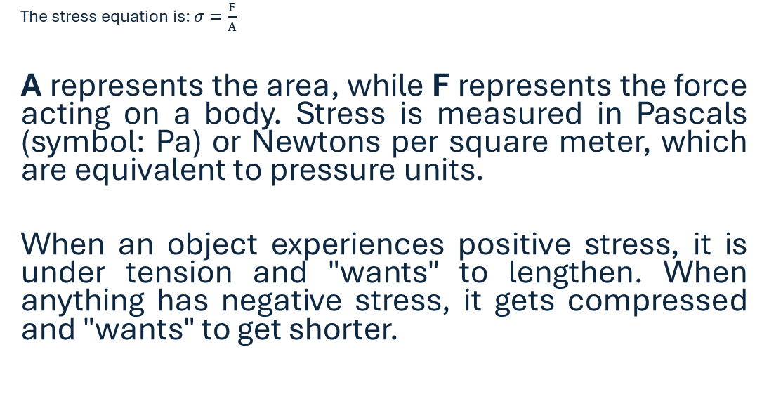

Slide 4
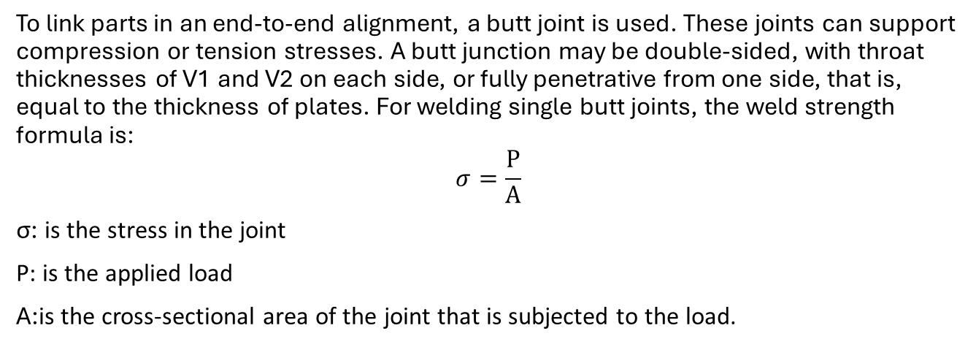
Butt weld

Slide 5
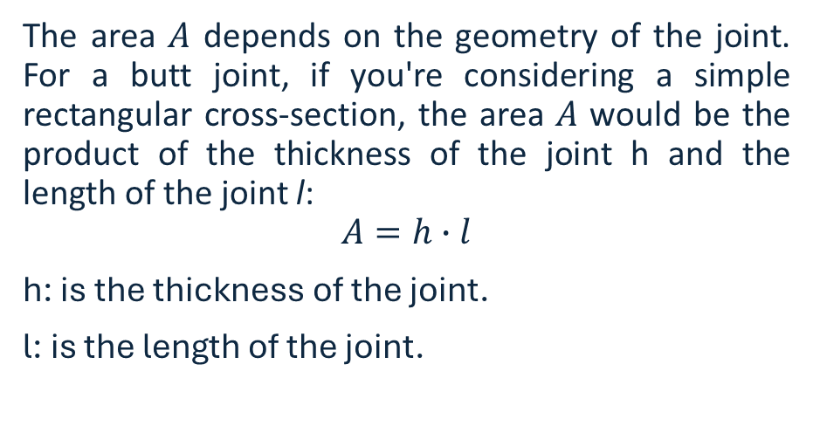
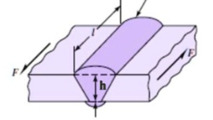
Area Calculation

Slide 6
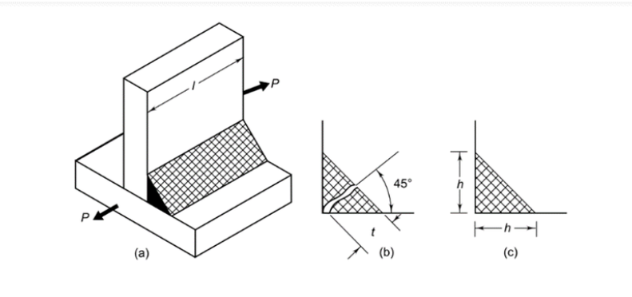
Fillet Weld
Fig. (a) depicts a parallel fillet weld that is under a tensile tension P. The fillet weld's magnified perspective can be seen in (c). Leg h and throat t are the two terms that pertain to the fillet weld's dimensions. The leg length determines the weld's size. The fillet weld cross-section is made up of a right-angled triangle with two equal sides. A leg is the length of each of the two equal sides. Generally, the thickness of the plate and the leg length h are equal. The weld's minimum cross-section, or throat, is situated at a 45° angle to the leg dimension. Therefore,
t = h cos (45°) or t = 0.707 h.

Slide 7
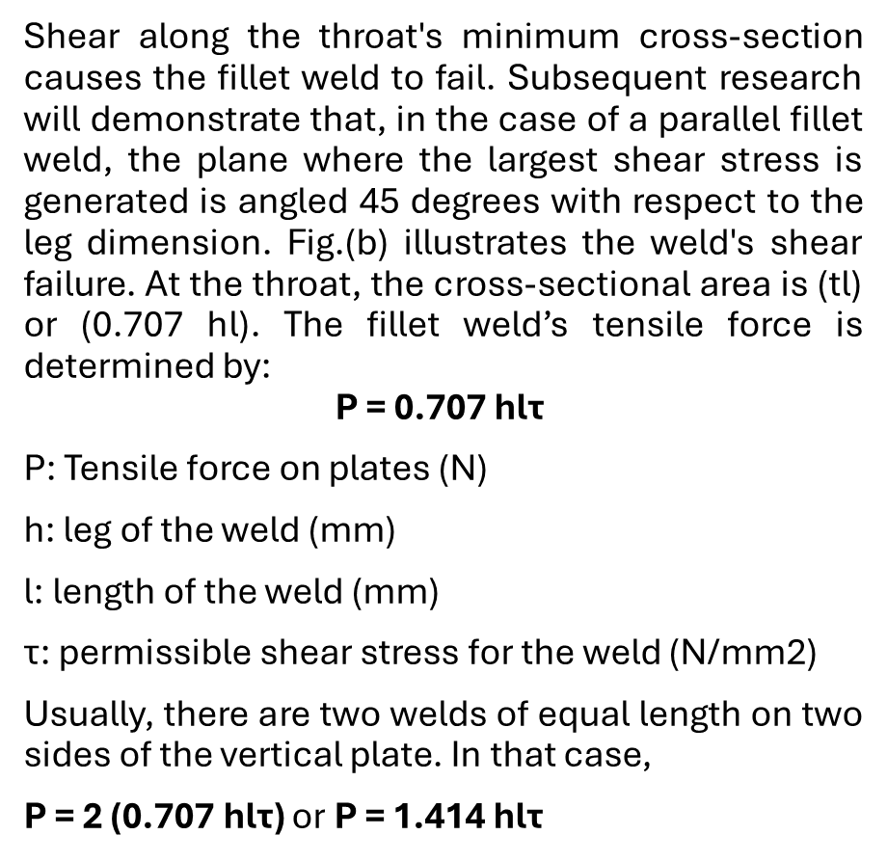
Fillet Weld

Slide 8

Example 1
Two steel plates are joined together in a butt joint configuration. Each plate has a thickness t=10 mm, and the length of the joint is L=100 mm. A tensile load of 𝑃=5000N is applied to the joint. Calculate the axial tensile stress (σ).

Slide 9
Solution:
Step 1:Calculate the Cross-Sectional Area (A)
A=t×L 𝐴=10 mm×100 mm=1000 mm2=0.001 m2A=10 mm×100 mm=1000 mm²=0.001 m²
Step 2 :Apply the Stress Formula
σ=P​/A
σ=0.001m/25000 N​=5×106 Pa=5 MPa
The axial tensile stress (𝜎σ) in the butt joint is 5 MPa.

Slide 10
Example 2
Determine the maximum allowable load P that a fillet weld can withstand based on given parameters.
Throat size (h): 6 mm
Effective length (𝑙): 50 mm
Allowable shear stress (𝜏): 120 MPa

Slide 11
Solution
Step 1:Convert Dimensions to Meters
Throat size h=6 mm =0.006=0.006 m
Effective length 𝑙=50 mm =0.05=0.05 m
Step 2:Apply Shear Stress Equation
P=0.707×h×l×τ
P= 0.707×0.006 m×0.05 m×120 MPa
P=0.707×0.0003 m2×120 MPa
P=25.452 MPa
The maximum allowable load P that a fillet weld can withstand is 25.452 Mpa.

Slide 12
References
Butler, L. J., & Kulak, G. L. (1971). Strength of fillet welds as a function of direction of load. Welding Journal, 50(5), 231s-234s.
Doerk, O., Fricke, W., & Weissenborn, C. (2003). Comparison of different calculation methods for structural stresses at welded joints. International journal of fatigue, 25(5), 359-369.
Jarosch, K. H., & Bowman, M. D. (1986). Tension butt joints with bolts and welds in combination. Engineering Journal, 23(1), 25-34.
Oliveira, L. F., Simpson, D. M., & Nadal, J. (1996). Calculation of area of stabilometric signals using principal component analysis. Physiological measurement, 17(4), 305.
Teng, T. L., Fung, C. P., & Chang, P. H. (2002). Effect of weld geometry and residual stresses on fatigue in butt-welded joints. International journal of pressure vessels and piping, 79(7), 467-482.
Yousefi, F., Witt, M., & Zenner, H. (2001). Fatigue strength of welded joints under multiaxial loading: experiments and calculations. Fatigue & Fracture of Engineering Materials & Structures, 24(5), 339-355.

