Slide 1


Field | Mechanics
Chapter | Calculations of Machine Parts
Subtitle | Weld Methods and their applications.

Slide 2
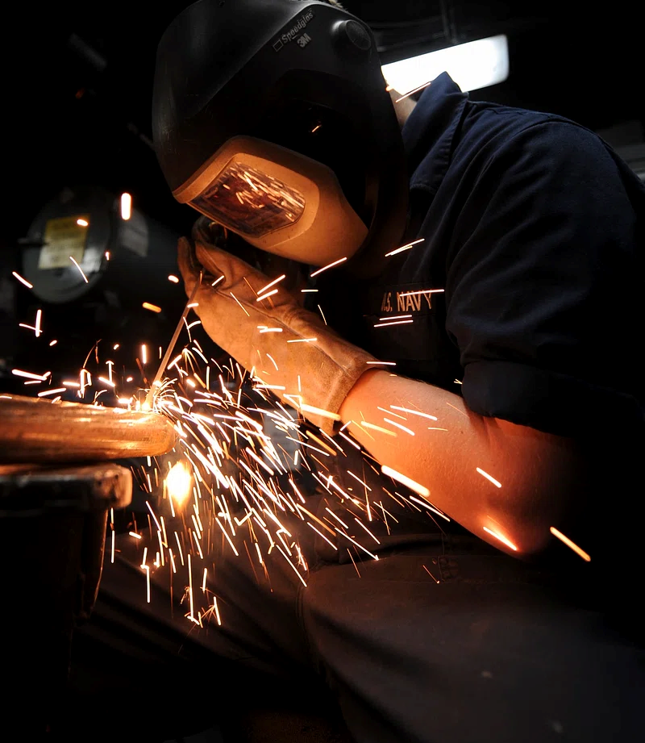
Arc welding
As the name suggests, arc welding unites materials by melting them with an electric arc. An electric arc is produced between a consumable or non-consumable electrode and the base metal by a power source in order to melt the metals at the point of contact. The welding region is typically surrounded by slag, mist, or any other type of shielding gas. This is because air interactions with the weld pool may lead to oxidation.This electric arc may reach temperatures up to 6300°F (3500°C), which is hot enough to melt metals like carbon steel.

Slide 3




Applications for Arc Welding:
SHIPBUILDING.
AUTOMOTIVE INDUSTRIES.
CONSTRUCTION INDUSTRIES.
MECHANICAL INDUSTRIES.

Slide 4





Advantages of Arc welding:
Appropriate for high-speed welding.
Basic equipment for welding.
Portability due to the basic equipment.
Able to operate on both AC and DC.
Ideal temperatures.

Slide 5



Disadvantages of Arc welding:
Irregular for joining thin metals.
Needs experienced welders.
Not suitable for use with reactive metals such as titanium or aluminium.

Slide 6

2. MIG welding
Metal inert gas welding, or MIG welding, is an additional method for producing welds using an electric arc. MIG, on the other hand, uses a continuous solid wire electrode that is heated and injected into the pool of weld using a welding pistol. The two base pieces fuse together to form a junction. In MIG welding, connecting the two metals is made simpler by the melted electrode. Because of this, MIG is ideal for joining various metals. Shielding gas is additionally supplied via the weld cannon to stop the weld pool from interacting with the air and oxidizing the weld zone.

Slide 7



Applications of MIG welding:
APPLIED TO THE MAJORITY OF SHEET METAL WELDING APPLICATIONS.
FABRICATION OF STEEL STRUCTURES AND PRESSURE TANKS.
AUTOMOTIVE INDUSTRY AND HOME IMPROVEMENT INDUSTRY.

Slide 8





Advantages of MIG welding:
Produces excellent welds.
Splatter from a minor weld.
Able to unite disparate metals.
Possibly fully or partially automated.
Fast welding.

Slide 9




Disadvantages of MIG welding:
Not appropriate for welding outside.
Not appropriate for heavy metals.
Metal preparation is required.

Slide 10
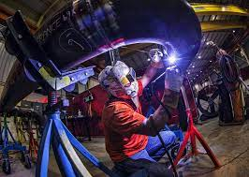
3. TIG welding
An arc is created between the metals using tungsten inert gas welding (TIG), which uses a non-consumable tungsten electrode. An inert shielding gas (helium or argon) shields the electrode and weld region from oxidation and other ambient contaminants. Occasionally, a filler metal is also utilized.TIG welding is compatible with both DC and AC power supplies. The ability to fuse non-ferrous metals such as titanium, nickel, copper, magnesium, aluminum, and so on is one of TIG welding's biggest advantages.

Slide 11



Applications of TIG welding:
AIRPLANE AND AEROSPACE BUILDING.
AUTOMOBILE SECTOR.
AUTO BODY MAINTENANCE.

Slide 12

Advantages of TIG welding:
Extremely clean welding
Gives the welder a high level of control.
Useful either way around with filler material.
Able to be carried out manually or automatically.
Produces robust welds.

Slide 13
Disadvantages of TIG welding:
Lengthy and requires experienced welders.
Not suitable for use with thicker metal joints.

Slide 14
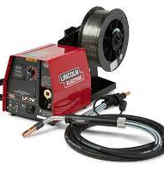
4. Flux-cored arc welding (FCAW)
A continuous wire-fed electrode, a constant-voltage welding power source, and equipment similar to that used in MAG welding are used in flux-cored arc welding (FCAW). Self-shielded and gas-shielded flux-cored welding are the two varieties of flux-cored arc welding. Depending on the shielding technique, there are two types of FCAW processes: one that protects the weld area entirely with the flux core and the other that requires an external shielding gas. When employed, the shielding gas prevents oxidation of the weld pool and is typically supplied externally by a high-pressure gas cylinder. Additionally, the slag production prevents flux melting on the weld metal. In situations where an external shielding gas is not utilized, the flux-cored electrode's inherent protection is what keeps the process running. In addition to forming a slag that covers and shields the molten metal in the weld, this electrode offers gaseous protection.

Slide 15





Applications of Flux-cored arc welding:
Manufacturing facilities.
Railroads.
Shipbuilding.
Industrial Piping.
Upkeep and restoration.

Slide 16
Advantages of Flux-cored arc welding:
Great penetration of the weld.
Ideal for joints with greater thickness.
Flexibility in the orientation and movement of the torch.
The greatest rate of metal deposition.

Slide 17



Disadvantages of Flux-cored arc welding:
May lead to the addition of slag.
Wires with flux cores cost extra.
Often, welds lack aesthetic appeal.

Slide 18
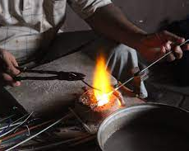
5. Gas welding (oxyacetylene welding)
Metals are melted and then joined by gas welding, which uses the heat from a concentrated flame. Filler metal can be used with or without gas welding. To regulate the flame, use a welding torch. The welding torch is attached to two gas canisters: one for oxygen and the other for fuel. Through the use of a pressure regulator, the welder may regulate the amount of gases delivered into the torch, so controlling the flame. The most frequent combination that we observe is oxygen and acetylene, which may produce temperatures as high as 3200°C (5792ºF). In gas welding, other fuel gases that are also used include propane, butane, and hydrogen.

Slide 19

Applications of Gas welding:
Production of sheet metal.
The automotive and aerospace sectors.
Fusing non-ferrous and ferrous metals together.
Integrating thin metals.

Slide 20

Advantages of Gas welding:
Equipment that is easily portable.
Superior management of flames.
Minimal upkeep and expense.
Suitable for Gas Cutting, Lower Equipment Cost.

Slide 21
Disadvantages of Gas welding:
Not appropriate for extremely thin parts.
Lower than that of arc welding temperature.
More difficult to flux shield.
Not appropriate for reactive metals.

Slide 22
References
Kah, P., Shrestha, M., Hiltunen, E., & Martikainen, J. (2015). Robotic arc welding sensors and programming in industrial applications. International Journal of Mechanical and Materials Engineering, 10, 1-16.
Khoshnaw, F., Krivtsun, I., & Korzhyk, V. (2023). Arc welding methods. In Welding of Metallic Materials (pp. 37-71). Elsevier.
Medzhidov, M. R., & Ostroverkhova, T. A. (2014). Benefits and drawbacks of TIG and MIG welding. In Новые технологии-нефтегазовому региону (pp. 112-114).
Murphy, A. B. (2015). A perspective on arc welding research: the importance of the arc, unresolved questions and future directions. Plasma Chemistry and Plasma Processing, 35(3), 471-489.
Popović, O., Prokić-Cvetković, R., Burzić, M., Lukić, U., & Beljić, B. (2014). Fume and gas emission during arc welding: Hazards and recommendation. Renewable and Sustainable Energy Reviews, 37, 509-516.
Singh, R. P., Kumar, S., Dubey, S., & Singh, A. (2021). A review on working and applications of oxy-acetylene gas welding. Materials Today: Proceedings, 38, 34-39.
Weman, K., & Lindén, G. (Eds.). (2006). MIG welding guide. Woodhead Publishing.

