Slide 1


Field | Mechanics
Chapter | Strength of materials
Subtitle | Load and stress

Slide 2
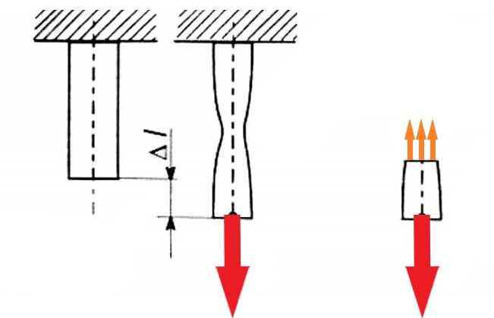
In the mechanics of deformable solids, externally applied forces act on a body and the body suffers a deformation. From the equilibrium point of view, this action should be opposed or reacted by internal forces which are set up within the particles of material due to cohesion. These internal forces give rise to the concept of stress.
Load is all external forces (moments) acting on the body.
Stress is an internal force in a loaded body (divided by the area
of the cross-section on which it acts) which opposes the action of the load.
F
F

Slide 3
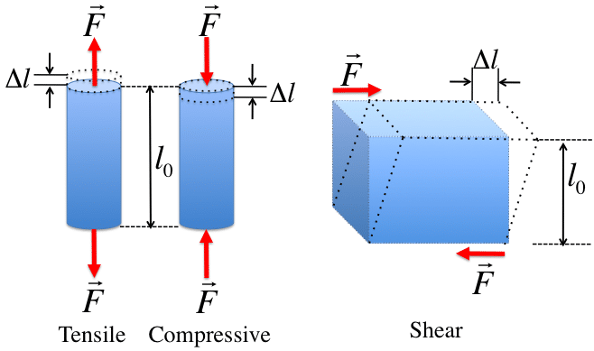
If the applied load (force) causes a change in dimension, those materials are said to be under stress. This force per unit area is the measurement of stress. The higher the load (force) per unit area, the higher is stress.
Load (force) can be tensile, compressive, and shear. Tensile and compressive stress are known as direct stress.

Slide 4
The basic units of stress in S.I units i.e. (International system) are:
N/m² (or Pa)
KPa = 10³ Pa
MPa = 10⁶ Pa
GPa = 10⁹ Pa
Units N/mm² are also used because this is equivalent to MPa. While US customary unit is pound-force per square inch (psi).

Slide 5
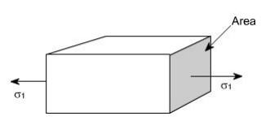
Types of stresses:
Normal stress - We have defined stress as force per unit area. If the stresses are normal for the areas concerned, then these are termed as normal stresses. The normal stresses are generally denoted by the Greek letter sigma (Ϭ).

Slide 6
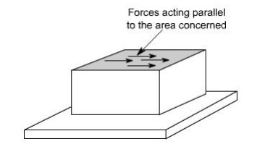
Types of stresses:
Sheer stress - Let us consider now the situation where the cross-sectional area of a block of material is subject to the distribution of forces that are parallel, rather than normal, to the area concerned. Such forces are associated with the shearing of the material and they are referred to as shear forces. The resulting force is known as shear stresses. The shear stresses are generally denoted by the Greek letter tau (τ).

Slide 7
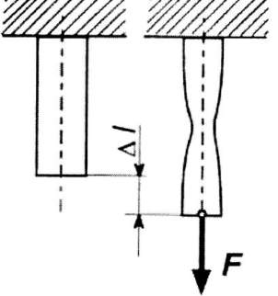
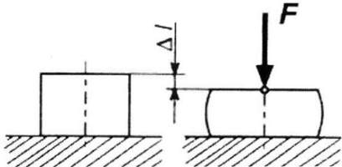
Types of loads:
Tension
Compression

Slide 8
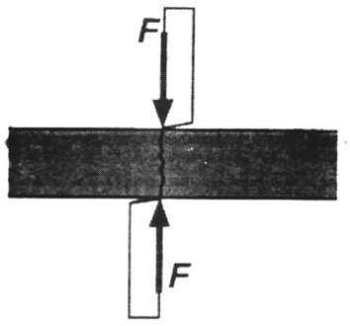
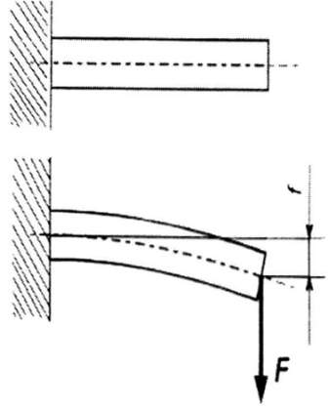
Types of loads:
Shear
Bending

Slide 9
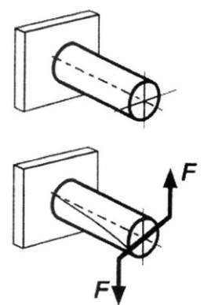
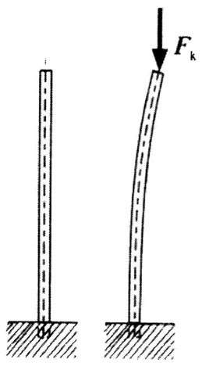
Types of loads:
Torsion
Buckling

Slide 10
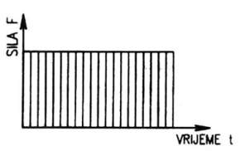
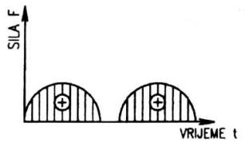
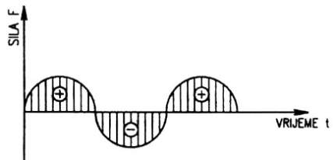
Types of loads:
Static
Dynamic
a
a
a
a
a
a

Slide 11
Static loads or forces are loads that do not change in size, position, or direction. On the other hand, dynamic loads or forces are loads that have a change in either size, position, or direction.
A good example of a static load is the weight of a building acting on the ground. Another example is a car parked in a car park.
A good example of a dynamic load is the weight of a moving car on the road.
Tension and compression have a common name and they are called axial loads or axial force.

Slide 12
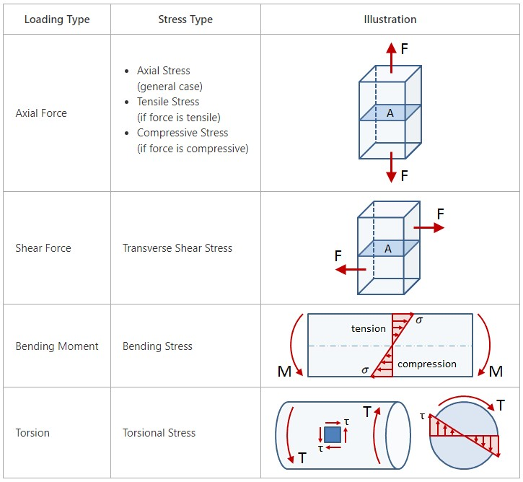
Illustrated connection between loading and stress

Slide 13

Time to play!
https://quizizz.com/join/quiz/634f0f2828d4d0001e72961e/start?studentShare=true

Slide 14
Reference list
[1] Kulišić, Boris, 2007, Tehnička mehanika - nauka o čvrstoći s vježbama, Element, Zagreb
[2] Kulišić, Boris, 2000, Tehnička mehanika - statika s vježbama, Element, Zagreb
[3] Špiranec, Vladimir, 2004, Tehnička mehanika - statika - otpornost - gibanje - mehanizmi, Školska knjiga, Zagreb
[4] Šutalo V., Maković B., Pasanović B., 2007, Tehnička mehanika 1, Neodidacta d.o.o., Zagreb
[5] Šutalo V., Maković B., Pasanović B., 2007, Osnove tehničke mehanike, Neodidacta d.o.o., Zagreb
[6] Mechanics of Slender Structures, from https://www.bu.edu/moss/mechanics-of-materials-bending-normal-stress/, 10.8.2022.
[7] Strength of Materials, from https://mechanicalc.com/reference/strength-of-materials, 14.8.2022.
[8] Strength of Materials, from https://sites.google.com/site/mechanicalstuff4u/contents-of-m/strength-of-materials, 14.8.2022.
[9] Forces, from https://technologystudent.com/forcmom/force1.htm, 15.8.2022.

