Slide 1
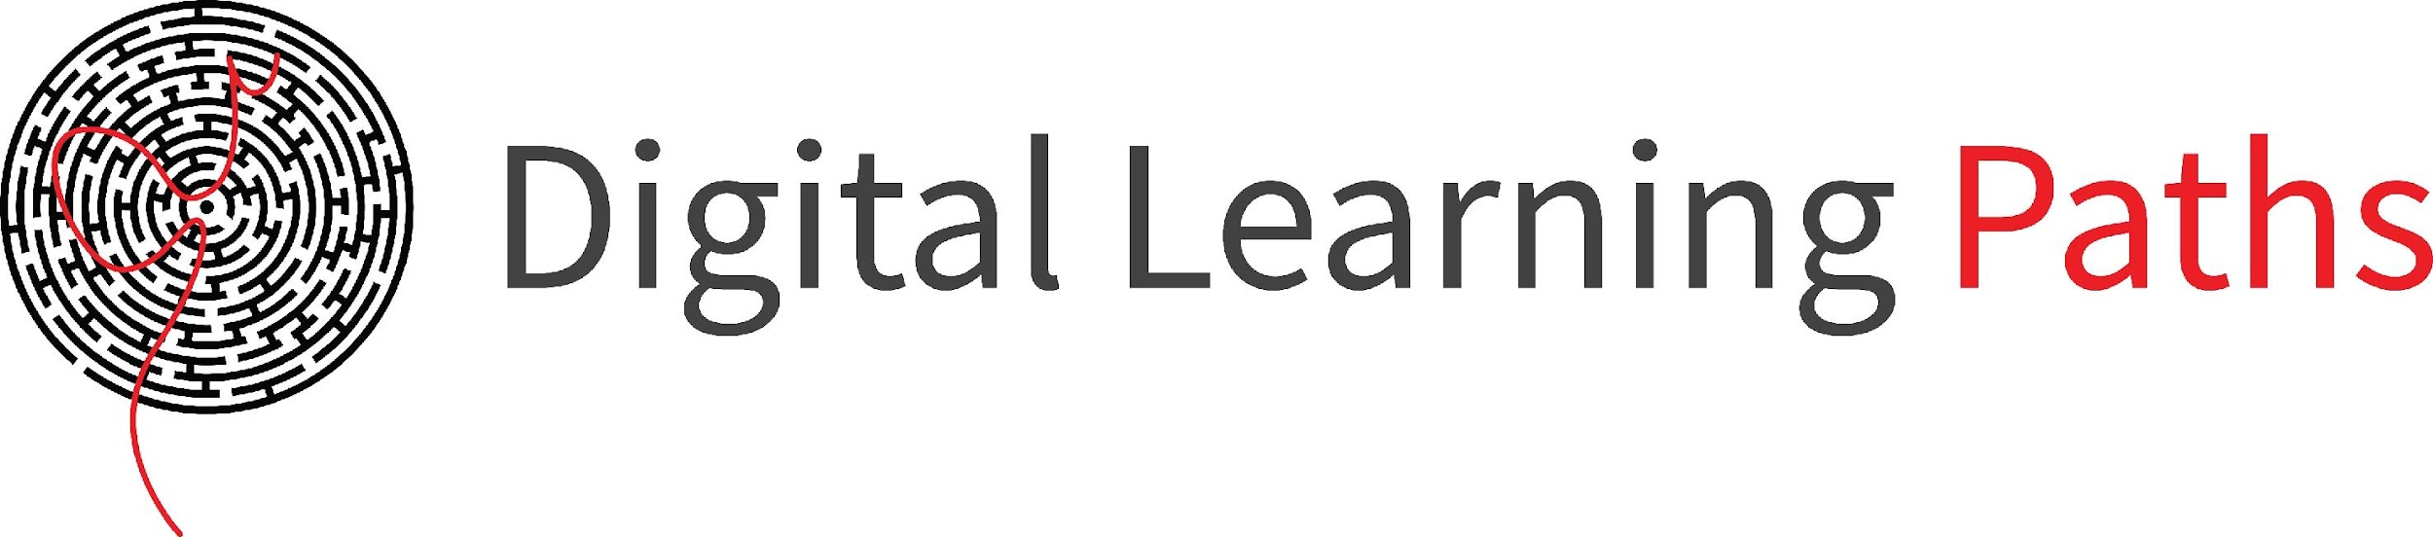

Field | Theoretical and Practical Mechanics
Chapter | Calculation of machine parts
Subtitle | Belt Transmission

Slide 2
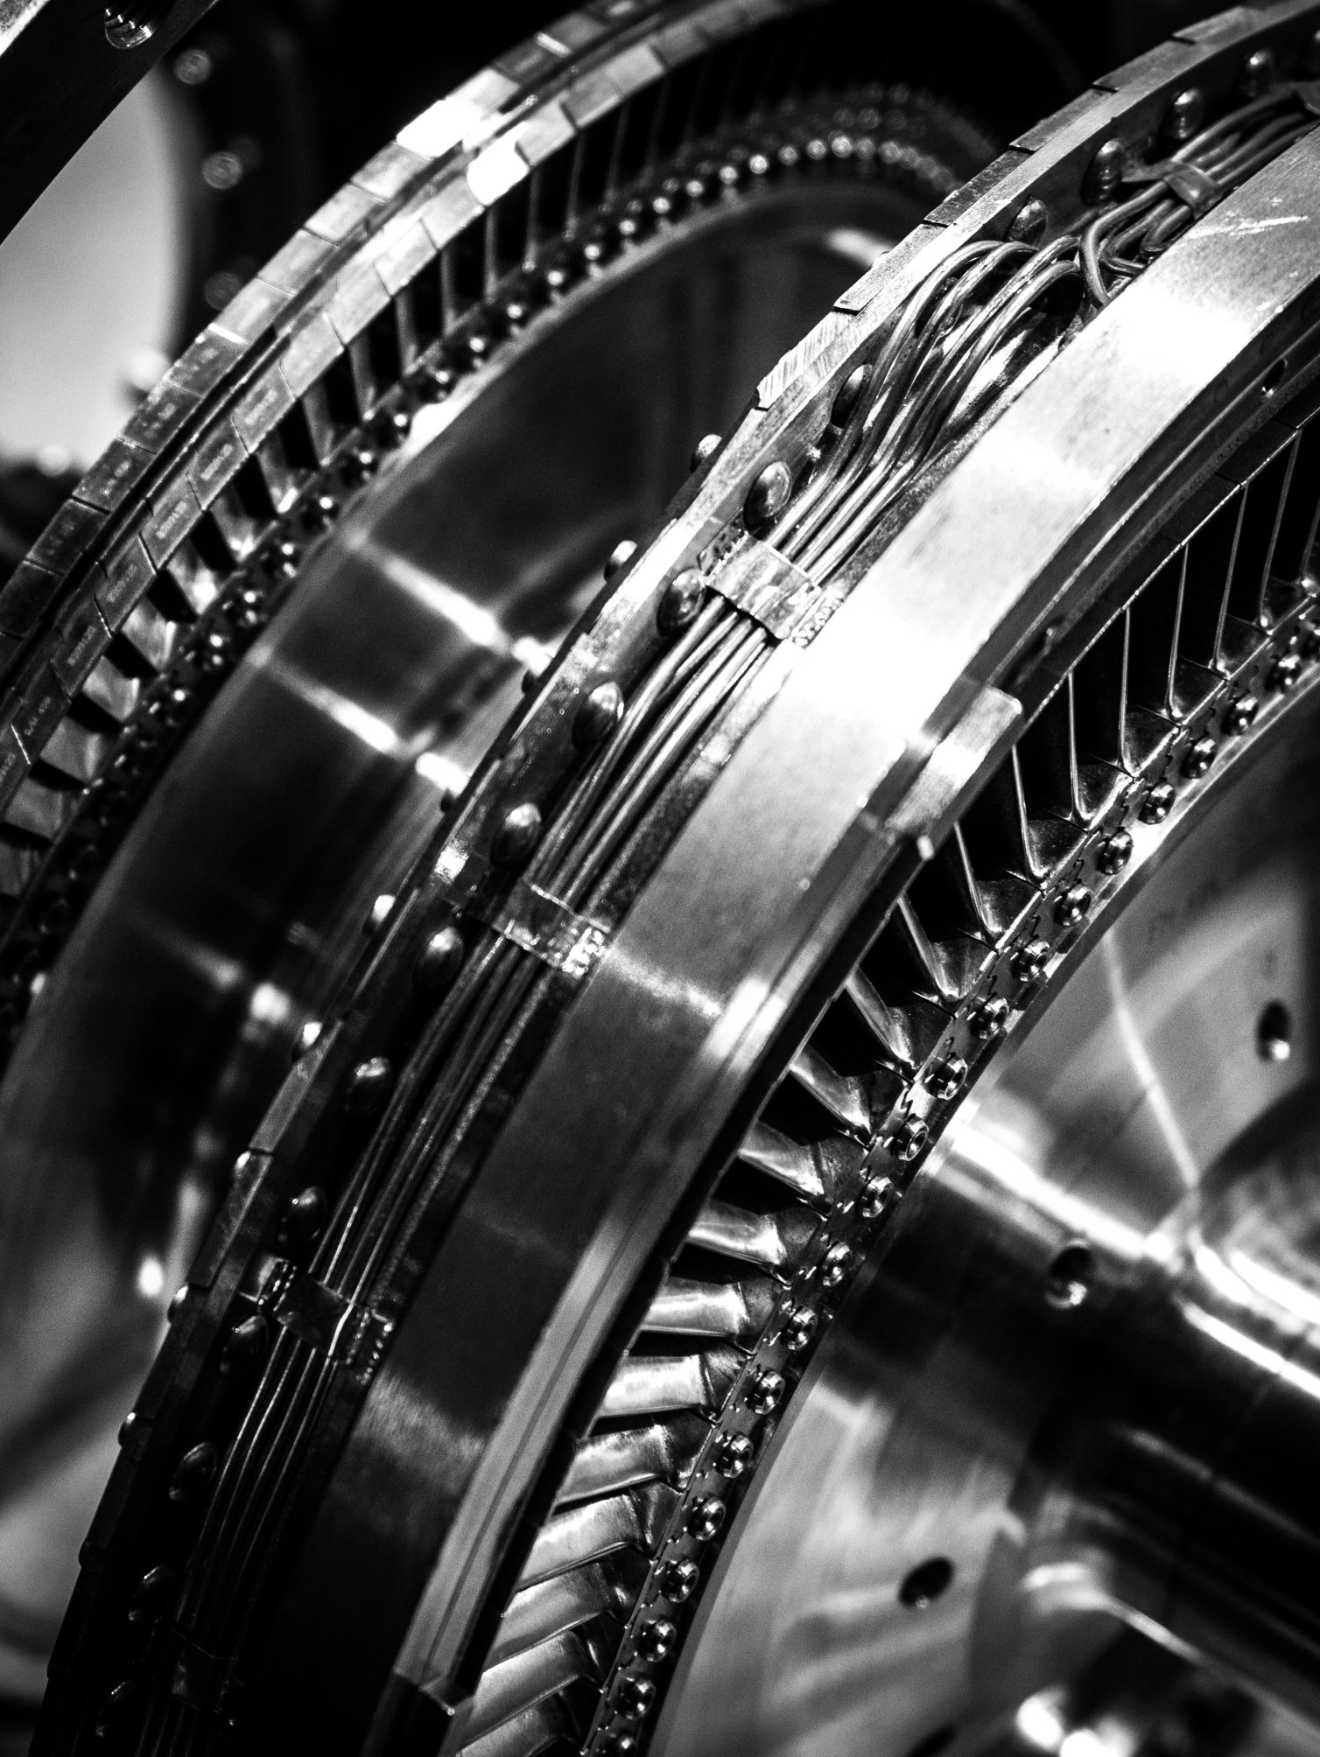
What is Belt Transmission?
A belt drive is a mechanical power transmission system that transfers motion and power between rotating shafts—which are usually parallel but can potentially be non-parallel—using a flexible looping belt and pulleys. Belts are looped over pulleys, and depending on the setup, there may be a twist between the pulleys, allowing the driven shaft to rotate in the same direction as the driving shaft or in the opposite direction. In contrast to gears and chain drives, this system is more adaptable and efficient, allowing for a certain degree of shaft misalignment and providing a more affordable installation and maintenance option. Conveyor belts are one of the many applications where belt drives are extensively utilized to continually transport loads between two places and also vary the speed of rotation.

Slide 3
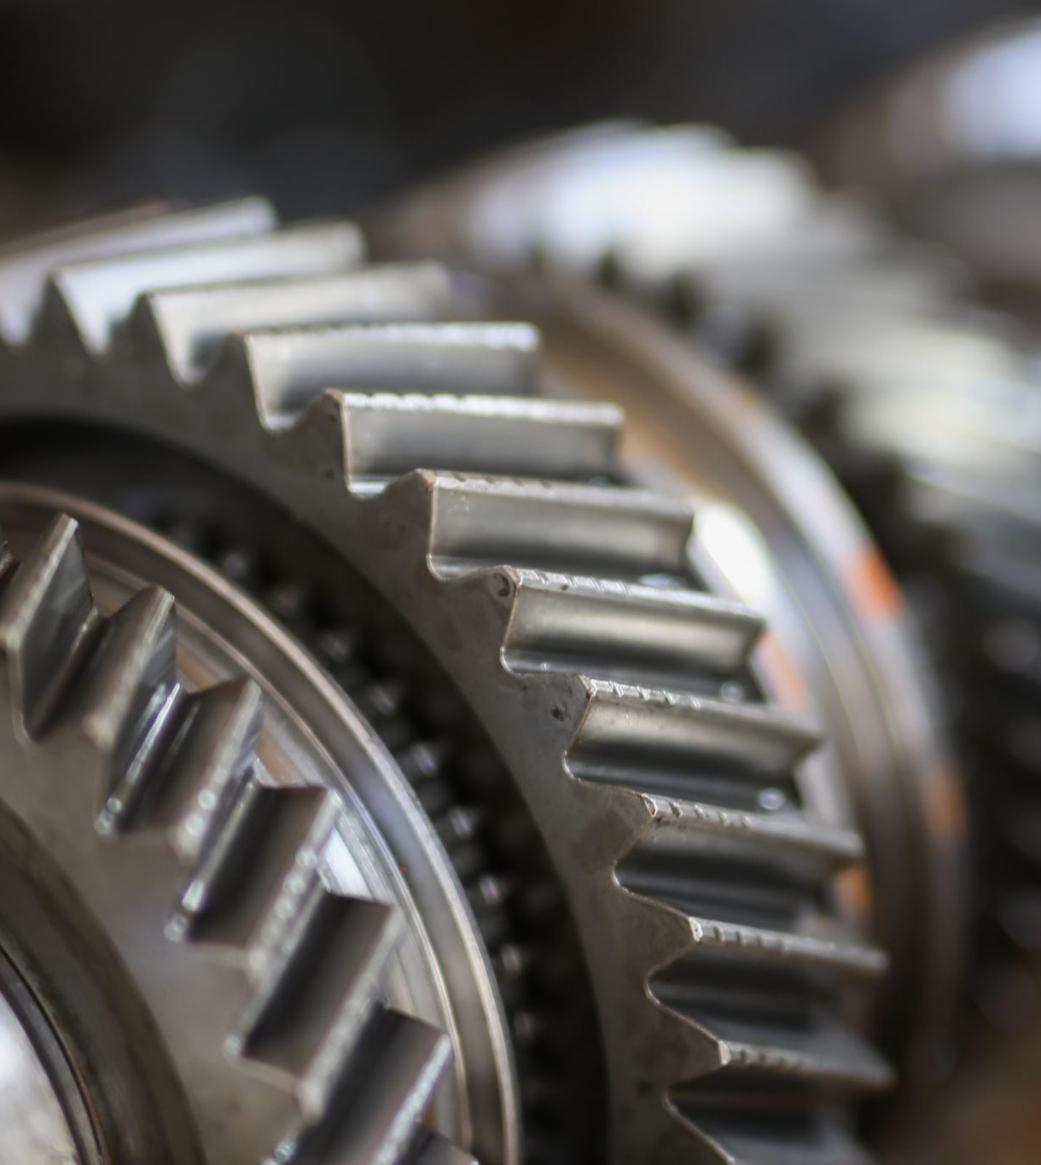
Components of a Belt Transmission
Belt: The main part, which can be constructed from leather, rubber, or polyurethane, among other materials. There are several varieties of belts, such as timing, V, and flat belts.
Pulleys: wheels on which the belt is wrapped around a grooved rim. The shafts that require driving have these fastened to them.
Tensioner: a tool that keeps the belt tension at the proper level to avoid slippage and guarantee effective power transfer.

Slide 4
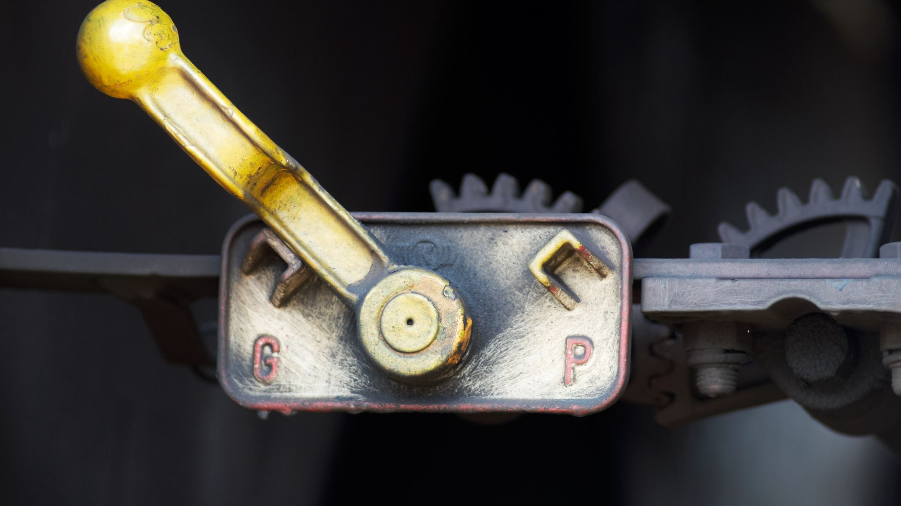
What Are the Different Types of Belt Drives?
Open belt drive
Closed or crossed belt drive
Fast and loose cone pulley
Stepped cone pulley
Jockey pulley drive
Quarter turn belt drive
Compound belt drive

Slide 5

Open belt drive
The most basic kind of belt drive system is an open belt drive, which consists of two or more pulleys connected by a single, continuous belt that is wound around them. The driving pulley rotates when the driving shaft receives power. One or more driven pulleys rotate as the belt moves along with it. Both pulleys rotate in the same direction in an open belt drive. The tight side of the belt is at the bottom and the slack side is at the top of horizontal pulley systems, increasing the angle at which the belt is in contact with the pulleys.
An open belt drive is distinguished by its simple design, which eliminates the need for the belt to be encased in a casing. This arrangement is frequently used to transfer power between shafts that are not oriented axially. Open belt drives are extensively used in many different applications, such as cars, conveyor systems, and machinery. They are a popular option for systems where precise tension control is not necessary because of their affordability, simplicity, and ease of maintenance.

Slide 6
Cross belt Drive
A cross belt drive, sometimes referred to as a twisted or closed belt drive, is a type of mechanical power transmission system in which two pulleys rotate in opposing directions due to the placement of a belt in a crisscross pattern between them. When a larger wrap angle is needed for effective power transfer or when the pulleys must rotate in different directions, this arrangement is employed. When a belt drives in a cross pattern, it crosses the driven pulley's top and then comes into contact with the driving pulley from below, giving the belt an eight-like shape.
In comparison to an open belt drive, a cross belt drive's enhanced wrap angle permits more power transmission for the same pulley diameters and center distance. Unfortunately, this arrangement necessitates a longer belt since it forces the belt to rub against itself in between the pulleys, which can lead to wear. By running the system at slower rates and positioning the pulleys at the greatest distance permitted, this problem can be lessened.
Applications needing high torque and power transmission, like heavy machinery, industrial equipment, and automotive systems, frequently use cross belt drives. The design improves grip and power transmission capabilities by guaranteeing that the wrap angle between the belt and the pulley is always more than 180 degrees. Because of this, cross belt drives are especially appropriate in scenarios where dependable power transfer is essential and the pulleys are not in the same plane axis.

Slide 7


Fast and loose cone pulley
A mechanical system with two pulleys—one fast and one loose—mounted on a driven shaft is known as a fast and loose cone pulley drive. While the loose pulley is installed without a key, enabling it to rotate freely relative to the shaft and rendering it incapable of power transmission, the fast pulley is keyed to the driven shaft, guaranteeing it rotates at the same speed as the shaft. A collared gun-metal or cast-iron bushing is used to secure the loose pulley in place and stop its axial movement. To give the belt some slack, the loose pulley's diameter is somewhat smaller than the fast pulley’s.
With this drive system, the driven shaft can be started and stopped instantly without changing its speed. When the belt is transferred from the loose pulley to the fast pulley, power is imparted; it ceases when the belt is returned to the loose pulley. This configuration is very helpful in situations where several machines are powered by a single power source. It is possible to start and stop each machine separately without halting the driving shaft, which could still be powering other machines.
The quick and loose cone pulley drive gives each driven shaft independent control, which is useful in configurations where the driving shaft must run continuously. This technique is frequently utilized in industrial environments where machine operation must be flexible and efficient.

Slide 8
Stepped cone pulley
A driven pulley with several diameters, akin to a stepped cone, is the feature of a stepped cone pulley drive, also called a step-cone pulley drive. By adjusting the belt to various diameter steps on the pulley, this design enables variable speed control of the driven shaft. The driven shaft speed rises when the belt is moved to a smaller diameter step; the speed falls when the belt is moved to a bigger diameter step.
When employing the same drive motor for multiple output speeds, such as in lathes and drilling machines, this kind of drive is frequently utilized. The step-cone pulley is constructed by joining two or more conical pulleys together so that their grooves mesh with one another to create a stepped shape. With this arrangement, the pulley size can be changed without changing the shaft diameter.
Step cone pulleys are installed on the driven and driver shafts in opposing directions in real-world applications to give different speed ratios between them while keeping the driver shaft running at a steady pace. The steps' diameters are engineered to allow the same belt to work on any pair of steps. Because of their adaptability, stepped cone pulley drives are perfect for machine tools because they allow for precise and effective speed adjustments.
For example, a four-step step cone pulley can convey varying power levels based on which step the belt engages, giving the required speed variation for various machining operations. This flexibility is necessary for accuracy and productivity when doing tasks that call for various speed settings.

Slide 9
Jockey pulley drive
The maximum force that can be communicated in a belt drive system is largely dependent on the diameter of the smaller pulley. Reduced contact area between the pulley and belt surface caused by smaller pulleys may limit the amount of power that can be transmitted. This impact is amplified if both pulleys are small since there may not be enough grip for efficient power transmission due to the narrow contact surface.
Furthermore, the wrap angle around the smaller pulley reduces if the pulleys are positioned very near to one another, which further reduces the smaller pulley's ability to transmit power. An idler pulley or jockey wheel can be utilized to solve these problems.
An idler pulley, sometimes referred to as a jockey wheel, is a mechanical component that directs or steers the belt to ensure peak efficiency. Usually, the idler pulley is positioned on the belt's slack side. Its main purposes are to raise the wrap angle around the smaller pulley, which improves the contact area between the belt and the pulley, and to lessen vibration by supporting the belt.
Maintaining the proper tension in the belt is facilitated by the use of an idler pulley. A belt must be properly tensioned to prevent excessive bending pressures on the pulley shafts and slippage or removal of the belt from the pulleys. The belt system should be able to be precisely adjusted to provide the right tension at the right time.

Slide 10
Quarter turn belt drive
Right-angle belt drives, another name for quarter turn belt drives, are made for applications in which the rotating shafts are oriented at right angles to one another. Power can be transferred perpendicularly using this kind of drive, which is advantageous if the shafts are positioned at a straight angle.
In a belt drive with a quarter turn, the belt completes a circuit by wrapping around the two perpendicular shafts. The pulley's breadth needs to be at least 40% wider than the cross-section of the belt in order to guarantee that the belt stays in place and does not come loose. In particular, the pulley face's width must be greater than or equal to 1.4 times the belt's width (1.4b), where "b" is the width of the belt.
Guides or idler pulleys are sometimes used to improve belt tracking and keep the belt from slipping off. These extra parts guarantee smooth functioning and aid in keeping the belt aligned.
When power needs to be transferred between shafts that are not parallel and are positioned at a right angle, quarter turn belt drives come in handy. They are appropriate for uses where the shafts must be oriented in a certain way due to the geometric layout.
Choosing the right belt type to operate the drive comes next, after the ideal belt drive arrangement has been determined based on the necessary geometric layout. To achieve effective operation, the belt type selection should take into account variables including load capacity, speed, and operating circumstances.

Slide 11
Compound belt drive
When power needs to be transferred between shafts via several shafts, a compound belt drive is the device used. When a larger speed ratio is required than what can be obtained with a single set of pulleys, this configuration is especially helpful.
Compound belt drives include more than two shafts, with several pulleys keyed to at least one of the shafts, in contrast to ordinary belt drives, which usually have two shafts with a driving pulley transmitting power to a driven pulley. Through these several shafts, the driving pulley distributes power from one shaft to another.
Compound belt drives enable larger speed ratios to be reached without the requirement for very large driven pulleys or additional space by adding more shafts and pulleys. With this configuration, power transmission can be optimized for applications that require accuracy in speed control and efficiency.
Applications for compound belt drives can be found in a variety of mechanical systems and industries where complicated motion transmission is necessary. They offer a versatile and effective way to reach the required speed ratios without sacrificing the system's overall compactness and dependability.

Slide 12
What Are the Different Types of Belt?
Round belt
Flat belt
V belt
Toothed belt
Link belt

Slide 13

Round belt
Round belts, sometimes referred to as endless drive or O-ring belts, have a circular cross section and are made to slide into pulleys' U- or V-shaped grooves. Due to their versatility, these belts are used in many different industries' motion control and power transmission systems.
Round belts have the advantage of being able to twist and turn a lot, which makes them good for situations where the belts come into contact with several pulleys. They ensure effective performance in intricate belt routing circumstances by having the ability to transmit power and provide friction from any region of their circular surface.
Round belts distribute torque through palpation when used with V-groove pulleys, increasing friction. However, low torque conditions are when they work best. Round belts offer versatility in installation and customisation since they can be bought in different lengths or cut to size and attached with staples, metal connectors, glue, or welding.

Slide 14
Advantages of Round belt
Versatility: Round belts come in a range of sizes, hues, and textures, and they may be tailored to match different pulley sizes and shapes to meet a variety of application needs.
Durability: These belts are appropriate for severe industrial applications due to their well-known strength and resilience.
Low Fraying: Round belts have a long lifespan and dependability because they don't fray.
Economical: They provide an affordable option for motion control and power transfer requirements.
Simple Cleaning and Maintenance: Round belts' ease of cleaning and maintenance adds to their durability and effectiveness.
Non-Marking: They are appropriate for situations where cleanliness is crucial because they do not leave marks on surfaces.

Slide 15
Flat belt
Flat belts are among the most often used industrial belt types because of their effectiveness and versatility. Flat belts have a rectangular cross section, rest on flat pulleys, and depending on the design, can transmit power from one or both sides. They are extensively used in a wide range of industrial machinery, including water pumps, sawmills, fans, belt conveyors, separators, compressors, and grinders.
At first, flat belt applications were the main usage for leather belts. But over time, the popularity of leather belts has decreased due to the development of other materials like rubber and synthetic polymers. Rubber and synthetic polymers are the most common materials used to make modern flat belts, which provide improved performance and durability.
Power is also transferred between shafts using thin flat belts, often known as flat high-strength belts or short infinitely woven belts. These belts transfer force through the pulleys' frictional output while the pulleys rotate in the same direction. While high-strength flat belts reduce the load on shaft bearings by eliminating the requirement for high belt tension, woven endless belts are useful for applications requiring less vibration on the driven pulley.

Slide 16
Advantages of Flat belt
High Power Transmission: Flat belts are appropriate for demanding industrial applications because they can transmit high power at high belt speeds.
Low Noise Operation: They create a quieter working atmosphere by operating with little noise.
High Efficiency: Flat belts ensure effective power transfer with efficiency levels as high as 98%.
little Bending Loss: The little bending loss produced by their small bending cross-section increases overall efficiency.
High Flexibility: The high flexibility of flat belts enables quick installation and seamless operation.
Long Service Life: They are durable and dependable in part because of their long service life and decent ability to withstand dust and grime.

Slide 17
V belt
Nowadays, the most popular belt type utilized in industrial applications is the V belt, which has a cross-sectional form resembling an isosceles trapezoid. These belts slide into sheaves' and pulleys' grooves, and because of their V-shaped construction, which increases the area of contact between the belt and the pulley, they can transmit more power while having the same dimensions.
They are frequently used in non-industrial settings and in a variety of machine tools, including drills, milling machines, lathes, and power tools. V belts are excellent in transmitting power across shorter distances between shafts because of their small size and effective power transmission capabilities.
Furthermore, there are two unique varieties of V belts that require additional discussion:
Hex Belts: These belts have a hexagonal shape and can be wedged into pulleys from both sides. They are created by gluing the top surfaces of two V belts together. Applications involving one or more reverse bends are perfect for them.
Kraftbands: A unique kind of V belt, kraftbands give the impression that multiple V belts are joined side by side at their upper ends. By expanding the power transmission contact area, they can serve as numerous belts in one, providing increased strength and efficiency.

Slide 18
Advantages of V belt
High-Speed Power Transmission: V belts are appropriate for applications needing quick motion because they can transfer power effectively at high speeds.
Compact shape: They can easily fit into pulley grooves thanks to their trapezoidal cross-section and compact shape, which enables effective power transmission in tight locations.
Cost-Effectiveness and Easy Installation: V belts are a popular option for a variety of industrial applications since they are both inexpensive and simple to install.
Improved Grip and Traction: The belt's V shape minimizes slippage and ensures effective power transmission by offering a firm grip and traction.

Slide 19
Toothed Belt
When compared to conventional belts like flat, round, and V belts, toothed belts—also referred to as timing belts or synchronous belts—offer a clear advantage: they completely eliminate belt slip. Toothed belts carry power by engaging teeth with grooves cut into the pulley, as opposed to using friction. This allows for exact timing and placement. They are therefore perfect for uses where it's essential to preserve precise timing and location.

Slide 20
Advantages of Toothed Belt
Dependable Positioning and Timing: Toothed belts are crucial for situations where accuracy is critical because they guarantee accurate positioning and timing.
High-Efficiency Power Transmission: Toothed belts transfer power effectively and do not slip, which improves the system's overall performance.
Low Noise Levels: Toothed belt drives function at far lower noise levels than chain or gear drives, improving user comfort and lowering noise pollution in industrial environments.
Toothed belts are versatile and have a wide range of uses, ranging from industrial machinery and equipment to automotive and motorcycle engines.
Low Maintenance: By requiring less upkeep and less lubrication, these belts save down on operating expenses and downtime.

Slide 21
Link belt
A unique kind of belt, link belts are made up of several separate links that are simple to install and remove in order to change the length of the belt as needed. These belts, which are usually made of polyurethane and reinforced with a polyester fabric woven in layers, provide special benefits for a range of uses.
Link belts have certain advantages that make them ideal for applications where environmental resistance and vibration damping are important considerations, even if they may cost more than other belt choices. Link belts are more expensive, but they provide long-term performance and dependability, which makes them an excellent investment in a variety of industrial situations.

Slide 22
Advantages of Linked Belt
Simple Installation: Link belts don't require specific pulleys and are easy to install. Due to the machine's simplicity of installation, belt adjustments may be made without disassembling the unit, saving time and labor.
Link belts perform exceptionally well in abrasive, chemical, and damp situations because of their exceptional resilience to these elements. Reliable performance is ensured by this durability, even under demanding circumstances.
Vibration Dampening: One of the best qualities of link belts is how well they can dampen vibrations. By lowering noise levels and minimizing vibration transmission, this improves user comfort and facilitates smoother operation.

Slide 23

References
Belt (mechanical). (2024, May 29). Retrieved from Wikipedia: https://en.wikipedia.org/wiki/Belt_(mechanical)
Belt Drive | Mechanics. (2023, May 6). Retrieved from HENGTUO: https://cn.htconveyor.com/resources/belt-drive-mechanics.html
Belt Drives and Types of Belt Drives? (n.d.). Retrieved from Digit: https://www.godigit.com/motor-insurance/automobile/belt-drives
Difference between Open Belt Drive and Cross Belt Drive: With Definition, Diagram. ( 2023, October 31). Retrieved from testbook: https://testbook.com/mechanical-engineering/difference-between-open-belt-drive-and-cross-belt-drive
FAST AND LOOSE PULLEY. (2013, November 8). Retrieved from Mechanical Engineering: https://blogpuneet.wordpress.com/2013/11/08/fast-and-loose-pulley/
Gimeno, P. (2022, July 11). Types of transmission belts and main differences. Retrieved from Dolz: https://www.idolz.com/en/types-of-transmission-belts-and-main-differences/
Kumar, E. A. (February , 2022 1). Difference Between Open Belt Drive and Cross Belt Drive [Notes & PDF]. Retrieved from The Mechanical Engineering,com: https://themechanicalengineering.com/open-belt-drive-and-cross-belt-drive/
Malwatkar, N. (2020, December 29). Different types of Belt-Drives used in Mechanical applications. Retrieved from Medium: https://neelmalwatkar.medium.com/different-types-of-belt-drives-used-in-mechanical-applications-d9f08554f00
Sild, S. (2022, 02 8). Belt Drives & Types of Belts. Retrieved from Fractory: https://fractory.com/belt-drives/
Step Cone Pulley Design Optimization. (2023, February 23). Retrieved from Design Optimation: https://apmonitor.com/me575/index.php/Main/StepConePulley

