Slide 1


Field | Mechanics
Chapter | Fundamental Engineering Concepts
Subtitle | Force

Slide 2
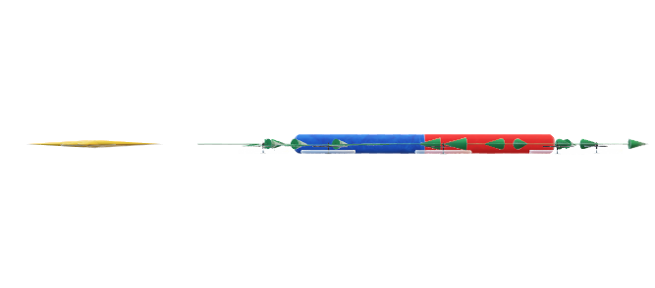
Definition
Fundamentally, a force is an activity that maintains or modifies an object's motion or shape. Simplistically, it can be seen of as either a push or a pull. An object's speed, direction, or even form can be changed by forces. Force is applied in situations like opening and closing doors and stretching rubber bands.

Slide 3
Definition
Force finds its explanation in mechanics, where it encompasses any action that either preserves or changes an object's motion or shape. Isaac Newton's principles, as elucidated in his Principia Mathematica (1687), lay down the foundational understanding of force.
Newton’s 1st law : a body will remain at rest or in uniform motion along a straight line unless acted upon by a force.
Newton’s 2nd law : an external force acting on a body induces an acceleration in the direction of the force, with the magnitude of acceleration directly proportional to the force and inversely proportional to the body's mass.
Newton’s 3rd law : when one body exerts a force on another, the second body reciprocates with an equal force. This principle elucidates why a force tends to cause deformation in a body, irrespective of whether it initiates movement.

Slide 4
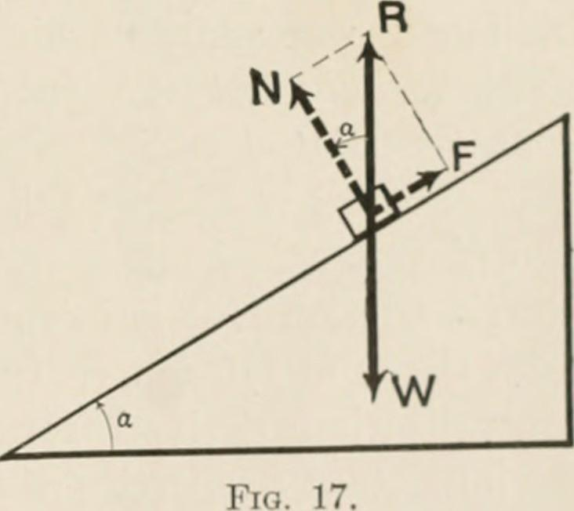
Characteristics of force:
Force is a vector quantity. When forces are represented by vectors, it is implied that they are concentrated at a single location or along a single line. However, this is not physically possible. For example, when a structural component is loaded, the applied force causes an internal force, or stress, that is distributed throughout the component's cross section. The force of gravity always experiences a uniform distribution throughout the volume of the body. Nevertheless, it is usually reasonable and easy to assume that the forces are concentrated at a single location when the primary consideration is the body's balance. It is reasonable to assume that a body's entire weight is concentrated at its centre of gravity when gravitational force is involved.

Slide 5
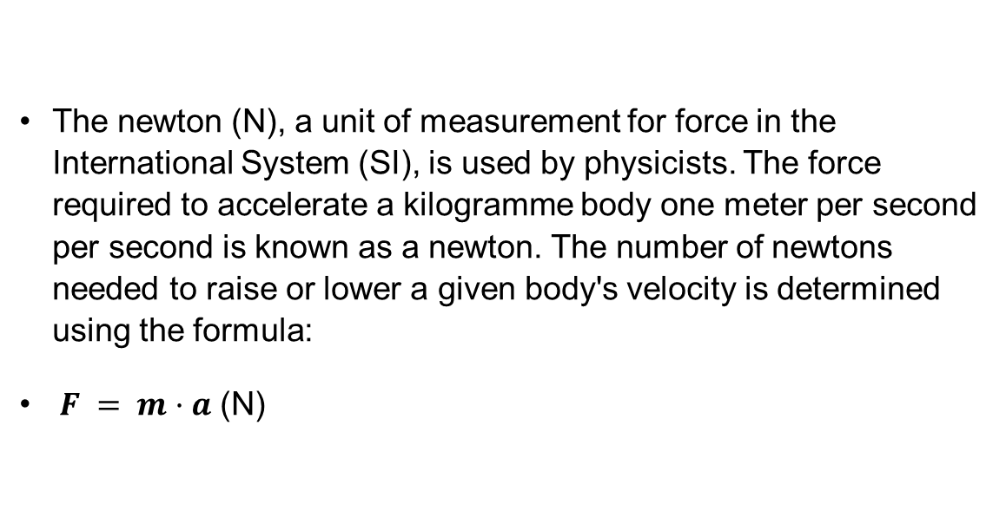
Formula of force:

Slide 6
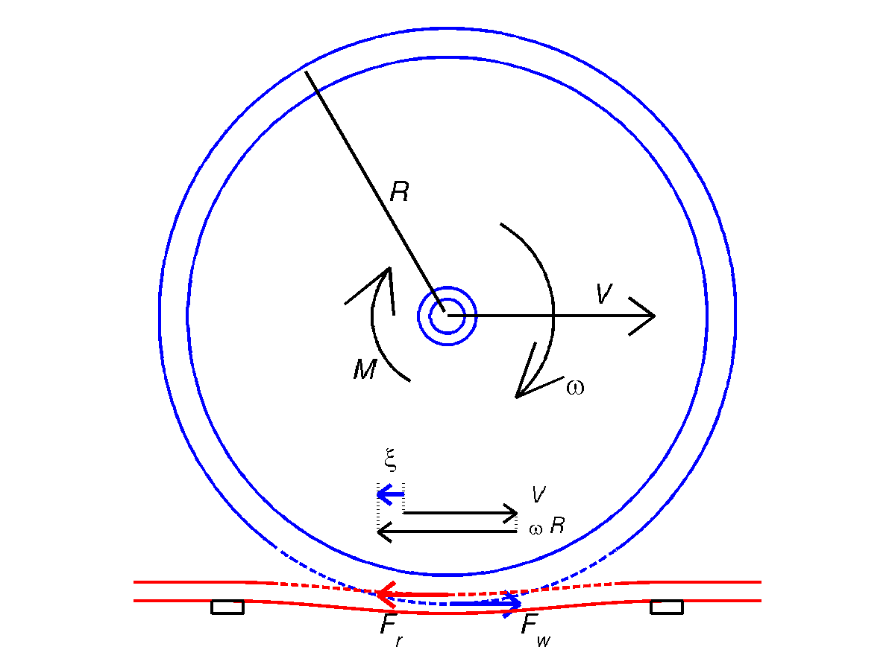
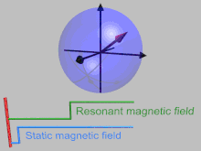
Types of forces:
Forces can be divided into primarily into two types of forces:
Contact Forces :refers to all forces that need to be in contact with another object. Every mechanical force is a force of contact.
Non-contact Forces :are the kinds of forces that can be applied without having to make touch with any object.

Slide 7
Types of contact forces:
Tension force: the pulling force that passes through any flexible connector, such as a cable, rope, or string.
Friction force : the force acting against the relative motion or tendency of two surfaces in touch to move in that direction.
  The force that maintains an object at rest is called static friction.
  The force acting on things in motion is known as kinetic friction.
Spring force : The force exerted by a compressed or stretched spring upon any object that is attached to it.
Drag force : the force of resistance experienced as an object moves through a fluid, such water or air.

Slide 8
Types of non-contact forces:
Gravitational Force : the force that attracts any two masses together. It is inversely proportional to the square of the distance between them and proportionate to the product of the masses.
Electromagnetic Forces : the force that exists between charged particles. This comprises:
  Electrostatic force : Force between charged particles that is stationary.
  Magnetic force : The force between two magnetic poles or charged particles in motion.

Slide 9
References
College, B. S. (2021, January 8). Statics (Classical Mechanics) Problem Image -numeric version. Retrieved from https://commons.wikimedia.org/wiki/File:20-S-FORCE-JK-C2S12-1c.png
Dadourian, H. M. (2014, July 30). Analytical mechanics for students of physics and engineering. Retrieved from Flickr: https://www.flickr.com/photos/internetarchivebookimages/14596085609
Britannica, The Editors of Encyclopaedia. "force". Encyclopedia Britannica, 19 Apr. 2024, https://www.britannica.com/science/force-physics. Accessed 29 May 2024.
Force. (2024, May 17). Retrieved from Wikipedia: https://en.wikipedia.org/wiki/Force
Jacob Moore, M. C. (n.d.). Forces. Retrieved from Mechanics Map: http://mechanicsmap.psu.edu/websites/1_mechanics_basics/1-3_forces/forces.html
Weideman, T. (n.d.). Types of Forces. Retrieved from LibreTexts Physics: https://phys.libretexts.org/Courses/University_of_California_Davis/UCD%3A_Physics_9HA__Classical_Mechanics/2%3A_Force/2.3%3A_Types_of_Forces
Common Forces in Mechanics - Learn Types, Friction and Examples. ( 2023, Aug 16). Retrieved from Testbook: https://testbook.com/physics/common-forces-in-mechanics
Morley, G. W. ( 2012, November 11). Animated Rotating Frame. Retrieved from Wikimedia Commons: https://en.wikipedia.org/wiki/Rotating_reference_frame#/media/File:Animated_Rotating_Frame.gif
Edwinv1970. (2012, April 27). Illustration of creepage for a railway wheel. Retrieved from Wikimedia Commons: https://commons.wikimedia.org/wiki/File:Illustration_of_creepage_for_a_railway_wheel.png

