Slide 1
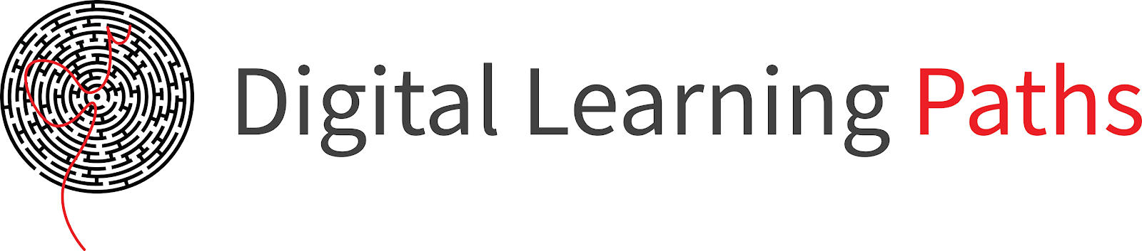

Field | Mechanics
Chapter | Calculations on Machine Parts
Subtitle | Loose Connections

Slide 2

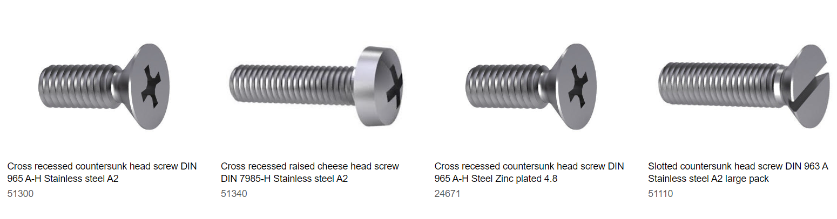
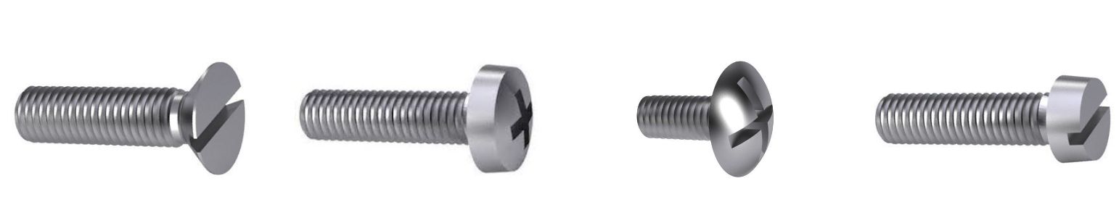
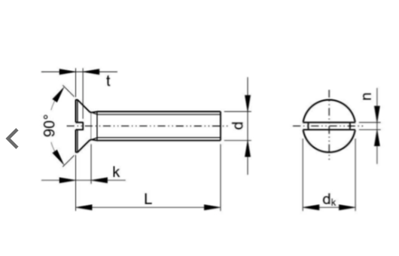

BOLT AND NUTS
This is a widely used thread connection consisting of a threaded bolt and a corresponding nut. It is used to join two or more components together, providing a secure and adjustable connection. Bolt and nut connections are commonly found in construction, machinery, automotive, and general industrial applications.

Slide 3

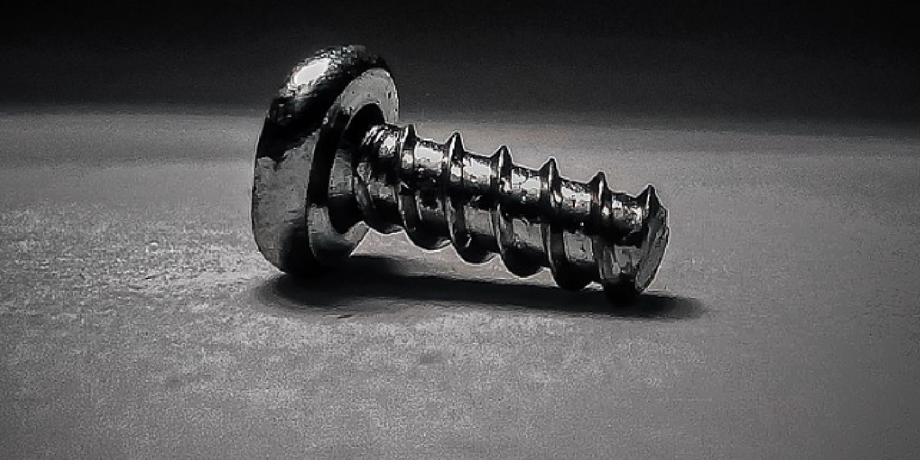

SCREW
A screw is a combination of simple machines : it is, in essence, an inclined plane wrapped around a central shaft, but the inclined plane (thread) also comes to a sharp edge around the outside, which acts as a wedge as it pushes into the fastened material, and the shaft and helix also form a wedge at the point. Some screw threads are designed to mate with a complementary thread, called a female thread (internal thread), often in the form of a nut object with an internal thread. Other screw threads are designed to cut a helical groove in a softer material as the screw is inserted. The most common uses of screws are to hold objects together and to position objects.

Slide 4
Why it is important to choose the proper loose connection and their maintenance?

Slide 5

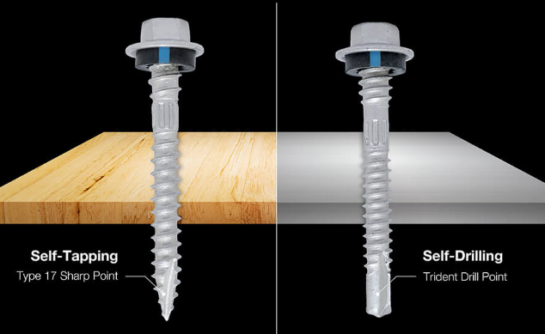

A pressurized bolted flange joint assembly begins to leak, creating a safety hazard. A rotor with its blades separates from the nacelle and spins off a wind turbine, crashing to the ground. Under constant vibration from the engine of an ocean freighter, loose bolts on a large piece of mining equipment work their way off the bolted joints and roll around the hull, inflicting further damage to the equipment.

Slide 6
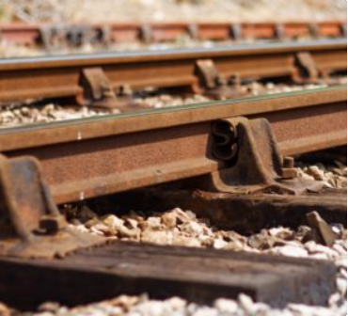
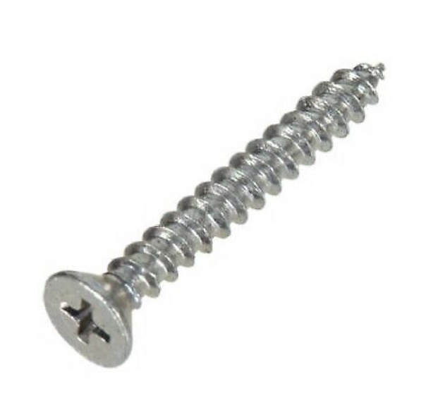
What Causes Loose Bolts?
Bolted joints are critical to the safe operation of many types of equipment in a wide range of applications, including power generation, manufacturing, mining, and transportation.
In a bolted joint, tightening the nut actually stretches the bolt a small amount, like pulling on a stiff spring. This stretching, or tension, results in an opposing clamp force that holds the two sections of the joint together. If the bolt comes loose, this clamp force weakens.
Loose bolts are not just an irritating nuisance. If the joint is not quickly retightened, the application may begin to leak fluid or gas, the bolt may break, equipment may become damaged, or catastrophic accidents may occur.

Slide 7
Six causes of loose bolts, which can occur separately or in combination
Under-tightening. By definition, an under-tightened bolt is already loose and the joint does not have enough clamp force to hold the individual sections together. This can lead to sideways slippage between sections, placing unwanted shear stress on the bolt that could eventually cause it to break.

Slide 8
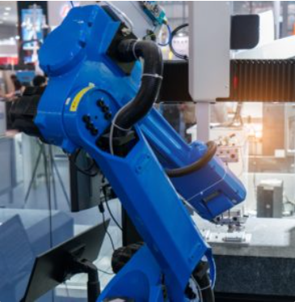
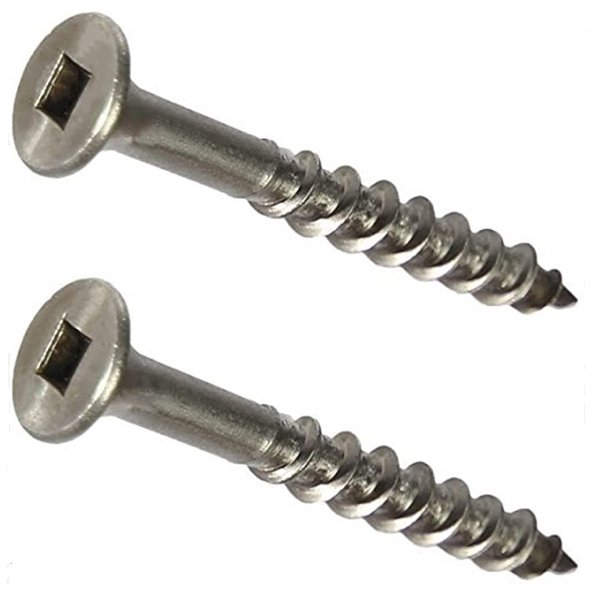
2) Vibration. Experiments on bolted joints under vibration show that many small “transverse” movements cause the two sections of the joint to move in parallel with each other and with the bolt head or nut. These repeated movements work against the friction between the bolt and joint threads that is holding the joint together. Eventually, vibration will cause the bolt to “unwind” from the mating threads and the joint to lose its clamp force.

Slide 9
3) Embedding. The design engineers who specify the tension on a bolt allow for a break-in period, during which bolt tightness relaxes to a certain degree. This relaxation is caused by micro-embedding of the bolt head and/or nut into the joint surface, and can occur with both soft materials, such as composites, as well as hard, polished metals. If the joint has not been designed properly, or if the specified tension was not achieved on the bolt at the start, this embedment of the joint can lead to a loss of clamp force.
4) Gasket creep. Many bolted joints include a thin, flexible gasket between the bolt head and the surface of the joint to seal the joint completely against gas or liquid leaks. The gasket itself acts as a spring, pushing back against the pressure of the bolt and the joint face. Over time, and especially near high heat or corrosive chemicals, the gasket may “creep,” which means it loses its springiness, leading to loss of clamp force. This can also happen if the gasket area directly next the bolts is crushed, or if the bolts are not tightened evenly across the entire face of the joint.

Slide 10
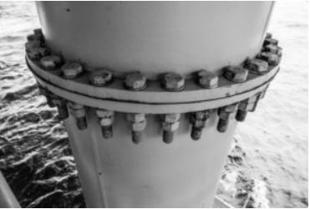
5) Differential Thermal Expansion. If the material of the bolt and the joint are different, large differences in temperature due to rapid environmental changes or cycling industrial processes can cause bolt material to expand or contract rapidly, possibly loosening the bolt.
6)Shock. Dynamic or alternating loads from machinery, generators, wind turbines, etc., can cause mechanical shock – a sudden force applied to the bolt or the joint – causing the bolt threads to slip relative to the threads of the joint. Just as with vibration, this slippage can ultimately lead to loosening of the bolts.

Slide 11
Maintaining Proper Tension Ensures Bolts Stay Tight
The combination of good bolted joint design, proper clamp force development, and suitable bolt retention devices can reliably secure a bolted joint against many of the challenges raised here.
A good bolted joint will be designed with the proper size and type of bolt and nut, and specify the optimal amount of tension to achieve the clamp force required to maintain joint integrity.
In the application itself, proper development of clamp force requires that the correct level of tension (preload) in each bolt has actually been achieved – and remains at that level throughout its operating lifetime.

Slide 12
Note!
It is important to select the appropriate screw type based on the specific application, material, and load requirements to ensure a secure and reliable fastening.

