Slide 1


Field | Mechanics
Chapter | Fundamental Engineering Concepts
Subtitle | Deformation

Slide 2
Deformation
The term "deformation" in engineering describes how an object's size or shape changes. A displacement is the complete shift in a point's location within an item. The relative shift in an object's external displacements is known as deflection. A non-dimensional change in the cube's length or angle of distortion can be used to convey strain, which is the relative internal change in shape of an incredibly small cube of material. A stress-strain curve connects strains to the forces operating on the cube, also referred to as stress. Up until the yield point, the relationship between stress and strain is often linear, reversible, and elastic. Young's modulus is the linear relationship for a material. Plastic deformation is the term used to describe the degree of permanent distortion that remains after unloading above the yield point. The field of material strength and structural analysis can be used to determine the stress and strain distribution throughout a solid object. As long as there is no appreciable change in the object's size, engineering stress and strain can be used to approximate the internal state based on exterior forces and deformations. The instantaneous size of the object can be used to calculate the true stress and strain in cases where there is a considerable change in size.

Slide 3
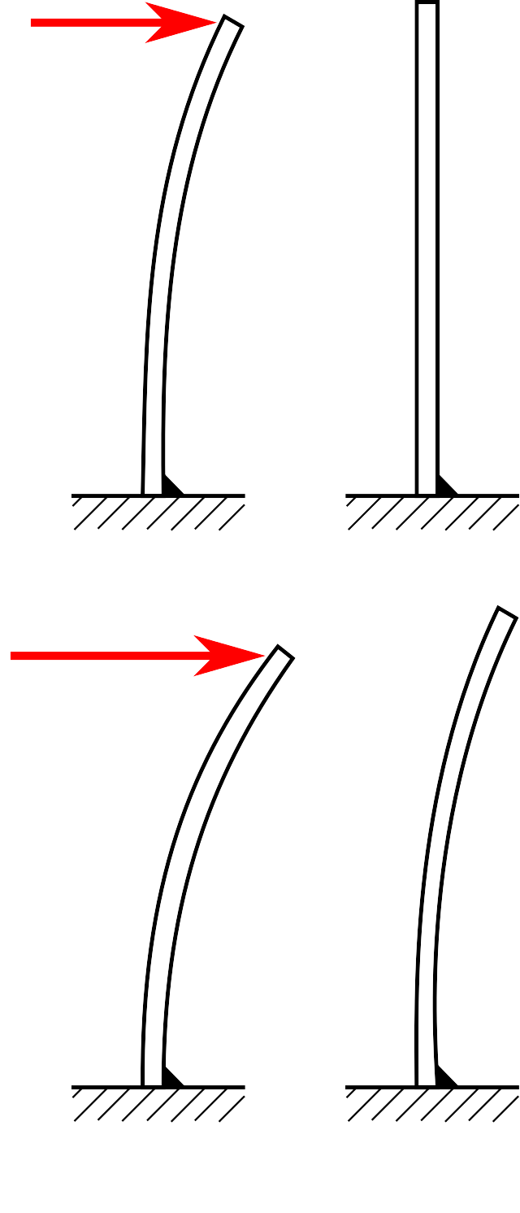
Types of deformation
Different kinds of deformation may occur depending on the material type, the object's size, shape, and applied forces. The engineering stress vs. strain diagram for a typical ductile material, like steel, is displayed in the image to the right. A deformation mechanism map can be used to illustrate how distinct deformation modes might arise in various circumstances.
Temporary deformation is recoverable since it goes away when applied forces are removed, but permanent deformation is irreversible and remains long after they are removed. Elastic deformation is another term for temporary distortion, whereas plastic deformation refers to permanent deformation.

Slide 4
Elastic deformation
Steel and concrete, two materials utilized in mechanical and structural engineering and prone to minute deformations, are studied in the context of transient or elastic deformation in engineering strain. Infinitesimal strain theory, also known as tiny deformation theory, small displacement theory, small displacement-gradient theory, or small strain theory when both rotations and strains are small, is used to model engineering strain.
Other more complicated definitions of strain, like stretch, logarithmic strain, Green strain, and Almansi strain, are needed for some materials, like elastomers and polymers, subjected to large deformations, for which the engineering definition of strain is not applicable, e.g., typical engineering strains greater than 1%. Rubber, elastomers, and shape memory metals like nitinol all have broad ranges of elastic deformation. These materials' elasticity is nonlinear, though. Most crystals, typical metals, and ceramics have linear elasticity with a narrower elastic range.

Slide 5
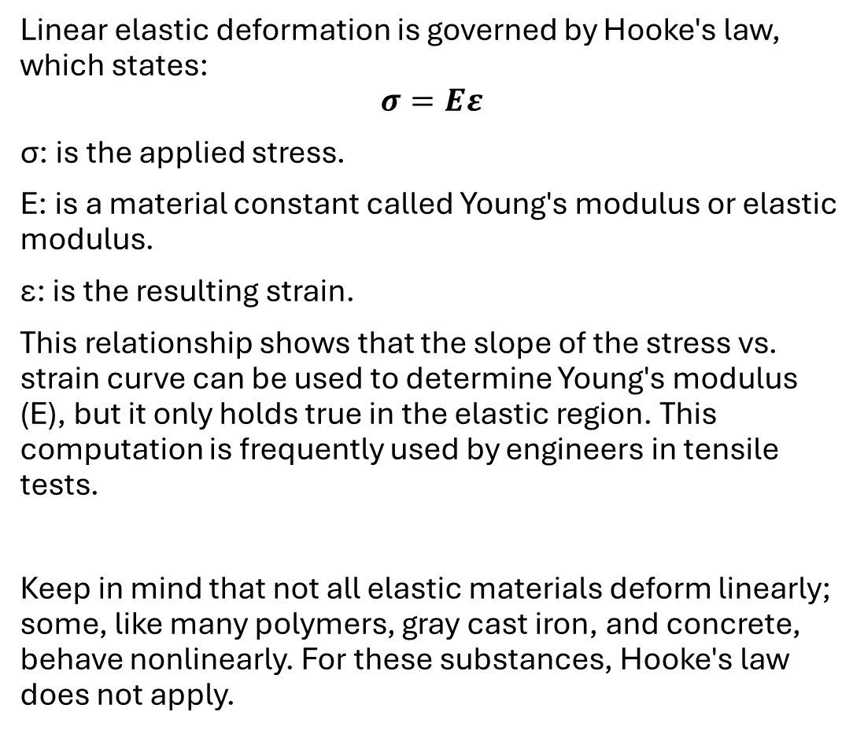
Elastic deformation
Linear elastic deformation is governed by Hooke's law, which states:
$$σ=Εε$$
σ: is the applied stress.
E: is a material constant called Young's modulus or elastic modulus.
ε: is the resulting strain.
This relationship shows that the slope of the stress vs. strain curve can be used to determine Young's modulus (E), but it only holds true in the elastic region. This computation is frequently used by engineers in tensile tests.
Keep in mind that not all elastic materials deform linearly; some, like many polymers, gray cast iron, and concrete, behave nonlinearly. For these substances, Hooke's law does not apply.

Slide 6
Plastic deformation
It is not possible to reverse this kind of deformation by only eliminating the applied force. However, an object in the plastic deformation range will have first experienced elastic deformation, which may be reversed by simply withdrawing the applied force. As a result, the object will partially revert to its initial shape. Soft thermoplastics and ductile metals like copper, silver, and gold both have a sizable plastic deformation range. Cast iron does not, but steel does. The plastic deformation ranges of hard thermosetting polymers, rubber, crystals, and ceramics are small. Wet chewing gum is an example of a material having a high plastic deformation range; it can be stretched to numerous times its initial length.

Slide 7
Plastic deformation
Plastic deformation under tensile stress is typified by a necking zone, a strain hardening region, and fracture (also known as rupture). Atomic dislocations cause the material to get stronger during strain hardening. A decrease in the specimen's cross-sectional area indicates the necking phase. After reaching the maximum strength, necking starts. The material can no longer bear the maximal force during necking, and the specimen's strain quickly rises. The material fracture marks the conclusion of plastic deformation.

Slide 8



Example:
A steel rod with a diameter of 10 mm and a length of 1 meter is subjected to a tensile force of 20 kN. If the modulus of elasticity for steel is 200 GPa, calculate the elongation of the rod.
Solution:
First, we need to determine the stress applied to the rod, which can be calculated using the formula:
Stress=Force​/Area (1)

Slide 9
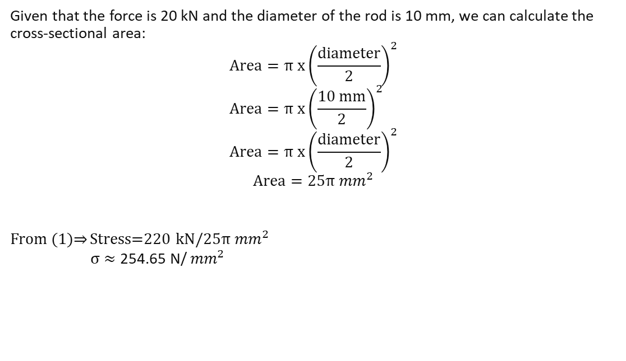
Solution:
Given that the force is 20 kN and the diameter of the rod is 10 mm, we can calculate the cross-sectional area:
$$Area=π{ x\left(\frac{ⅆiameter}{2}\right)}^{2} \\ Area=π{ x\left(\frac{10 mm}{2}\right)}^{2}$$
$$Area=π{ x\left(\frac{ⅆiameter}{2}\right)}^{2}$$
$$Area=25π{ mm}^{2}$$
From (1)⇒ Stress=220 kN​/$25π{ mm}^{2}$
σ $≈\text{254.65 }\text{N}\text{/}{ mm}^{2}$

Slide 10
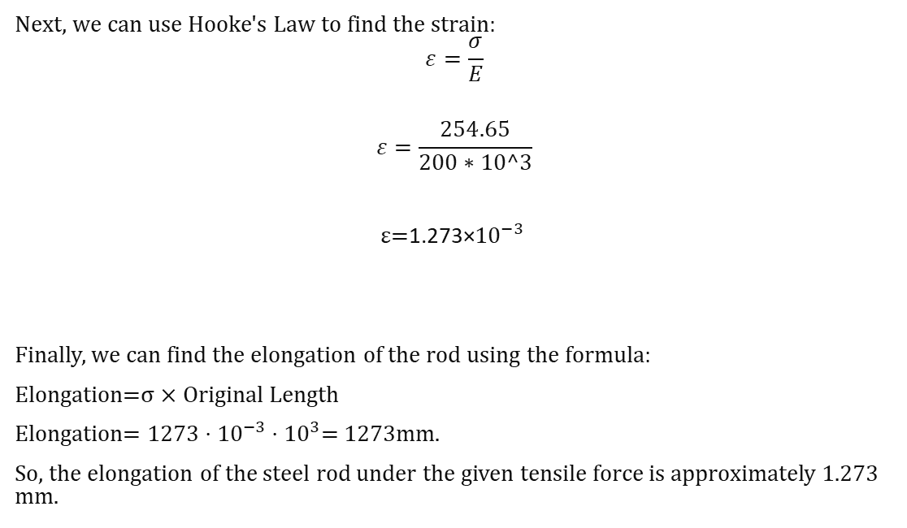
Solution:
Next, we can use Hooke's Law to find the strain:
$$ε=\frac{σ}{E}$$
$$ε=\frac{254.65}{200∗10^3}$$
ε$=$1.273×${10}^{−3}$
Finally, we can find the elongation of the rod using the formula:
Elongation=σ × Original Length
Elongation= $1273⋅{10}^{−3}⋅{10}^{3}$= 1273mm.
So, the elongation of the steel rod under the given tensile force is approximately 1.273 mm.

Slide 11
References
Deformation. (n.d.). Retrieved from Wikipedia, the free encyclopedia: https://en.wikipedia.org/wiki/Deformation_(engineering)
Deformation. (n.d.). Retrieved from ChemEurope.com: https://www.chemeurope.com/en/encyclopedia/Deformation.html
Elasticity and Plasticity. (n.d.). Retrieved from openstax: https://openstax.org/books/university-physics-volume-1/pages/12-4-elasticity-and-plasticity
Modes deformation. (2008, December 12 ). Retrieved from https://commons.wikimedia.org/wiki/File:Modes_deformation.svg

