Slide 1


Field | Mechanics
Chapter | Fundamental Engineering Concepts
Subtitle | Moment of Force

Slide 2
Moment of force:
Torque is the rotating equivalent of linear force in physics and mechanics. Another name for it is the moment of force, which is frequently shortened to moment. The lowercase Greek letter tau, τ , is commonly used as the symbol for torque. The amount of torque that an object experiences when subjected to a force determines how much the thing rotates.

Slide 3
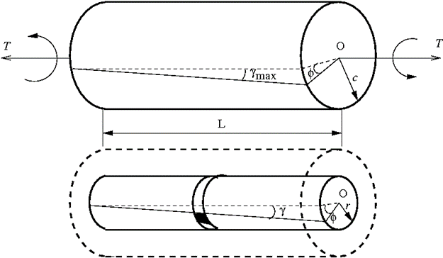
Characteristics of torque:
A vector quantity is torque. Torque has both magnitude and direction. The direction is perpendicular to the plane formed by the position and force vectors, determined by the right-hand rule.

Slide 4
Characteristics of torque:
A vector quantity is torque. Torque has both magnitude and direction. The direction is perpendicular to the plane formed by the position and force vectors, determined by the right-hand rule.

Slide 5
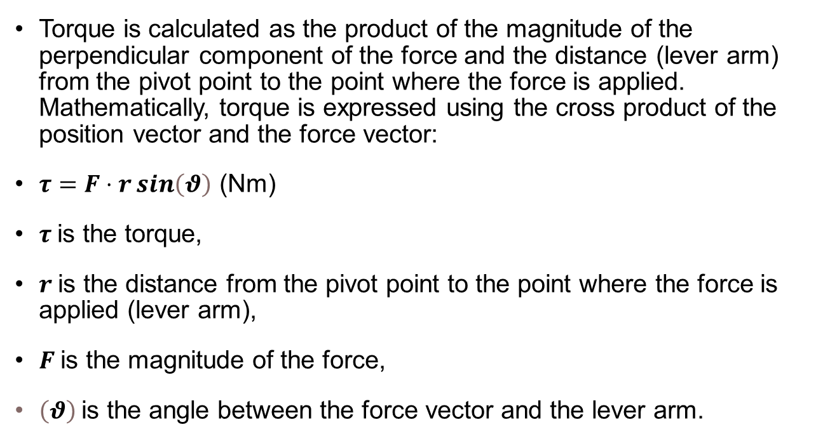
Formula of torque:

Slide 6
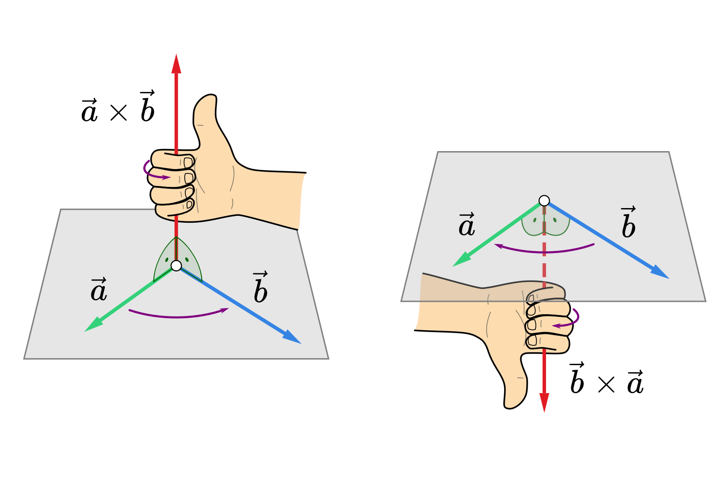
Direction of torque:
The direction of the torque vector is determined using the right-hand rule: If you point the fingers of your right hand in the direction of the lever arm and curl them towards the direction of the force your thumb will point in the direction of the torque vector. This indicates that the torque vector is perpendicular to both the position and force vectors, defining the plane in which they lie.

Slide 7
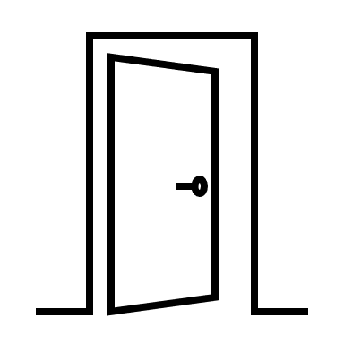
Intuitive Understanding
Anyone who has opened a door has an intuitive understanding of torque. Pushing on the side near the hinges to achieve the same rotational effect. This is because the lever arm is longer, increasing the torque for the same amount of force.

Slide 8
Types of Torque:
Static Torque: Doesn't accelerate an angle. For instance, applying pressure to a closed, stationary door or riding a bicycle at a steady pace.
Dynamic Torque: Accelerates an angle. Take the drive shaft of a race car when it accelerates off the starting line.

Slide 9
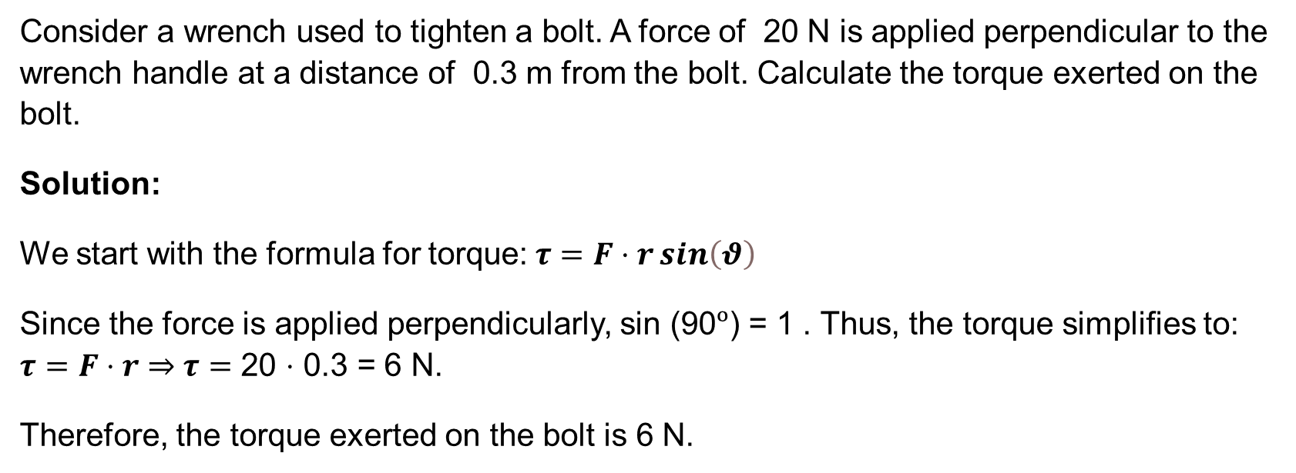
Example

Slide 10
References
Torque. (n.d.). Retrieved from https://www.khanacademy.org/science/physics/torque-angular-momentum/torque-tutorial/a/torque
Torque and Rotational Motion Tutorial. (n.d.). Retrieved from University of Guelph: https://www.physics.uoguelph.ca/torque-and-rotational-motion-tutorial
Torque. (n.d.). Retrieved from LibreTexts Physics: https://phys.libretexts.org/Bookshelves/University_Physics/University_Physics_(OpenStax)/Book%3A_University_Physics_I_-_Mechanics_Sound_Oscillations_and_Waves_(OpenStax)/10%3A_Fixed-Axis_Rotation__Introduction/10.07%3A_Torque
Torque. (2024, May 26). Retrieved from Wikipedia: https://en.wikipedia.org/wiki/Torque
MikeRun. (2022, April 15). Cross-product-right-hand rule. Retrieved from Wikimedia Commons: https://commons.wikimedia.org/wiki/File:Cross-product-right-hand_rule.svg

