Slide 1


Field | Mechanics
Chapter | Couplings
Subtitle | Different types of Mechanical Couplings

Slide 2

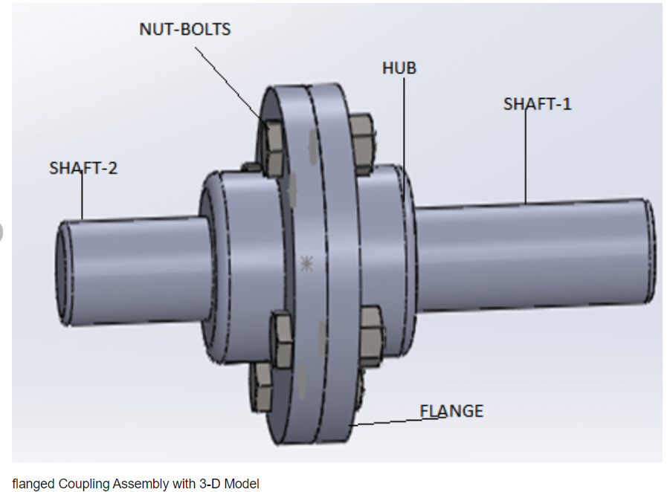

FLANGE COUPLING
Flange Coupling: A flange coupling is a type of coupling that uses bolts to connect two flanges together. The flanges are attached to the ends of the shafts and are then bolted together to form a rigid connection. Flange couplings are commonly used in industrial applications where high torque transmission is required.

Slide 3

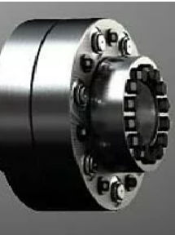

CLAMPING BUSH COUPLING
A clamping bush coupling is a type of coupling that uses a bushing to connect two shafts together. The bushing is mounted on one shaft and then clamped onto the other shaft using bolts or set screws. Clamping bush couplings are commonly used in low to medium torque applications.
The figure shows an example of this type of coupling developed by KTR Company. In specific, according to the company
Pin & bush coupling with clamping set for frictionally engaged torque transmission. The flexible coupling REVOLEX® KX-D made of steel with KTR 650 is a fail-safe pin & bush coupling with clamping set.
Large drives often do without a feather key connection.
Transmitting torques with smooth drive shafts requires frictionally engaged connections. This is typically done via oil press fits. For that purpose the bore needs expensive grinding, the hub is heated and the shaft cooled for mounting.
With the pin & bush coupling REVOLEX KX-D with clamping set KTR 650 assembly and disassembly is simply made with a CLAMPEX clamping set. For this purpose the clamping set is screwed to a coupling flange having the benefit that the solid hub body is replaced by the clamping set. Having unscrewed the clamping screws the coupling flanges including the pin can be radially dismounted.

Slide 4
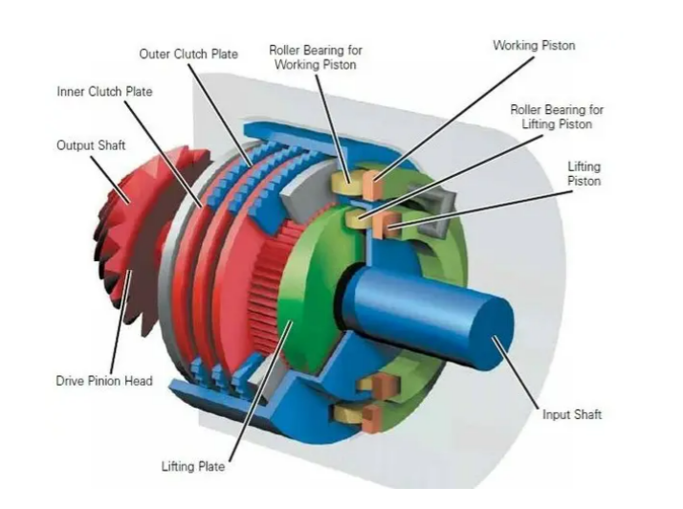
MULTIPLATE CLUTCH
A multiplate clutch is a type of coupling that uses multiple friction plates to transmit power between two shafts. The clutch is engaged by pressing the friction plates together using a mechanical or hydraulic mechanism. Multiplate clutches are commonly used in automotive and industrial applications.
Figure from studentlesson.com `

Slide 5
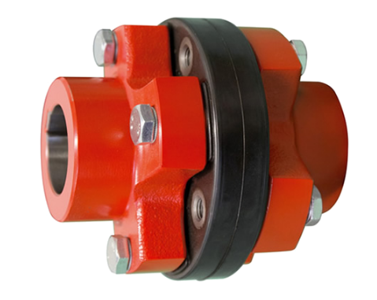
ELASTIC COUPLING OR GASKET
An elastic coupling is a type of coupling that uses an elastic element, such as a spring or rubber bushing, to transmit power between two shafts. The elastic element absorbs shock and vibration and helps to reduce wear and tear on the shafts. Elastic couplings are commonly used in applications where misalignment is expected.
The figure shows an example of an elastic coupling made by West Car Italian Company.
Rotoflexi G-GN elastic alignment coupling encompasses all the features of an elastic coupling, integrating constructive simplicity and cost-effectiveness. Thanks to the different configurations, it responds to the most diverse installation requirements as motor coupling, pump coupling, reducer coupling.
Figure from http://www.westcar.it/

Slide 6
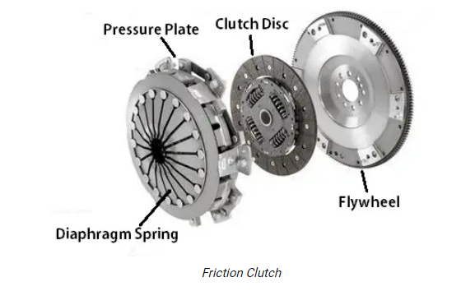
FRICTION CLUTCH
A friction clutch is a type of coupling that uses friction to transmit power between two shafts. The clutch is engaged by pressing two friction surfaces together using a mechanical or hydraulic mechanism. Friction clutches are commonly used in automotive and industrial applications.
A friction clutch will consist of the following main components
Flywheel
Pressure plate
Clutch Plate

Slide 7
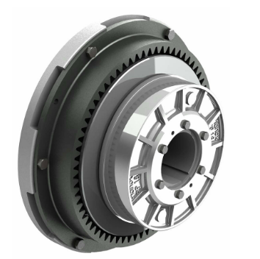
PLANOX COUPLING
A Planox coupling is a type of coupling that uses a curved tooth profile to transmit power between two shafts. The teeth engage and disengage smoothly, allowing for high torque transmission and reducing wear and tear on the shafts. Planox couplings are commonly used in high torque applications.
The Planox clutch, type PPT, is switched off pneumatically and is based on the two design features of the PP and PT type clutches. A switching component similar to that installed in the PP type is attached to the extended clutch hub of the PT model. The compressed air is fed axially through the shaft. The axial force generated by this presses against the cup spring packs via the piston, thereby separating the parts within the frictional connection. The clutch is switched off. When depressurized, the clutch is switched on automatically by spring force. This means that when in operation, no actuating medium needs to be constantly present. The specific model of the clutch is developed from DESCH.
Torque range from 1,100 Nm to 825,000 Nm

Slide 8
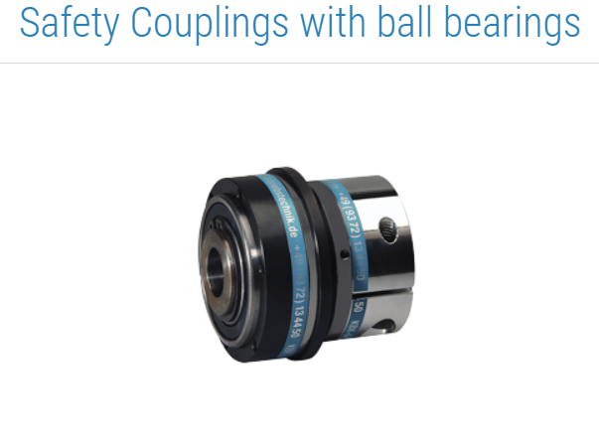
SAFETY COUPLING
A safety coupling is a type of coupling that is designed to protect machinery from damage in the event of a sudden overload or jam. The coupling is designed to disengage when a certain torque limit is exceeded, preventing damage to the machinery.
Safety Couplings with Roller Bearings
Due to the integrated roller bearing, backlash-free safety couplings offer a compact possibility of torque limitation for indirect drives for attaching belt pulleys, sprocket wheel.

Slide 9
Torque/Power transmission capacity
The maximum torque which can be transmitted calculated using the equation: Mtmax = π da2 B p μ / 2000.
Mtmax = maximum transmissible torque [Nm]
da = shaft diameter [mm]
B = effective pressure length (equal to da) [mm]
p = minimum surface pressure between shaft and inner sleeve[N/mm2]
μ = coefficient of friction

Slide 10
Torque/Power transmission capacity
If the coupling is subjected to axial forces, their effect on the power transmission capacity is generally insignificant. The transmissible torque is obtained from the equation: Mt = √(Mtmax2 - ( Fa da / 2000)2) .
Mtmax = maximum transmissible torque [Nm]
Fa = axial force [N]
da = shaft diameter [mm]

Slide 11
Torque/Power transmission capacity
The permissible torque is obtained from: M = Mtmax or Mt / f .
M= permissible torque [Nm]
Mtmax = maximum transmissible torque [Nm]
f = safety factor

