Slide 1


Field | Theoretical and Practical Mechanics
Chapter | Calculation of machine parts
Subtitle | Clutch

Slide 2
Clutch
A clutch is a mechanical device that engages and disengages power transmission, especially from a drive shaft (driving shaft) to a driven shaft. In the simplest application, clutches connect and disconnect two rotating shafts (drive shafts or line shaft)
Use:
Manual transmission cars
Automatic cars
Cordless drill
Chain saws
Yo-yos

Slide 3
A clutch can be a standalone component, used to connect the internal combustion engine to the transmission(ICE) , or can be the subcomponent or another main component: torque converter , automatic transmission, transfer case, limited-slip differential (LSD), etc.
Depending on the number of friction plates, a clutch can be:
single plate clutch
multi-disc clutch
Depending on the type of friction, we can have:
dry clutches
wet (Oil) clutches

Slide 4
A clutch can have 4 operating states:
open, zero torque is transmitted between the input and the output shafts
slipping, some amount of torque is transmitted between input and output shafts; the speed difference between input and output shaft is significant (e.g., 500 rpm)
micro-slipping, almost all the input torque is transmitted through the clutch; the speed difference between input and output shaft is very small, around 5-10 rpm
closed (clamped, locked-up), there is no slip between input and output shaft, all the input torque is transmitted through the clutch

Slide 5
Regardless of the type, every clutch has a torque capacity. The torque capacity of the clutch is the amount of torque that can be transmitted by the clutch when it’s slipping or when it’s fully closed. The torque capacity of a clutch depends on a series of factors:
total area of the friction surface
friction coefficient
normal force acting on the clutch
number of friction elements
To calculate the torque capacity of the clutch we’ll have a look at the geometry of the clutch (friction) disc. Within the area of the friction surface we are going to represent an elementary area dx, at the distance x from the center.

Slide 6
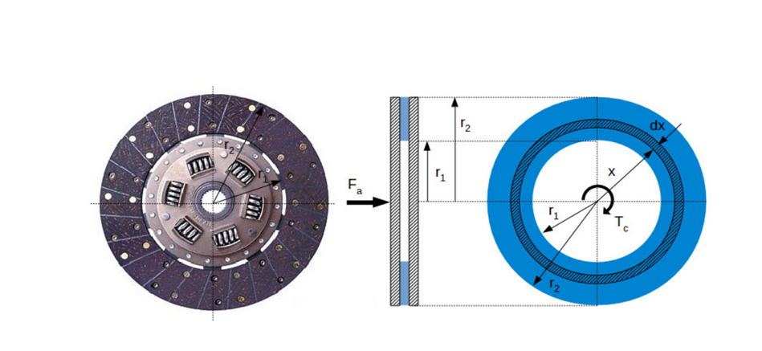
Clutch torque capacity calculation

Slide 7
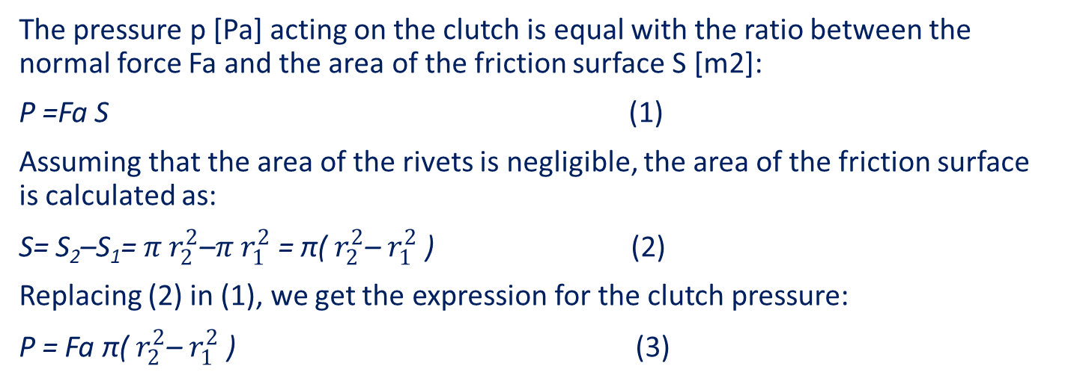
where:
F [N] : the normal force pressing the clutch plate
Tc [Nm] : the torque capacity of the clutch
r₁ [m] : the inner radius of the friction surface
r₂ [m] : the outer radius of the friction surface

Slide 8
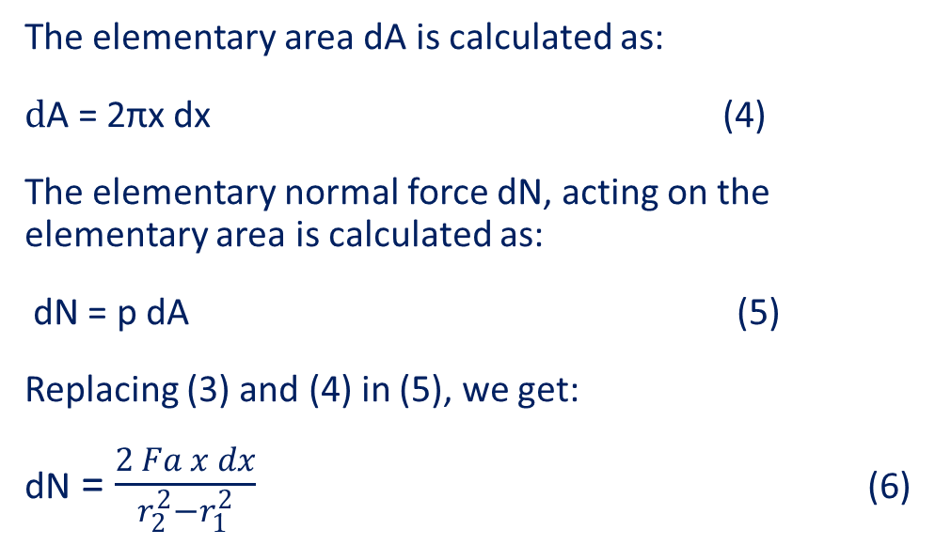
The elementary friction force dF is calculated as:
dF = μ dN (7)
where μ [-] is the friction coefficient of the clutch disc.

Slide 9
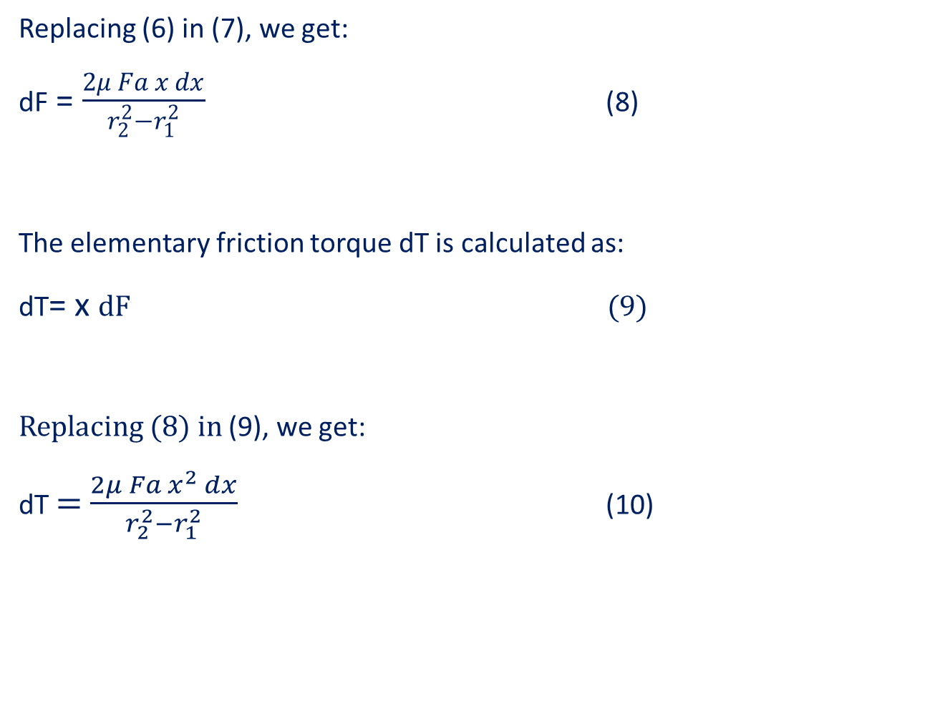

Slide 10
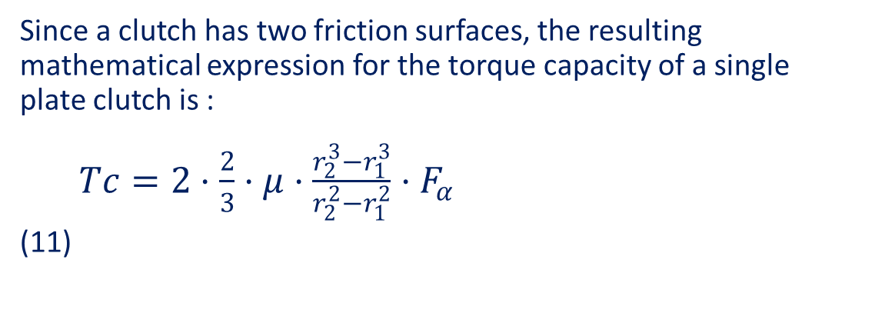
Integrating equation (10) from r₁ to r₂, we get the mathematical expression of the torque capacity of the clutch:

Slide 11
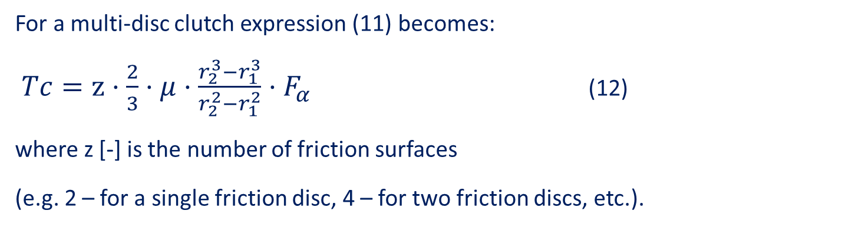
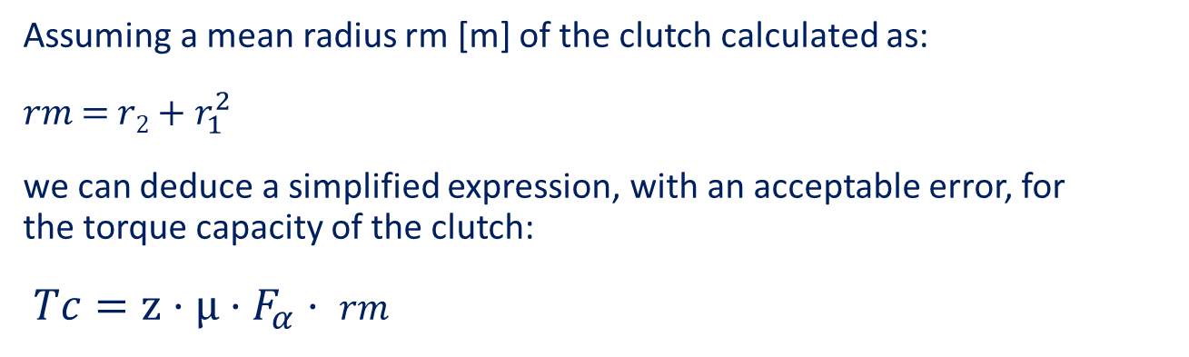

Slide 12
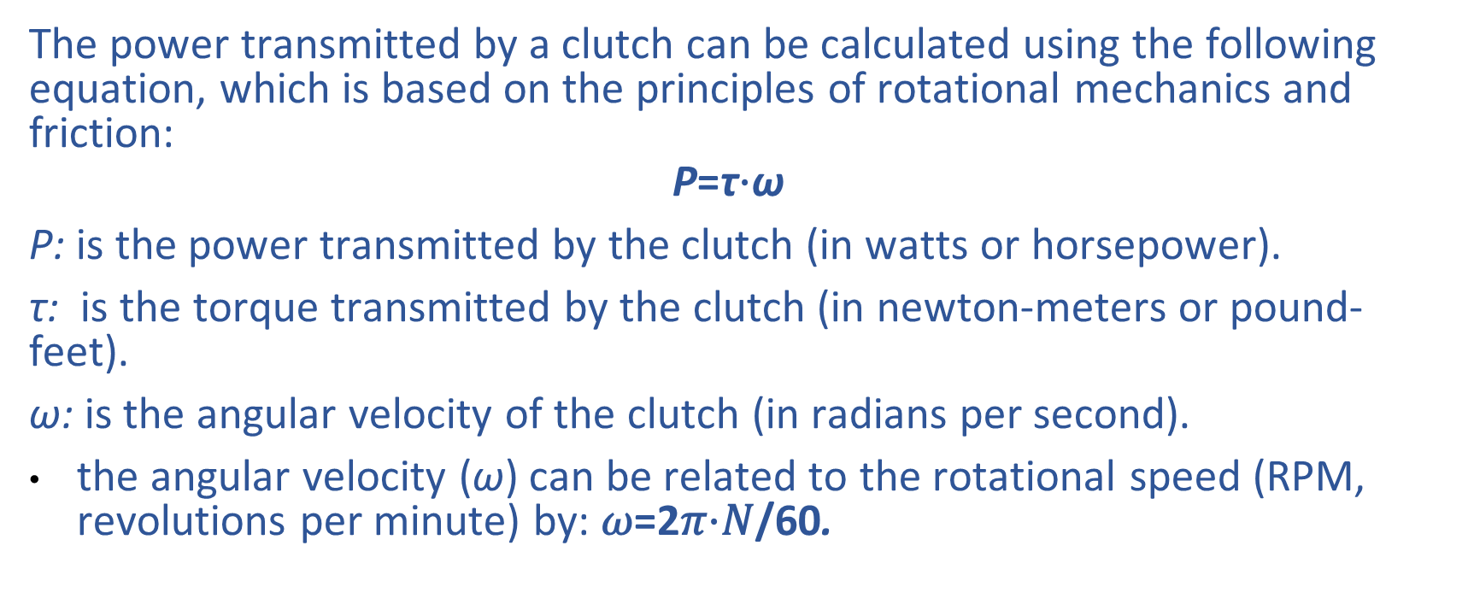
Power Calculations
The power transmitted by a clutch can be calculated using the following equation, which is based on the principles of rotational mechanics and friction:
$$\text{P}\text{=}\text{τ}\text{⋅}\text{ω}$$
P: is the power transmitted by the clutch (in watts or horsepower).
τ: is the torque transmitted by the clutch (in newton-meters or pound-feet).
ω: is the angular velocity of the clutch (in radians per second).
the angular velocity (ω) can be related to the rotational speed (RPM, revolutions per minute) by: 𝜔=2𝜋⋅𝑁/60.

Slide 13
