Slide 1


Field | CONSTRUCTION
Chapter | Architectural material
Subtitle | Plastics

Slide 2
Through this lesson, the student will learn the types of polymers and plastics, their application in construction, and protection from plastic pollution.

Slide 3
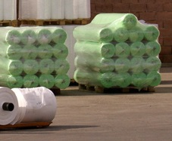
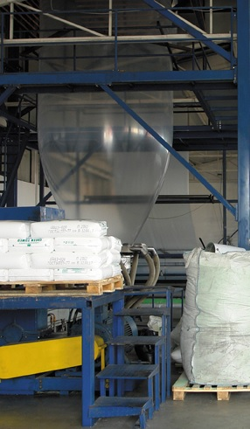
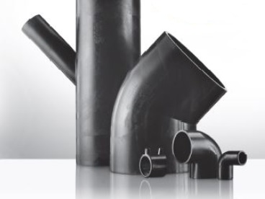
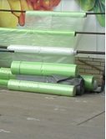
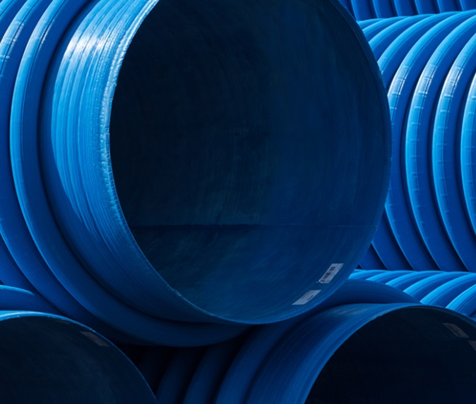
Plastic

Slide 4
Plastic
Plastics are artificial materials produced from synthetic or semi-synthetic resins and various additives (fillers, softeners, stabilizers, and pigments) which are at least occasionally in a plastic state during processing.
The substances used to make plastics are usually synthetic, usually derived from petrochemicals, although many are partly natural.

Slide 5
Additives for plastic production
The bulk properties of a polymer can often be altered considerably by the incorporation of additives. Probably the most well-known examples of this occur in rubber technology where variations in the choice of additives can produce widely differing products such as tires, battery boxes, latex foam upholstery, elastic
bands and erasers.
Physically, additives may be divided into four groups, solids, rubbers, liquids, and gases, the last of these being employed for making cellular polymers. In terms of function, there are rather larger numbers of groups, of which the following are the most important:
(1) Fillers.
(2) Plasticisers and softeners.
(3) Lubricants and flow promoters.
(4) Anti-aging additives.
(5) Flame retarders.
(6) Colorants.
(7) Blowing agents.
(8) Cross-linking agents.
(9) Ultraviolet-degradable additives.

Slide 6
Application of plastics
Due to its relatively low cost, ease of production, versatility, and water resistance, plastics is used in a wide variety of products. They have already replaced many traditional materials, such as wood, stone, horn, bone, leather, paper, metal, glass and ceramics. Plastics is processed by rolling into foils, extrusion under pressure, injection molding, kneading, etc. Due to its mechanical properties and formability, plastics have supplanted many other materials and their industry is constantly growing. About one-third of the plastic produced is used for packaging, one third is used in construction. The rest is used to make auto parts, furniture, toys, and pharmaceutical products.

Slide 7
Good properties of plastic materials are:
- not subject to corrosion,
- they are resistant to chemicals,
- they are good electrical, sound, and heat insulators,
- optically, they can be transparent or opaque...
The disadvantages of plastic materials are:
- polymer aging,
- they are unstable at elevated temperatures,
- cracks on the surface,
- material deformation,
- color change,...

Slide 8
Thermoplastic and thermostable polymers
Thermoplastic polymers are linear polymers in which the mobility within the macromolecules increases upon heating.
When heated, they first soften, then melt, and after cooling they harden again, retaining their basic properties.
Thermoplastic polymers are:
Polyethylene (PE), polypropylene (PP), polyvinyl chloride (PVC), polystyrene (PS), polytetrafluoroethylene (PTFE)...
Positive features:
- low specific mass
- low thermal conductivity,
- high chemical resistance
Negative features:
- instability at elevated temperatures,
- low modulus of elasticity,
- brittleness at lower temperatures with large deformations,
- tendency to age

Slide 9
Thermoplastic and thermostable polymers
Thermostable polymers can be linear or branched macromolecular structures. When heated, they soften (go into a plastic state) with the formation of a polymer network structure. When heated, their physical and mechanical properties change, so they lose their ability to dissolve in solvents and lose their ability to change to a plastic state when heated.
Thermostable polymers are phenol formaldehyde (PF), amino formaldehyde, epoxy (EPOX), polyesters (PES), polyurethanes (PUR),...

Slide 10
The most commonly used plastics is:
Polyethylene (PE) is most often used for the production of packaging, bags, foils, membranes, tanks, bottles...
It is a thermoplastic polymer composed of hydrocarbon chains. Depending on the molecular weight, the melting point of polyethylene can vary from 105 to 130°C.
A large number of types of polyethylene are harmless, so they are widely used in the food industry. In the form of foam, it is used for vibration damping and insulation. It is used to produce furniture parts, computer parts, electronic components, sports products, bowling balls, pressure pipes...
Polyvinyl chloride (PVC) is most often used in the construction industry (carpentry, installations, wall and floor coverings, etc.), but also in many other areas (medicine, textile industry, electrical industry, etc.).
It is resistant to environmental influences (chemicals and alkali metals), has high hardness and strength, and can be recycled.

Slide 11
The most commonly used plastics is:
Polystyrene (PS) and modified polystyrene are most often used to make Styrofoam, but they are also used as packaging for packaging food products (containers and cups for fruit and vegetables, ice cream, yogurt, and sour milk, and sweets), as packaging for packaging pharmaceutical and chemical products ( e.g. Boxes for medicines and creams), then they are used to make parts of various appliances and devices, to make parts for doors, partitions, and boxes in refrigerators, housings for radios and televisions, to make household appliances and toys...
Epoxides are polymers that contain a so-called epoxy group (in liquid and solid-state) within their structural formula. They are resistant to elevated temperatures (up to 150°C) and have high chemical resistance (except strong oxidizing agents and wet chlorine). They are used as adhesives for concrete, wood, ceramics, glass, and metal, as binders for epoxy mortars and concrete, for the production of industrial floors, as waterproofing materials...

Slide 12
Polymers are made in the form of powder, flakes, granules, grains, or resin, and their processing into finished products is carried out by processing processes such as: pressing, extrusion, injection, soaking, and numerous cutting and joining methods.
Today, plastics is used in various forms of science and production, in a word, it is difficult to imagine modern products without plastics. Plastic has become indispensable for the functioning of society and people's lives. No other material is as prevalent in all branches of industry as plastics, so we can safely say that we are living in the century of plastics.

Slide 13
Application of plastics in construction
Plastics are most often used for:
- Production of roof covering, corrugated or flat plates which
they can be transparent or colored (ondulin, ...),
- Production of materials for finishing the floor (linoleum, vinas
boards, vinyl, carpets made of synthetic materials,...),
- Production of water and sewage pipes and shaped pipes pieces (fittings),
- Production of polymer concrete and polymer mortar (synthetic resin),
- Production of filter plastic for use in civil engineering for separation of different soil layers,
– For the production of polyester nets used for rehabilitation of pavement structures and provision of slopes

Slide 14
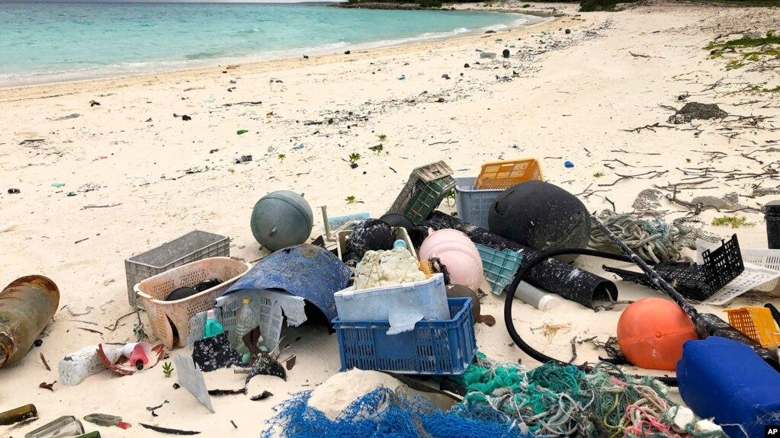
Plastic pollution is the accumulation of plastic objects and particles in the environment that negatively affects people, wildlife, and their condition. Plastic that acts as a pollutant is divided into micro-, meso-or macro-residues. Plastic is resistant to many natural degradation processes and therefore decomposes slowly. This allows large amounts of plastic to enter the environment as mismanaged waste and remain in the ecosystem.
Plastic pollution can affect land, waterways, and oceans. Living organisms, especially marine animals, are exposed to the harmful effects of plastic, such as entanglement in plastic objects and problems related to the ingestion of plastic waste. Degraded plastic waste can directly affect humans through direct consumption (i.e. In tap water), indirect consumption (eating animals), and disruption of various hormonal mechanisms. A small percentage of plastic is recycled, so there is more and more waste plastic.
The solution to the problem of plastic pollution should be sought in greater recycling, replacement of plastic with environmentally friendly materials, and conscientious disposal of plastic waste.

Slide 15
This presentation can be used for the purpose of informing and educating students, that is, for the purposes of teaching in schools.

Slide 16



Reference to the source of the figures:
GRAĐEVINSKI MATERIJALI SA OSNOVAMA GEOLOGIJE za 1. razred građevinske škole, autor Ilić Anđelija
GRAĐEVINSKI MATERIJALI SA OSNOVAMA GEOLOGIJE za 1. razred građevinske škole, autori I Stojiljković,
D Miletić

