Slide 1


Field | CONSTRUCTION
Chapter | Architectural material
Subtitle | Wood

Slide 2
Through this lesson, the student will learn about different types of wood, their application in construction, mistakes that occur with wood, modern wood materials, and types of wood protection. Some slides contain a text document that explains that slide in more detail. Double-click the text document icon to open its contents

Slide 3

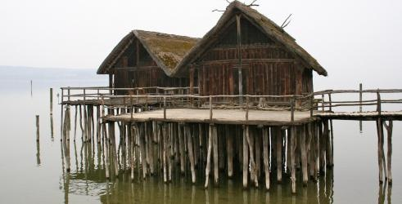
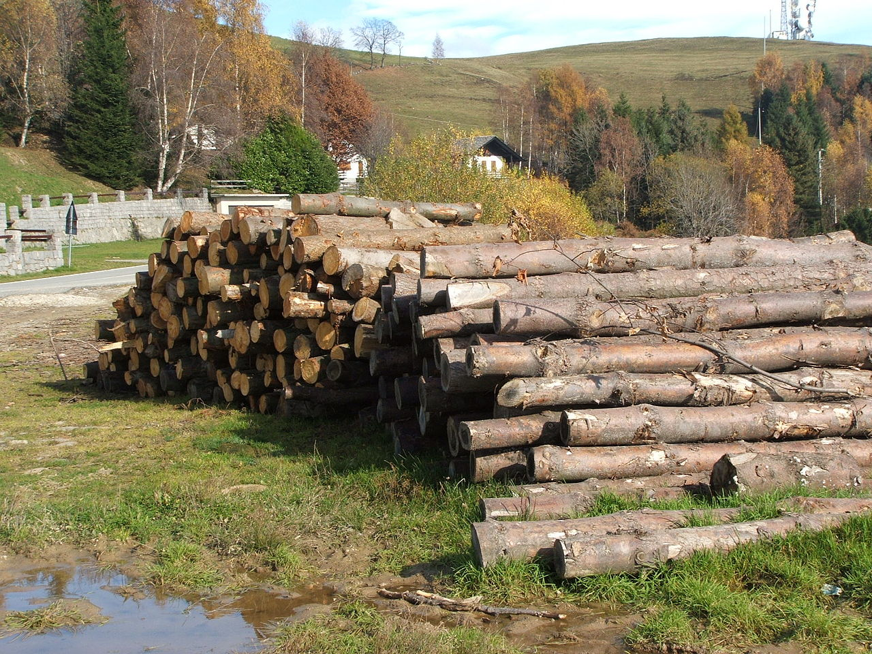
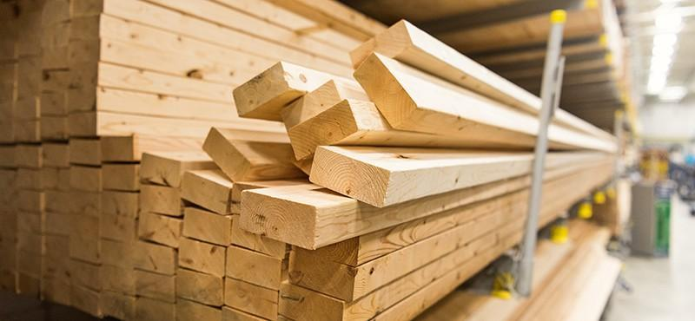
Wood

Slide 4

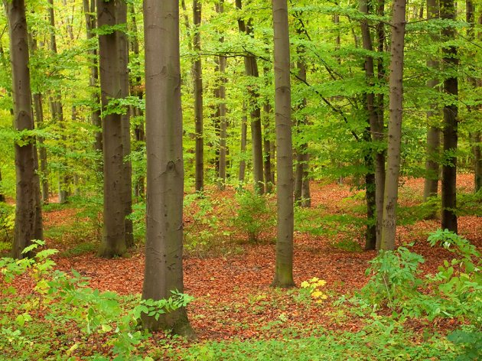

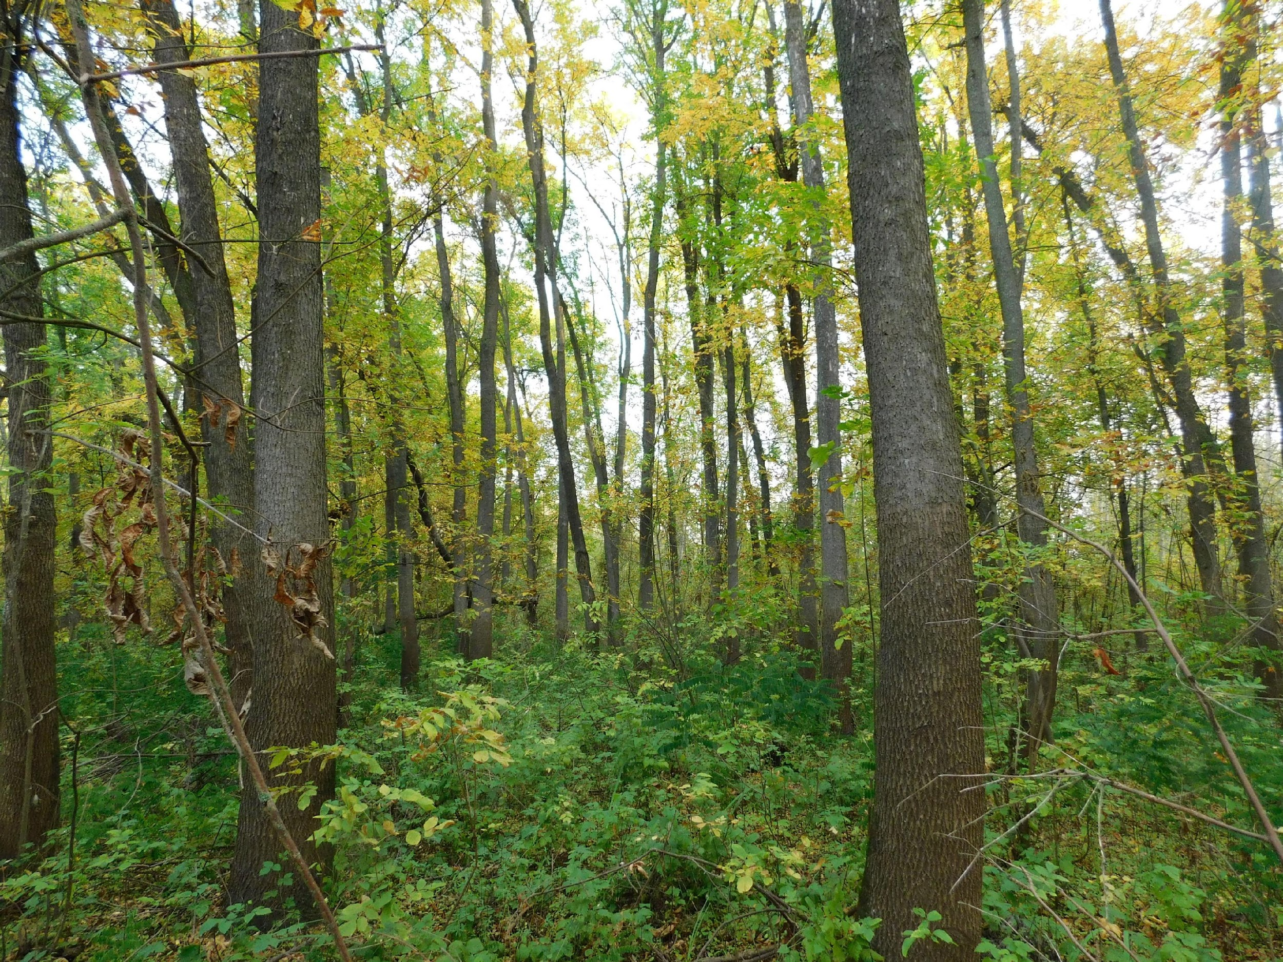
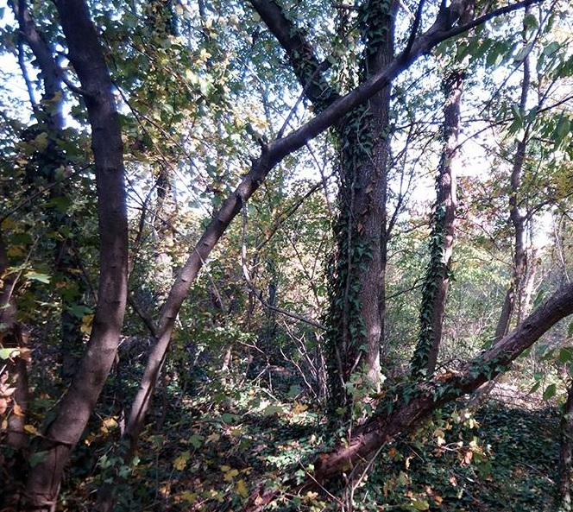
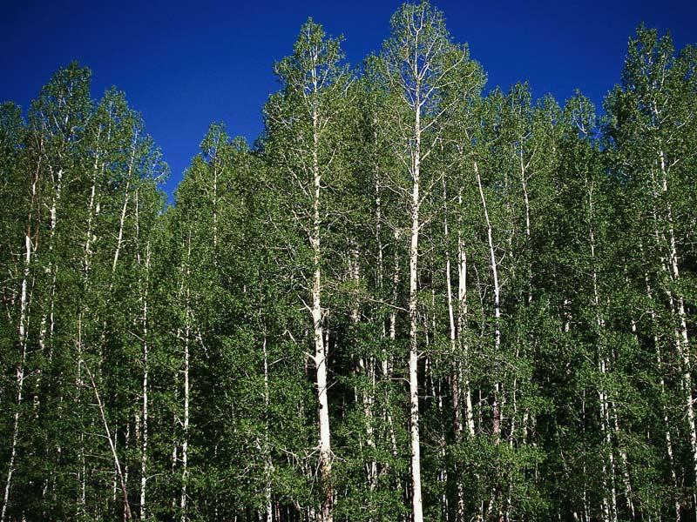
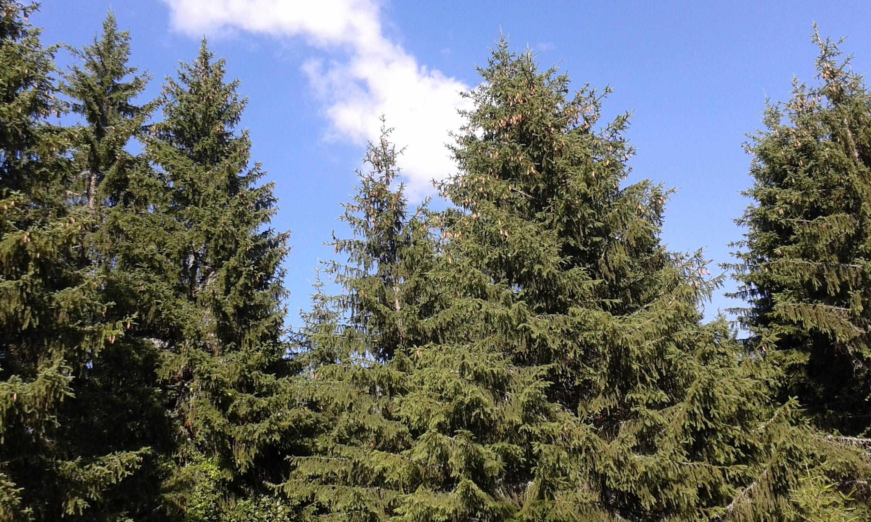
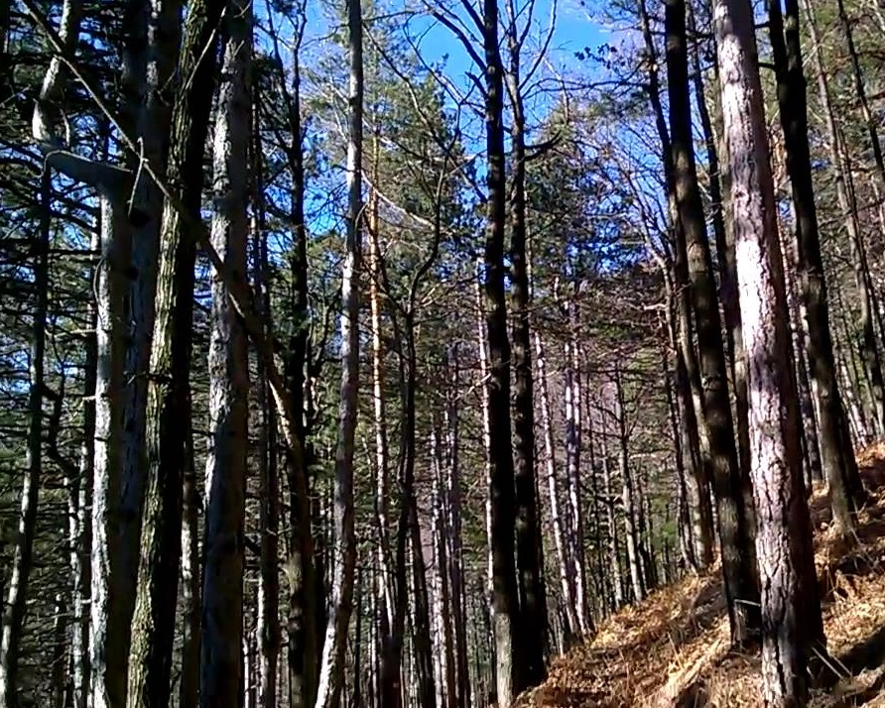
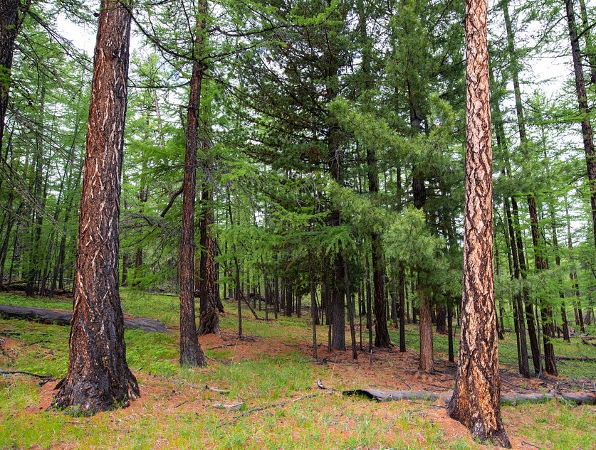
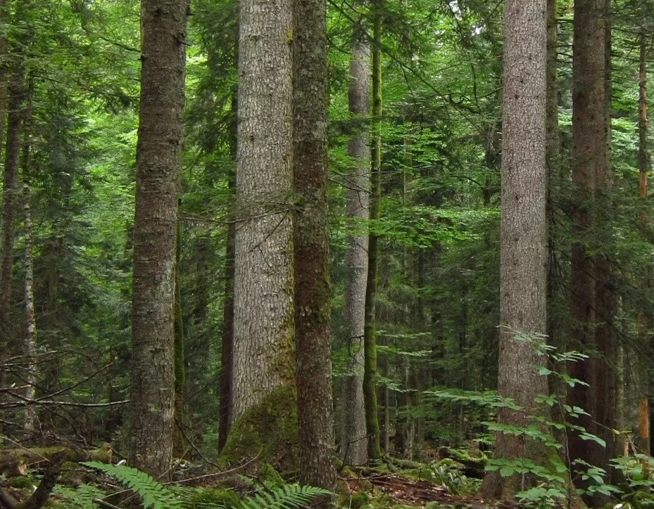
TYPES OF WOOD
Deciduous trees
BEECH
OAK
ASH TREE
ELM FOREST
POPLAR
Conifers
SPRUCE
PINE TREE
LARCH
SILVER FIR

Slide 5
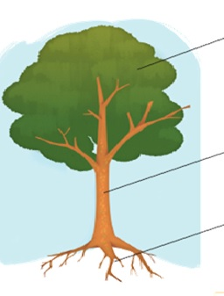
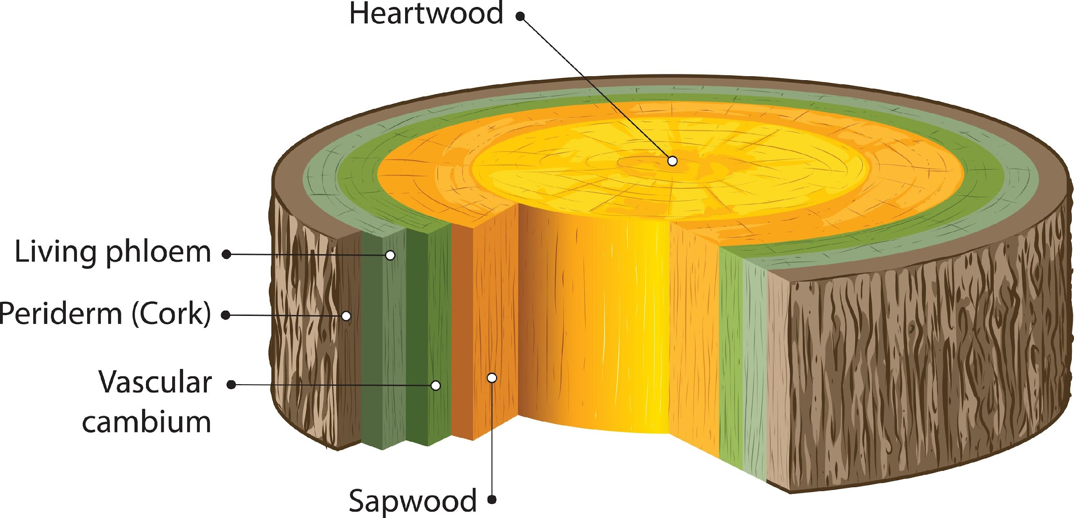
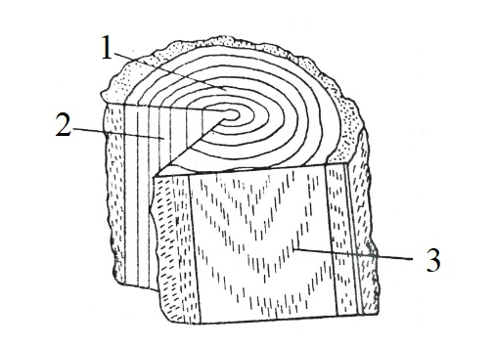
Wooden construction
crown
trunk
1. Transverse surface
roots
2. Radial surface
3. Tangential surface

Slide 6
Physical properties of wood
Sectional appearance and colors
Volume mass
Humidity
Thermal properties
Acoustic properties

Slide 7
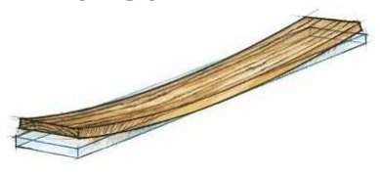
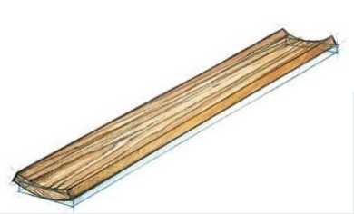
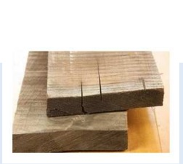
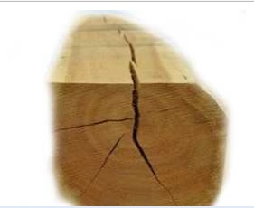
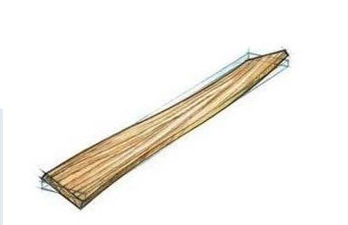
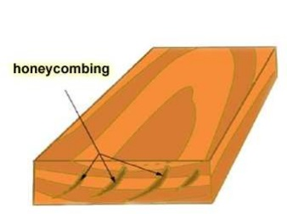
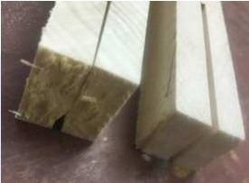
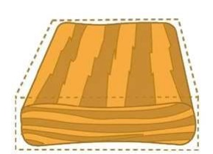
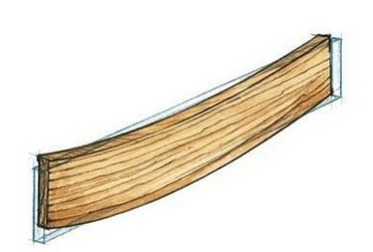
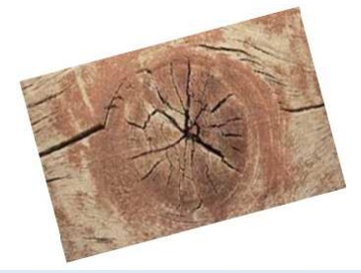
Types of Defects in Timber as a Construction Material
Defects in Sawn Timber (Lumbers) during kiln drying process
1. Bow
2. Cup
3. Check
4. Split
5. Twist
6. Honeycombing
7. Case Hardening
8. Collapse
9. Warp
10. Radial Shakes

Slide 8
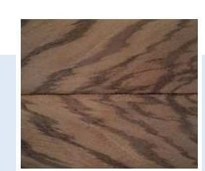
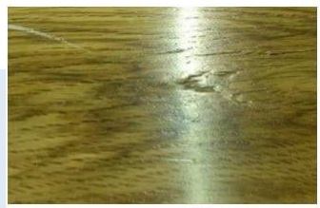
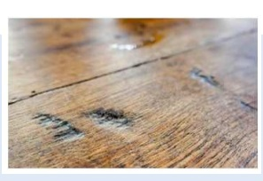
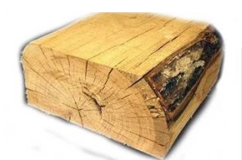
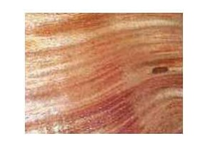
Types of Defects in Timber as a Construction Material
Wood Defects During Sawing
1. Diagonal Grain Defect in Timber
2. Torn Grain
3. Chip Mark
4. Wane
5. Slope of Grain

Slide 9
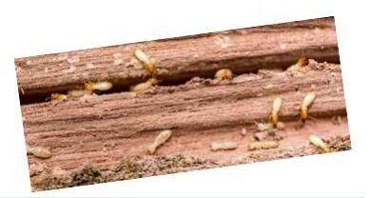
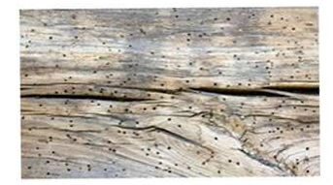
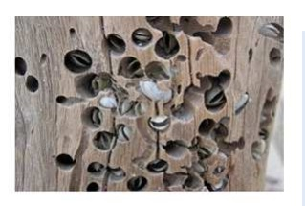
Types of Defects in Timber as a Construction Material
Defects in timber due to Insects
1. Termites in Timber
2. Beetles in Timber
3. Marine Borers in Timber

Slide 10
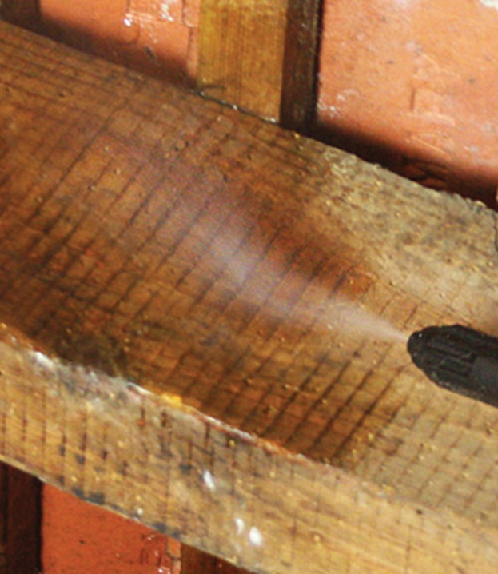
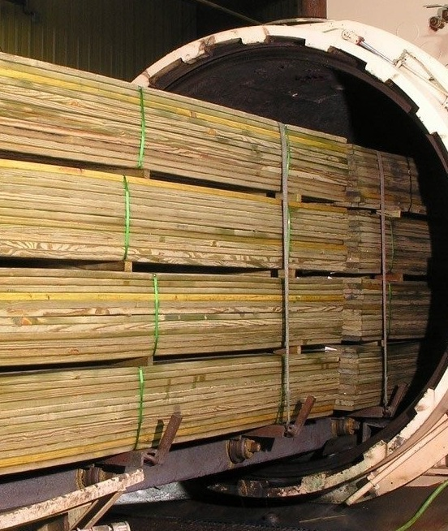
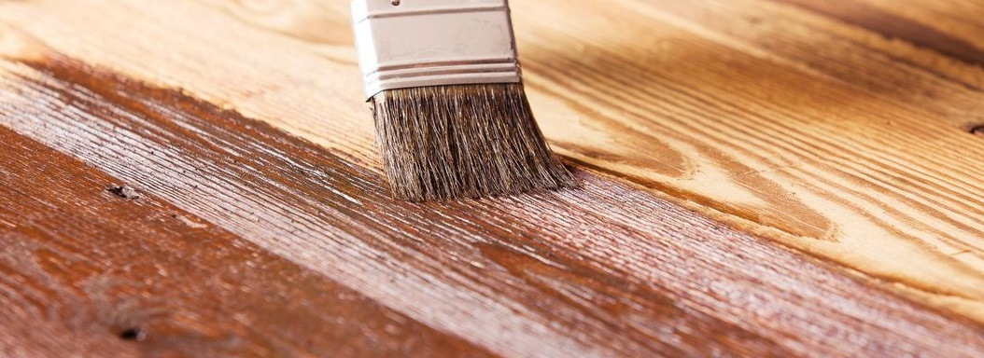
Wood protection

Slide 11
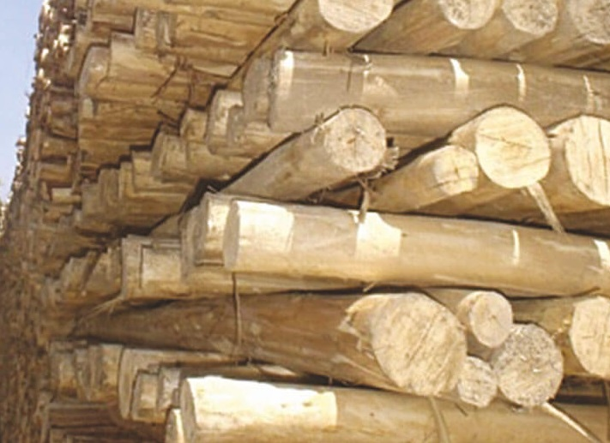
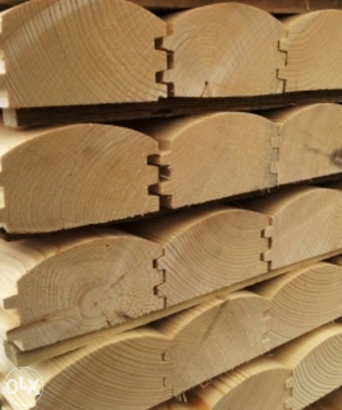
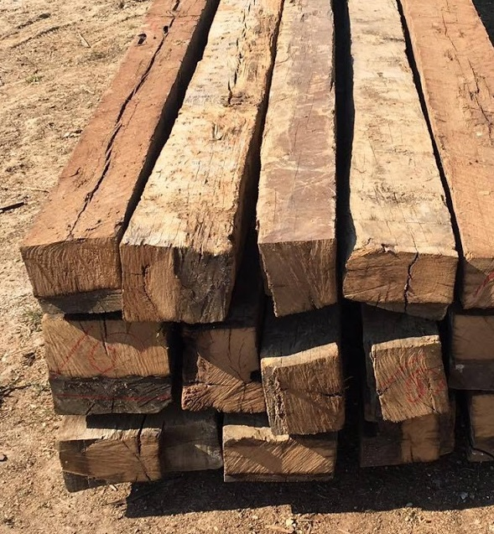
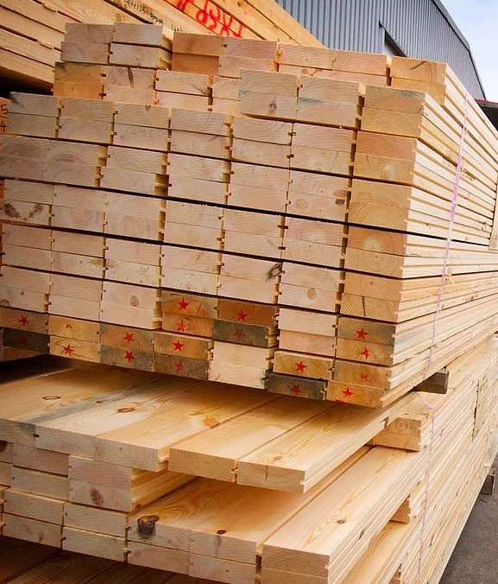
Construction products made of wood
Timber
1. Round timber
2. Semi-round timber
3. Hand-cut timber
4.Plain-sawn timber

Slide 12
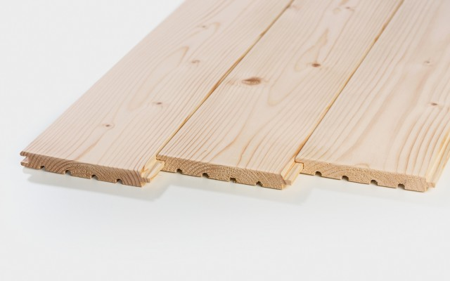
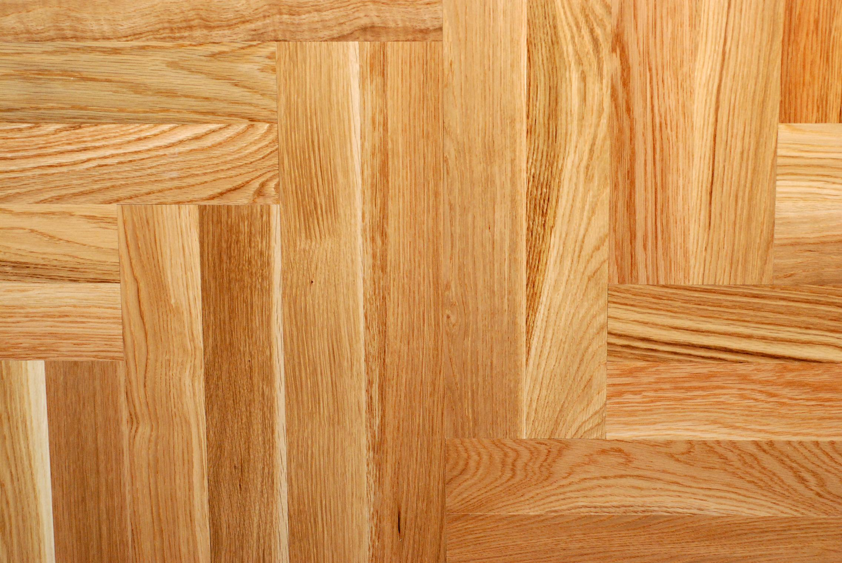
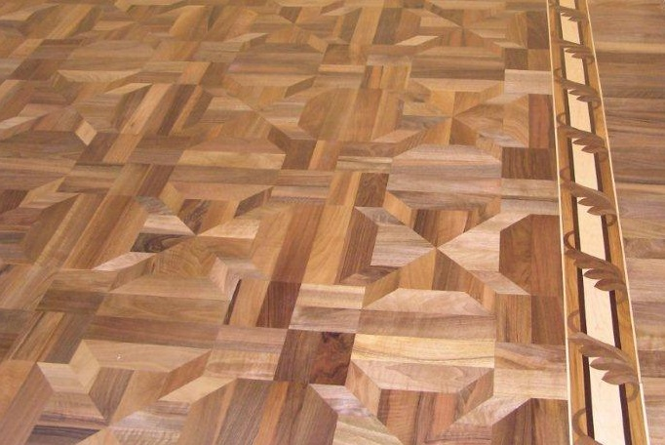
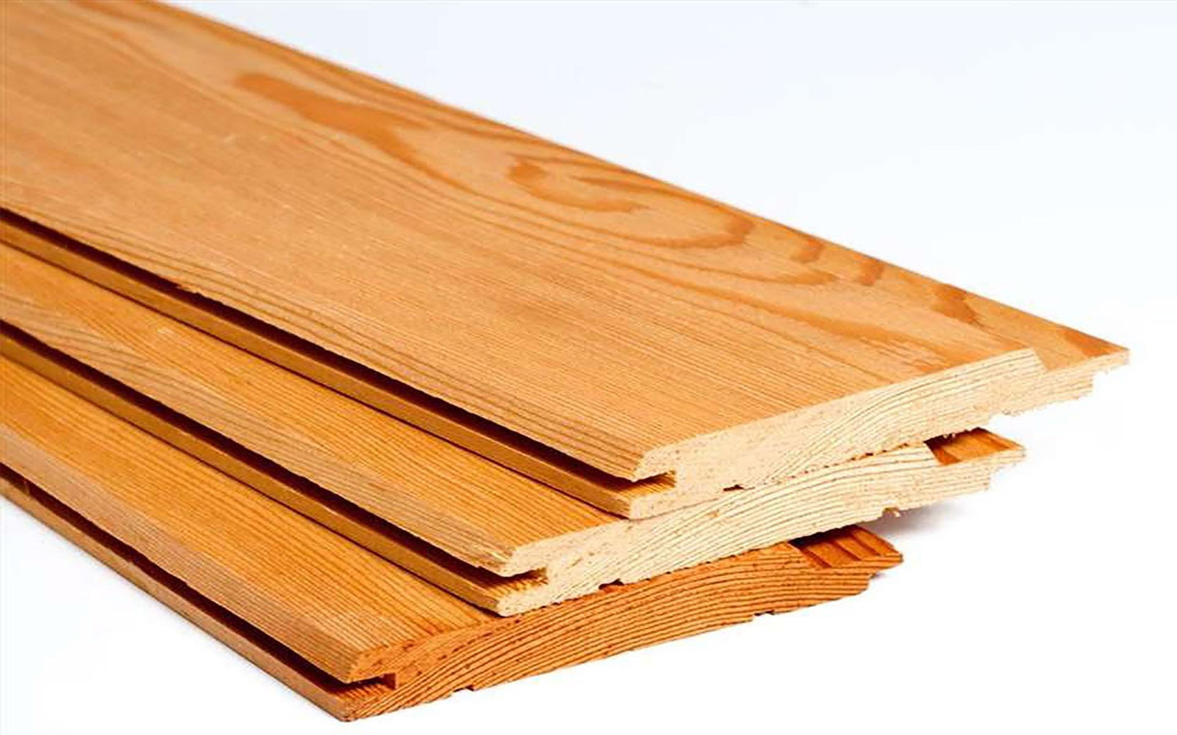
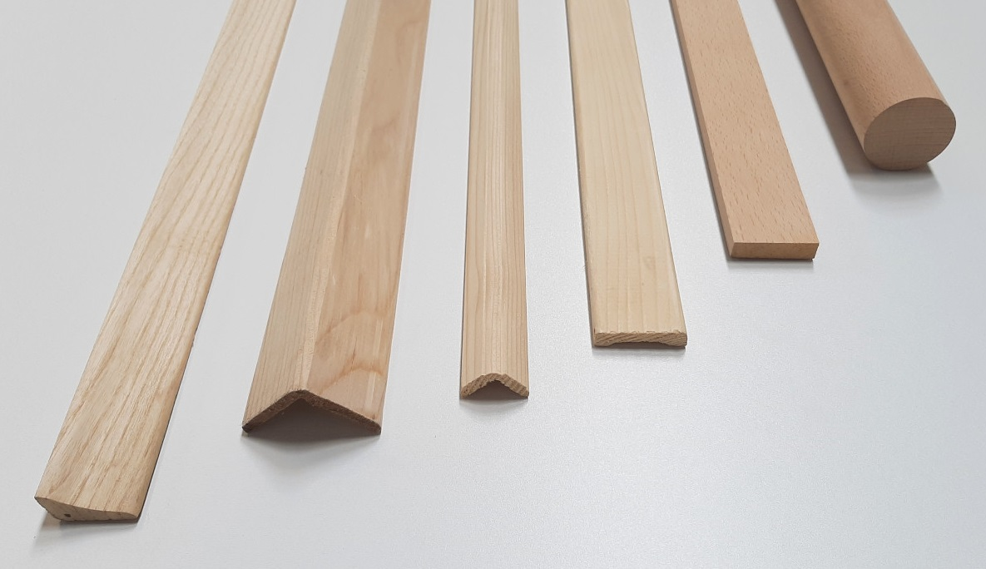
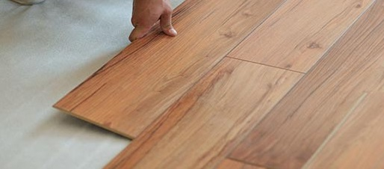
Construction products made of wood
Construction elements
1. Matched floor
2. Parquet
3. Mosaic parquet
4. Matchboarding
5. Profile elements
6. Laminate

Slide 13
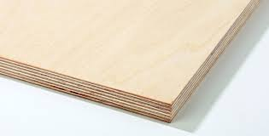
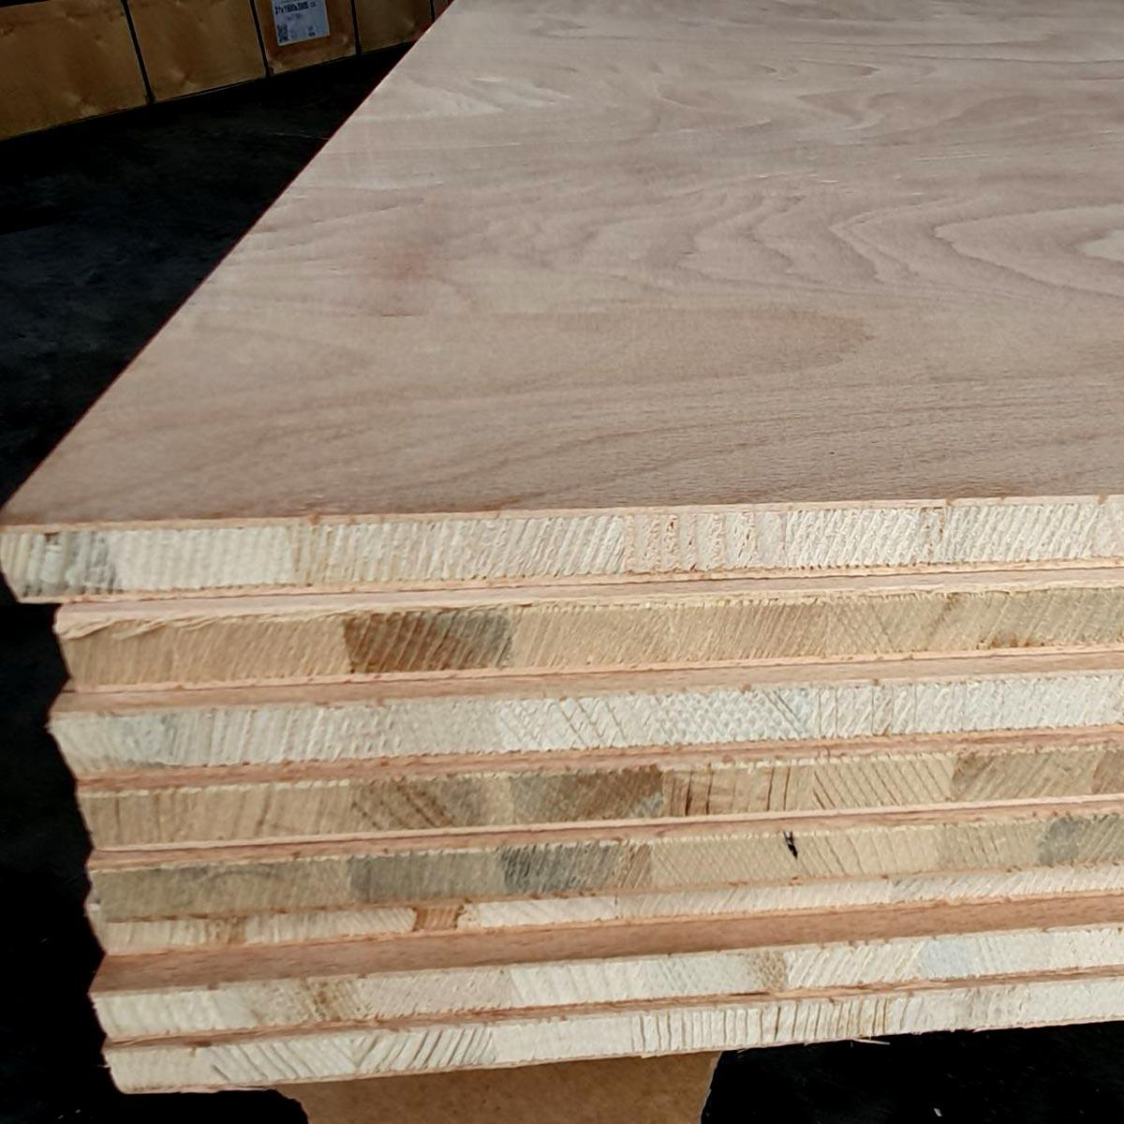
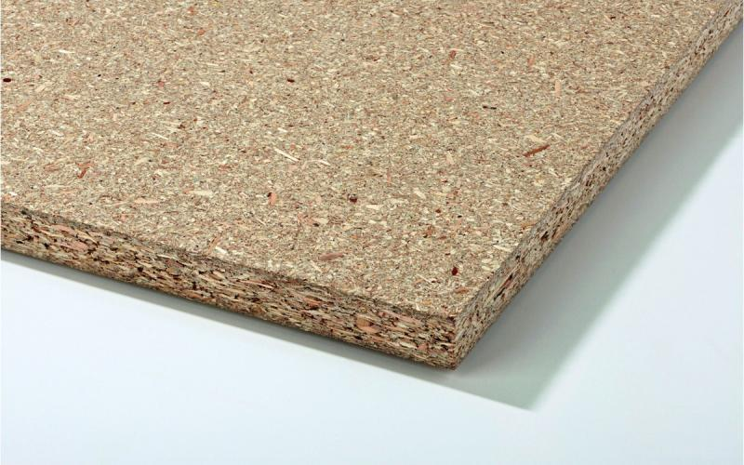
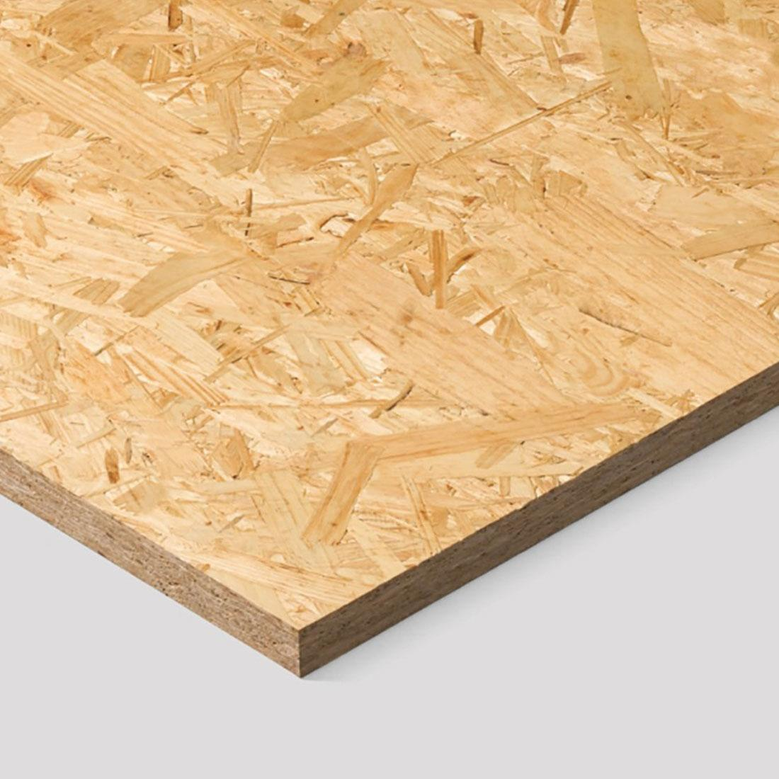
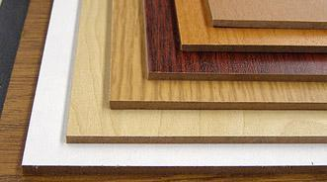

Construction products made of wood
Other wooden construction elements
1. Plywood
2. Panel board
3. Chipboar
4. OSB board
5. Hard board
6. Lepljeno lamelirano drvo

Slide 14





Building structures made of wood

Slide 15
This presentation can be used for the purpose of informing and educating students, that is, for the purposes of teaching in schools.

Slide 16



Reference to the source of the figures:
GRAĐEVINSKI MATERIJALI SA OSNOVAMA GEOLOGIJE za 1. razred građevinske škole, autor Ilić Anđelija
GRAĐEVINSKI MATERIJALI SA OSNOVAMA GEOLOGIJE za 1. razred građevinske škole, autori I Stojiljković,
D Miletić

