Slide 1


Field | CONSTRUCTION
Chapter | Databases+types of architectural plans
Subtitle | Drawing of a plan for a small object in AutoCAD

Slide 2
The presentation provided drawings of a small building from the foundation to the facades. These drawings are for educational purposes and have no commercial character. Through making drawings, students acquire a routine in applying the program for making technical drawings.

Slide 3
The goals of the exercises are:
Enabling students to use drawing commands,
assigns drawing commands,
measure the length and calculate the area of the object,
forms layers and organizes the drawing using layers, colors and lines of different types and thicknesses,
adjust layer visibility,
understands when it is necessary to create layers

Slide 4
find the required hatch,
set the scaling factor for the corresponding hatches,
hatches the drawing,
forms a text style,
write and adjust the text,
corrects the text,
adjust the scale of the drawing,
forms a corner style,
quotes the drawing according to the given scale

Slide 5
enter the formed dimension style into a new drawing,
arrange the drawing on the print environment list,
prepare the drawing for printing,
prints the drawing in the specified scale

Slide 6
Situation plan

Slide 7
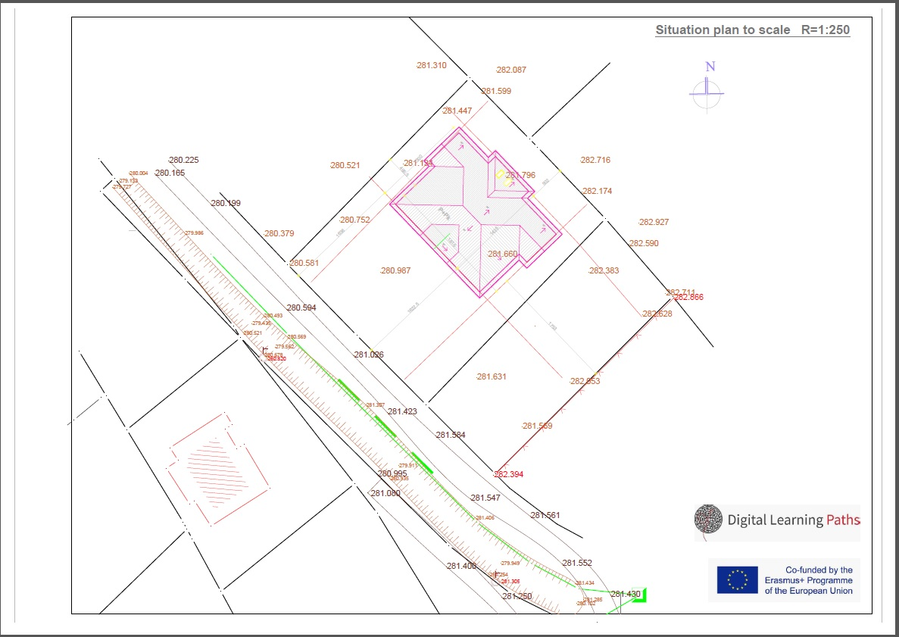

Slide 8
The basis of the foundation

Slide 9
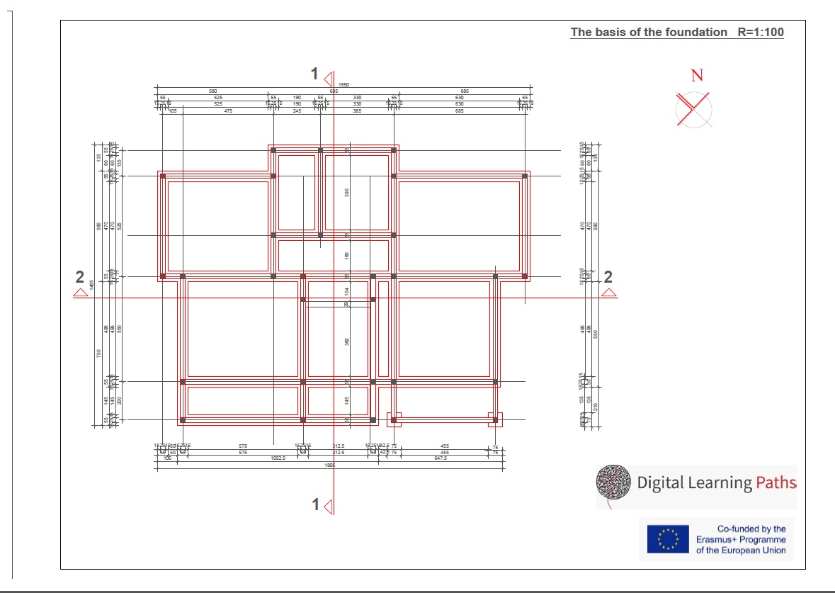

Slide 10
The base of ground floor

Slide 11
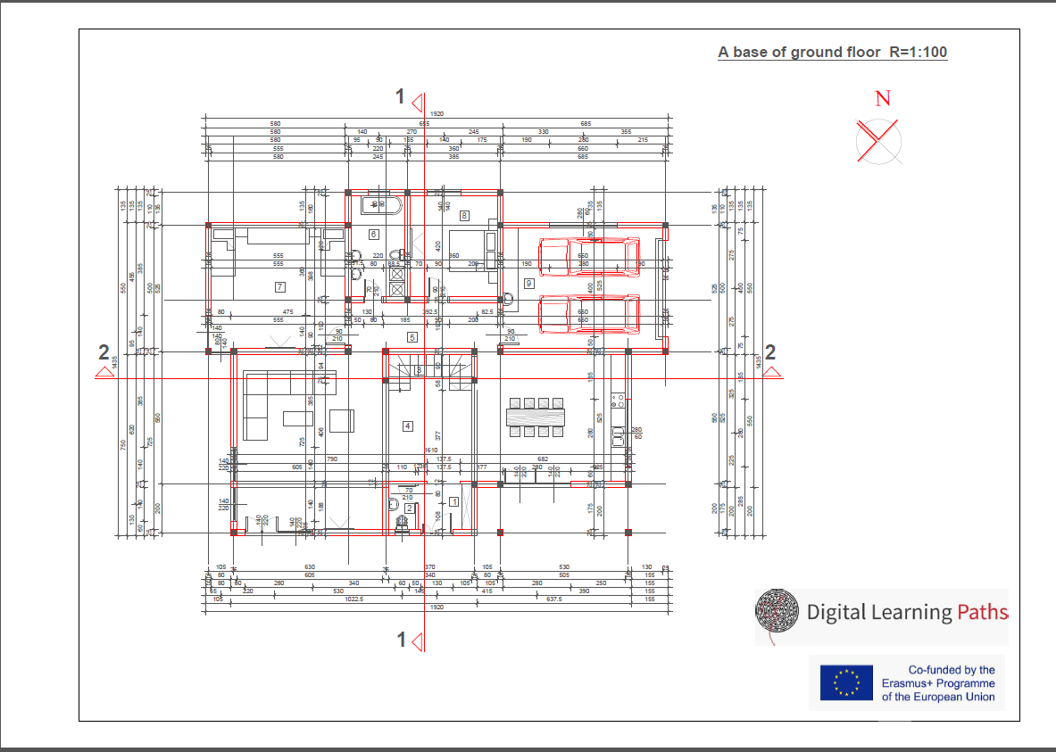

Slide 12
The basis of the attic

Slide 13
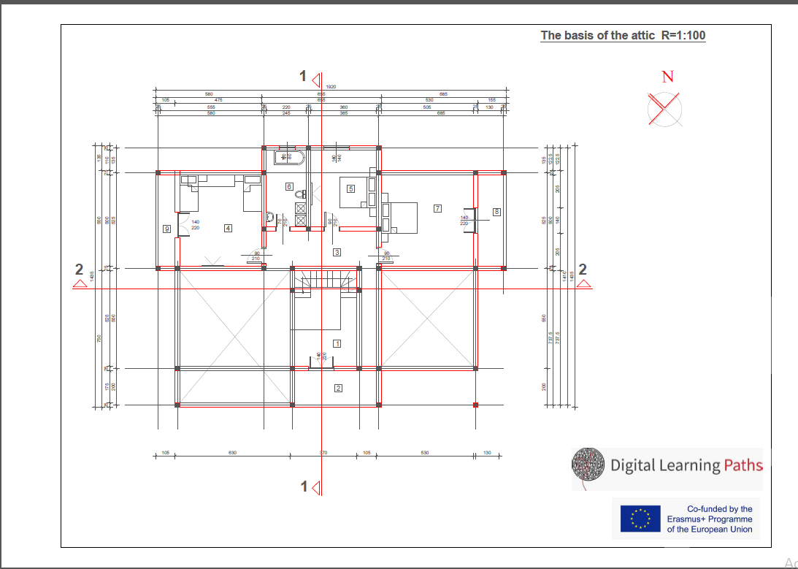

Slide 14
The basis of the roof structure

Slide 15
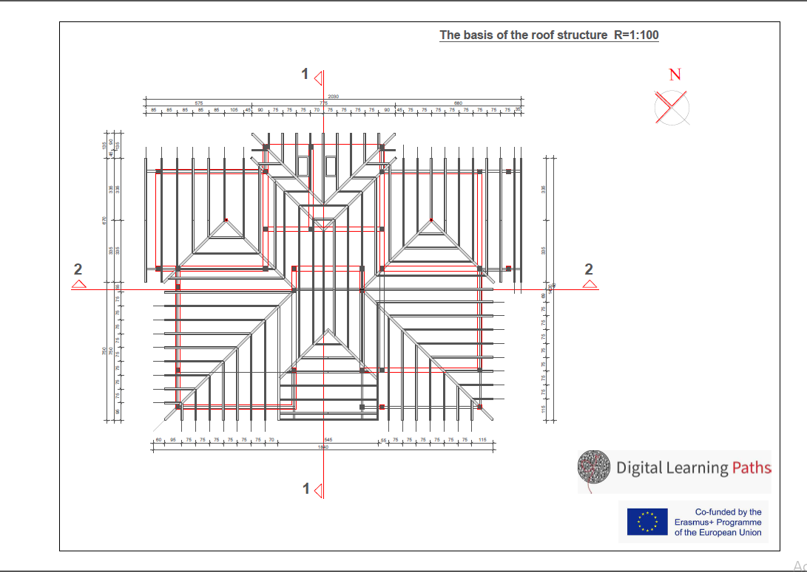

Slide 16
The basis of the roof planes

Slide 17
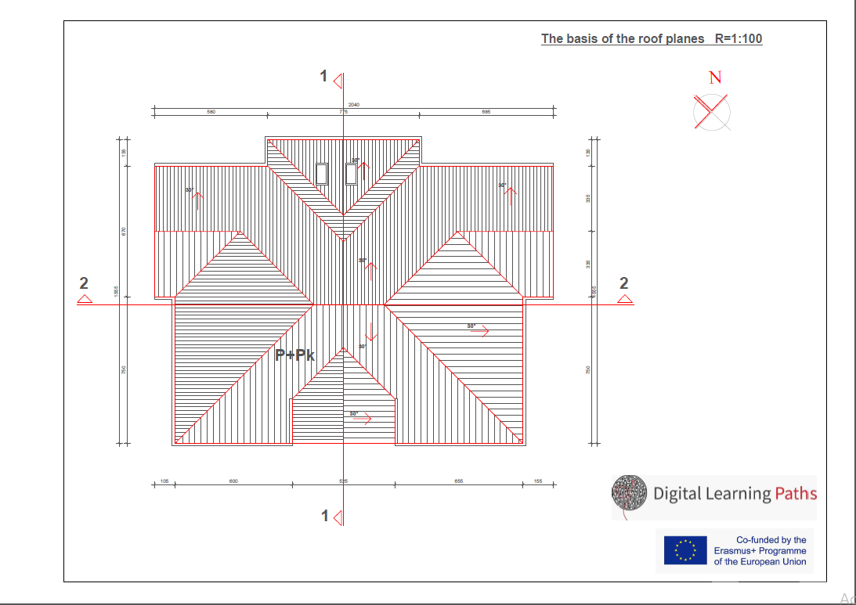

Slide 18
Sectional plane

Slide 19
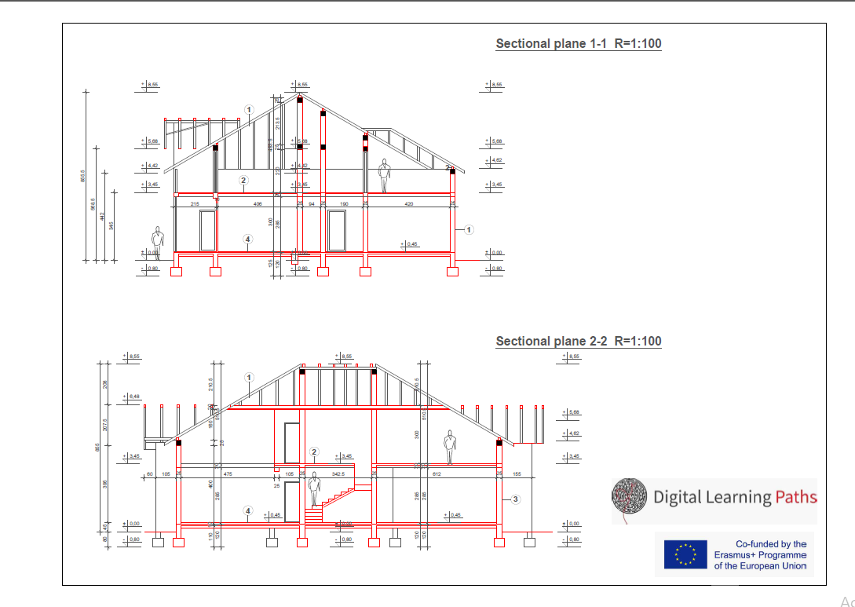

Slide 20
Facade

Slide 21
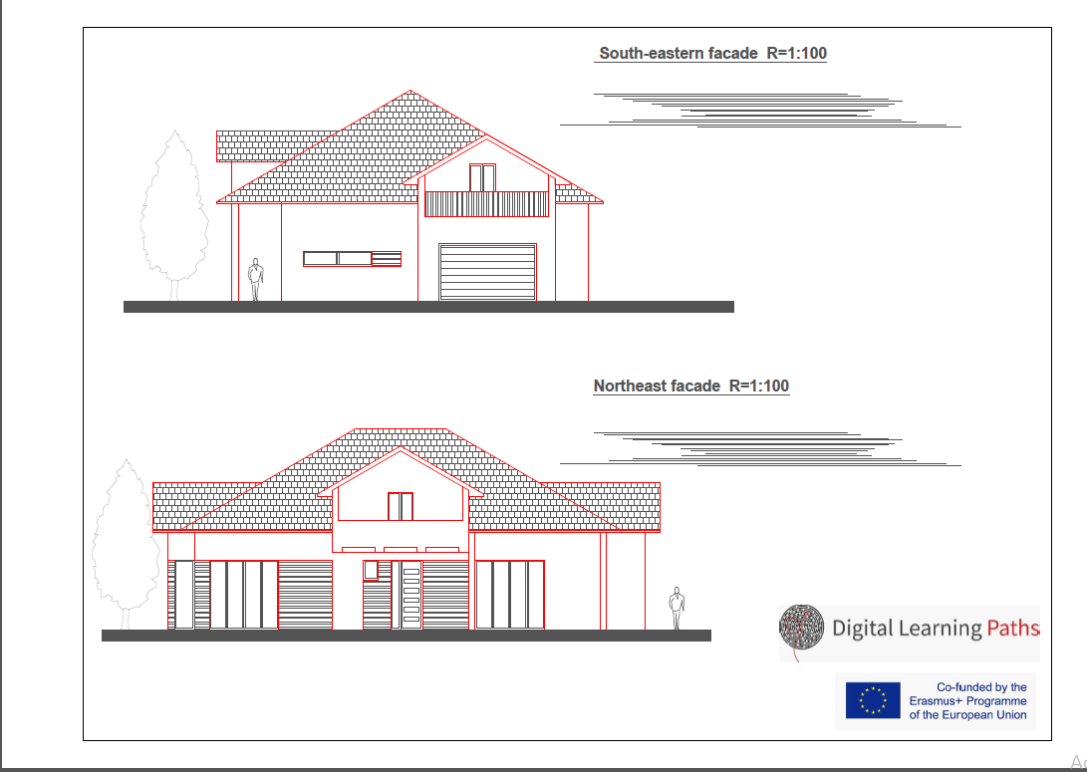

Slide 22
Facade

Slide 23
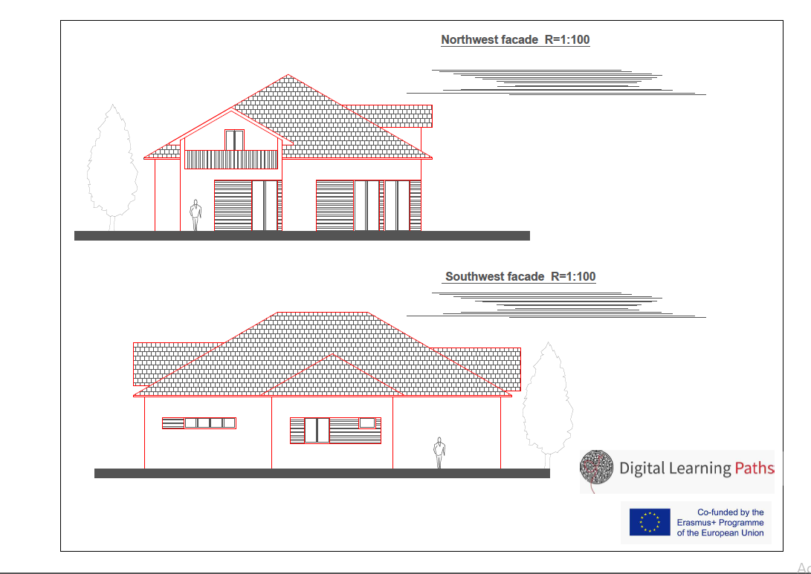

Slide 24
Field | CONSTRUCTION
Chapter | Databases
Subtitle | Creation of animation

Slide 25
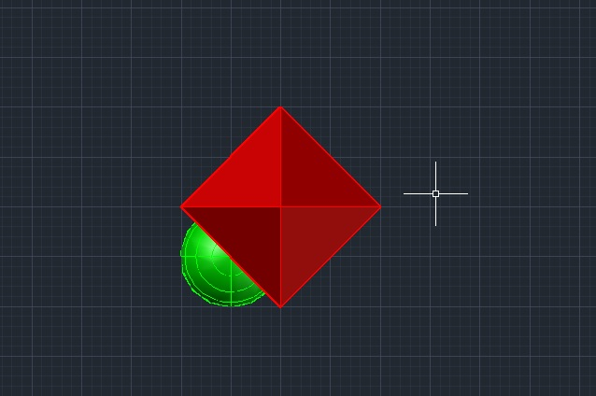
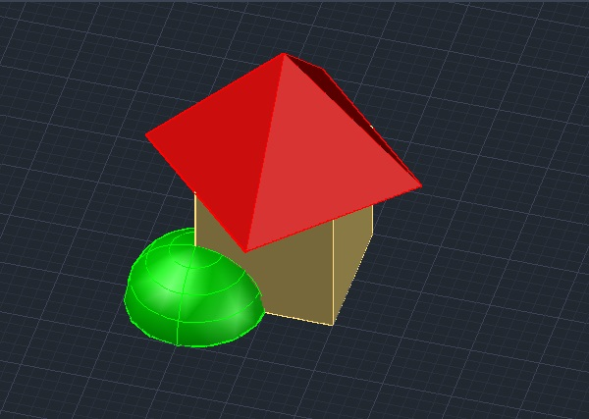
Draw a 3D object

Slide 26
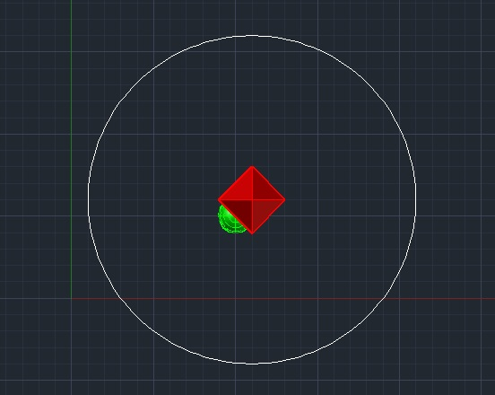
Set the camera path. It can be a circle or something else. The path should be far enough away from the object.

Slide 27
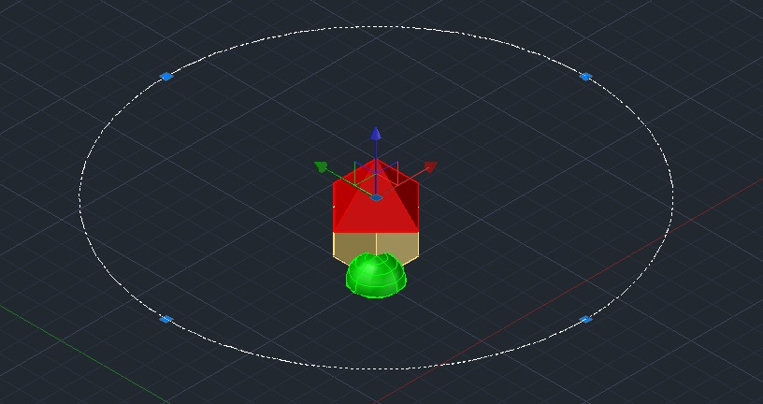
Adjust the height of the camera movement, moving the path along the z axis.

Slide 28
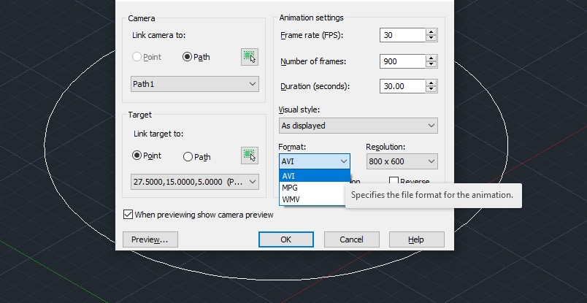
Issue the ANIPATH command and set the parameters in the tab.

Slide 29
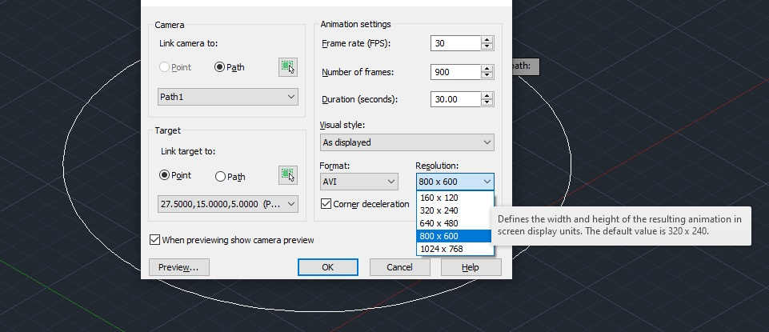
Set the recording resolution and click the preview button.

Slide 30
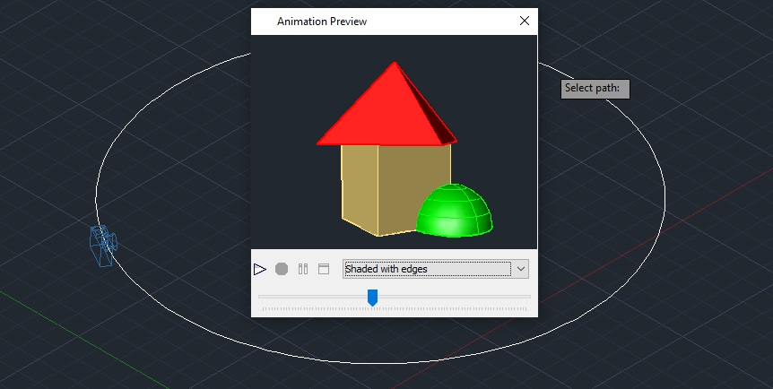
If you're satisfied, turn it off Animation Preview, then click OK and save your animation.

Slide 31
