Slide 1


Field | CONSTRUCTION
Chapter | Calculation of construction
Subtitle | Determination of reaction of supports for statically determined polygonal beam

Slide 2
The girders
Girders are rigid bodies that carry loads and are attached to appropriate bases with supports

Slide 3
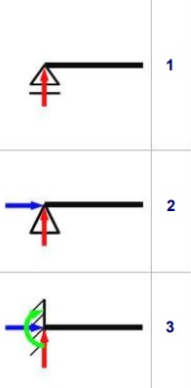
Supporting the girders
In practice, we often meet :
Movable supports
Immovable supports
Pinches

Slide 4
Carrier load
  Carrier loads can be different and we divide them according to:
  Shape,
  Mode of action i
  During the duration.
  With regard to the shape, we distinguish :
    Concentrated (concentrated forces acting at a point, vertically or diagonally),
    Distributed loads (evenly or unevenly distributed).

Slide 5
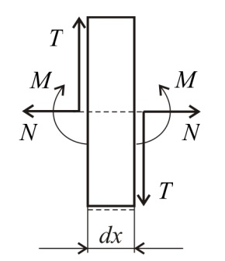
Convention on the sign and graphical representation of forces in a section

Slide 6
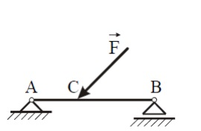
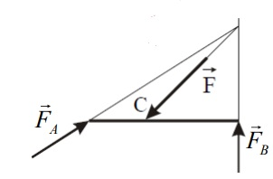
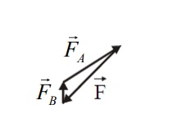
Determination of reactions in supports
Graphical method
Model
Graphic balancing
Polygon of forces

Slide 7
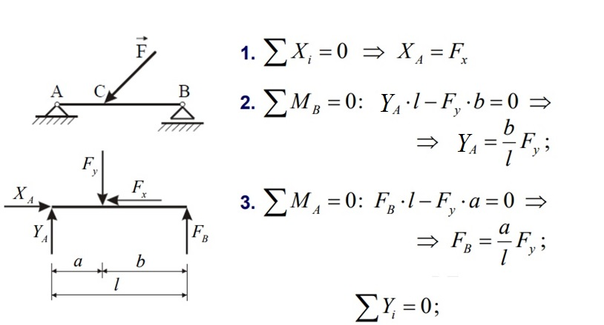
Determination of reactions in supports
Analytical method

Slide 8
Field | CONSTRUCTION
Chapter | Calculation of construction
Subtitle | Diagrams of intersecting forces for statically determined polygonal beam

Slide 9
Shear force diagrams
Due to the action of the external load and reactions in the supports, internal forces appear in the rods of the beam support
1. Normal forces
2. Transverse forces
3. Bending moments
Internal forces are represented by internal force diagrams

Slide 10
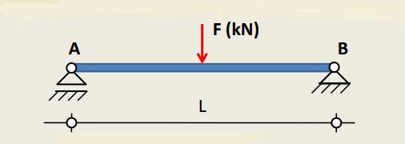
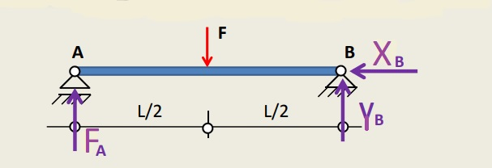
Task solving procedure
We draw the support with supports and external load
Let's replace supports with support reactions

Slide 11
We determine the reactions in the supports using equilibrium conditions
1. ΣXi=0 the sum of all horizontal forces is equal to zero
2. ΣYi=0 the sum of all vertical forces is equal to zero
3. ΣMi=0 the sum of the moments at a point is equal to zero

Slide 12
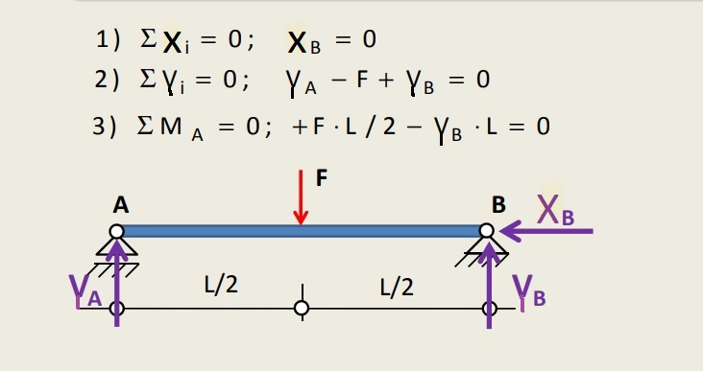
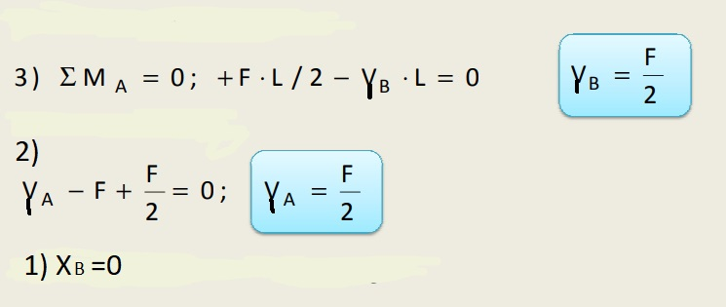

Slide 13

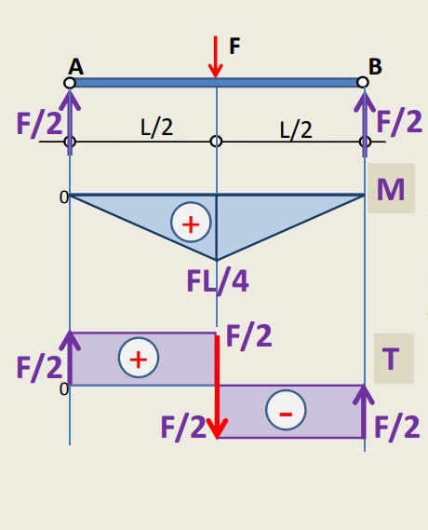

Drawing a diagram of shear forces
Bending moments
MA=0 MB=0
for z=L/2 M1=F/2*L/2=F*L/4
1
Transverse forces
TA-1=F/2
TB-1=-F/2
Normal forces
N=0

Slide 14
Field | CONSTRUCTION
Chapter | Calculation of construction
Subtitle | Determination of dangerous intersection

Slide 15
A dangerous intersection
1
Mz=F/2*z-F*(Z-L/2)
for z=L/2 M1=F/2*L/2=F*L/4
The dangerous intersection is at point 1

Slide 16
Field | CONSTRUCTION
Chapter | Calculation of construction
Subtitle | Sizing of axially stressed bars

Slide 17
We determine the reactions in the supports using equilibrium conditions
1. ΣXi=0 the sum of all horizontal forces is equal to zero
2. ΣYi=0 the sum of all vertical forces is equal to zero
3. ΣMi=0 the sum of the moments at a point is equal to zero

Slide 18
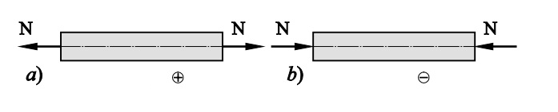
Axial rod tension is a type of tension where the internal forces are reduced to one normal or axial force, the direction of action of which coincides with the axis of the rod
In axial stress, the rod can be subjected to pressure or tension. By convention, tension is positive and pressure is negative

Slide 19
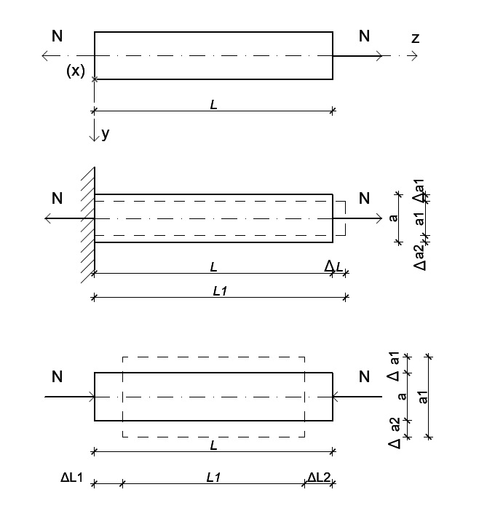
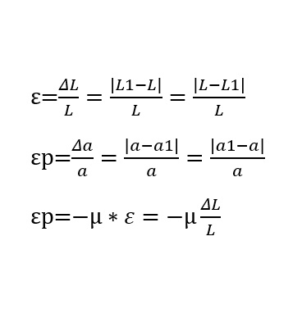
The tension is positive in the case of decompression, while the tension is negative in the case of compression
σz=N(z)/A(z)

Slide 20
Field | CONSTRUCTION
Chapter | Calculation of construction
Subtitle | Deformation and tension during bending

Slide 21
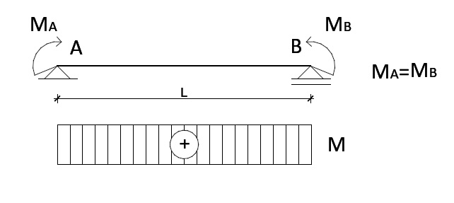
Bending is a type of tension that occurs in a support that is subjected to forces. The tension created when longitudinal couplings of forces of the same magnitude and opposite directions act on the ends of the supports is called pure bending.

Slide 22
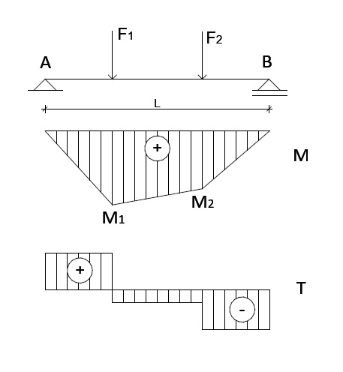
Bending by forces occurs if the support is acted upon by forces along the axis of the support cause, in addition to bending moments, transverse forces as well.

Slide 23
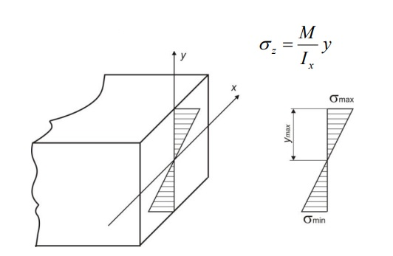
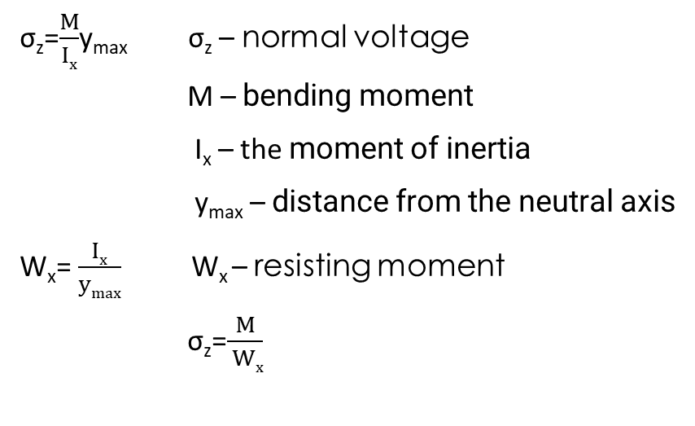
Bending causes compressive and tensile pressure in the cross-section of the beam. The highest compressive and tensile pressure occur at the points furthest from the neutral axis.

Slide 24
Field | CONSTRUCTION
Chapter | Calculation of construction
Subtitle | Sizing of various cross-section wooden and steel bearers Examples

Slide 25
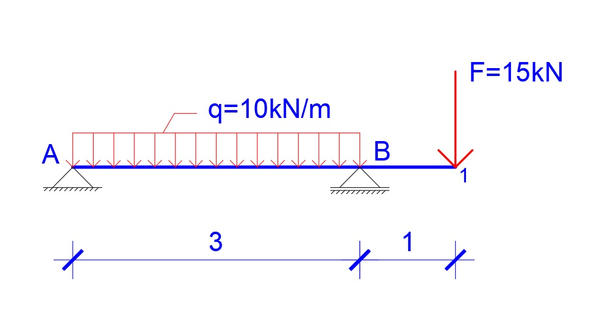
Task: A beam of length 4m with one overhang, loaded with a uniform continuous load q and a vertical concentrated force F as in the sketch. Determine:
- support reactions graphically and analytically,
- draw diagrams of transverse forces and attack moments,
- determine the maximum value of the intensity of bending moments and
- dimension the beam if it has a square cross-section and if it is of a normal I profile.
The permissible bending tension for steel is Ϭdf=100MNm², and for wood Ϭdf=10MNm²
Determine the weight ratio of a square section beam and an I profile beam if they are made of the same material.

Slide 26
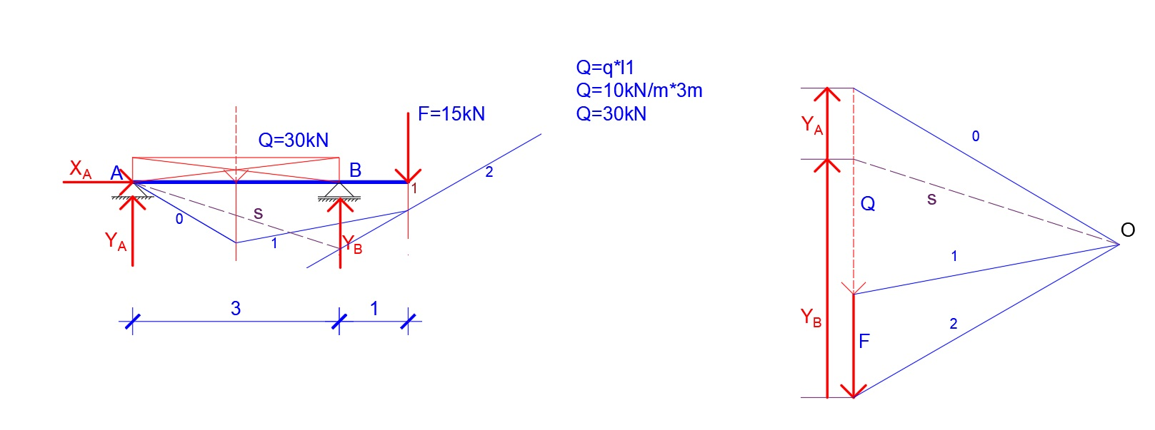
Determination of support reactions
- graphical
Measured values:
YA=10kN
YB=35kN

Slide 27
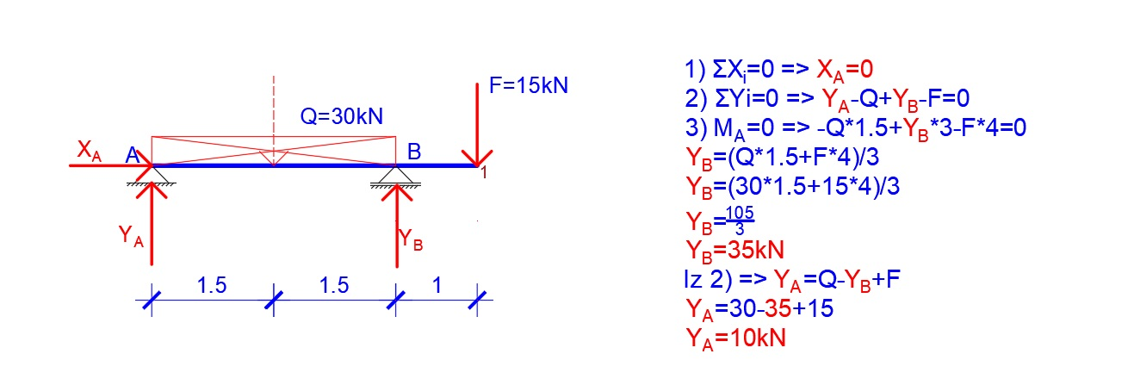
Determination of support reactions
- analytical

Slide 28
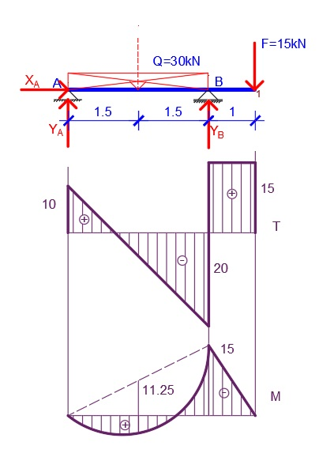
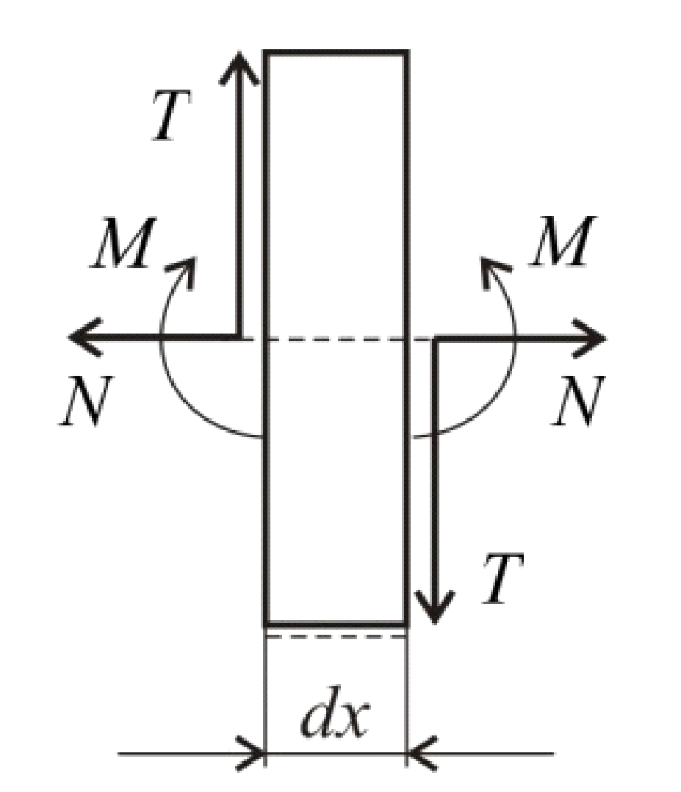
Diagrams of transverse forces and attack moments
TAd=YA=10kN
TBl=YA-Q=10-30=-20kN
TBd=F=15KN
T1l=F=15kN
MA=0
MB=-F*1=-15*1=-15kNm
Arrow size
q*l²/8=10*3²/8=90/8=11.25kNm
Determination of the maximum moment
Mmax=(MB)=15kNm

Slide 29
Dimensioning of steel beams
- for a square cross-section
Necessary WX=Mmax/Ϭdf=15kNm/(100MN/m²)
WX=15000Nm/(100*10⁶N/m²)
WX=150*10⁻⁶m³
WX=150cm³
a³/6=150cm³ => a=9.66cm
A1=9.66²=93.3cm²
For the required resistance moment in the tables for the normal I profile, we read from the tables that it satisfies
NPI180 sa WX=161cm³ i A2=27.9cm²
Weight ratios
G2/G1=A2/A1=93.3/27.9=3.34
Dimensioning of wooden beams
- for a square cross-section
WX=Mmax/Ϭdf=15kNm/(10MN/m²)
WX=15000Nm/(10*10⁶N/m²)
WX=1500*10⁻⁶m³
WX=1500cm³
a³/6=1500cm³ => a=20.9cm
A3=20.9²=436.81cm²

Slide 30

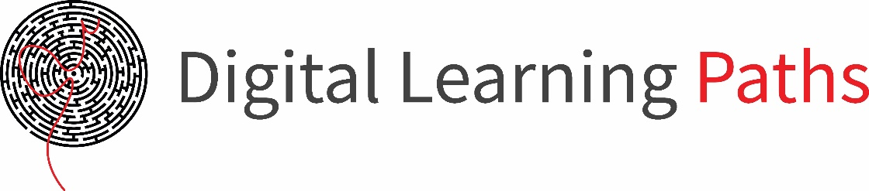

References:
STATIKA I OTPORNOST MATERIJALA za 3. razred gradjevinske škole, autori Stanković – Milošević
Katarina, Veličković Dragica, Veličković Bratislav, Jovanović Dragoslav

