Slide 1
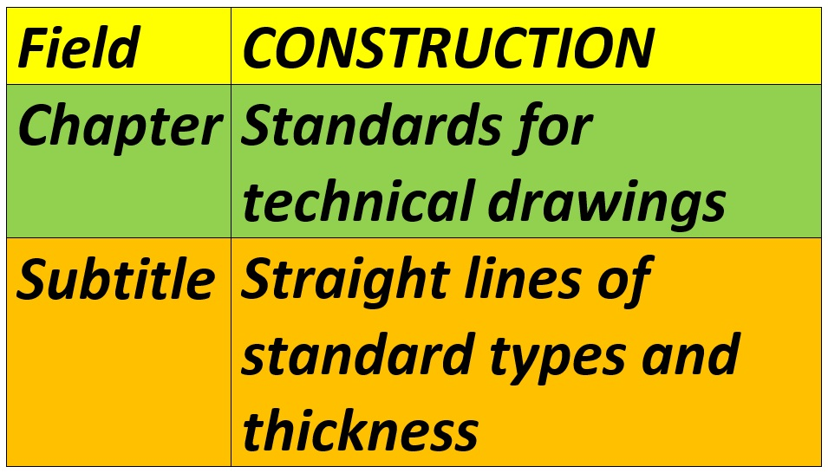




Slide 2
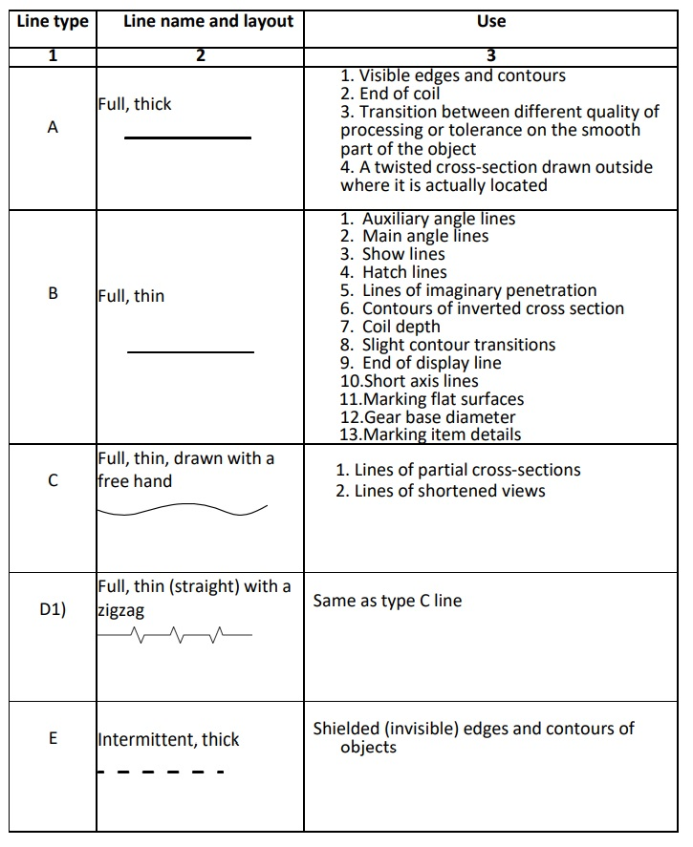
STRAIGHT LINES OF STANDARD TYPES AND THICKNESS
Types of lines

Slide 3
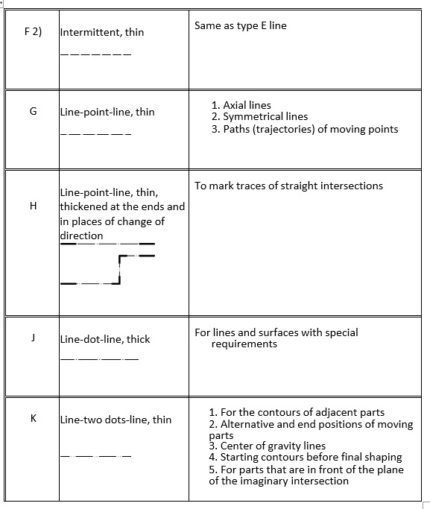
Types of lines

Slide 4
Priority of drawing lines
1. Visible edges and contours - type A line,
2. Contour of objects in front of cutting planes; contours of the object before shaping; center of gravity lines; contours of adjacent parts - type K line,
3. Shielded edges and contours - type E and F lines,
4. Intersection levels - type H line,
5. Axial lines and bisectors - type G line,
6. Auxiliary angle lines - line type B and
7. Lines of shortened views and partial sections - lines of type C and D.

Slide 5
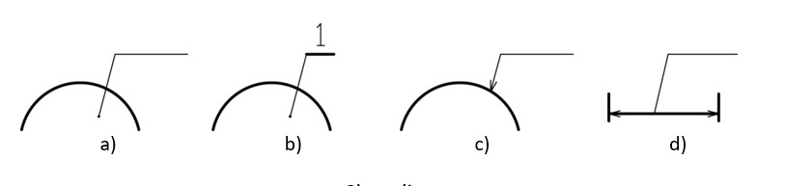
Demonstration lines

Slide 6
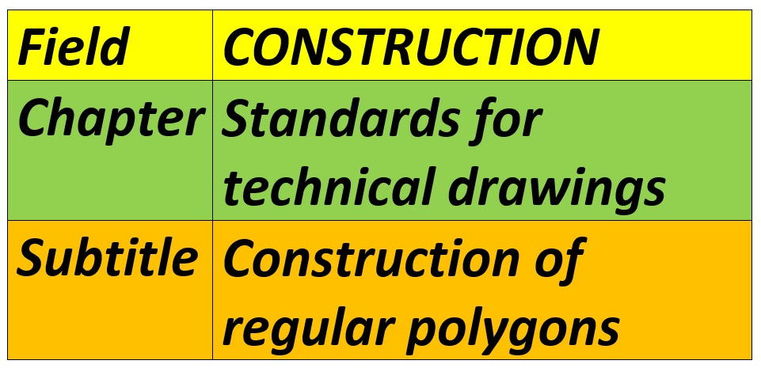

Slide 7
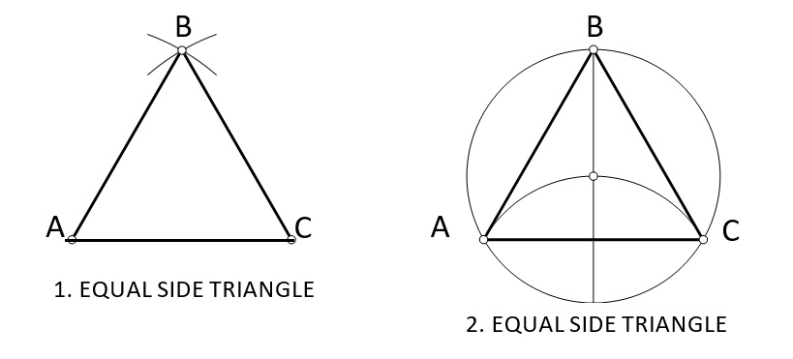
CONSTRUCTION OF REGULAR POLYGONS
Regular polygons are geometric shapes whose sides and angles are equal
An equilateral triangle

Slide 8
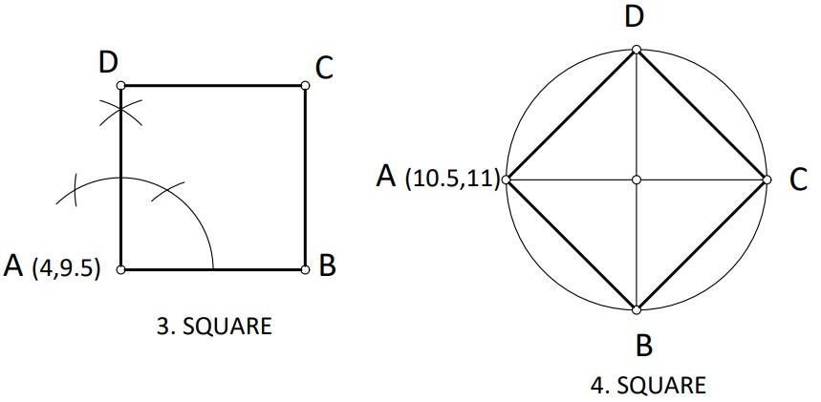
Square

Slide 9
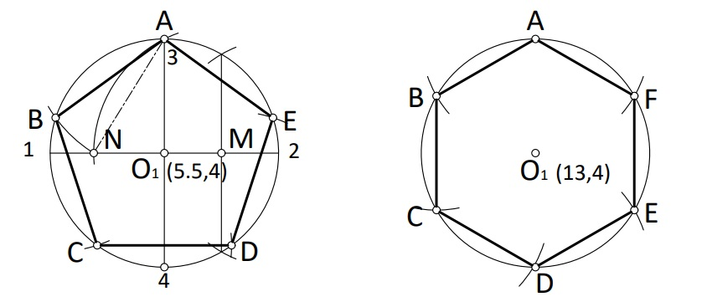
Pentagon
Hexagon

Slide 10
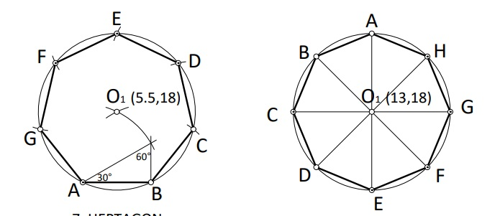
Heptagon
Octagon

Slide 11
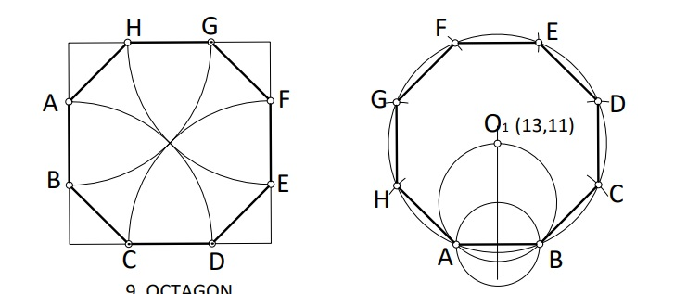
Octagon

Slide 12
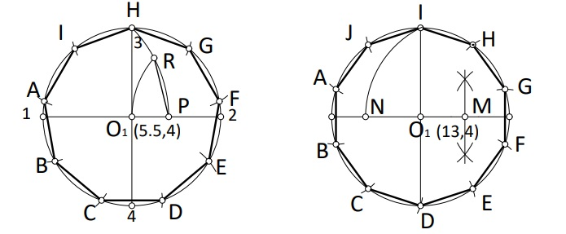
A regular nine-angle
Decagon

Slide 13
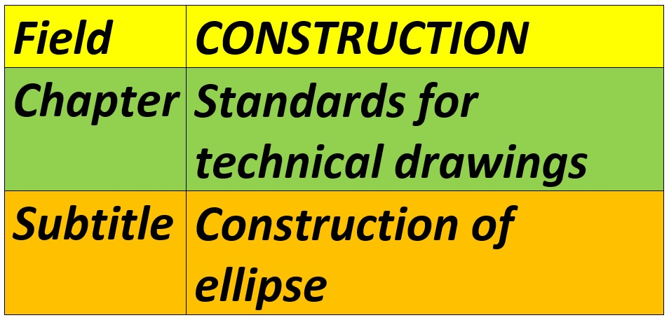

Slide 14
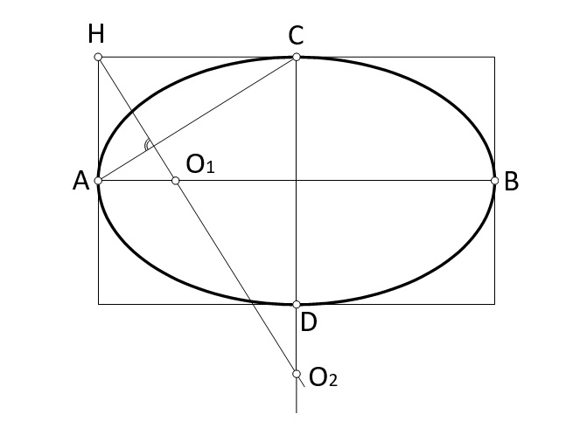
Construction of an ellipse using the radius of curvature

Slide 15
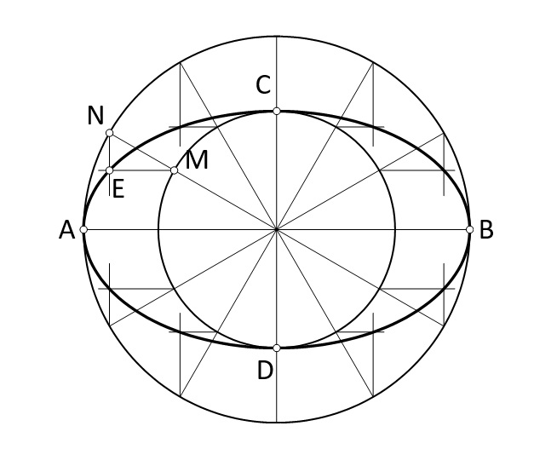
Construction of an ellipse using inscribed and described circles

Slide 16
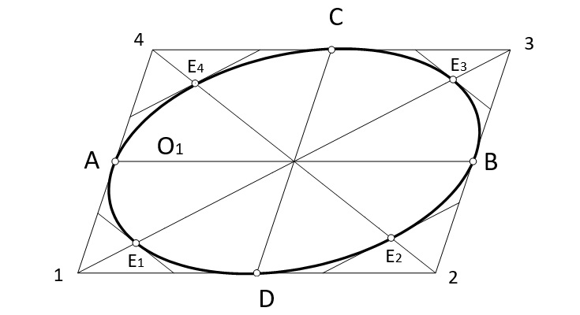
Construction of an ellipse using the radius of curvature

Slide 17
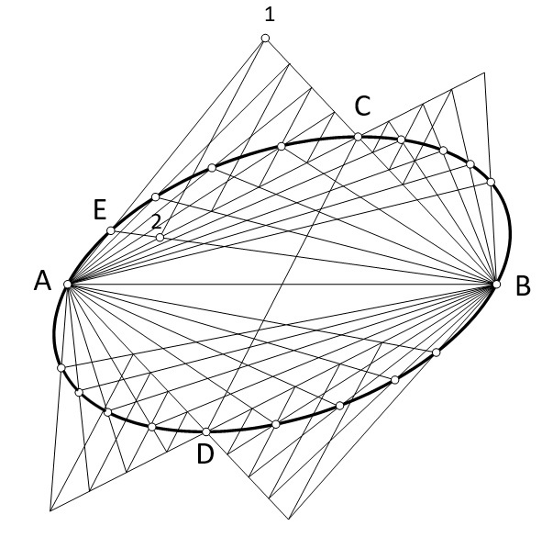
Construction of an ellipse by finding its points

Slide 18
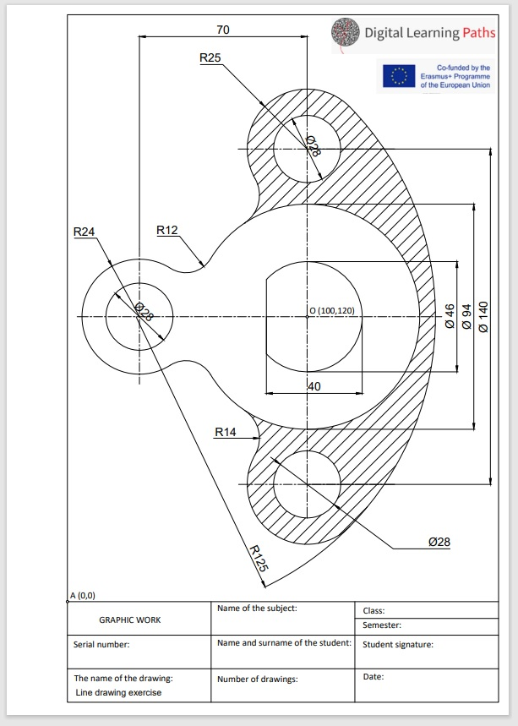
EXAMPLES OF DRAWINGS

Slide 19
References:
TEHNIČKO CRTANJE SA ČITANJEM PLANOVA za 1. Razred gradjevinske škole, autor Dulić Gordana

