Slide 1


Slide 2
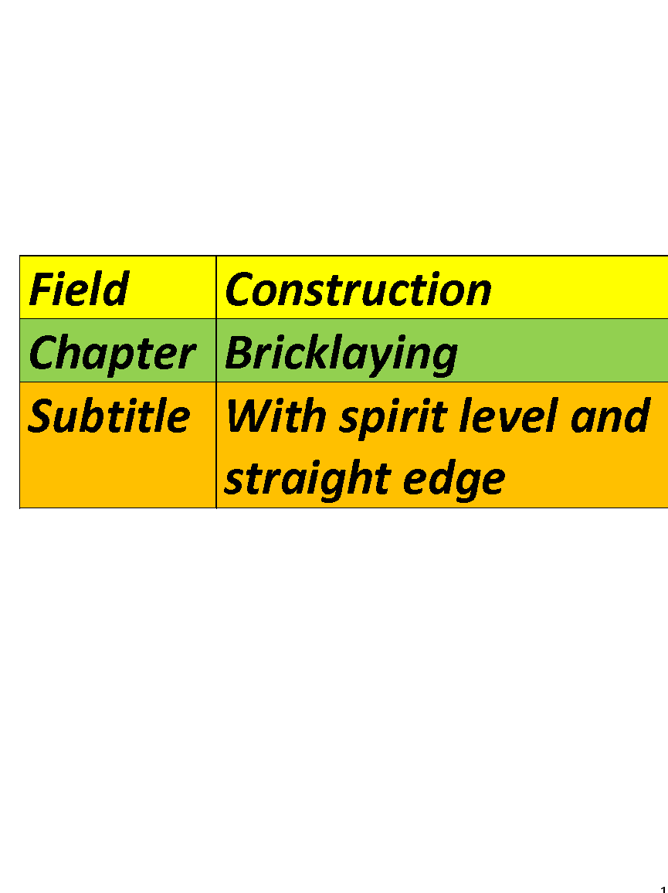

Slide 3
Bricklaying :
There is more to it than just bricks
1: Required tools:
Folding gauge – mason’s pencil.
Level-plumpbob-ruler-hand brush
Maison’wire –line tensioners.
Device/rotating laser-joint nail.

Slide 4
2: Materials & equipment:
Stones-mortar.
Mortar tubs – profiles.
3: Safety:
Work clothes-safety shoes
Safety helmet- gloves.
Eye & ear protection.

Slide 5
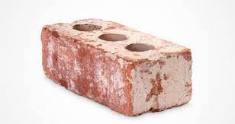
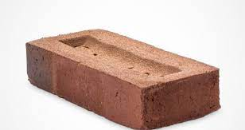
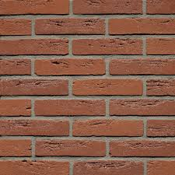
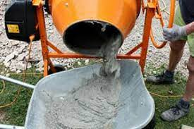
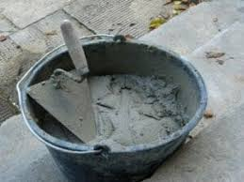
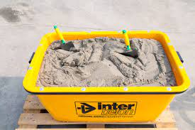
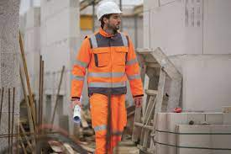
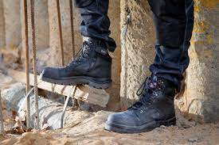
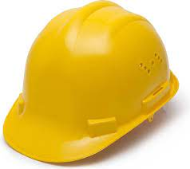
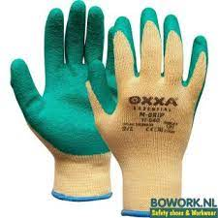


@wienerberger
Ecoform Europe Interbeton
CWS HPS Bol.com First aid kit

Slide 6
4:.
Reference point designated by
teacher. Masonry preparation:
Study the assigment.
Determine the construction line
Measure and mark
the construction line.

Slide 7
Place the profiles on the
construction line perpendicularly.
Set the profiles level and plumb.
Use level and plumb.
Use planed wood profiles
aluminium of triango profiles.
Place the profiles with 2 men.

Slide 8
One looks with the spirit level and
issues command.
The other must”fetch or bring”
until they are level.
Then final check with the plumb.
Watch this video.
https://youtu.be/Q4kQdxzjnr8

Slide 9
Setting up the workplace.
Placing the mortar tubs,distance
+/- 80cm behind the construction
line.
Between the tubs we place the
stones.

Slide 10
Making the mortar and filling the
tubs with the mortar.
Watch the video’s:
https://youtu.be/2Kdjst2h1aA
https://youtu.be/8dxcp2GyQ4Y

Slide 11
Start the masonry.
1: The inner wall:
First the kim block( ytong) and the
flood barrier.
Than further bricking of the inner
wall.
1

Slide 12
When bricklaying, take care of all
the provided wall openings.
The inner wall must be full and sat
bricked.
That means, all ribbon and butt
joints must be closed.
Then brush well.

Slide 13
2: The outer wall( façade).
Lay out the first layer without mortar.
Take into account the butt joints.
Than brick the first layer.
On the first layer you place the
flood barrier.

Slide 14
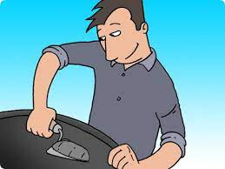
3:Tips for bricklaying:
The right masonry technique:
3.1.Picking up mortar with the truss.
Important sep, requires a lot of
practice.

Slide 15
3.1.1:Turn “sausages”by scraping up with the side of your trowel.
3.1.2:Then drop the mortar on your trowel again and turn your trowel away from the wall of the tube.
3.1.3:Repeat 3 times until you have an even”sausage” on your trowel.

Slide 16
4:Laying down mortar:
4.1:Lay down the mortar in one smooth motion.
4.1.1: For the first layer, lay the mortar slightly thicker.
This way you can remove the unevenness from the concrete floor.

Slide 17
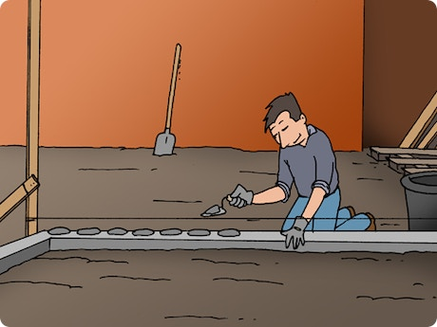
4.1.2:Importantly, the first layer should be perfectly level.

Slide 18
5: Placing the stones:
5.1:Press the stones into the mortar, flush with the masonry wire.
5.1.1:Use the side of your trowel.
5.1.2:With a cavaty wall, no mortar residue in the cavaty.
Always scrape off the mortar.

Slide 19
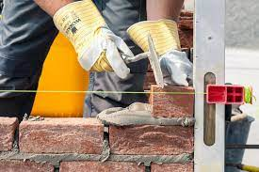
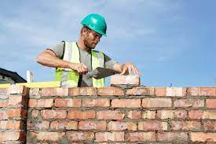
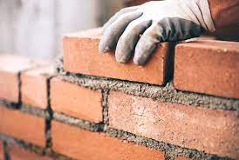
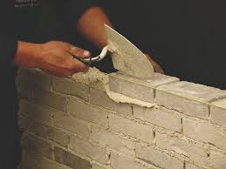
Stamix Livios.be
Bouwinfo.be @Wienerberger

Slide 20
5.1.3:Tighen the butt joints well
6:Different way of bricklaying:
6.1:Lay the “buns”along the entire lenght of the wall.
6.1.1:Iron mortar on the end of the stone.

Slide 21
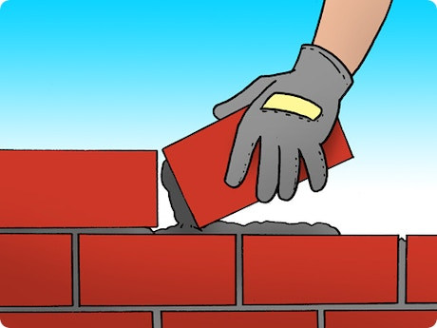
6.1.2:Press the stone down into the mortar and to the side to the already laid stone.
6.1.3:Tap in with the trowel.
6.1.2:Press the stone down into the mortar and to the side to the already laid stone.

Slide 22
7:Bricklaying straight edge:
7.1:A straight edge can end:
a)With a stretch.
b)With a half a stone.
c)With a three-quarter(tricolored)
For new construction, never end up on ¼ brick.(klezor)

Slide 23
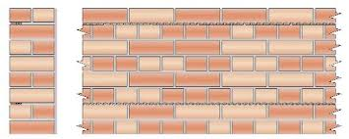
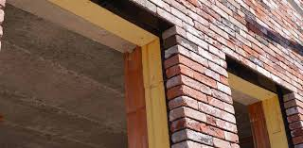
Total wall
Straight termination windows

Slide 24
8:Control with the spirit level:
8.1:Check if something is flat/straight.
8.1.1:How does the spirit level work?
*A spirit level is a liquid-filled tube with an air bubble.

Slide 25
*Fluids at rest are perpendicular to the direction of gravity.
*Place the spirit level on the straight end.
*The bubble is between2 dashes.
*Then the straight termination state is level.

Slide 26
9:Accuracy of the spirit level.
9.1:Have a tolerance of 0.3mm per m.
9.1.1:This depends on the so-called tolerance of the dragonfly.
9.1.2:Control deviation level?
*Place the spirit level on a plane and draw a line on both sides.

Slide 27
*Flip the spirit level 180°
*Both positions indicate the same thing.
*Then the spirit level is in order.
*Control vertically is done together with the plumb.

Slide 28
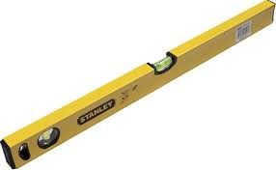
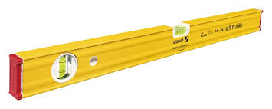
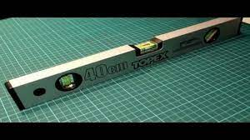
Stanley
Stabila
Control spirit level.

Slide 29
Watch the video, check spirit level.
https://youtu.be/Lw80aOSf0KU
How the use a spirit level, masonry.
Watch the video https://youtu.be/ygxPWzCiVNU

Slide 30
Sources:
Wienerberger – Ecoform- Interbeton
You tube – Stabila- Stanley.

