Slide 1



Slide 2
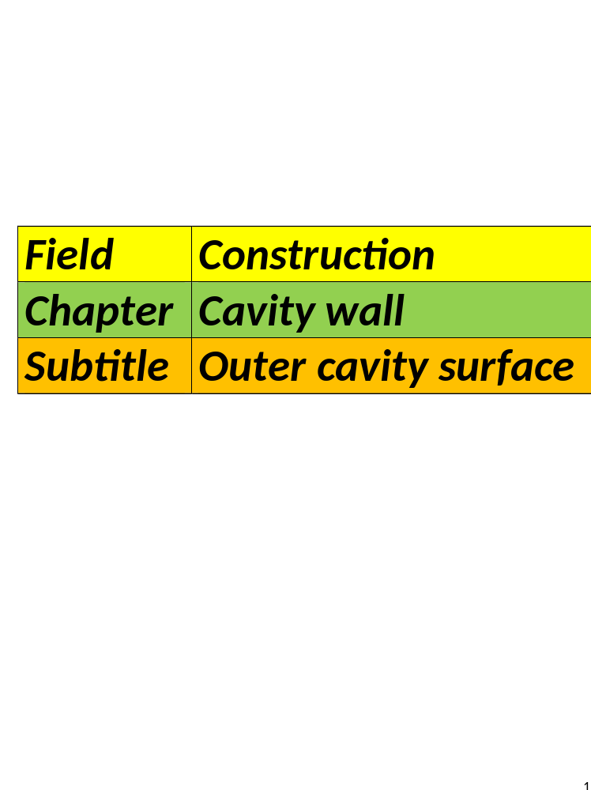

Slide 3
Outer cavity wall
Facades:
Normally a building consists of 4
facades.
1: Front facade – 2: Back facades
3 and4: right- and left side facade.

Slide 4
The front facade is also the
building line.
Function of the facades:
Protection against wind, moisture
and drafts.

Slide 5
Aesthetic function
Determined by several elements.
1: The materials used.
2: The type of grouting.
3: The details that can be found.

Slide 6
Materials:
1:Facing bricks
We already discussed these in a
previous chapter.
On the next page you can find different images of facing bricks.

Slide 7
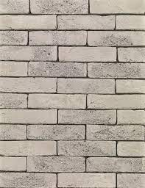
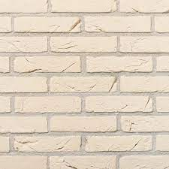
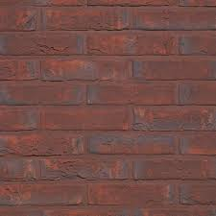
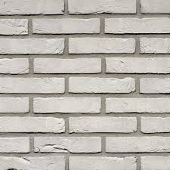
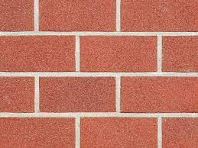
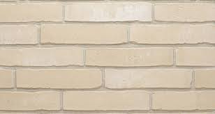
Images of facing bricks:
Hand-moulded stones
@wienerberger
Strict press stone Molded brick

Slide 8
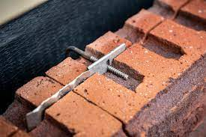
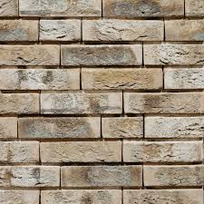
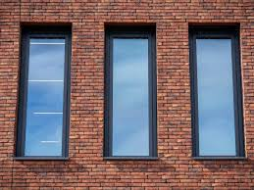
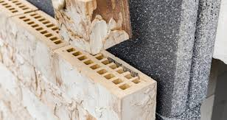
Clickbrick @wienerberger

Slide 9
2: Stone strips:
They are real stones, thinly sawn.
No visible difference with real stones
They are glued to an existing wall.
(usually against insulation boards).
As an alternative to crepi ( a coat of plaster).

Slide 10
Advantages of stone strips:
1: Space-saving
2: Authentic view of stone.
3:Quick installation.
There are also stone strips made
of ceramic tiles and in natural
stone.

Slide 11
Placement stone strips:
1: On insulation:
By bonding
With or without grout.
2:On a dry, flat, dust- and grease free surface.

Slide 12
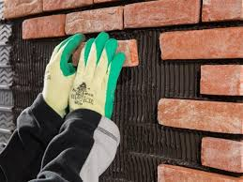
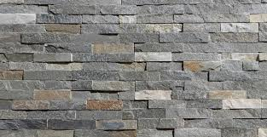
Images stone strips:
Stone strips Natural stone
@livios strips
@façade works

Slide 13
Facade plastering:
Can be used on both old and new
exterior facades.
The most famous is crepi (a coat of plaster).
It is a good combination with
insulation.

Slide 14
There are 2 types of crepi (coat of plaster):
1: One with synthetic resin.
This a flexible product
The chances of laceration or damage are
small.
The wall is protected against moisture and frost.

Slide 15
It is also excellent to combine with
insulation.
Good attachment to all surfaces.

Slide 16
2:Crepi (coat of plaster) based on minerals:
It’s a natural mixture of sand, lime and
cement.
The best option for decorative
finishing.
You can apply relief or texture
with this one.

Slide 17
It also offers weather protection.
It is a bit more stiff than synthetic resin
It is best applied in a quiet
environment.

Slide 18
Advantages and
disadvantages of crepi (a coat of plaster)
1:Advantages:
Protection against moisture.
Energy-saving and many colors.
Fits all homes.

Slide 19
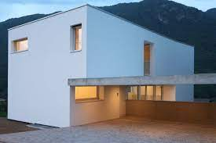
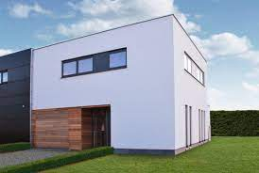
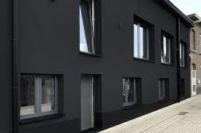
2: Disadvantages:
Difficult to clean.
The color can change.
Crepi.be Pinterest Crepi.be
White crepy Black crepy

Slide 20
Spray cork
What is spray cork?
Facade cladding made of cork
granules or cork granulates.
With acrylic resin and vegetal oils.
Sometimes there is an addition of pigments.

Slide 21
It gives gives either a rough or a
smooth finish.
Rough finish= rural appearance.
Smooth finish= modern homes.

Slide 22
Advantages-disadvantages.
1:Advantages:
An environmentally friendly way of facade cladding.
Easy to apply.
It can be applied to all types of
surfaces.

Slide 23
Spray cork also has an insulating
effect, thermally and
acoustically.
The insulating effect helps replace
cold bridges.
It also has a moisture-resistant effect.
Many decorative possibilities.

Slide 24
Spray cork is elastic.
It has an high resistance to laceration and damage.
It’s fire resistant.
2: Disadvantages:
It does not work for a 100% as insulation.

Slide 25
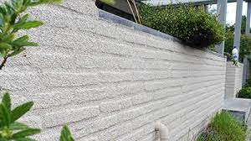
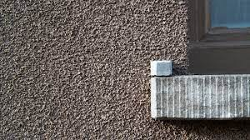
Only applicable to facades in good condition
    Is expensive, but pays for itself
MEC DECOR WWW.Spuit-kurk.be

