Slide 1



Slide 2
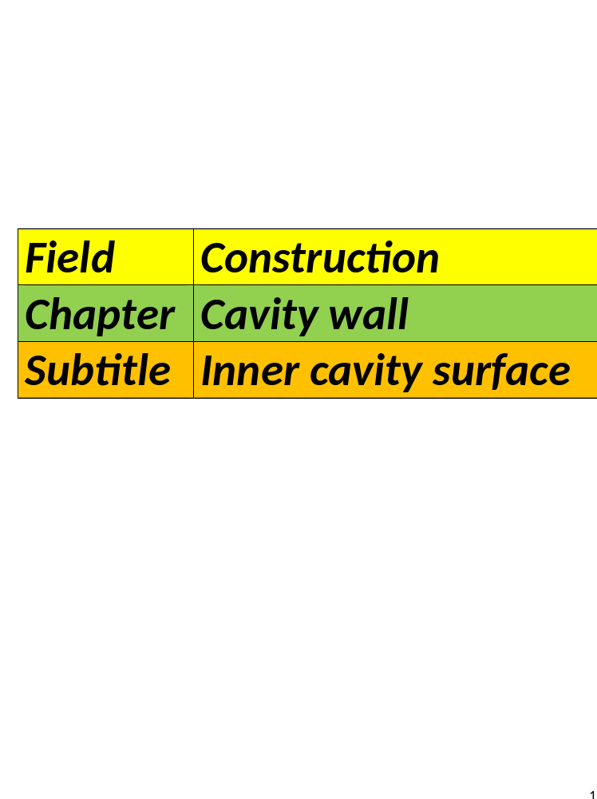

Slide 3
Load-bearing interior
walls:
What is a load-bearing inner wall?
It carries the weight of the
overhead structure (the weight of the floor or roof structure above).

Slide 4
Transfers the forces to the
foundation.
Never remove these walls during
renovations.
If you do so, the load-bearing function must be replaced.

Slide 5
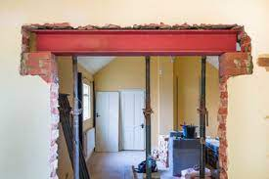
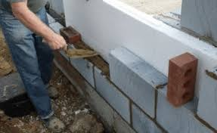
Replace it by another construction element for example: a beam.
Replacing it with a steel beam is
also possible.

Slide 6
How many load-bearing interior
walls are there?
There are at least 4 load-bearing walls.
With a long span you have more chance of load-bearing interior walls.
Load-bearing interior walls close
off any space.

Slide 7
Walls on wich floors and beams
lean= load-bearing wall.
Thickness of a load-bearing wall.
It must be more than 10cm
The most common thicknesses are 14 cm and 19 cm.

Slide 8
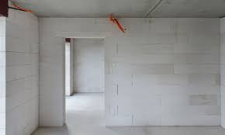
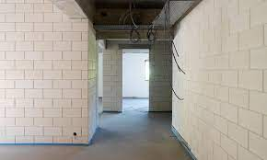
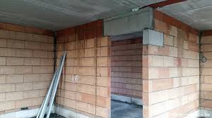
Examples :

Slide 9
Non load-bearing interior walls:

Slide 10
Recognizable by their smaller thickness ( 9 cm).
They are not supporting other building
elements.
It serves as a room layout.
Recommended for a partition wall=
7-10cm thick.

Slide 11
Wall openings in non-load-
bearings walls are bridged by:
Concrete, steel or wooden lintels.
Non-load-bearing walls are usually glued.

Slide 12
Materials:
Plaster, aerated concrete,
concrete, quick-build blocks.
a)Gypsum blocks:
Non-insulating, moisture resistant
Hydro gypsum blocks for bathroom and kitchen.

Slide 13
Process:
Tongue and groove system.
Glued with glue based on plaster.
Filming the connection joints and
joints with plaster glue.
Direct wallpapering and painting
can be done.

Slide 14
b)Aerated concrete:
Low density concrete.
Strong insulating capacity.
Fire resistant.
Heat-accumulating capacity.
Frost resistant.

Slide 15
Process:
It is usually glued.
The surface must be clean.
If there is an uneven surface= 1st layer has to go off.
The horizontal bricklaying with mortar. Further apply glue, place subsequent layers.

Slide 16
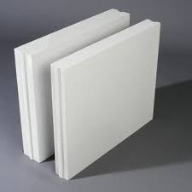
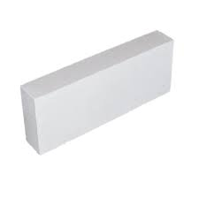
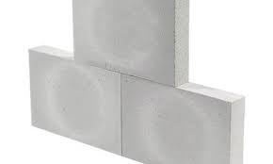
Anchoring other walls is necessary.
Anchoring with galvanized spring
anchor.
Securing spring anchor with impact
sleeve or wire nail.

Slide 17
c) Concrete, solid wall:
Is usually a prefabricated wall.
In reinforced concrete.
Walls are made with a 10cm
thickness.

Slide 18
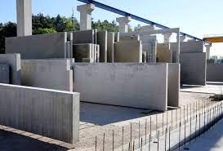
Airtightness of the walls is
important.
Air leaks significantly reduce
sound isolation.
@Megaton/Structo prefab Systems.

Slide 19
d) Quick building blocks:
Still the most used blocks.
They are perforated bricks of a larger size.
They are lighter and easy to use.
They are actually only suitable for non-visible masonry.

Slide 20
Exceptions: garages.
Joints are added immediatly.
The most commonly used quick-
build block for interior walls is:
290x140x90mm
But they also use 290x 140x 140mm

Slide 21
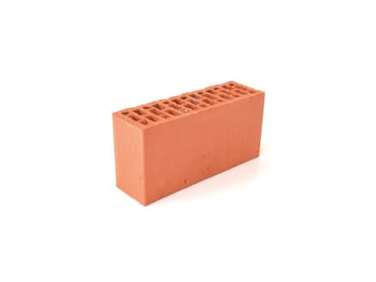
Anchor these in the inner
walls of the cavity wall.
The interior walls are connected
with each other.
Quick building blocks 290x90x140
L x BR x H

Slide 22
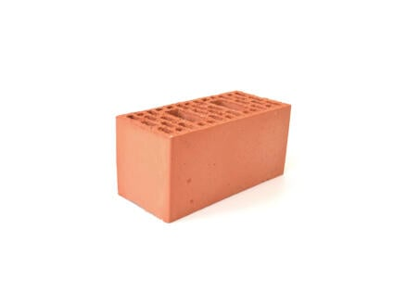
Quick building blocks
290 x 140 x 140
L X BR x H

