Slide 1


Field | Central Heating
Chapter | Regulatons concerning the annual maintenance of installations.
Subtitle | Discharge of Combustion Products

Slide 2
Flue Gas Discharge Systems
All appliances are required to be connected to a discharge duct for combustion products.
EXCEPT:
- Devices with type C
- Stove, built-in hob, domestic and artisanal oven, brazier and artisanal burner.
- Type A kitchen water heater installed for intermittent use.
- Household washing machine and dryer of type A with a power limited to 10 kW, the same goes for a refrigerator.

Slide 3
Discharge of Combustion Products
All central heating boilers with open combustion circuit must be connected to a drainage duct.
- The discharge of the combustion products consists of 2 parts: a connecting channel and a discharge channel.
- The electrical continuity of the metal parts of the drainage systems of the combustion products must be insured.
- The metal parts need to be brought to the same electrical potential as all the other metal structures in the building (excluding parts that are electrically insulated/protected).
- The installation is not allowed to serve for another installation/electrical appliance.

Slide 4
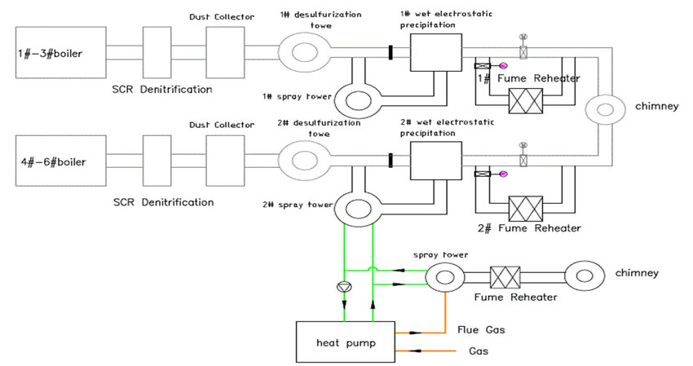

Slide 5
Discharge of Combustion Products from Type A Appliances
- Good ventialtion is necessary in in a room with type A heating appliance.
- A duct for top ventilation is provided in each room where a kitchen geyser with type A with intermittent operation is intalled.
- The opening of the duct has a FREE PASSAGE OF AT LEAST 150 CM².
- No obstacles may obstruct the straight-line view.

