Slide 1


Field | Central Heating
Chapter | Gas Storage
Subtitle | Tank Test

Slide 2
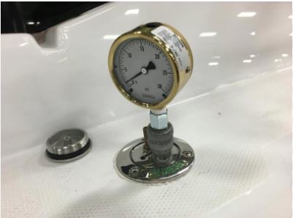
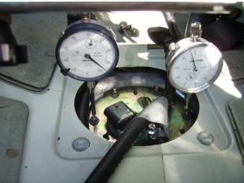
1. Fuel Tank Test
- All fuel tanks are tested to a pressure of 24.525kPa / 2.5m water / 3.6psi.
- The pressure test can be measured with a Liquid Manometer or a Pressure Gauge.

Slide 3
2. How to take the Test.
- The readings must be taken under a specified pressure/vacuum inside the fuel tank.
- The fuel tank needs to be fully sealed in order to prevent a reading error.
- The vehicule must be fitted on vehicule stands to prevent suspension movements.
- The vehicule must be placed in a levelled horizontal position.

Slide 4
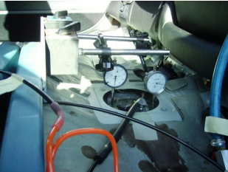
Testing for leaks.
- Air is applied to the tank until the required test pressure is
achieved.
- The air is then shut off and all welded seams, joints and connections are tested with soapy water to determine if there are any leaks.
- When there’s a leak, keep testing with soapy water until there are no further leaks.

