Slide 1


Field | Central Heating
Chapter | Gas Storage
Subtitle | Installation of Gas Tank

Slide 2
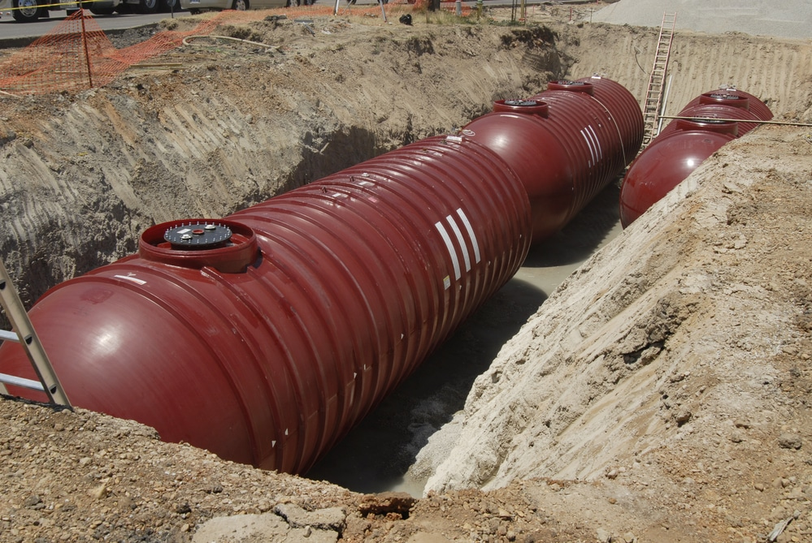
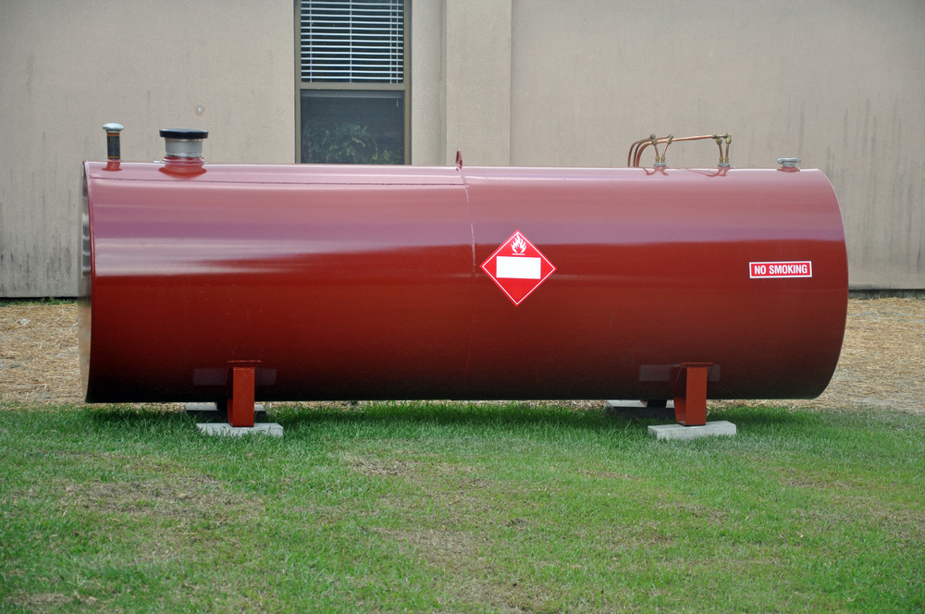
1. Gas Storage
Underground gas tank
Overground gas tank
Only the tank lid is visible

Slide 3
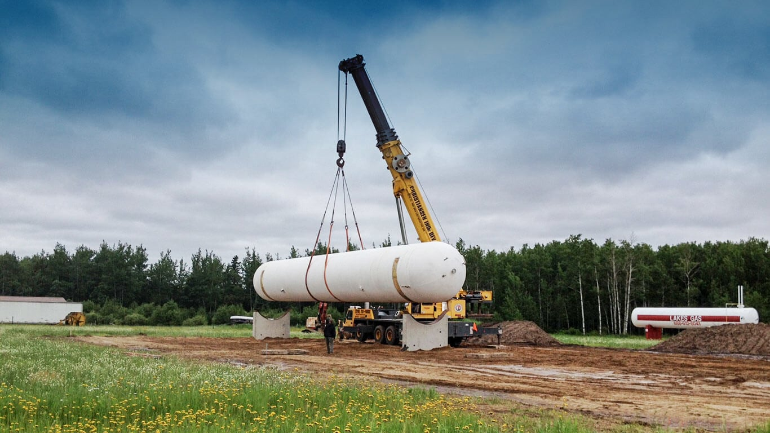
2. Installation Gas Tank
The installation starts with the propane crew delivering and positioning the tank. They connect the LP Gas yard line, backfill the trench, and test for leaks. A delivery driver fills the tank with propane. After a safety inspection, the installers light pilot lights, check appliances, and review the installation with you.

Slide 4
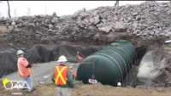
2. Installation Gas Tank

Slide 5
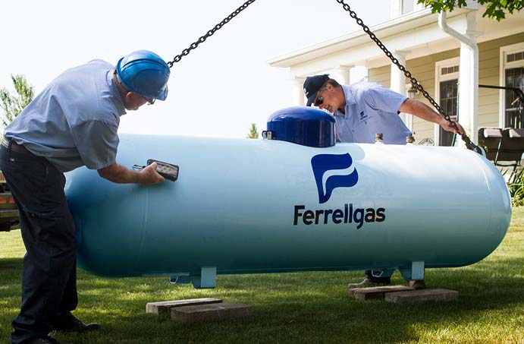
3. Connection gas tank
Propane in your tank is stored at high pressure, but applications need it at low pressure. Hence, a release button is used at specific points.
• Standard pipework with facade box
The propane gas is stored in the tank under high pressure. For low pressure end applications, two regulators were usually installed: one on the propane tank that releases to medium pressure, and one that relaxes to low pressure; namely the second-stage release in a box on the facade.

Slide 6
4. Types of Gas Tanks
4.1) Steel Industrial Storage Tanks
- Higher cost effectiveness than tanks made of other materials.
- Tanks made of stainless steel are resistant to U.V rays, fire, rust, and have a good longevity even without painting.

Slide 7
4. Types of Gas Tanks
4.2) Fiberglass Industrial Storage Tanks
- More economical choice than concrete tanks (especially for large to medium capacity systems).
- Extreme durability and tightness
- No waterproofing coating or maintenance program needed. (Due to its impermeable and mono hull nature).
- Much lighter than comparable concrete tanks
- More salable compared to concrete tanks.

