Slide 1


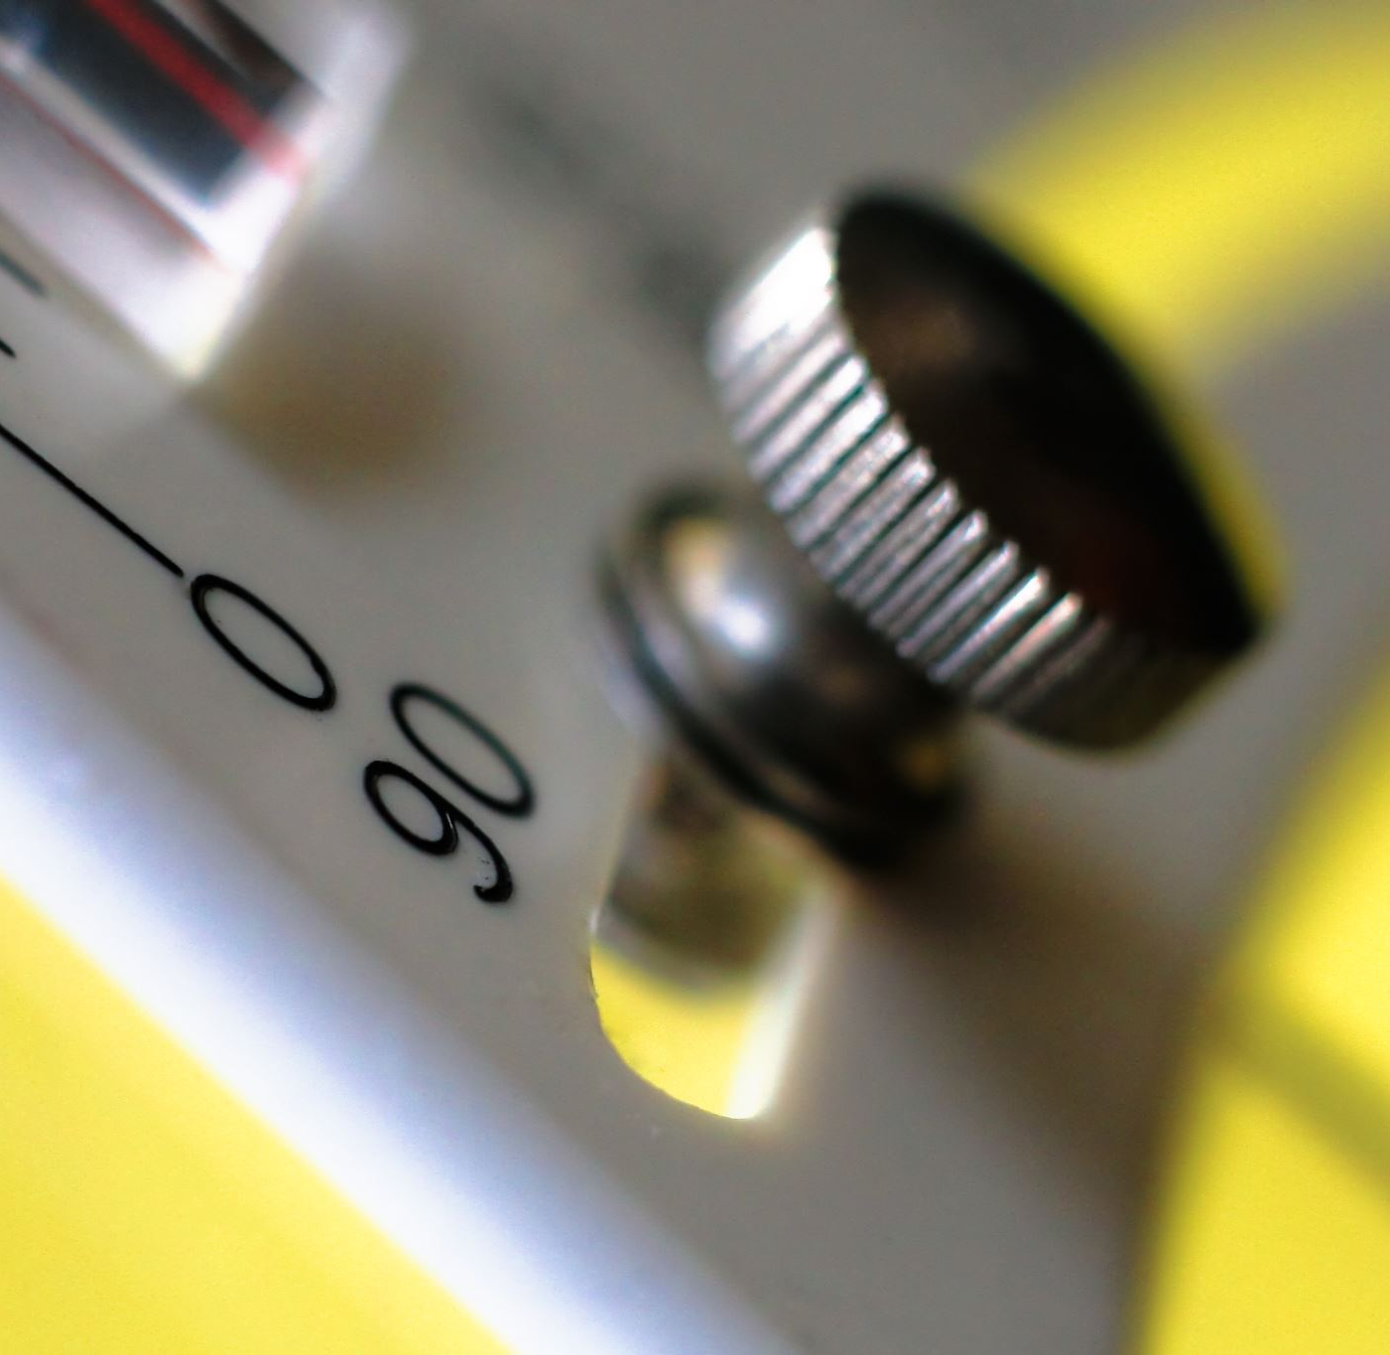
Field | Central heating
Chapter | Electricity and electrical connections
Subtitle | Room thermostats, electrical diagrams, control systems

Slide 2
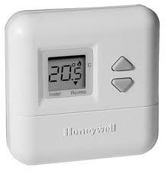
Room thermostats
Classification according to connection

Slide 3
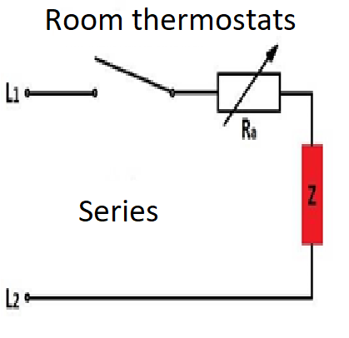
Two – wire connection,

Slide 4
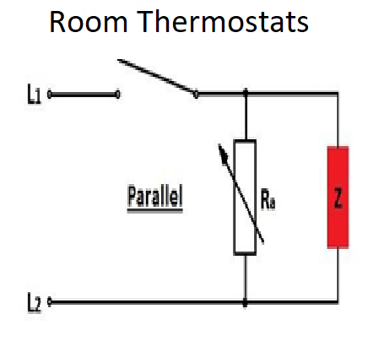
Two – wire connection

Slide 5
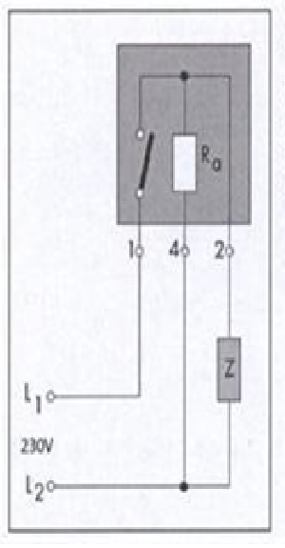
TREE – wire connection

Slide 6
Room thermostats
Classification according to tYPES

Slide 7
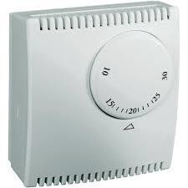
Analog thermostat

Slide 8
Digital thermostat

Slide 9
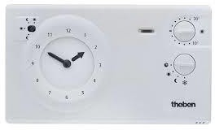
Analog clock thermostat

Slide 10
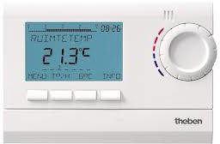
Digital clock thermostat

Slide 11
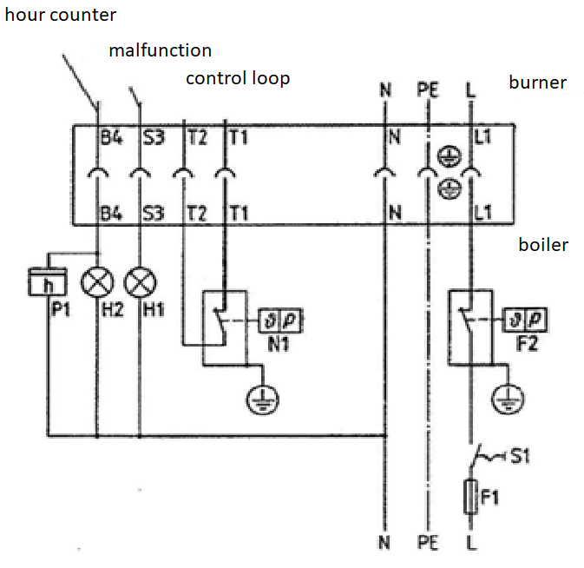
Electrical diagram oil boiler :
Room thermostat or boiler thermostat is placed add t1

Slide 12
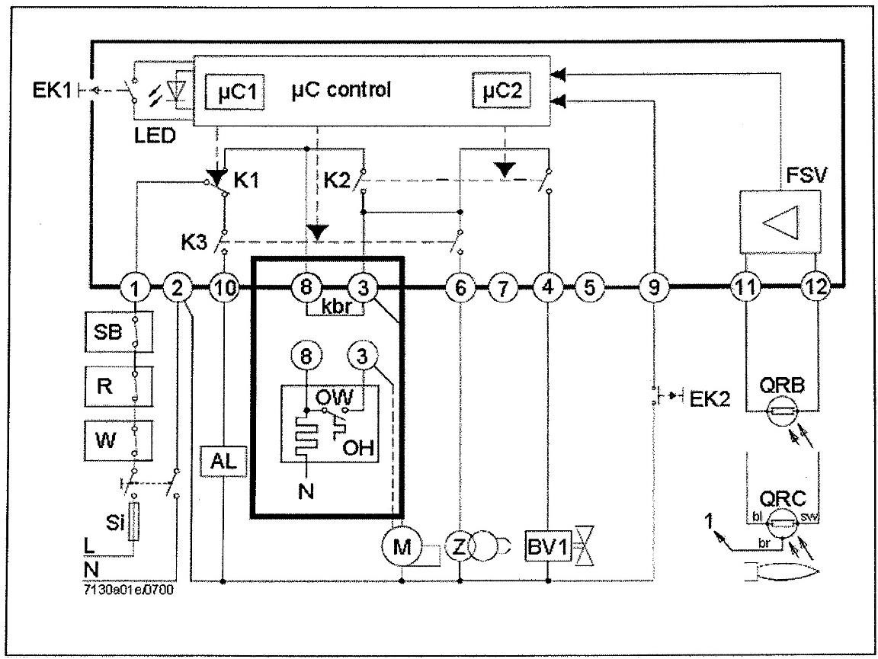
Si : fuse
W : boiler thermostat
R : room thermostat
SB : security thermostat boiler
M : motor
Z : ignition
BV1 : electromagnet valve
QRB : infra-red photocell
Electrical diagram burner relay oil burner

Slide 13
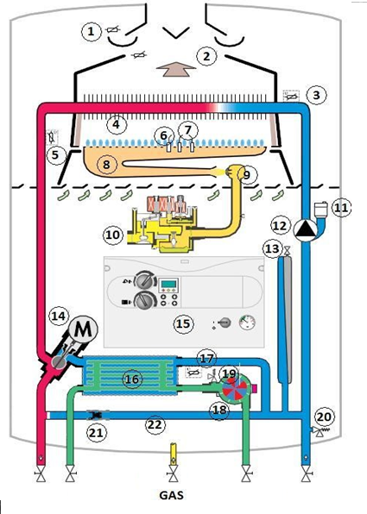
1 : thermal kickback protection (PTC )
3 : temperature sensor input central heating ( NTC )
5 : temperature sensor output central heating ( NTC )
6 : Ionization electrode
7 : ignition electrode
15 : control panel
Electrical compounds gas boiler

