Slide 1
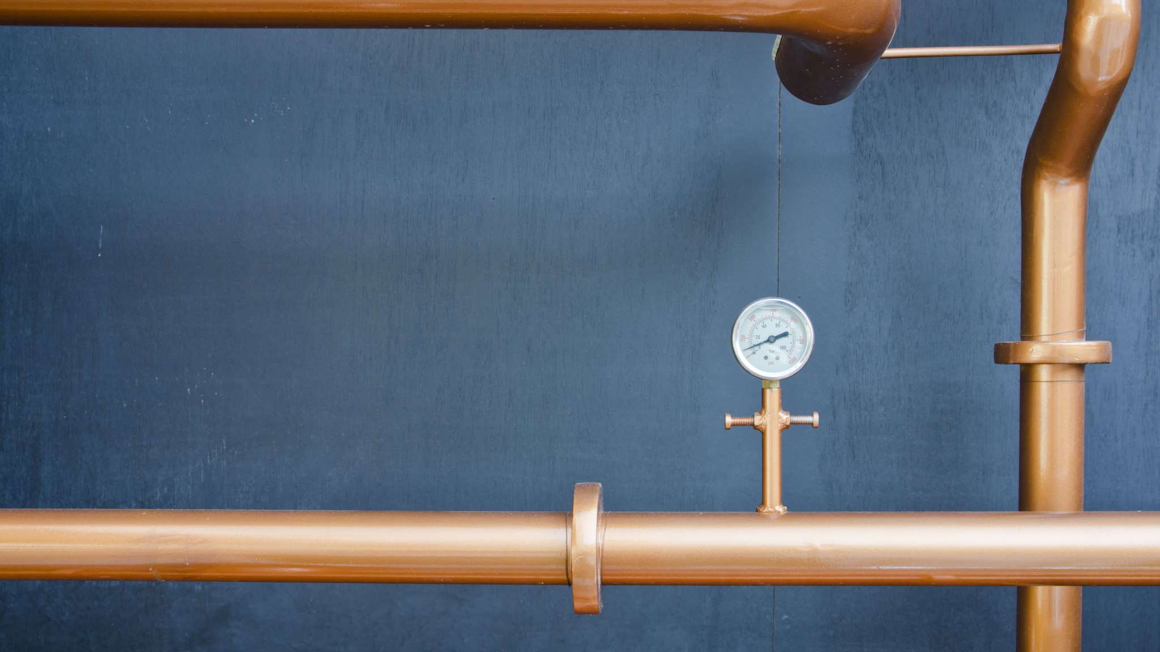


Steel pipes, fittings, tools
Field | Central Heating
Chapter | Materials and installation technology for central heating
Subtitle | Steel pipes, fittings and tools

Slide 2
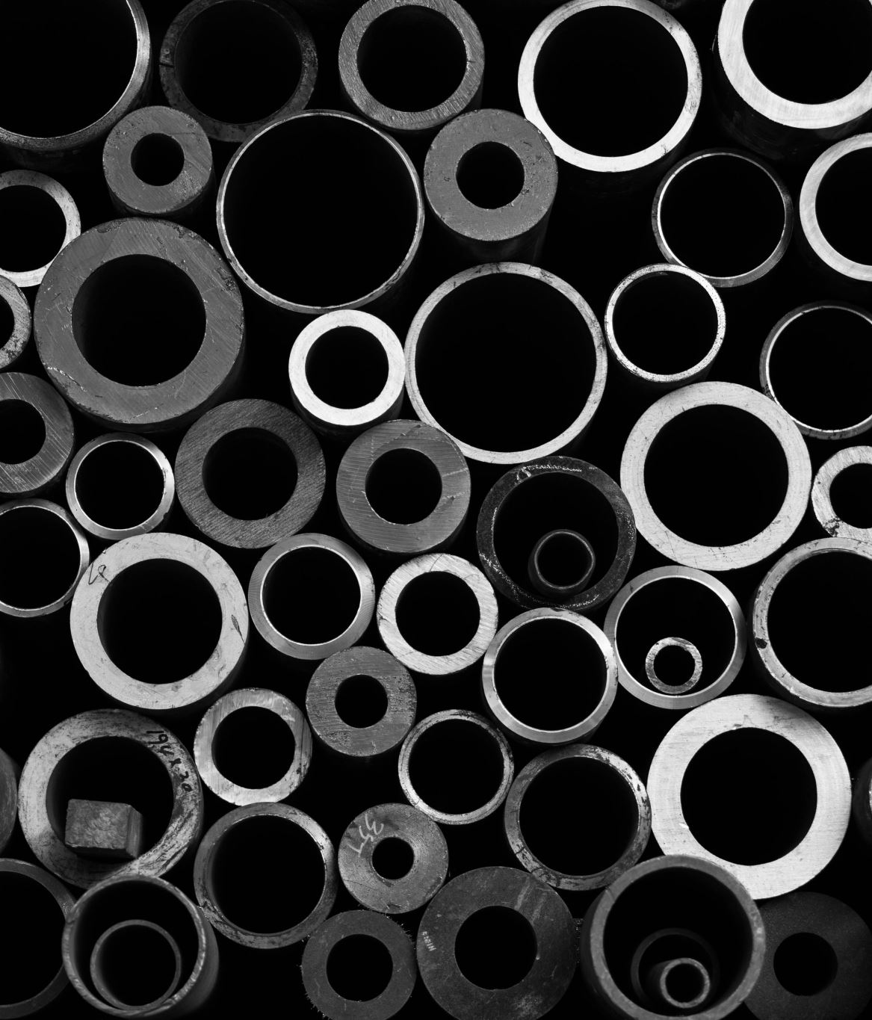
Diameters of steel pipes
3/8 ‘’ 1 ‘’ 2 ‘’
1/2 ‘’ 5/4 ‘’ 2,5 ‘’
3/4 ‘’ 6/4 ‘’ 3 ‘’

Slide 3
Applications
Central heating tube : painted red or blue
Water pipe : galvanized pipe
Gas pipe : painted yellow

Slide 4
Fittings
Denomination :
Mail thread = Male M
Internal thread = female F
Largest diameter – smallest diameter

Slide 5

Fittings
ELBO

Slide 6
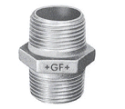
Fittings
Hexagon Nipple

Slide 7
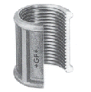
Fittings
Socket

Slide 8
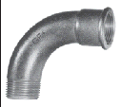
Fittings
Bend

Slide 9
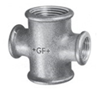
Fittings
Cross

Slide 10
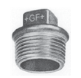
Fittings
Plug

Slide 11

Fittings
Hexagon cap

Slide 12
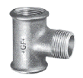
Fittings
Tee

Slide 13
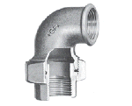
Fittings
Union Elbo

Slide 14

Fittings
Bushing

Slide 15
Central Heating Sealants
Kolmat
Loctide
Acrylic fiber seal
Teflon tape
Hennep streng

Slide 16
Water pipe sealants
Kolmat
Loctide
Acrylic fiber seal
Teflon tape
Hennep streng

Slide 17
Gas pipe sealants
Kolmat
Loctide
Acrylic fiber seal
Teflon tape

Slide 18
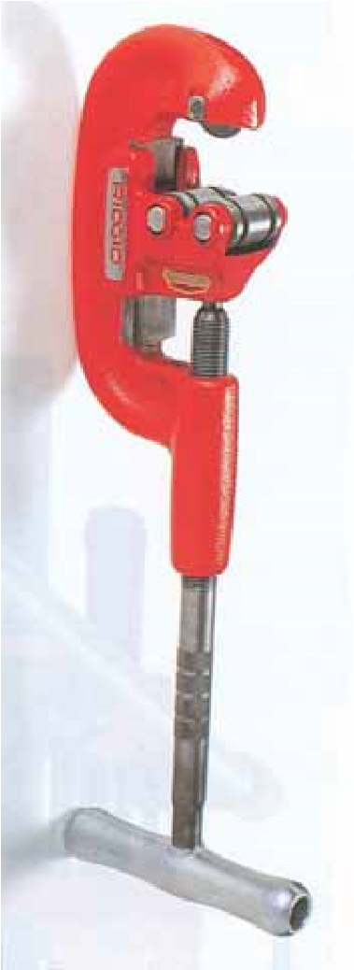
Tools to process steel pipes
Tube Cutter

Slide 19
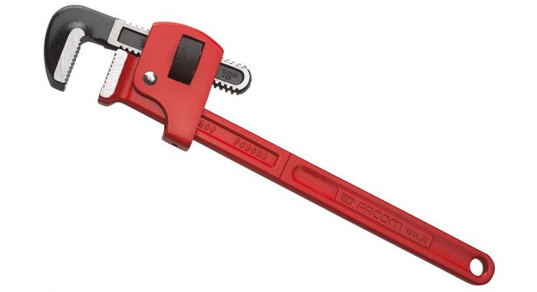
Tools to process steel pipes
pipe wrench

Slide 20
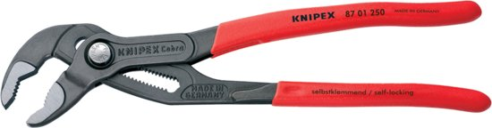
Tools to process steel pipes
Waterpump pliers

Slide 21
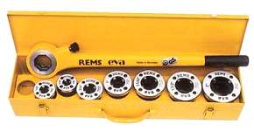
Tools to process steel pipes
pipe threading kit

Slide 22
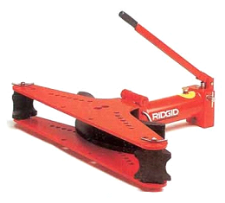
Tools to process steel pipes
Hydraulic tube bender

Slide 23
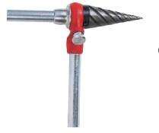
Tools to process steel pipes
Pipe reamer

Slide 24
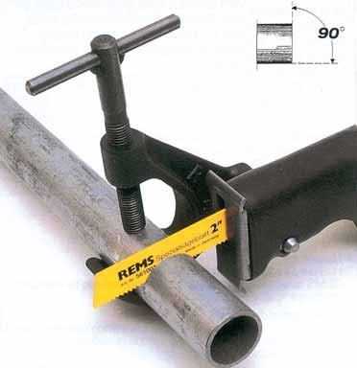
Tools to process steel pipes
Electric reciprocating pipe saw
BRON: REMS (DUITSLAND)

Slide 25
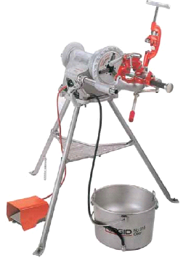
Tools to process steel pipes
Pipe threading machine

Slide 26
Clamp distance
3/8 ‘’ 1.5 m 5/4 ‘’ 2 m
1/2 ‘’ 1.5 m 6/4 ‘’ 2 m
3/4 ‘’ 1.5 m 2 ‘’ 2.5 m
1 ‘’ 2 m

