Slide 1
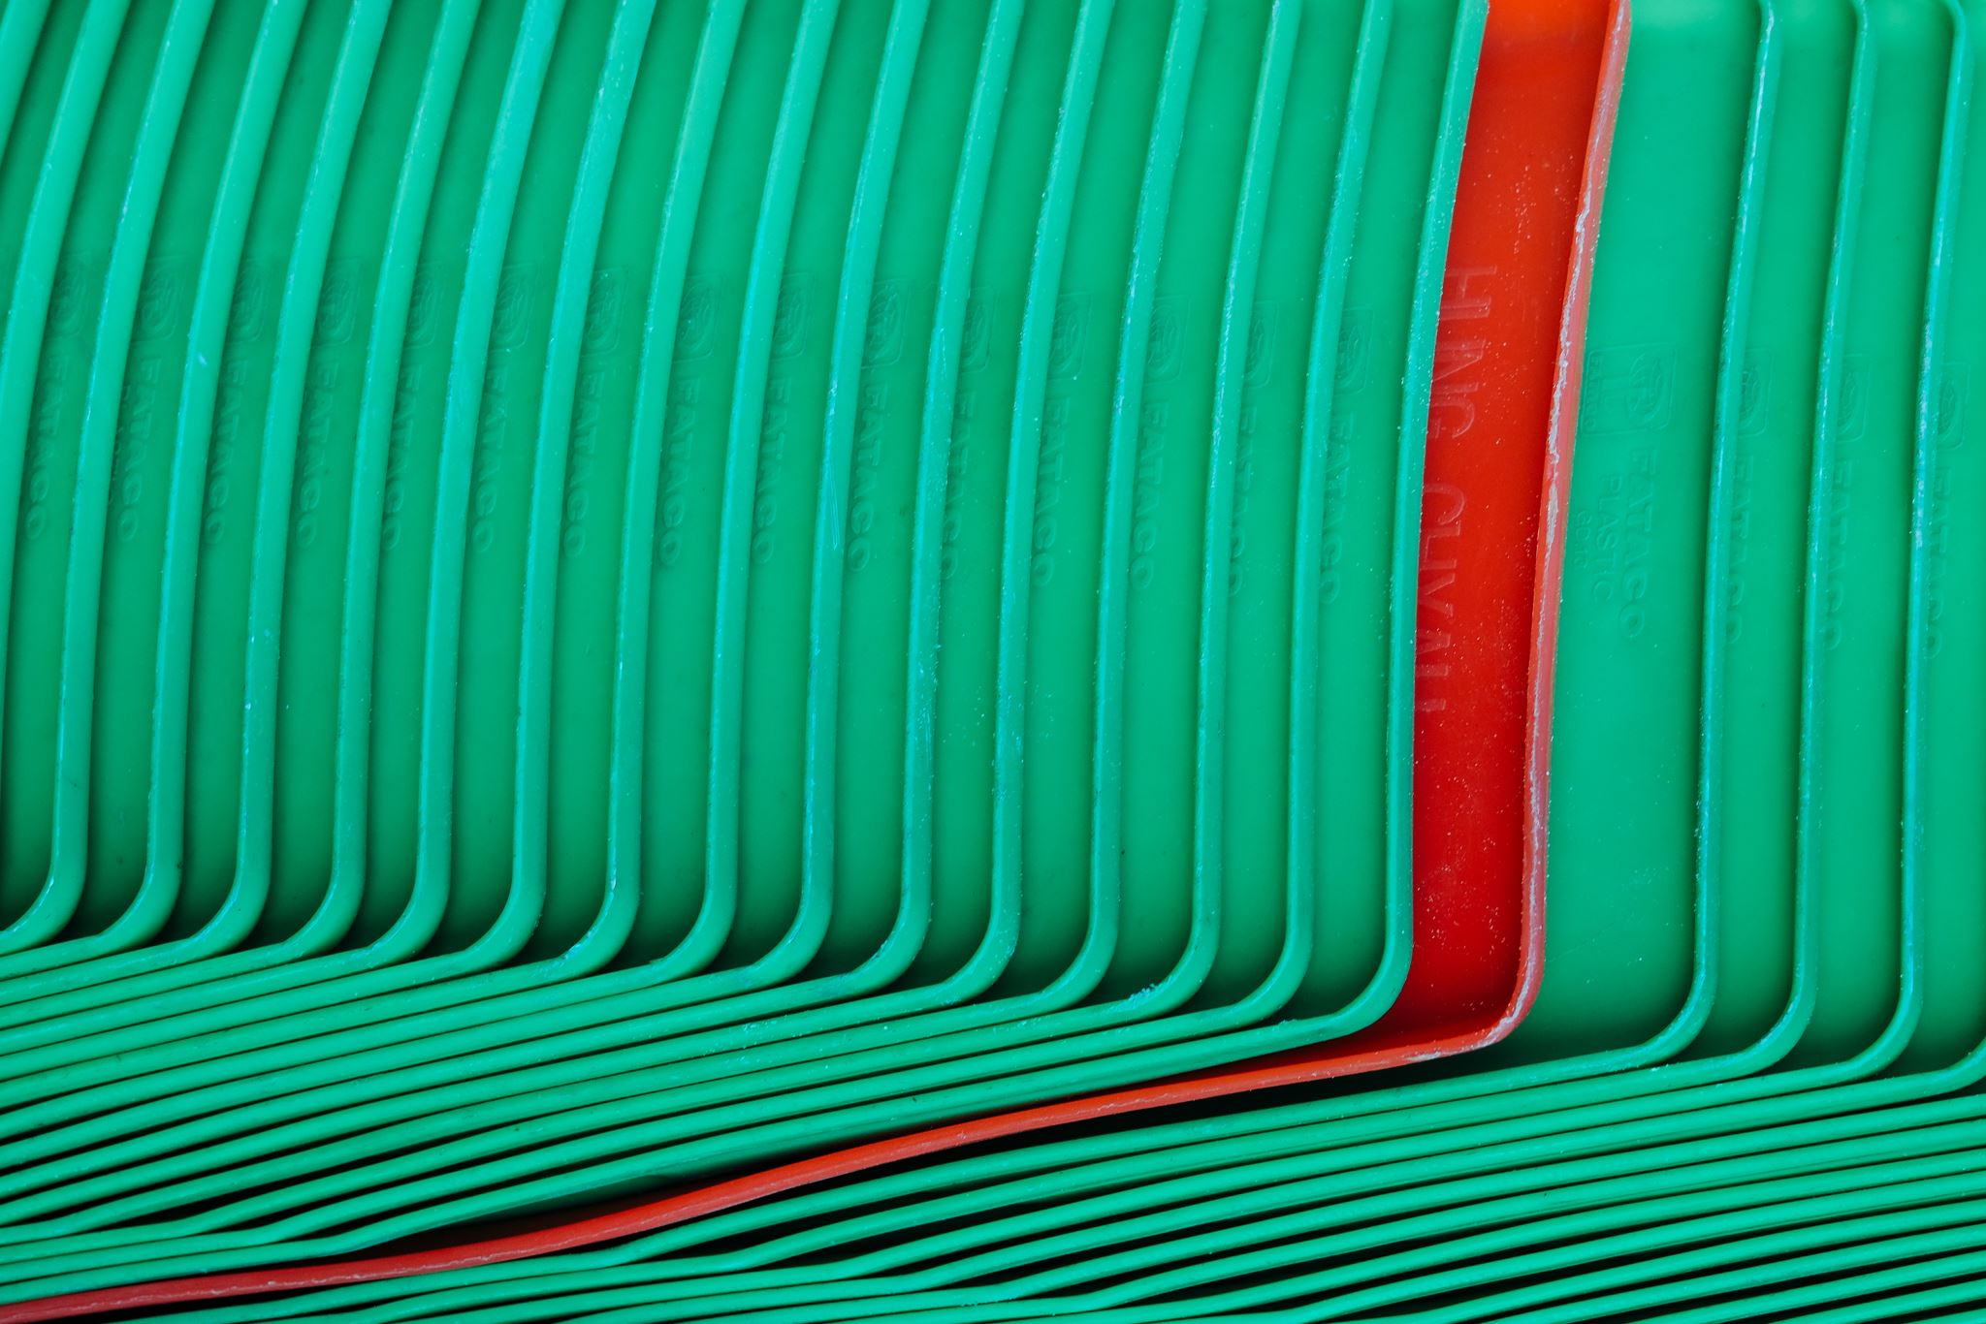


Plastic Pipes
Field | Central Heating
Chapter | Materials and installation technology for central heating
Subtitle | Plastic pipes

Slide 2
Types of Plastic
Thermoplastics
Thermosets
Elastomers

Slide 3
PVC : applications
Wastewater
Water drainage : rain
Compressed air
Swimming pool pipes

Slide 4
PVC : diameters
32 mm
40 mm
50 mm
75 mm
90 mm
110 mm
125 mm

Slide 5
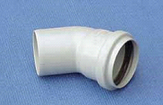
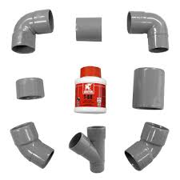
PVC : connection techniques
Fittings with seal
Fittings for gluing

Slide 6
PE : types of PE
LDPE : low density PE
HDPE : high density PE
XPE : reticulated PE

Slide 7
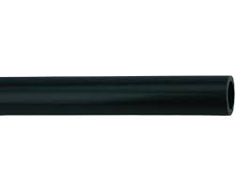
HDPE : applications
Wastewater
Water drainage : rain
Distribution of drinking water
Distribution of gas

Slide 8
HDPE : diameters
32 mm
40 mm
50 mm
70 mm
80 mm
100 mm

Slide 9
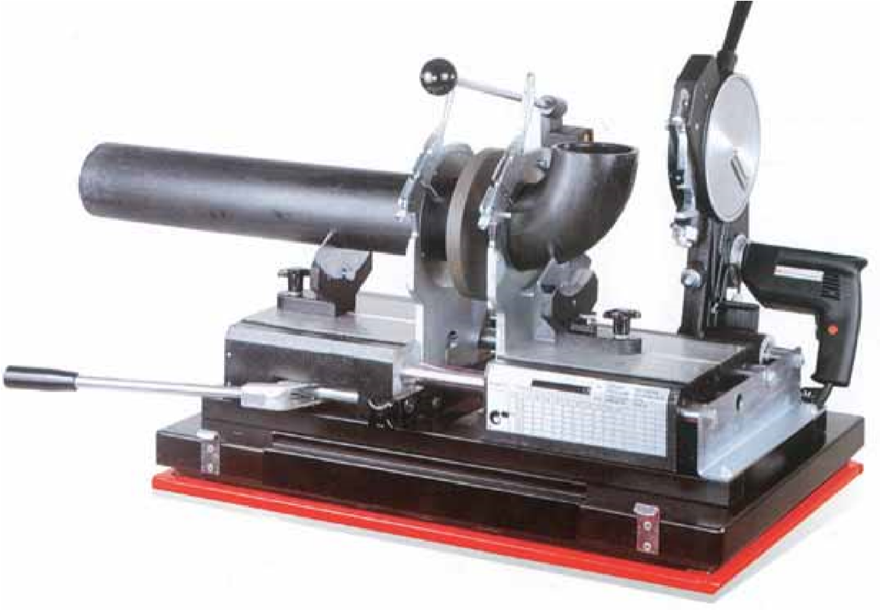
HDPE : connection techniques
Mirror welding

Slide 10
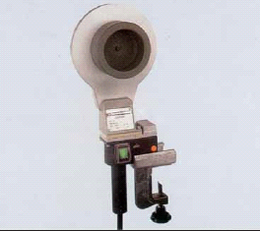
HDPE : connection techniques
Socket welding

Slide 11
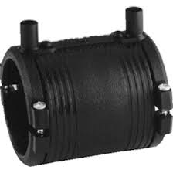
HDPE : connection techniques
Electro fusion pipe welding

Slide 12
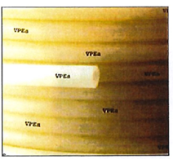
XPE : applications
Distribution cold drinking water
Distribution warm drinking water

Slide 13
XPE : diameters
16 mm
20 mm
25 mm
32 mm

Slide 14
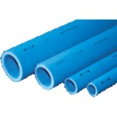
PP ( polypropeen ) : applications
Distribution cold drinking water
Compressed Air

Slide 15
PP : diameters
16 mm
20 mm
25 mm
32 mm
40 mm
50 mm

Slide 16
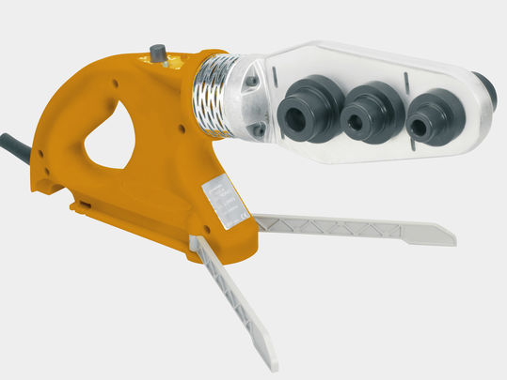
PP : connection techniques
Welding PP

Slide 17
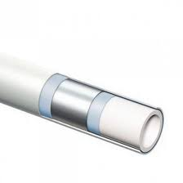
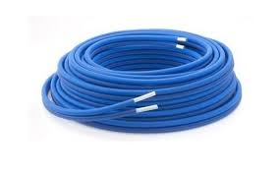
Multilayer pipe

Slide 18
Multilayer pipe : applications
Distribution of cold drinkingwater
Distribution of warm drinkingwater
Central heating tubes

Slide 19
Multilayer pipe : diameters
12 mm
16 mm
20 mm
26 mm
32 mm

Slide 20
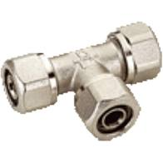
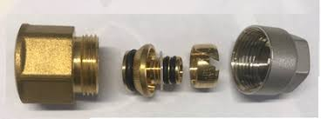
Multilayer pipe : connection techniques
Mechanical connection

Slide 21
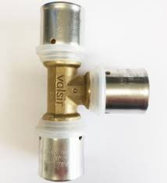
Multilayer pipe : connection techniques
Press connection

