Slide 1



Materials and installation technology for central heating
Hydraulic systems
Field | Central heating
Chapter | Materials and installation Technology for central heating
Subtitle | Hydraulic systems

Slide 2
Four systems ( wich could be combined ) :
Open system
Closed system ( expansion tank )
Natural circulation
Forced circulation ( pump )

Slide 3
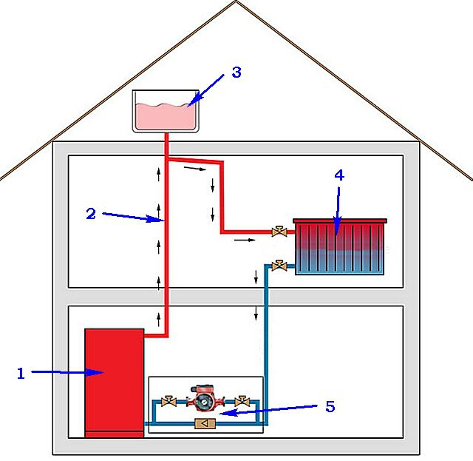
Open system
1 Boiler central heating
2 Rising pipe
3 Open expansion tank
4 Radiator
5 Circulation pump

Slide 4
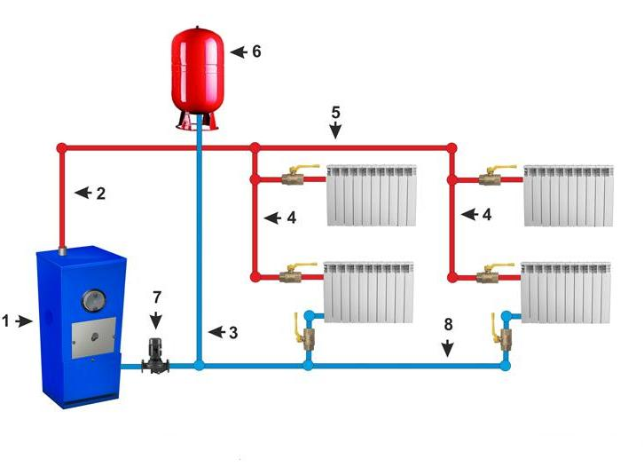
Closed system

Slide 5
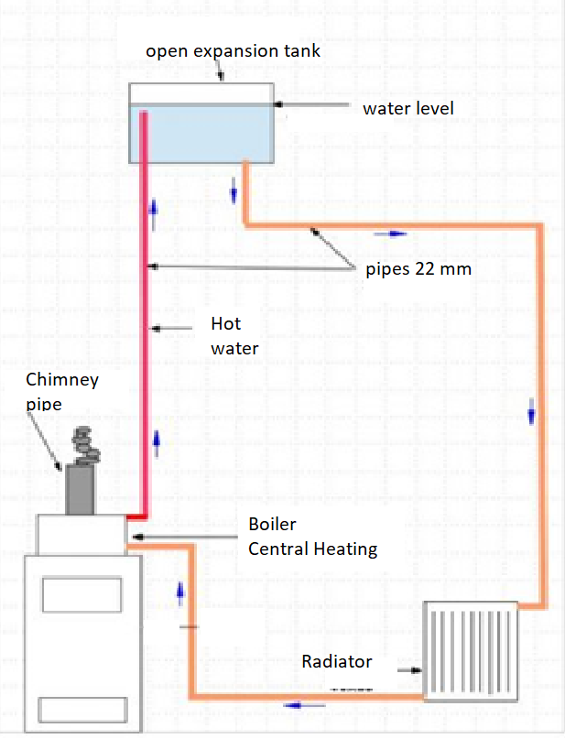
Natural circulation
In natural circulation there is no pump, the hot water rises and the cold water is going down.

Slide 6
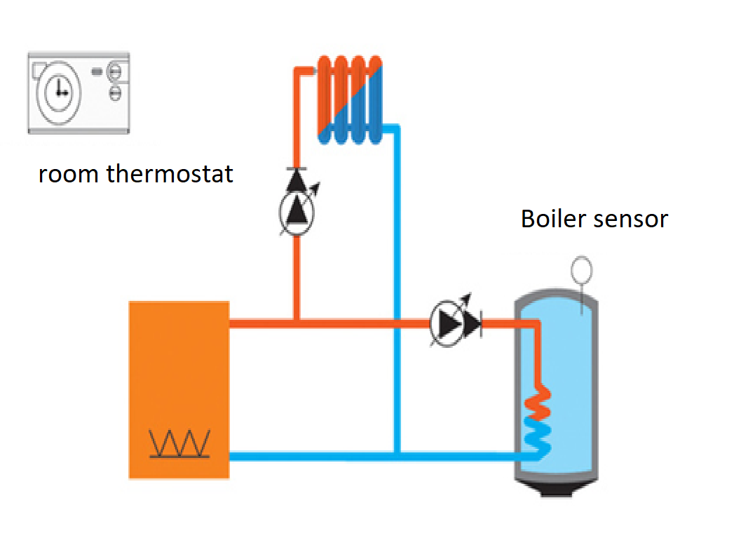
Forced circulation
Forced circulation is using a circulation pump.

Slide 7
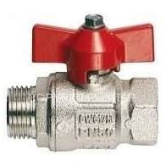

Hydraulic components and symbols
Valve

Slide 8

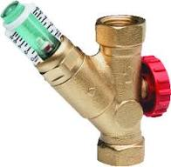
Hydraulic components and symbols
adjustment valve

Slide 9

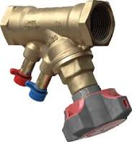
Hydraulic components and symbols
Adjustment valve with measering pressure nipples

Slide 10


Hydraulic components and symbols
Dirt seperator

Slide 11
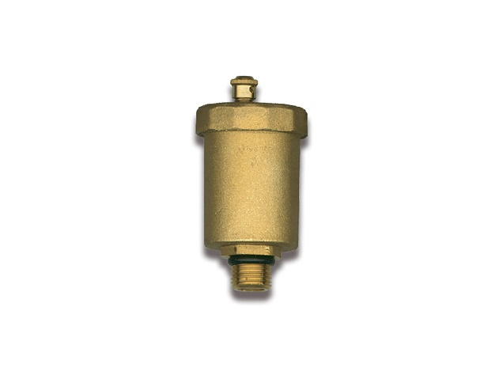
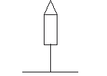
Hydraulic components and symbols
air vent

Slide 12
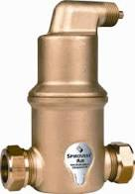
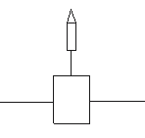
Hydraulic components and symbols
air separator

Slide 13
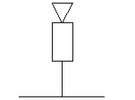
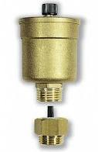
Hydraulic components and symbols
aerator

Slide 14


Hydraulic components and symbols
expansion tank

Slide 15

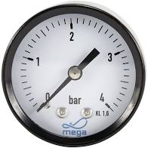
Hydraulic components and symbols
pressure gauge

Slide 16
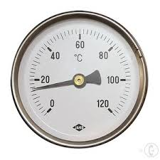
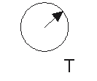
Hydraulic components and symbols
thermo gauge

Slide 17


Hydraulic components and symbols
Circulation pump

Slide 18
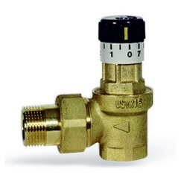

Hydraulic components and symbols
differential pressure regulator

Slide 19
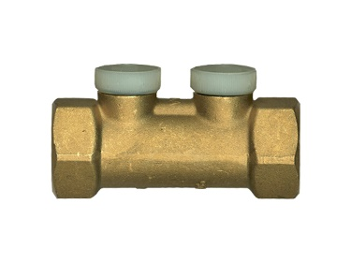

Hydraulic components and symbols
check valve

Slide 20
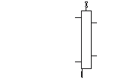
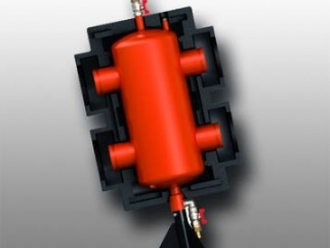
Hydraulic components and symbols
hydraulic seperator

Slide 21
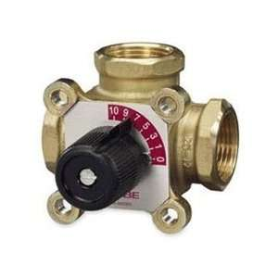

Hydraulic components and symbols
three-way valve

Slide 22
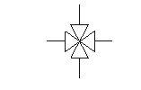
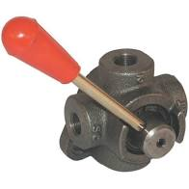
Hydraulic components and symbols
four-way valve

Slide 23
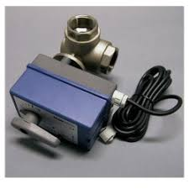

Hydraulic components and symbols
Servo motor

Slide 24

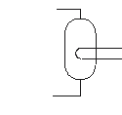
Hydraulic components and symbols
Boiler

Slide 25


Hydraulic components and symbols
Radiator with air vent

Slide 26


Hydraulic components and symbols
Heating boiler

Slide 27
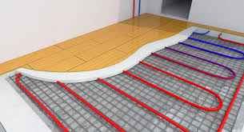

Hydraulic components and symbols
Underfloor heating

Slide 28


Hydraulic components and symbols
Heat pump ( Source : Daikin )

Slide 29
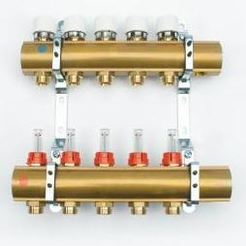
Hydraulic components and symbols
collector central heating ( source : Begetube )

