Slide 1


Field | Central Heating
Chapter | Regulations concerning the annual maintenance of installations
Subtitle | Inspection Certificates

Slide 2
Inspection certificates
According to the applicable laws regarding the maintenance of heating systems, such certificates must certainly mention a number of things.
When drawing up the necessary certificates, we must therefore take this into account. For example, we have different certificates depending on the work delivered.

Slide 3
Types of certificates
Cleaning certificate: is filled in after each maintenance
2) Combustion certificate: is filled in after each intervention on the burner section

Slide 4
Types of certificates
3) Inspection report: before using a new device, an inspection report must be completed. To this end, we look closely at:
- The documentation (must remain with the device)
- The boiler and burner are checked
- The ventilation of the boiler room is checked
- The flue gas exhaust must be installed and connected correctly
- The hydraulic system is connected according to the regulations
- The electrical installation meets all safety requirements
- A combustion certificate has been drawn up
- A final assessment is noted on the report.

Slide 5
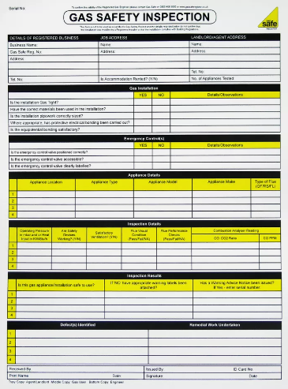
Examples of Certificates

Slide 6
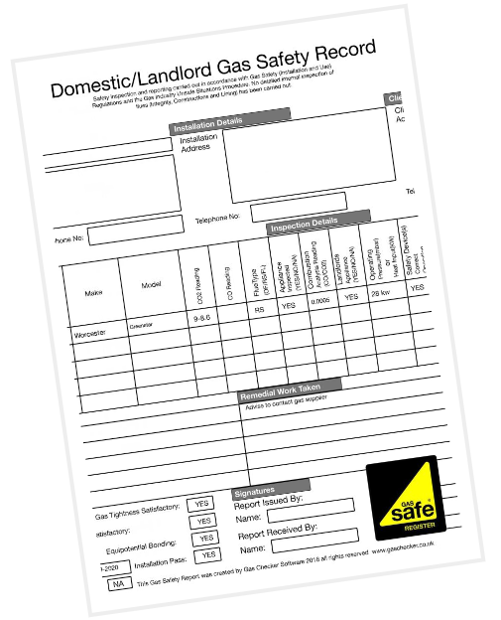
Examples of Certificates

