Slide 1


Field | Central Heating
Chapter | Regulations concerning the annual maintenance of installations.
Subtitle | Number Plate

Slide 2
Number Plate
Inspection certificates must contain all kinds of data. We can ask the customer for the customer's data, but the characteristics of the device can be found on the license plate.
The number plate can tell us a lot about the device. It can look very different depending on the brand and type. There is no standard license plate. However, it is mandatory to note down certain things:
- Brand (manufacturer of the device)
- Model (device type)
- Serial Number
- Power
- Construction Year

Slide 3
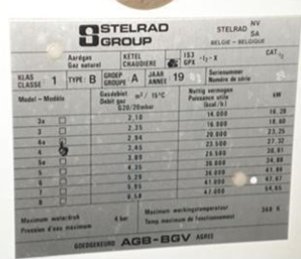
Number Plate
(example 1)
- Brand: Stelrad NV
- Model: 4
- Construction Year: 1983
- Gas flow rate: 3,45 m³
- Power: 27,32 kW

Slide 4
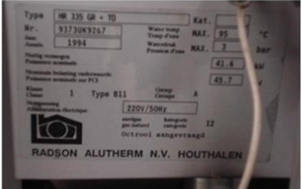
Number Plate
(example 2)
- Brand: Radson Alutherm NV
- Model: HR 335 GR + TO
- Construction Year: 1994
- Power: 45,7 kW
- Useful power 41,6 kW

Slide 5
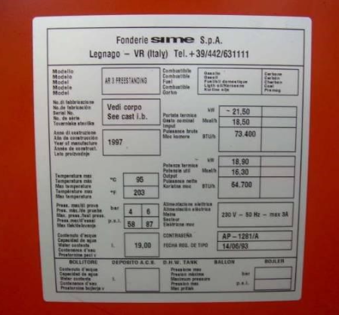
number Plate
(example 3)
- Brand: Sime S.p.A.
- Model: AR 3 freestanding
- Construction Year: 1997
- Power: 21,5 kW
- Useful power 18,90 kW
- Gas flow rate: 3,45 m³

