Slide 1


Field | Central Heating
Chapter | Heating Theory & Heating Techniques
Subtitle | Advantages & Disadvantages of Underfloor heating

Slide 2

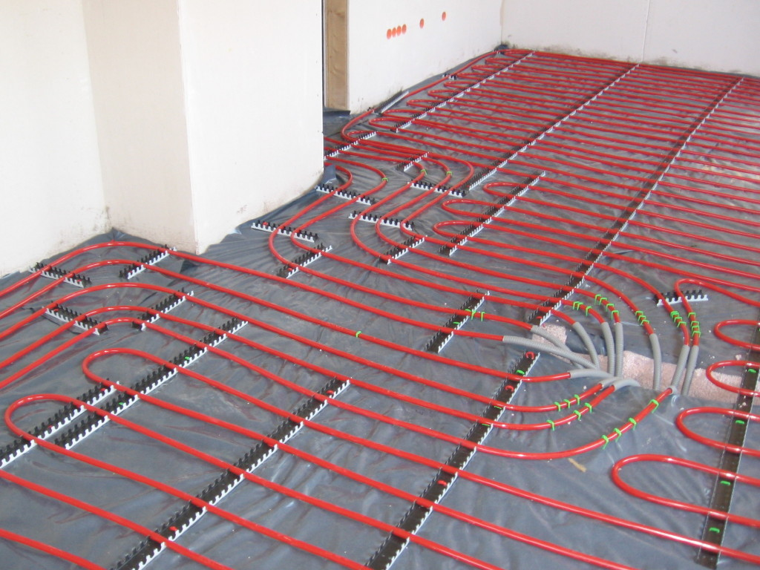
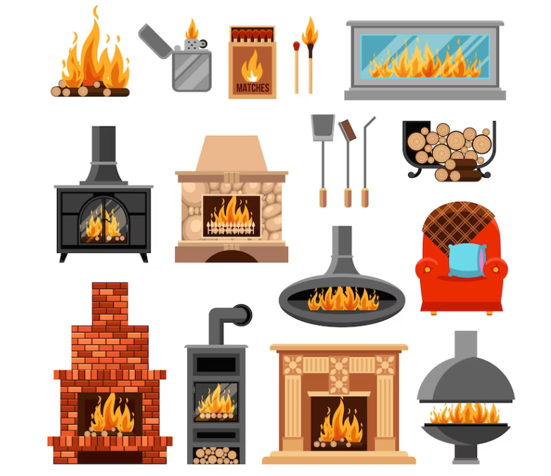

Underfloor Heating
A heating technique that combines cost-effectiveness and thermal comfort is underfloor heating. Through the use of a system of pipes set into the floor, hot water between the temperatures of 35°C and 45°C is circulated, thus turning the floor into a giant radiator. Without generating significant air currents, the heat is transferred from the floor to the surrounding area via radiation, maintaining a consistent temperature distribution from the ground to the ceiling.

Slide 3


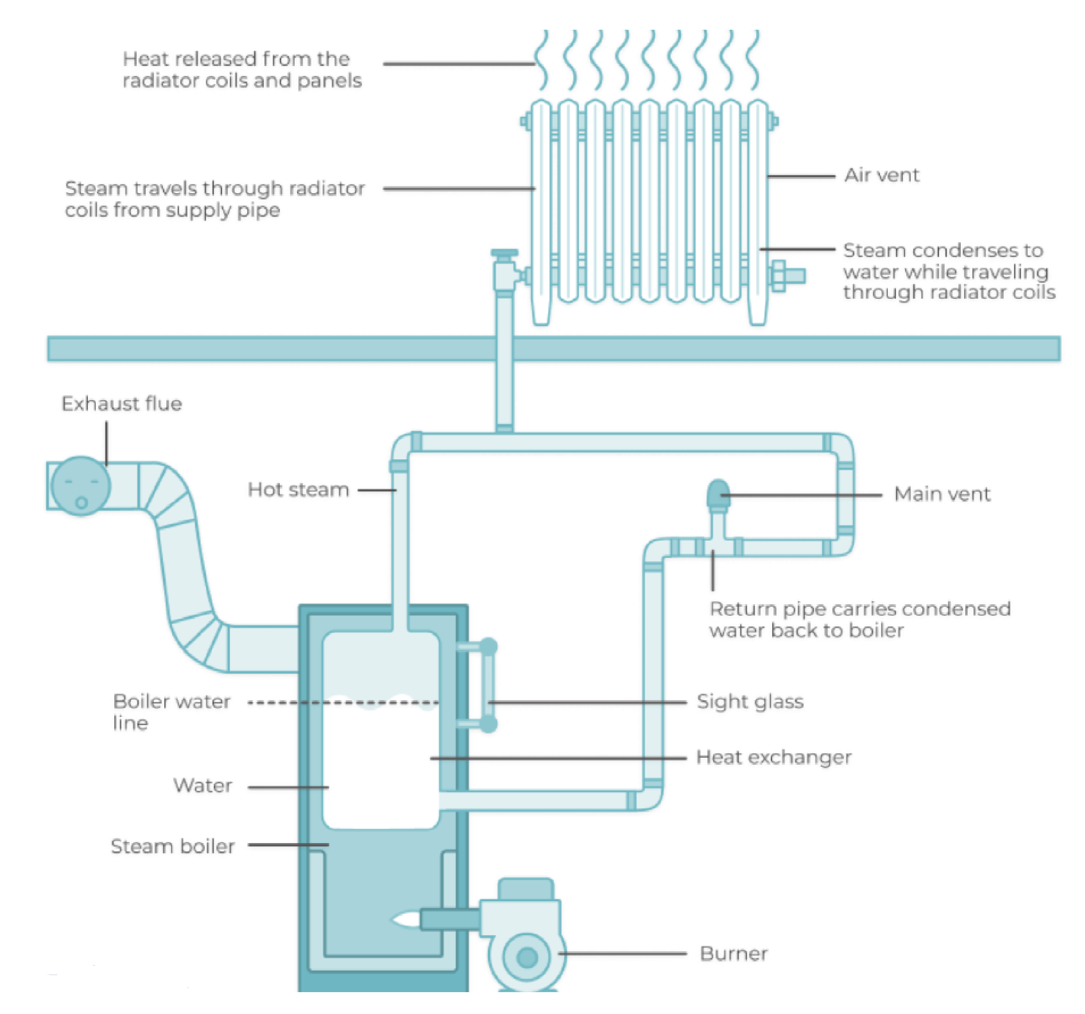
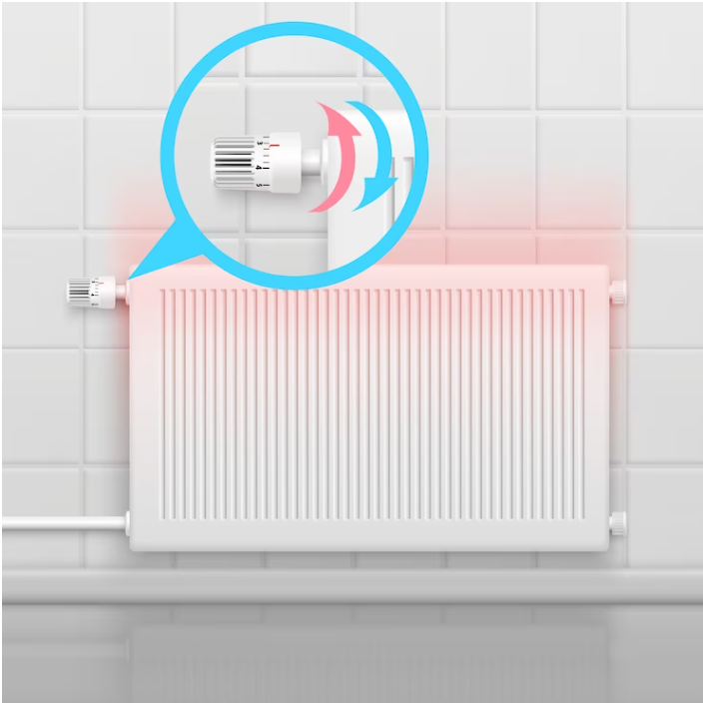

Thermal Comfort and Healthy Living Environment: A comfortable living space free from cold patches is created with underfloor heating, which guarantees an even distribution of heat across the floor. This technology provides a cooler head and warm feet—the perfect combination for human physiology—by achieving optimal temperature stratification. Because underfloor heating preserves air humidity and reduces the movement of dust and allergens, it maintains a healthier interior environment than traditional heating systems.
Energy Efficiency and Cost Savings: Lower operating temperatures (between 35°C and 45°C) greatly minimize heat loss, which results in significant energy savings. Because of the system's efficiency, less energy is used, which results in cheaper heating costs. Long-term cost-effectiveness is ensured by the shorter payback period for the original installation investment due to the lower operating and maintenance costs.
Space Utilization and Aesthetics: Underfloor heating increases usable area by doing away with large radiators, giving designers and furniture arrangers more freedom. This offers total flexibility in creating sophisticated architectural designs without sacrificing style. Furthermore, the lack of exposed hot surfaces improves safety, especially in homes with small children and senior citizens, as hot radiators do not represent a risk of burns or other harm.

Slide 4
ADVANTAGES OF UNDERFLOOR HEATING
4. Environmental Friendliness:Compared to conventional systems, underfloor heating uses water at a lower temperature, which saves energy and lessens its environmental impact. The system's sustainability is further increased by its interoperability with renewable energy sources like heat pumps, geothermal systems, and solar panels. By reducing dependency on fossil fuels, this integration helps to create a heating solution that is more environmentally friendly.
5. Versatile Application and Combination:Underfloor heating has a wide range of applications and is appropriate for a variety of building types, including residential, commercial, and industrial spaces. It offers adaptable heating solutions catered to particular demands when combined with other heating systems, such as fan coils or radiators, for periodic heating. Because of its versatility, underfloor heating can be used to accommodate a wide range of architectural installations
6. Cooling Capabilities : If an underfloor heating system has a cooling component, like a heat pump or chiller, it can also be utilized for summertime cooling. With its dual functionality, you can manage the climate all year round and feel more comfortable in any weather. The low running costs and silent cooling mechanism provide a quiet and comfortable environment during the warmer months. It also doesn't produce air drafts.

Slide 5
Disadvantages of Underfloor Heating
1. Installation Costs and Complexity: Because underfloor heating requires intricate installation, particularly for water-based systems, the initial cost of installing it is much higher than that of typical heating systems. These systems are more costly because they demand high labor and material expenditures. Because it frequently requires cutting channels into the existing floor or increasing the floor level, retrofitting an old building can be very expensive and disruptive. For large-scale restorations or new constructions when the flooring are being renovated anyhow, underfloor heating becomes a more attractive alternative.
2. Slow Response Time :The response time of underfloor heating systems is slower than that of conventional radiators. It takes longer for heat to go through the layers and heat the space because the heating elements are buried beneath the floor. Due to its sluggish warm-up, the system is less responsive to abrupt temperature fluctuations or the requirement for rapid heating and must be turned on well in advance to reach the appropriate temperature. As a result of this inertia, the system may use more energy because it must operate constantly to ensure comfort.
3. Repair and Maintenance Challenges: Underfloor heating system repairs can be expensive and time-consuming. In the event of an issue, lifting is necessary to reach the embedded pipes or electric mats, which could cause damage to the floor and cause a great deal of inconvenience and expense. Because of this, hiring knowledgeable and skilled installers is essential to reducing the possibility of installation mistakes. In comparison to conventional heating systems, the system may require more involved and intrusive repairs, yet routine maintenance is still necessary to guarantee optimal performance.

Slide 6
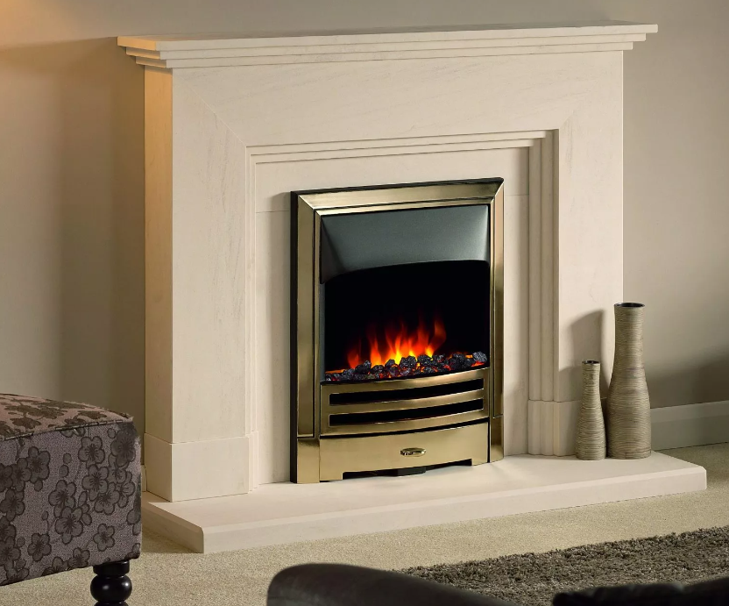
Disadvantages of Underfloor Heating
4. Health Concerns : If underfloor heating is not correctly managed, there may be health risks. Uneven temperatures can result from shoddy installation or excessive heating, producing "warm-cold-cold" effects in various parts of the room. This uneven warmth can cause veins and circulation to become stressed, especially in people who already have circulatory problems. In order to prevent the health concerns that come with prolonged exposure to high temperatures, it is crucial to maintain stable and moderate temperatures.
5. Longer Installation Period: Underfloor heating system installation typically requires more time than traditional heating techniques. The requirement for exact positioning of heating elements, pipelines, or electric mats beneath the floor, together with other procedures like screeding or applying self-leveling solution, is the reason for this prolonged installation time. Timelines for renovations or construction may be impacted, therefore careful planning is needed to prevent delays.
6. Suitability for Older Buildings : Extremely old buildings with solid brick floors and walls might not be the best candidates for underfloor heating. The increased heat retention of these buildings may cause problems for underfloor heating systems operating efficiently. Furthermore, it can be difficult and expensive to retrofit underfloor heating in these kinds of buildings, which makes it less feasible for older structures without major modifications.

Slide 7


Types of Underfloor Heating
Hydraulic Systems:
Operation: These systems circulate hot water through specialized plastic pipes embedded in the floor.
Applications: Suitable for a wide range of building types, from residential homes to large industrial facilities.
Electric Systems:
Operation: These systems use electric heating cables or mats placed beneath the floor to generate heat.
Applications: Often used in smaller areas or where a quick and simple installation is required

Slide 8
References
Underfloor heating pipes.jpg. (2006, June 20). Retrieved from Wikimedia Commons:https://commons.wikimedia.org/wiki/File:Underfloor_heating_pipes.jpg
The pros and cons of underfloor heating. (n.d.). Retrieved from Gregory Heating, Electrical and Renewable Energy: https://www.gregorheating.co.uk/pros-cons-underfloor-heating/
Jones, G. ( 2023, June 22). Pros and Cons of Underfloor Heating. Retrieved from Underfloor Heatinh Trading Supplies: https://www.underfloorheatingtradesupplies.co.uk/blog/pros-and-cons-of-underfloor-heating/
6 Pros and Cons of Underfloor Heating You Didn’t Know. ( 2022, June 22). Retrieved from Warmup: https://www.warmup.co.uk/blog/pros-cons-underfloor-heating
Hedges, C. (2023, August 15). What are the pros and cons of underfloor heating? Retrieved from Thermo Sphere: https://www.thermosphere.com/blog/the-pros-and-cons-of-underfloor-heating
Flores, P. (2022, November 17). Underfloor heating pros and cons. Retrieved from Which?: https://www.which.co.uk/reviews/underfloor-heating-systems/article/underfloor-heating-pros-and-cons-a8GBb3u9pXxj
UNDERFLOOR HEATING. (2022, February 3). Retrieved from AK Papaplast: https://palaplast.com/2022/02/03/underfloor-heating/
Traditional Underfloor Heating Systems. (n.d.). Retrieved from Hercuglas Renewables: https://hercuglas.ie/traditional-underfloor/
HYDRONIC UNDERFLOOR HEATING SYSTEM. (n.d.). Retrieved from KlimaControl Heating 7 & AirConditioning: https://klimacontrol.com.cy/index.php?pageid=17&sub_action=details&ItemID=5&l_act=chnglng&lng=1

