Slide 1


Field | Central Heating
Chapter | Heating Theory & Heating Techniques
Subtitle | Ceiling Heating & Wall Heating

Slide 2

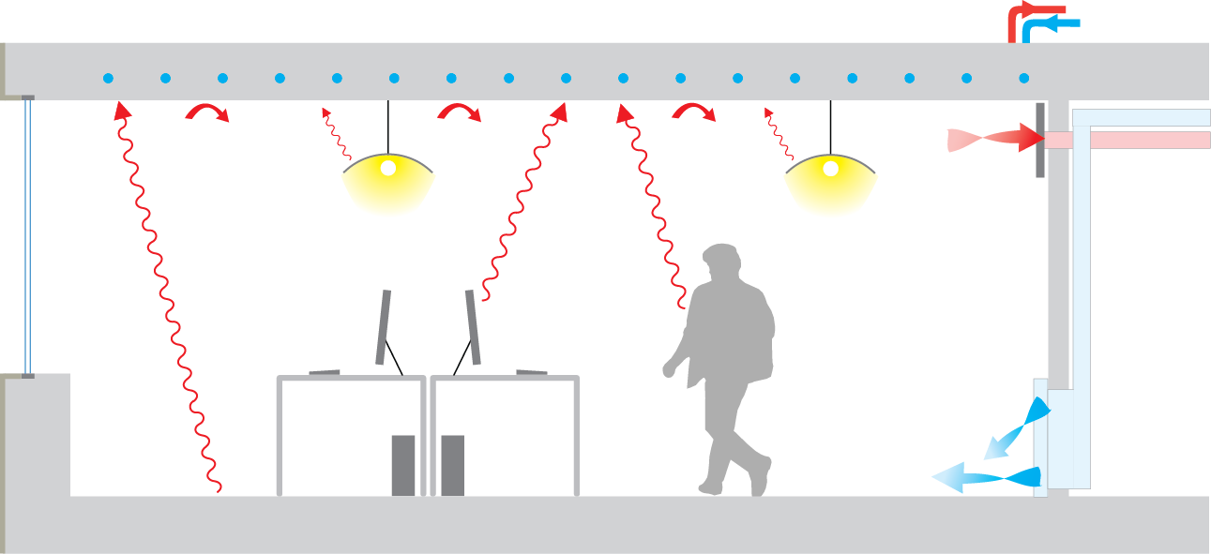

Ceiling Heating
Ceiling heating is a type of heating system where heating elements or radiant panels are installed in the ceiling to provide warmth.
Ceiling heating radiates the room and heats it to a comfortable temperature. It is laid over a large area, which means that it can work with low flow temperatures.
©Center for the Built Environment at UC Berkeley, ©Caroline karmann. Original uploader was Caroline karmann at en.wikipedia

Slide 3
Advantages of Ceiling Heating
Even Heat Distribution: Similar to underfloor heating, ceiling heating provides even heat distribution across the room. The warm air radiates downward, creating a comfortable and consistent temperature throughout the space.
Space-Saving: Ceiling heating systems do not require additional space on the floor or walls, as the heating elements or panels are installed in the ceiling. This can be beneficial in rooms with limited wall space or specific design requirements.
Energy Efficiency: Ceiling heating can be energy-efficient, especially when using radiant panels. Radiant heat does not rely on air circulation, reducing heat loss and improving energy efficiency. It can also respond quickly, providing near-instant warmth.
Aesthetically Pleasing: Since the heating elements are concealed in the ceiling, ceiling heating systems can provide a clean and unobtrusive appearance. This allows for greater flexibility in interior design and furniture placement.

Slide 4
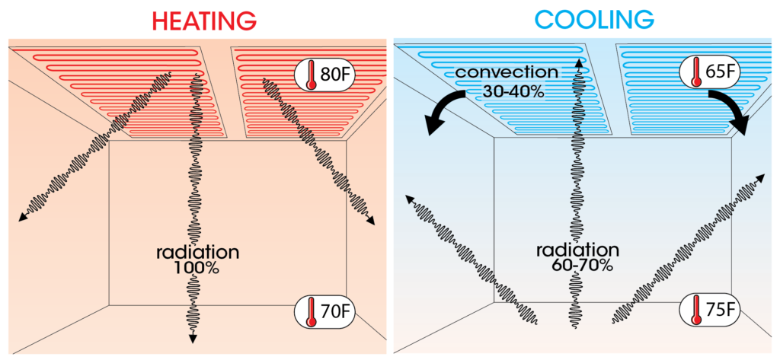
Copyright © Copyright © 2021 codesellsk.shop. Powered by codesellsk.shop

Slide 5


Disadvantages of Ceiling Heating
Installation Challenges: Installing ceiling heating can be more complex compared to other heating systems. It requires professional installation and may involve modifications to the ceiling structure. This can be challenging in existing buildings or during renovation projects.
Limited Cooling Capability: Ceiling heating systems are primarily designed for heating purposes. While some systems can be combined with cooling elements, they may not be as effective in providing cooling compared to dedicated cooling systems like air conditioners.
Heat Accumulation: In rooms with high ceilings, heat can accumulate near the ceiling, leading to temperature stratification. This can result in a warmer upper portion of the room and cooler lower areas, affecting overall comfort levels.

Slide 6
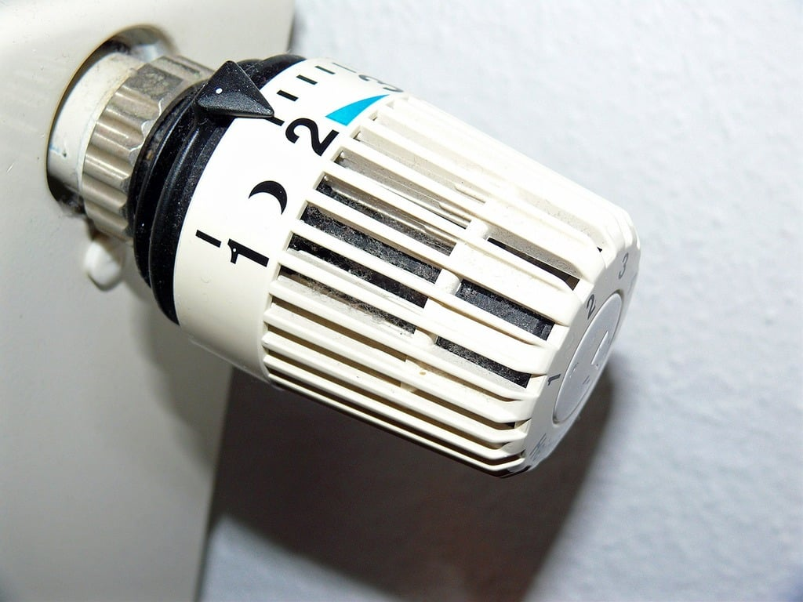
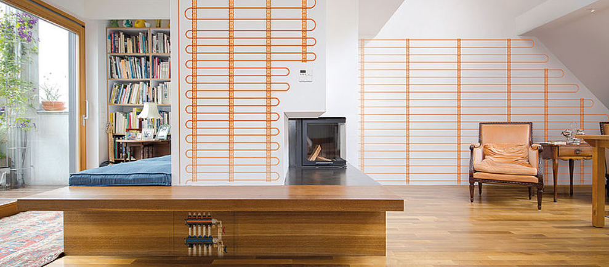
Wall Heating
Wall heating is another type of radiant heating system where heating elements or pipes are installed within the walls to generate heat.
Developed by GetArchive LLC - creator of the public domain search engine, PICRYL.com

Slide 7
Advantages of Wall Heating
Heat Distribution: Wall heating provides radiant heat that is evenly distributed across the room. The warm air radiates outward from the walls, creating a comfortable and cozy environment.
Space-Saving: Similar to ceiling heating, wall heating systems do not occupy floor space or require additional equipment mounted on walls. This allows for greater flexibility in room layout and design.
Quick Response Time: Wall heating can provide near-instant warmth, as the heat is radiated directly into the room. This can be advantageous in situations where quick heating is required.

Slide 8
Disadvantages of Wall Heating
Installation Challenges: Installing wall heating systems can be more challenging compared to traditional heating systems. It involves professional installation and modifications to the walls, which can be disruptive and time-consuming.
Limited Cooling Capability: Similar to ceiling heating, wall heating systems are primarily designed for heating purposes. Cooling capabilities may be limited, and separate cooling systems may be needed to provide adequate cooling during warmer months.
Affects Wall Coverings: Wall heating requires the installation of heating elements or pipes within the walls, which can affect wall coverings such as wallpapers or paint. It may require careful selection of wall coverings or additional considerations during installation.

Slide 9
Ceiling heating and wall heating similarities
Radiant Heat Distribution: Both ceiling heating and wall heating systems utilize radiant heat to warm up a space. Instead of relying on air circulation or convection, they emit heat directly from the heating elements or pipes, creating a comfortable and even temperature in the room.
Space-Saving: Both ceiling heating and wall heating systems do not require additional equipment or radiators taking up floor space. The heating elements or pipes are integrated into the ceiling or walls, allowing for greater freedom in room design and furniture placement.
Energy Efficiency: Both systems can offer energy-efficient heating solutions. Radiant heat reduces heat loss and can operate at lower temperatures compared to forced-air systems, resulting in potential energy savings.

Slide 10
Ceiling heating and wall heating similarities
Comfort: Ceiling heating and wall heating systems provide a comfortable and cozy environment by ensuring an even distribution of heat throughout the space. They eliminate cold spots and drafts often associated with other heating systems, enhancing overall comfort levels.
Design Flexibility: Both systems offer design flexibility since the heating elements or pipes are concealed within the ceiling or walls. This allows for unobstructed wall space, offering more freedom for interior design and decoration choices.

Slide 11
Ceiling heating and wall heating similarities
Energy Efficiency: Both systems can offer energy-efficient heating solutions. Radiant heat reduces heat loss and can operate at lower temperatures compared to forced-air systems, resulting in potential energy savings.
Comfort: Ceiling heating and wall heating systems provide a comfortable and cozy environment by ensuring an even distribution of heat throughout the space. They eliminate cold spots and drafts often associated with other heating systems, enhancing overall comfort levels.
Design Flexibility: Both systems offer design flexibility since the heating elements or pipes are concealed within the ceiling or walls. This allows for unobstructed wall space, offering more freedom for interior design and decoration choices.

