Slide 1


Field | Central Heating
Chapter | Insulation & Ventilation
Subtitle | Ventilation in Boiler Rooms

Slide 2

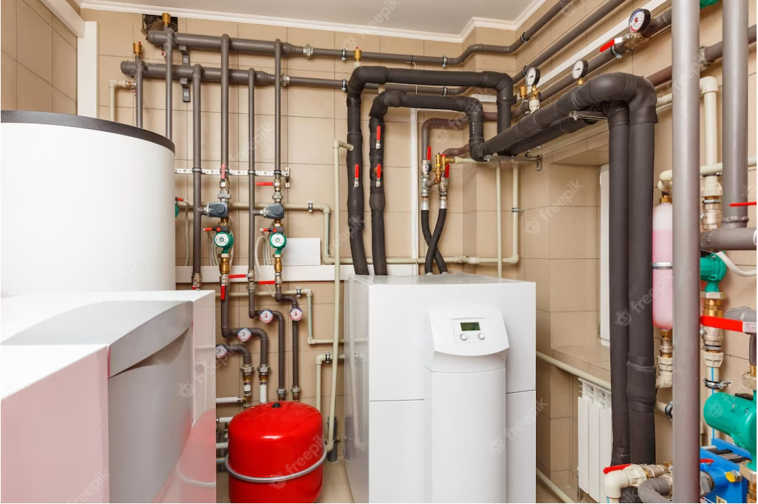
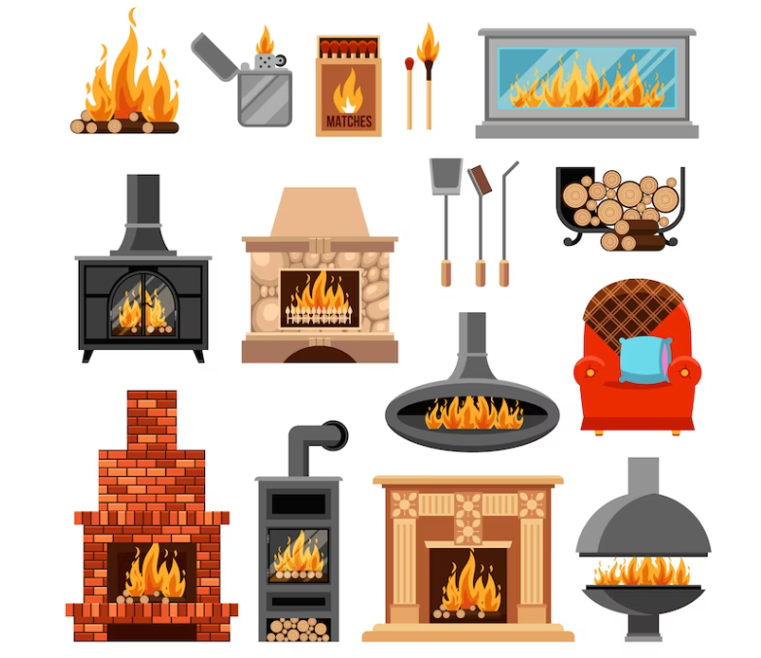

boiler rooms
Mechanical rooms and boiler plants are engineered to meet these make-up air requirements by having proper ventilation along with maintaining the correct free space.
This means that using a boiler room for storage is not among the best practice. Boilers that are being starved of air requirements will rapidly develop combustion problems and can lead to serious fireside problems along with increased fuel consumption.

Slide 3
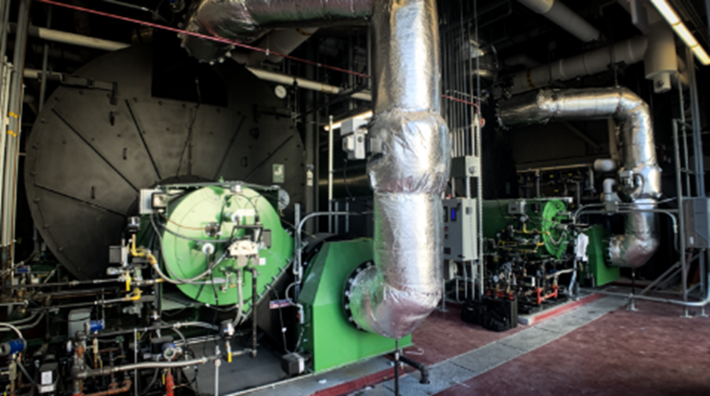
the reasons why ventilation is necessary in boiler rooms
Combustion Air Supply: Boilers require a sufficient supply of fresh air for combustion. Ventilation provides the necessary air intake for combustion, ensuring that the boiler operates efficiently and safely. Without proper ventilation, the boiler may not receive adequate oxygen, leading to incomplete combustion and the potential release of harmful gases like carbon monoxide.
Exhaust Gas Discharge: Boiler combustion produces exhaust gases that need to be safely and efficiently discharged from the boiler room. Ventilation systems help remove and vent out these gases, preventing their accumulation in the room and ensuring proper air quality for occupants.

Slide 4

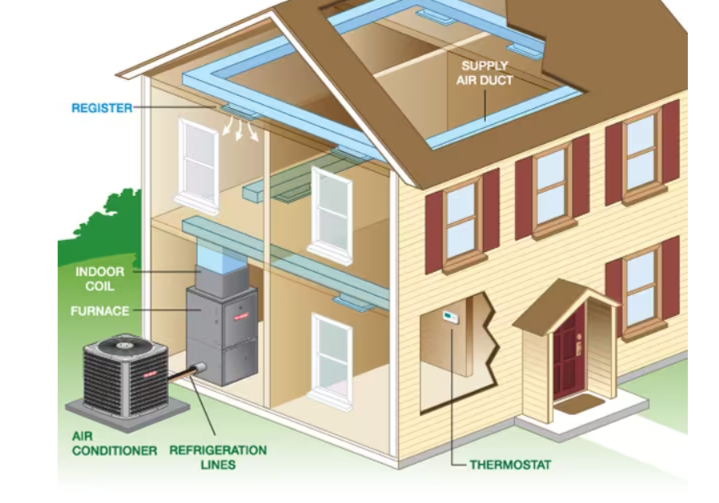

the reasons why ventilation is necessary in boiler rooms
Heat Dissipation: Boilers generate a significant amount of heat during operation. Proper ventilation helps dissipate the heat and maintain a suitable temperature in the boiler room. Without adequate ventilation, the excessive heat buildup can lead to discomfort for personnel, equipment overheating, and potential fire hazards.
Humidity Control: Boiler operation can produce moisture and humidity, particularly in steam-based systems. Ventilation helps control and remove excess humidity, preventing moisture-related issues like condensation, mold growth, and structural damage.
Safety Compliance: Local building codes and regulations often stipulate specific ventilation requirements for boiler rooms. These regulations ensure compliance with safety standards and help protect occupants from potential hazards associated with boiler operation.

Slide 5
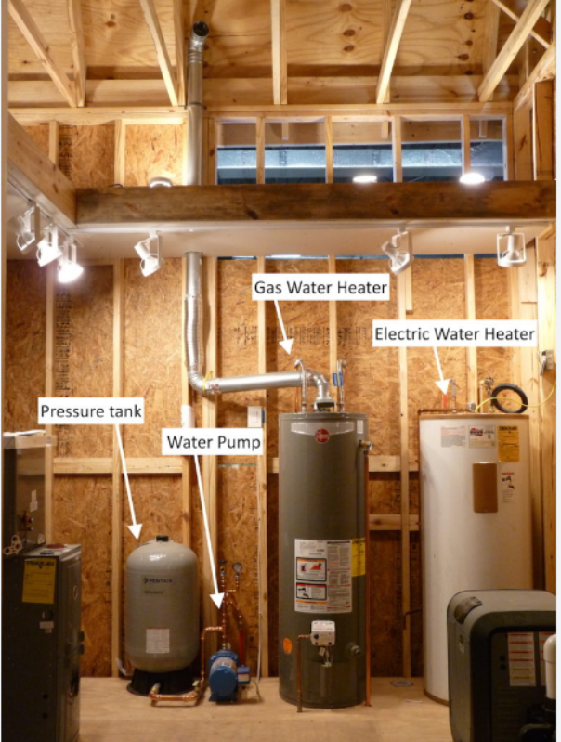
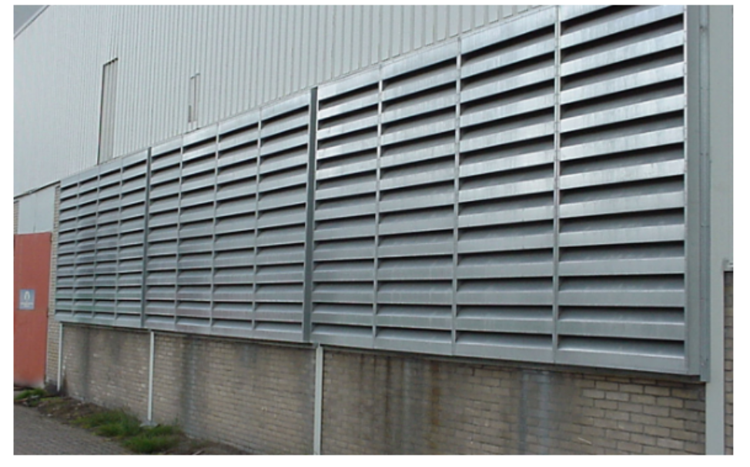
Conclusion
It is crucial to follow local building codes and manufacturer recommendations regarding ventilation requirements for boiler rooms. Adequate ventilation design, including proper air intake and exhaust systems, should be implemented to ensure the safe and efficient operation of boilers and maintain a healthy environment within the boiler room.

