Slide 1


Field | Central Heating
Chapter | Heating Theory & Heating Techniques
Subtitle | Heating appliances

Slide 2

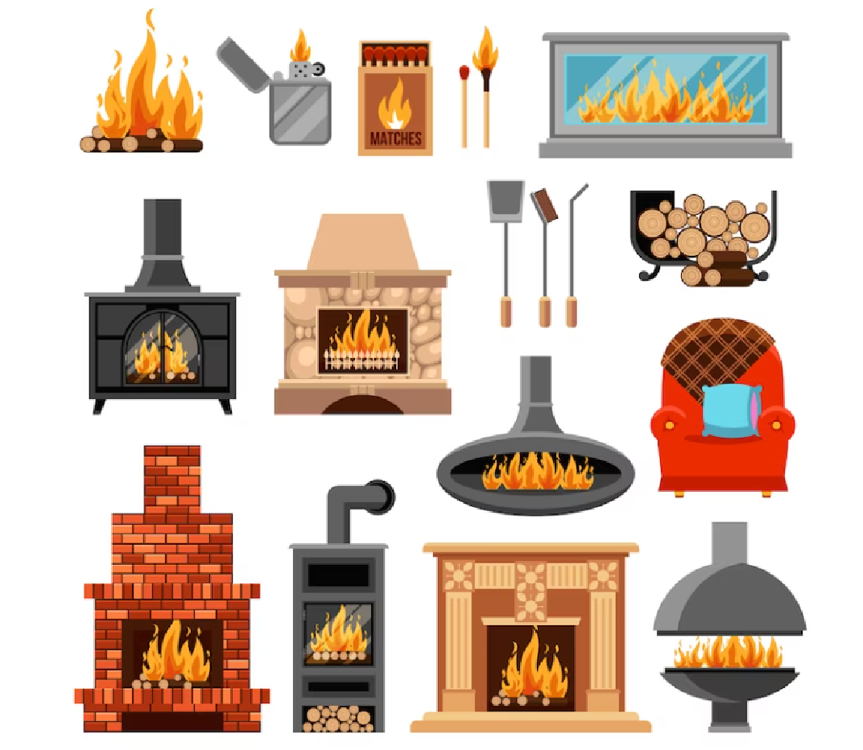


HEATING APPLIANCES
Heating appliances are devices designed to provide warmth and increase the temperature of a space. They can be used for residential, commercial, and industrial purposes.

Slide 3

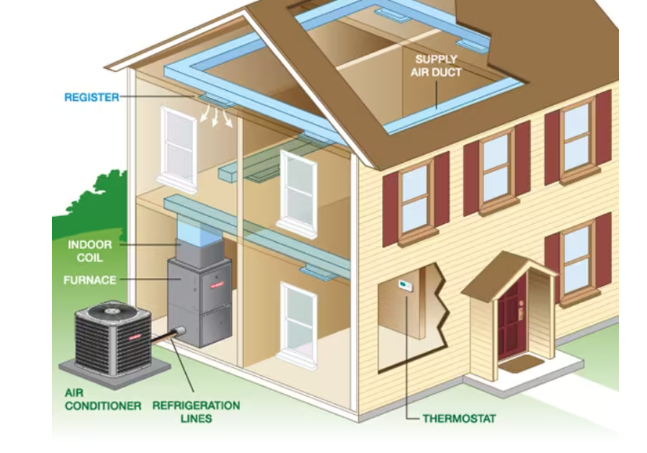

Here are some of the main gas furnace components to know.
Thermostat: A temperature activated switch that signals to the furnace, via a control board, that the home needs heat (indoor temperature dips below a set point). This signal turns on ithe ignition switch in the furnace to light the burners.
Draft Hood/Fan: The fan draws air into the burner assembly where it mixes with gas to create combustion.
Burners: Like a gas grill, furnace burners are a set of tubes through which gas is directed and burned
Heat exchanger: A series of metal tubes that are heated by the burners in order to warm the inside air
Blower: The blower fan directs air coming from return ducts into the hot heat exchanger.
Flue: The flue vent collects the spent combustion gases used to create heat and carries them outside the home.

Slide 4
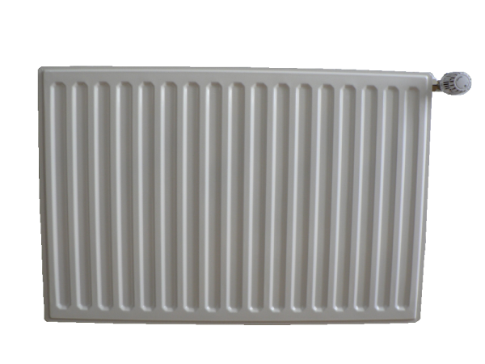
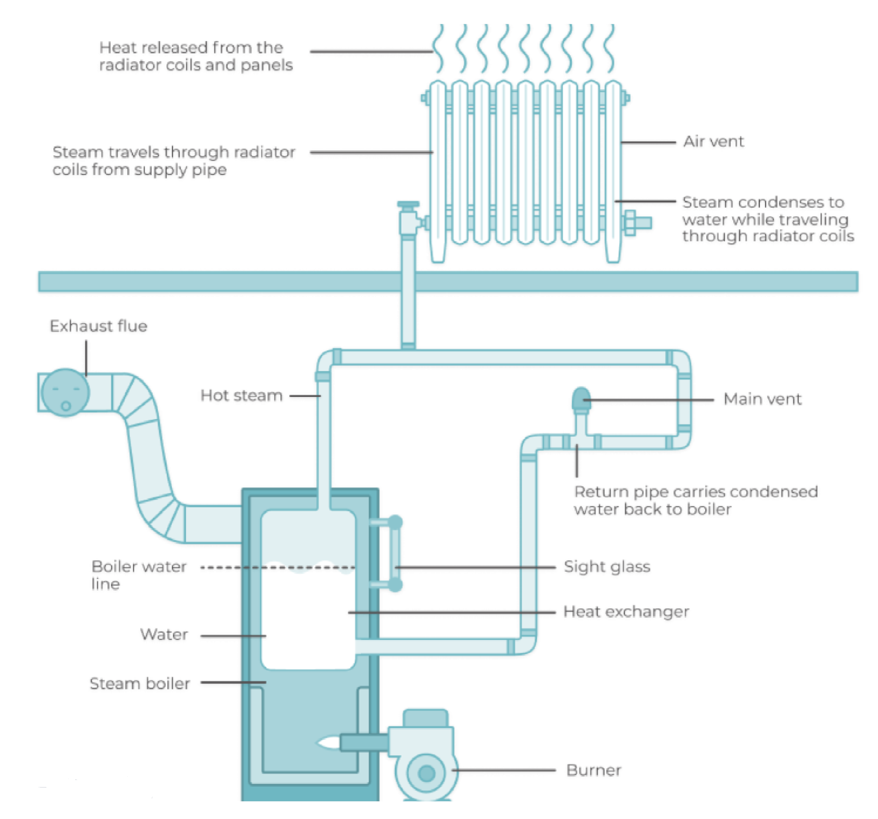
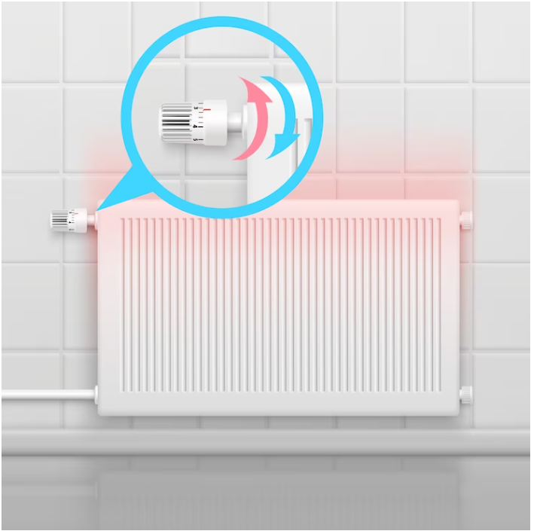
RADIATOR
Radiators work by utilizing convection and radiation to transfer heat from a hot surface to the surrounding air. They are commonly used in heating systems to warm up indoor spaces.
Heating Source: Radiators are connected to a heating system, such as a boiler or a heat pump, which produces hot water or steam.
Heat Transfer: The hot water or steam enters the radiator through an inlet valve and flows through a series of pipes or fins within the radiator.
Convection: As the hot water or steam passes through the pipes or fins, it transfers heat to the metal surface of the radiator.
Radiation: The hot metal surface of the radiator emits infrared radiation, which can directly heat objects and people in the room. This radiation contributes to warming the space.
Heat Distribution: The heated air and radiation from the radiator warm up the surrounding room.
Thermostat Control: The heating system is usually equipped with a thermostat that senses the room temperature.

Slide 5
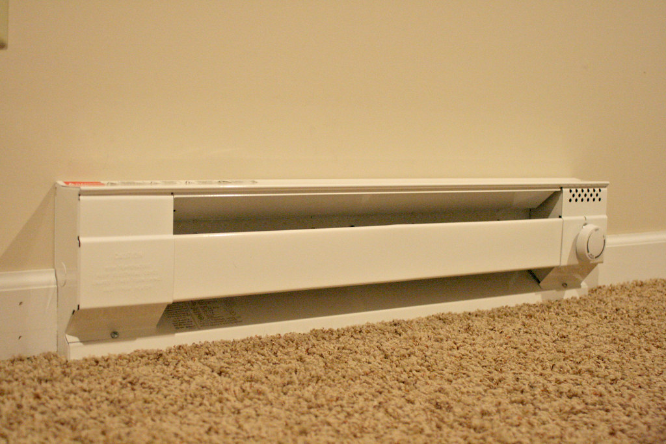
BASEBOARD HEATER
Baseboard heaters are electric heaters installed along the baseboards of a room. They work by convection, where the cool air enters the heater at the bottom, gets heated, and rises, creating a circulation of warm air.

Slide 6
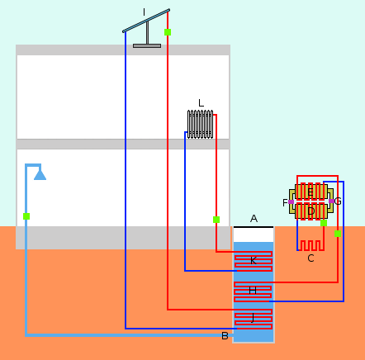
HEAT PUMPS
The heat pump itself consists of a compressor, which moves a refrigerant through a refrigeration cycle, and a heat exchanger, which extracts heat from the source.

Slide 7
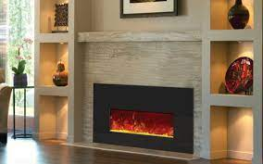
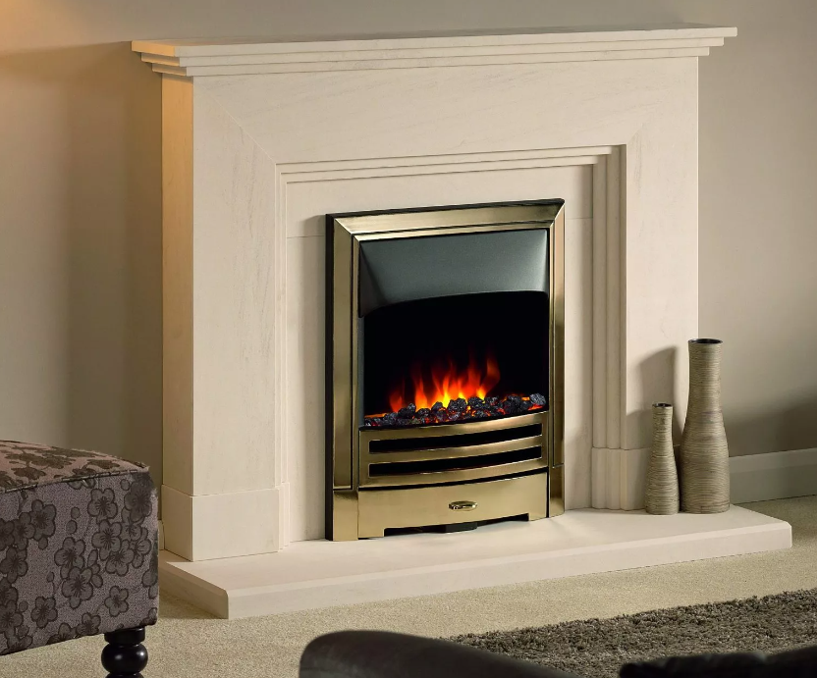
ELECTRIC FIREPLACE
Electric fireplaces provide the visual ambiance of a traditional fireplace while also producing heat. They use electricity to power heating elements and often have built-in fans to distribute warm air.

Slide 8

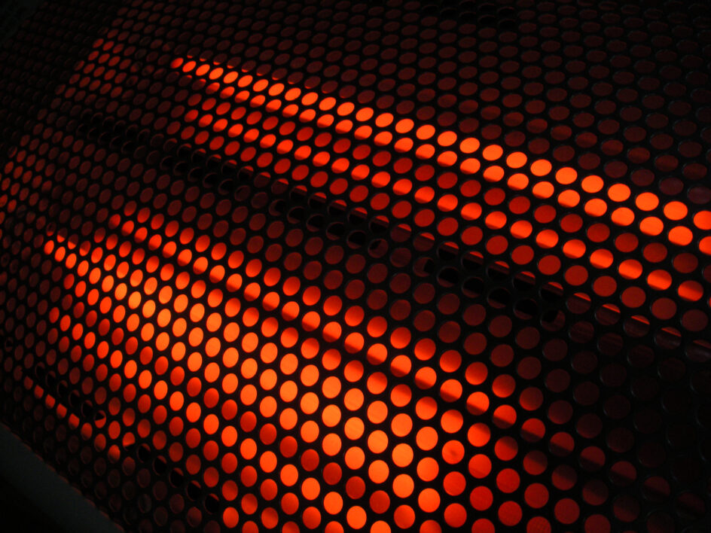

INFRARED HEATER
Infrared heaters emit infrared radiation that directly heats objects and people in its path. They are often used for outdoor spaces, patios, or garages.

Slide 9
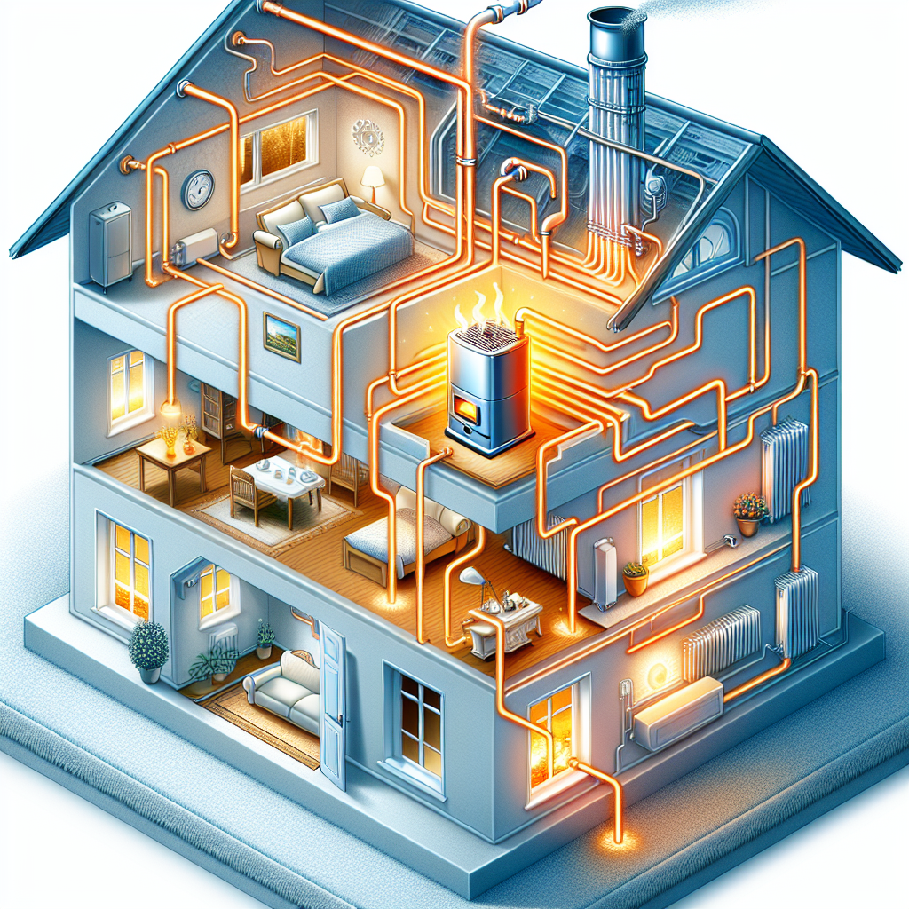
CENTRAL HEATING SYSTEM
This type of heating system is commonly used in larger buildings or homes. It consists of a central heating unit, such as a boiler or furnace, which heats water or air. The heated water or air is then distributed throughout the building via ducts, pipes, or radiators.

Slide 10
References
Daken, A. (n.d.). How Does a Heat Pump Work? Retrieved from Energy Star: https://www.energystar.gov/products/ask-the-experts/how-does-heat-pump-work
What Are the Main Parts of a Furnace? (2022 , September 28). Retrieved from Herchenbach Mechanical Heating and Cooling: https://www.herchenbach.com/blog/what-are-the-main-parts-of-a-furnace
Deziel, C. ( 2024, Febuary 06). Understanding the Different Parts of a Furnace. Retrieved from Family Handiman: https://www.familyhandyman.com/article/parts-of-a-furnace/
Active Indirect Water Heater Diagram.svg. (2010, April 18). Retrieved from Wikimedia Commons: https://commons.wikimedia.org/wiki/File:Active_Indirect_Water_Heater_Diagram.svg
What is Central Heating? Different Central Heating Systems UK Guide. (2024, May 21st). Retrieved from iheat: https://iheat.co.uk/boiler-help/different-types-of-central-heating-systems
Central heating. (2024, May 27). Retrieved from Wikipedia: https://en.wikipedia.org/wiki/Central_heating
How does a radiator central heating work? (2016 , May 9). Retrieved from Central Heating: https://www.central-heating.co.nz/how-does-a-radiator-central-heating-work/
Radiator. (2024, April 21). Retrieved from Wikipedia: https://en.wikipedia.org/wiki/Radiator
Dunn, D. S. (2024, May 31). How Do Radiator Heaters Work? Retrieved from Today's Homeowner: https://todayshomeowner.com/hvac/guides/how-do-radiator-heaters-work/
HEAT PUMP / part 1 - principle of operation and structure. (2023, July 15). Retrieved from hajster: https://hajster.com/en/heat-pump-part-1-principle-of-operation-and-structure-en
Infrared heater. (2024, May 13). Retrieved from Wikipedia: https://en.wikipedia.org/wiki/Infrared_heater

