Slide 1

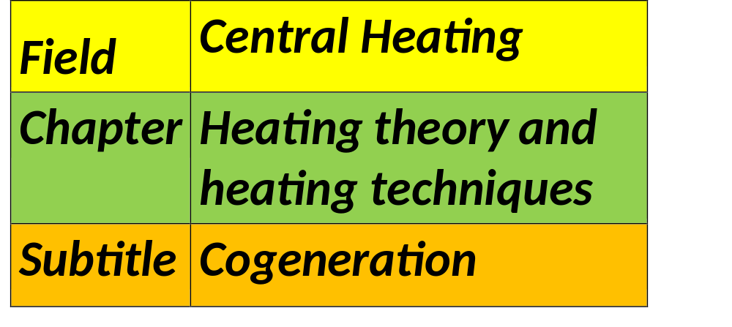


Slide 2
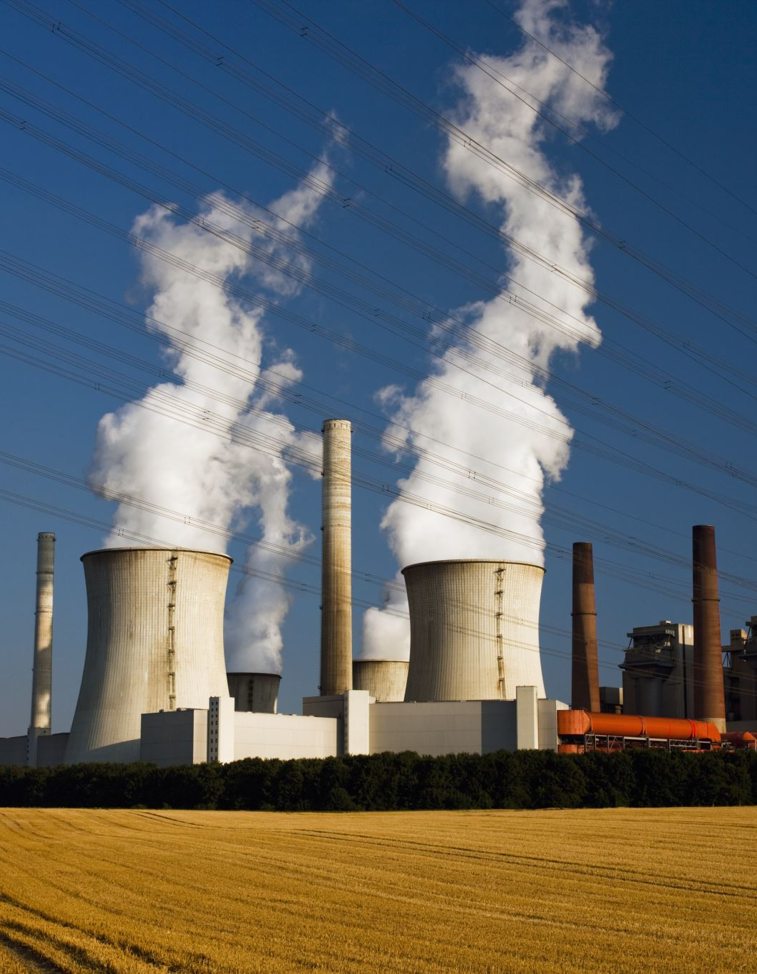
What is Cogeneration?
Cogeneration, also known as combined heat and power, or CHP, is a technique that greatly increases energy efficiency by concurrently producing useable heat and electricity from a single fuel source. By repurposing heat that would otherwise be squandered in traditional power generation, this system maximizes the use of the primary energy input for either heating or cooling.

Slide 3
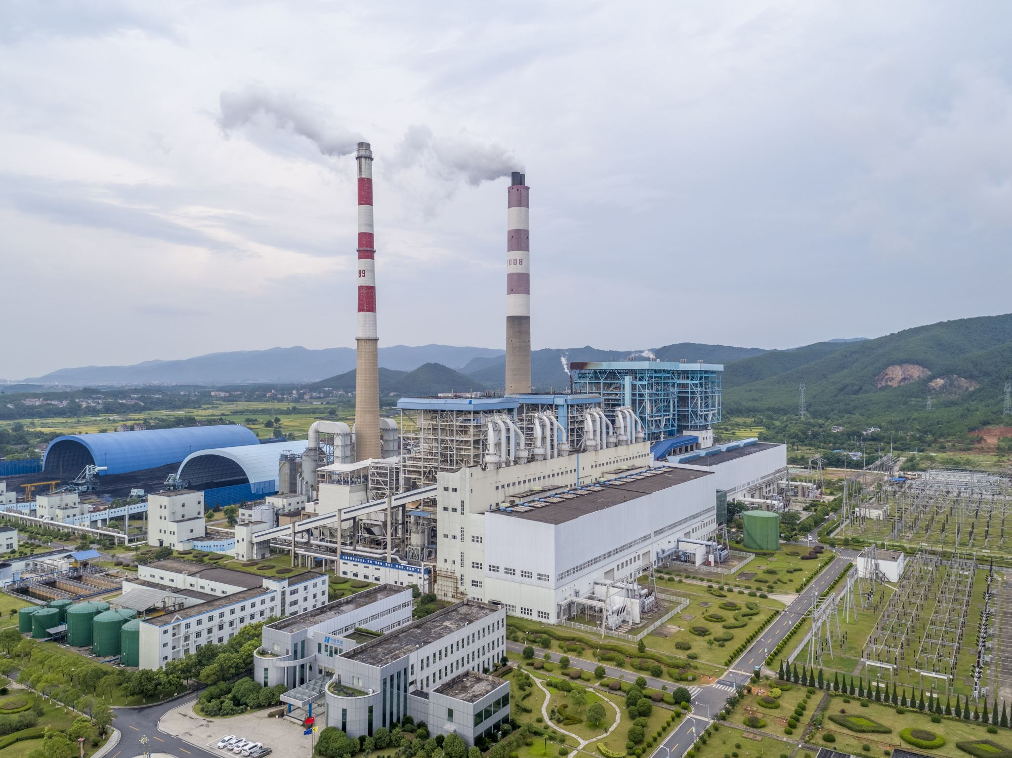


Types of Cogeneration Systems
Cogeneration with Gas Turbines
Fuel: Typically gas from nature.
Procedure: A turbine is powered by combustion gasses to produce energy. Steam or hot water for industrial processes or heating is subsequently produced from the hot exhaust gasses.
Benefits: Excellent dependability and efficiency. Well suited for extensive industrial uses.

Slide 4
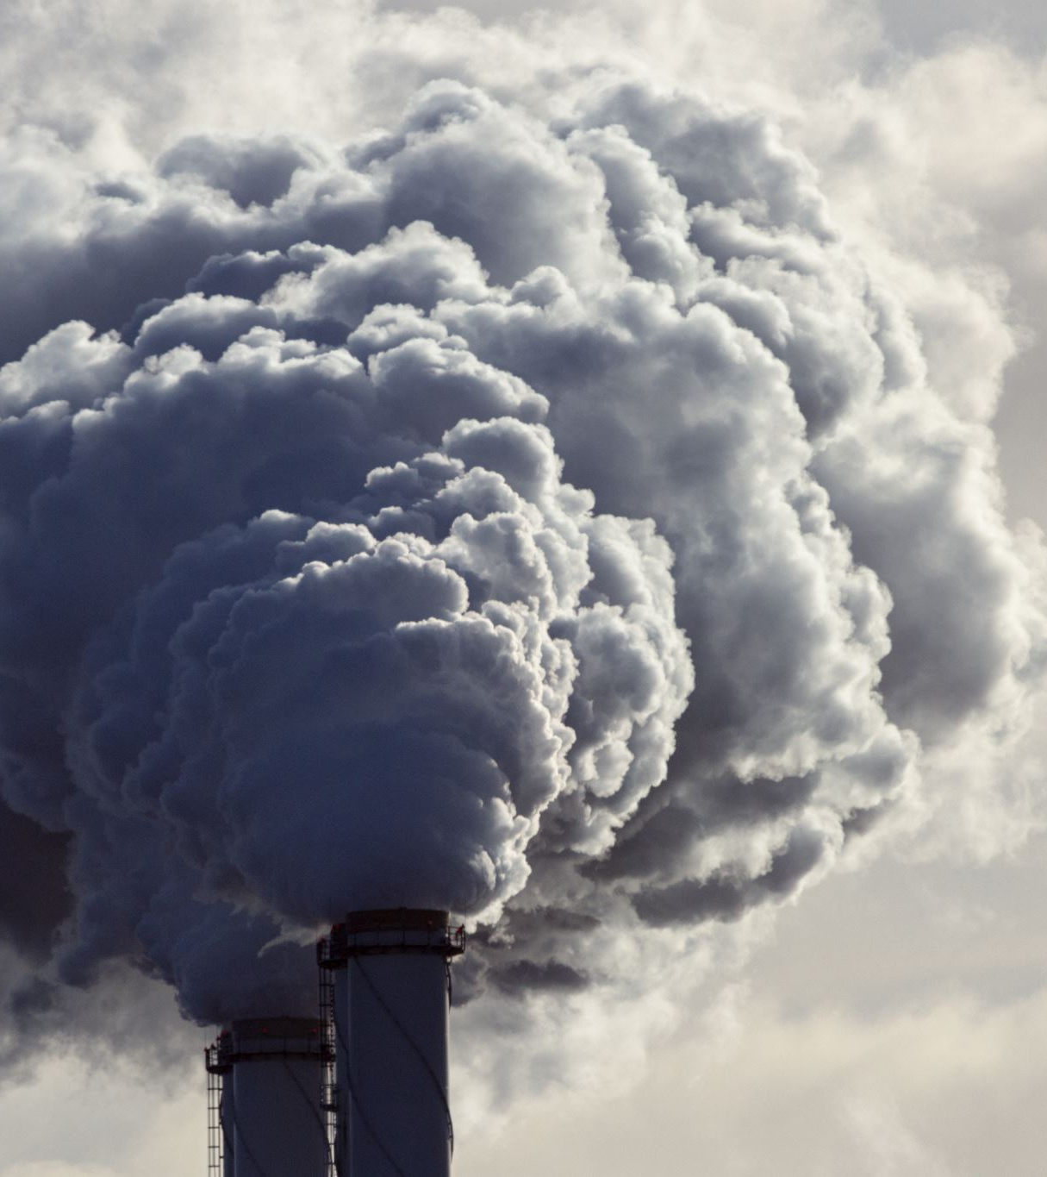


Types of Cogeneration Systems
Cogeneration with Steam Turbines
Fuel: Various fuels, such as biomass, coal, natural gas, or waste from municipal solid waste, can be used.
Method: To produce energy, a steam turbine is powered by high-pressure steam that comes from a boiler. Heat is produced by the low-pressure steam that leaves the turbine.
Benefit: Adaptability in fuel use. Ideal for sectors requiring a lot of thermal energy.

Slide 5
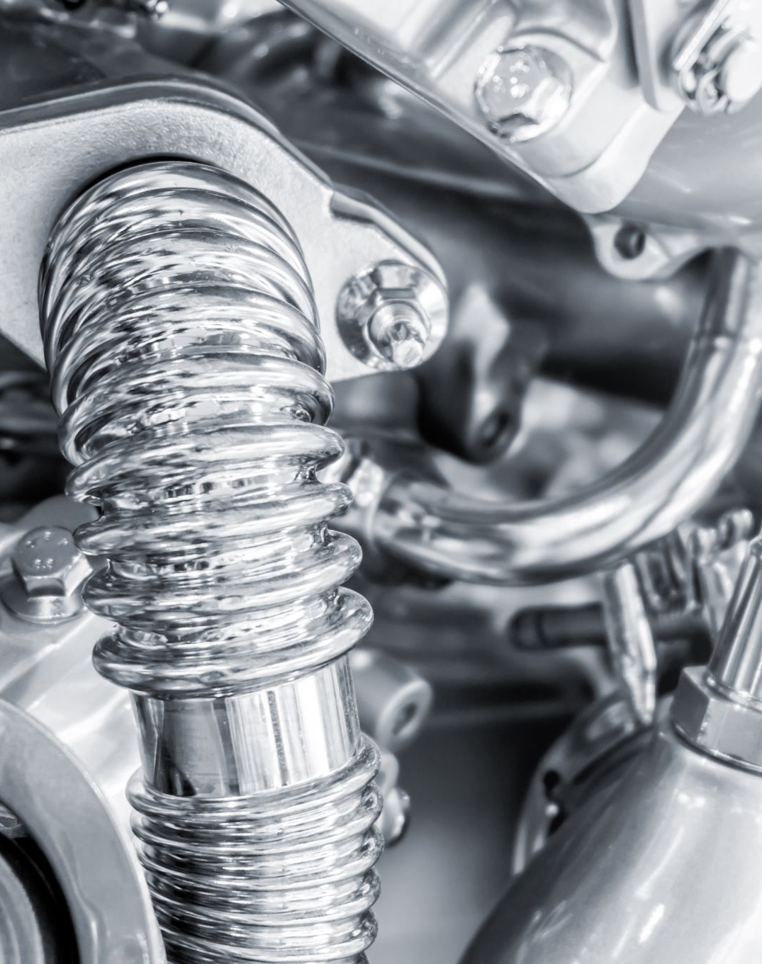


Types of Cogeneration Systems
Utilizing Internal Combustion Engines for Cogeneration
Fuel: A range of fuels, such as diesel, biogas, natural gas, or synthetic gas.
Procedure: Fuel's chemical energy is transformed into mechanical energy by internal combustion engines, which powers an alternator to generate electricity. Heating is accomplished by utilizing waste heat from the cooling system and engine exhaust.
Benefits: Extreme flexibility and efficiency. Ideal for applications on a small to medium scale.

Slide 6
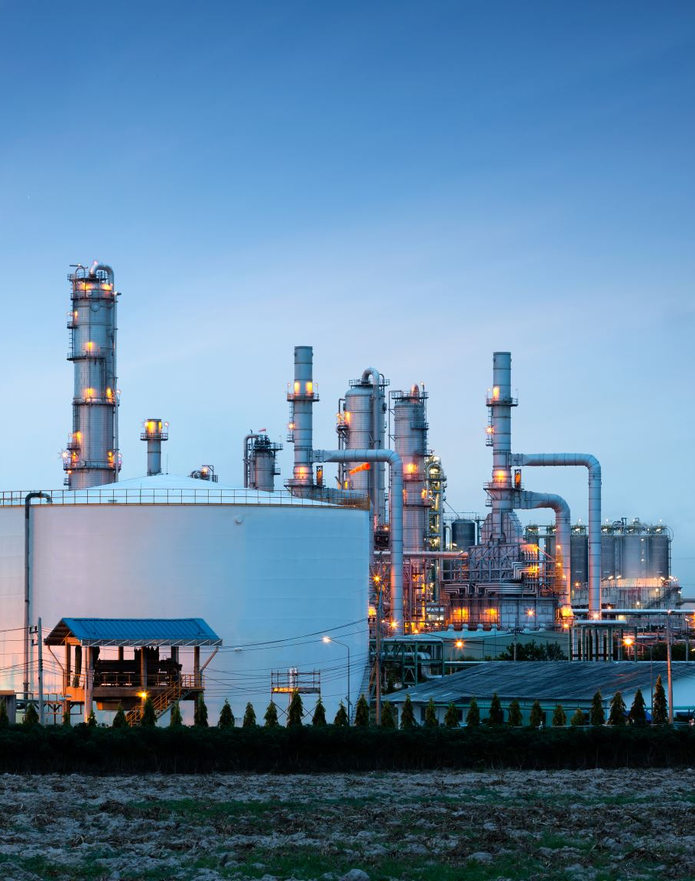
Key Points of Cogeneration:
Efficiency: Compared to standalone heat and electricity generation, which usually has substantially lower efficiency, cogeneration plants can attain energy efficiency levels of about 90%. Conventional power plants frequently release a significant quantity of energy as waste heat, whereas CHP systems reclaim this heat for useful purposes.
Fuel Sources: Natural gas, diesel, biogas, bio-methane, vegetable oil, and biomass are the fuels most frequently utilized in cogeneration systems. The selection of fuel is frequently influenced by factors such as cost, availability, and environmental impact.

Slide 7
Key Points of Cogeneration:
Technology and Uses:
Larger cogeneration systems often use gas and steam turbines to power generators, with the waste heat produced being used for heating.
Internal Combustion Engines: Gas or diesel engines are utilized at smaller scales (usually less than 1 MW) to enable cogeneration for smaller industrial applications or buildings.
Geothermal Power Plants: These facilities use cogeneration to take advantage of low-quality heat for the production of electricity and direct heating.
Absorption Refrigeration: Absorption refrigerators can be used to chill by-product heat, which increases the usefulness of cogeneration systems.

Slide 8
Key Points of Cogeneration:
Economic and Environmental Benefits:
Lower Emissions: Cogeneration lowers greenhouse gas emissions when compared to standalone heat and power generation by increasing fuel usage efficiency.
Cost savings: Lower operating and fuel costs are a direct result of increased efficiency.
Decentralized Energy Production: Decentralized energy production is made possible by small CHP plants, which also improve energy security by lowering the requirement for substantial transmission infrastructure.

Slide 9
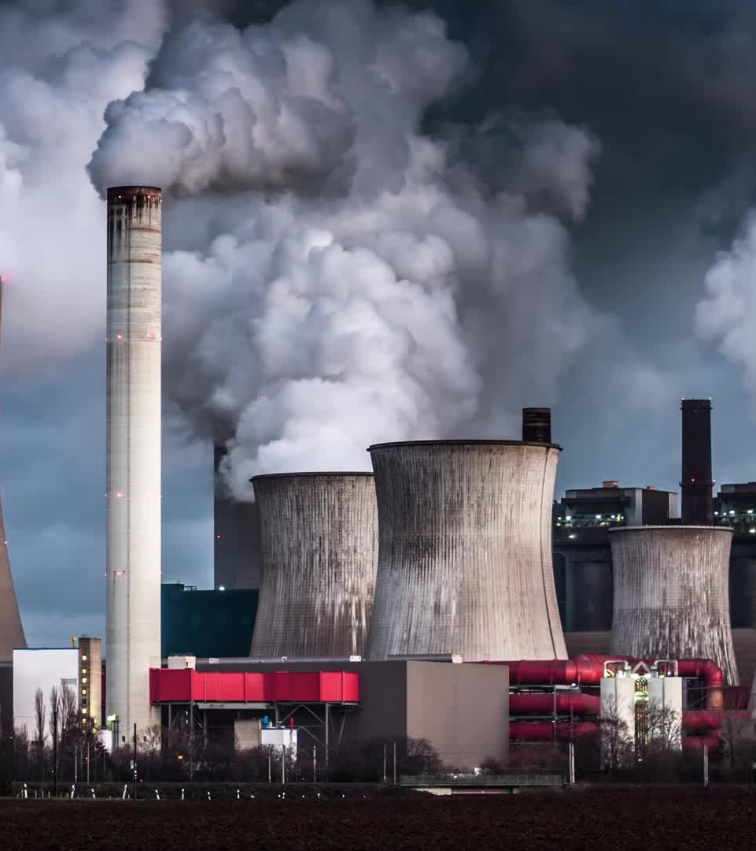
Trigeneration
Trigeneration—also referred to as combined cooling, heat, and power, or CCHP—expands the idea of cogeneration by incorporating the capacity to generate cooling energy alongside heat and electricity. While the fuels and technologies used in this process are similar to those in cogeneration, cooling energy is produced through the use of an absorption refrigerator.

Slide 10
How Trigeneration Works
Principal source of energy
Trigeneration, like cogeneration, can run on a variety of fuels, including biomass, natural gas, LPG, biogas, diesel, and vegetable oil.
Production of Heat and Electricity:
In conventional cogeneration systems, power is produced by an internal combustion engine, steam turbine, or gas turbine.
As electricity is produced, heat is a byproduct that is collected and used to heat buildings.
Production of Cooling:
The absorption refrigerator, which generates cooling energy from the waste heat from the combustion process, is the main component of trigeneration.
A unique cooling liquid in this system evaporates at low temperatures, absorbing heat and chilling the water as a result. This process is known as the refrigeration cycle.
The generated cold water can be utilized directly to chill areas or indirectly to run air conditioners.

Slide 11

Utilization of Trigeneration
Private Customers: Ideal for small businesses and residences that need both cooling and heating.
Large Facilities: Perfect for large, simultaneous heating, cooling, and electricity demands seen in factories, office buildings, hospitals, and data centers.

Slide 12


Differences Between Cogeneration and Trigeneration
Cogeneration (CHP): This process uses a single fuel source to produce both heat and power. Usually, the heat is utilized for water heating, room heating, or industrial operations.
Trigeneration (CCHP): Produces cooling energy in addition to cogeneration, extending its use. Trigeneration systems employ an absorption refrigerator to transform waste heat into cooling energy, delivering cold air or water in addition to power and heat.

Slide 13
References
Cogeneration. (n.d.). Retrieved from enaon EDA, Hellenic Gas Distribution Company: https://www.edathess.gr/cogeneration/
Cogeneration. ( 2024, May 28). Retrieved from Wikipedia: https://en.wikipedia.org/wiki/Cogeneration
Cogeneration of heat and power. (n.d.). Retrieved from European Commision: https://energy.ec.europa.eu/topics/energy-efficiency/cogeneration-heat-and-power_en
Cogeneration: energy’s two-for-one. (n.d.). Retrieved from enel: https://www.enelgreenpower.com/learning-hub/cogeneration
ENEL X S.R.L. (n.d.). What is cogeneration and what are its benefits? Retrieved from enel x: https://corporate.enelx.com/en/question-and-answers/what-are-cogeneration-systems
What Is Cogeneration. ( 2024). Retrieved from Cogen Europe: https://www.cogeneurope.eu/knowledge-centre/what-is-cogeneration
What is cogeneration of energy? ( 2024). Retrieved from PEPSOL: https://www.repsol.com/en/energy-and-the-future/future-of-the-world/cogeneration/index.cshtml

