Slide 1

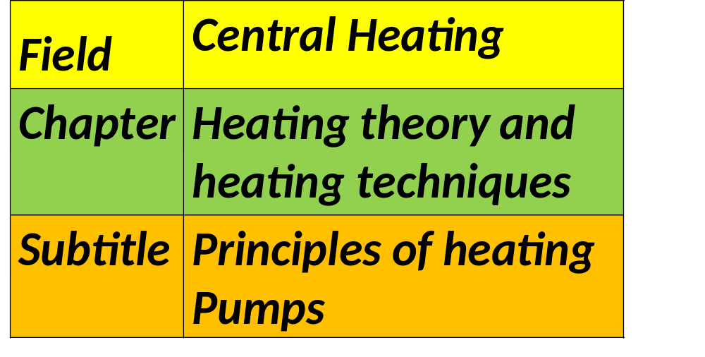


Slide 2



What is a heating pump?
Using a refrigerant to absorb and release heat as it circulates around the system, a heat pump transfers heat from one location to another. This is how the procedure is broken down:
Evaporation, or heat absorption:
Refrigerant: At the start of the journey, the refrigerant is a liquid at low pressure and low temperature.
Heat Exchanger: As the outside air passes through the heat exchanger on the outside, the refrigerant absorbs heat from the air—even in the winter—and causes it to evaporate into a gas.

Slide 3
What is a heating pump?
Compression:
Compressor: After entering the compressor, the gaseous refrigerant is condensed into a smaller volume. As a result, the temperature and pressure of the refrigerant both rise.
Temperature Rise: The refrigerant turns into a high-temperature gas after compression, frequently exceeding 100°F (37°C).
Heat Release (Condensation):
Indoor Heat Exchanger: The indoor heat exchanger is filled with hot gaseous refrigerant. It warms the room here by releasing its heat into the interior. This heat transfer results in the refrigerant condensing back into a liquid state.
Expansion:
Expansion Valve: After that, the liquid refrigerant goes via this valve. It returns to a low-temperature liquid condition as it expands, causing its pressure and temperature to decrease.
Restarting the cycle: The refrigerant is now prepared to take in heat from the ambient air once more.

Slide 4


Types of Heat Pumps
The most popular kind of heat pump that draws heat from the air is the air-source heat pump.
Ground-source heat pumps, or geothermal heat pumps, draw heat from the earth and have a better efficiency but usually require more expensive installation.
Take-up Heat pumps: These devices run on heat, usually from solar-heated water or natural gas. They are useful in some situations when using electricity is less feasible.

Slide 5



Heating and Cooling Modes
Heating Mode: Heat is drawn into the house from the outside air by the heat pump. The refrigerant's low boiling point allows this process to function well even in cold weather.
1
Cooling Mode: The opposite of the cycle. Like an air conditioner, the heat pump draws heat from inside the house and delivers it outdoors.
2

Slide 6



Efficiency and Benefits
Energy Efficiency: Heat pumps frequently have a coefficient of performance (COP) above three, indicating their high level of efficiency. This indicates that for every unit of power used, they can generate three units of heat.
Versatility: Modern heat pumps can be used for both heating and cooling because they are made to function well in a variety of temperatures.
Environmental Impact: Heat pumps lessen dependency on fossil fuels and contribute to the reduction of carbon footprints by harnessing ambient heat from the air, soil, or water.

Slide 7
References
Daken, A. (2022). How Does a Heat Pump Work. Retrieved from Green Living: https://www.greenlivingpdx.com/how-does-a-heat-pump-work/
Daken, A. (n.d.). How Does a Heat Pump Work? Retrieved from Energy Star: https://www.energystar.gov/products/ask-the-experts/how-does-heat-pump-work
HEAT PUMP / part 1 - principle of operation and structure. (2023, July 15). Retrieved from hajster: https://hajster.com/en/heat-pump-part-1-principle-of-operation-and-structure-en
How do heat pumps work? (2023, Apr 13 ). Retrieved from nationalgrid: https://www.nationalgrid.com/stories/energy-explained/how-do-heat-pumps-work
HOW DOES A HEAT PUMP WORK IN SUMMER? (2022, March 25). Retrieved from DeepClean NL: https://deepcleannl.com/how-does-a-heat-pump-work-in-summer/
page, C. C. (2023, Febuary 14). Everything you need to know about the wild world of heat pumps. Retrieved from MIT Technology Review: https://www.technologyreview.com/2023/02/14/1068582/everything-you-need-to-know-about-heat-pumps/

