Slide 1


Field | Central Heating
Chapter | Fuel Storage
Subtitle | Fuel Oil Tanks

Slide 2
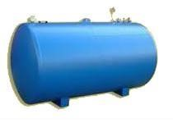
Fuel Oil Tanks

Slide 3
Manner of storage
1. not accessible fuel oil tanks
2. accessible fuel oil tanks

Slide 4
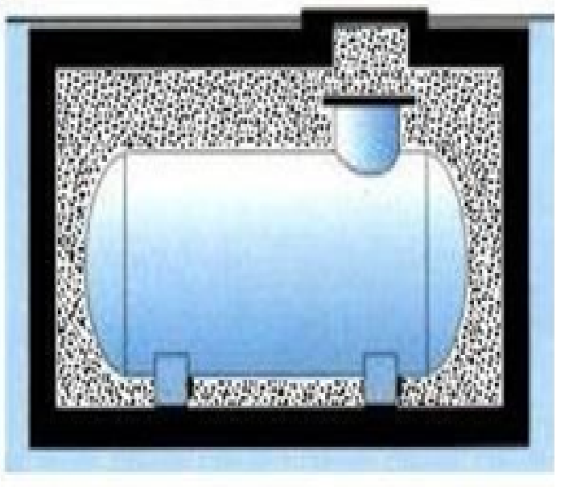
not accessible fuel oil tanks
Reservoir in filled up pit

Slide 5
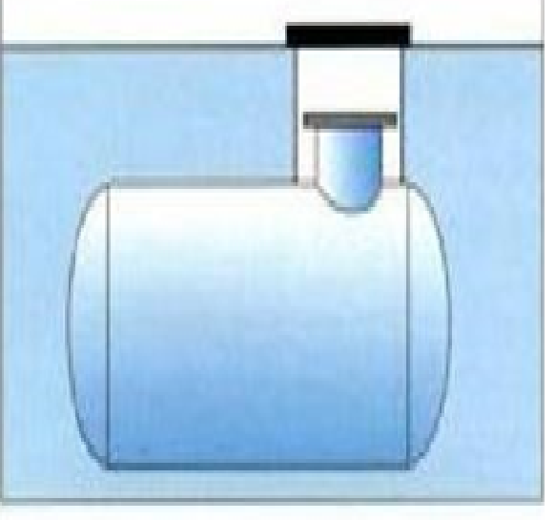
not accessible fuel oil tanks
Reservoir directly buried

Slide 6
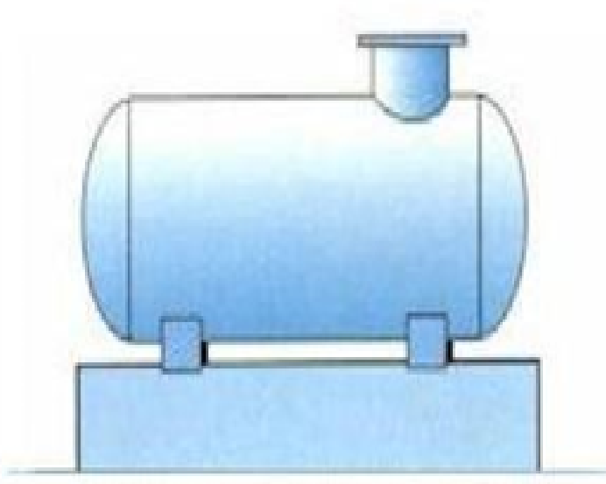
accessible fuel oil tanks
Reservoir in open air

Slide 7
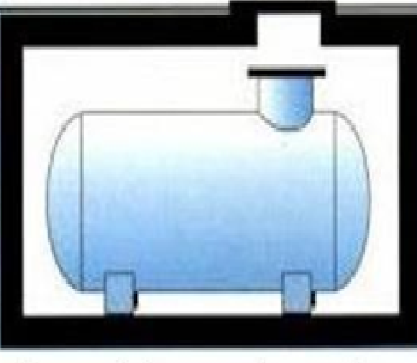
accessible fuel oil tanks
Reservoir in accessible pit

Slide 8
Materials for construction
Steel reservoir with 2 layers of anti-rust paint ( accesseble )
Steel reservoir with a epoxy coating or polyurethane coating ( unaccessable )
PE reservoir ( accessseble )
PE reservoir with reinforcing ribs ( unaccessable )
Stainless steel reservoir ( very expensive )
All reservoirs have to be double-walled

Slide 9
Identification plate
Name and address of the constructor
Date and manufacturingnumber
Reference of the prototype inspection
EN norm of the reservoir
Volume and dimensions of the reservoir
Proof in bar

Slide 10
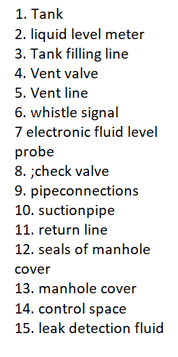
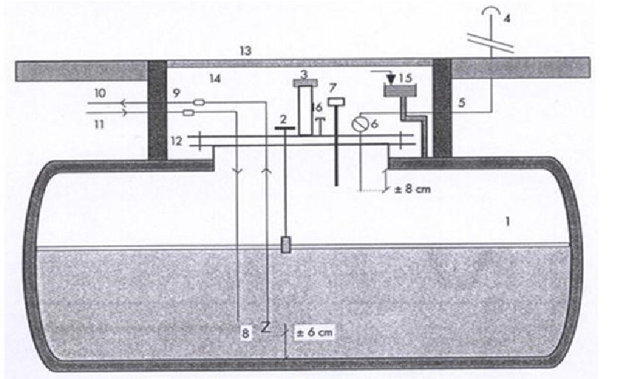
Principle diagram of storage in a double-walled tank

