Slide 1


Field | Automation and robotics
Chapter | Types of equipment in mechanical transport operations
Subtitle | Equipment in mechanical transport operations

Slide 2
Types of equipment in mechanical transport operations

Slide 3
Mechanical transport operations involve the movement of goods, materials, or people using various types of equipment. Here are some common types of equipment used in mechanical transport operations

Slide 4
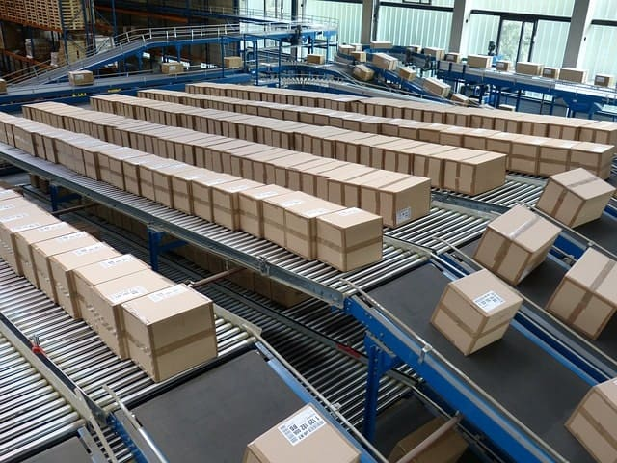
Conveyor systems
Conveyor belts or systems are extensively used in production facilities to transport materials, components, or finished products between different stages of the production process. They help streamline the flow of materials and improve efficiency.

Slide 5
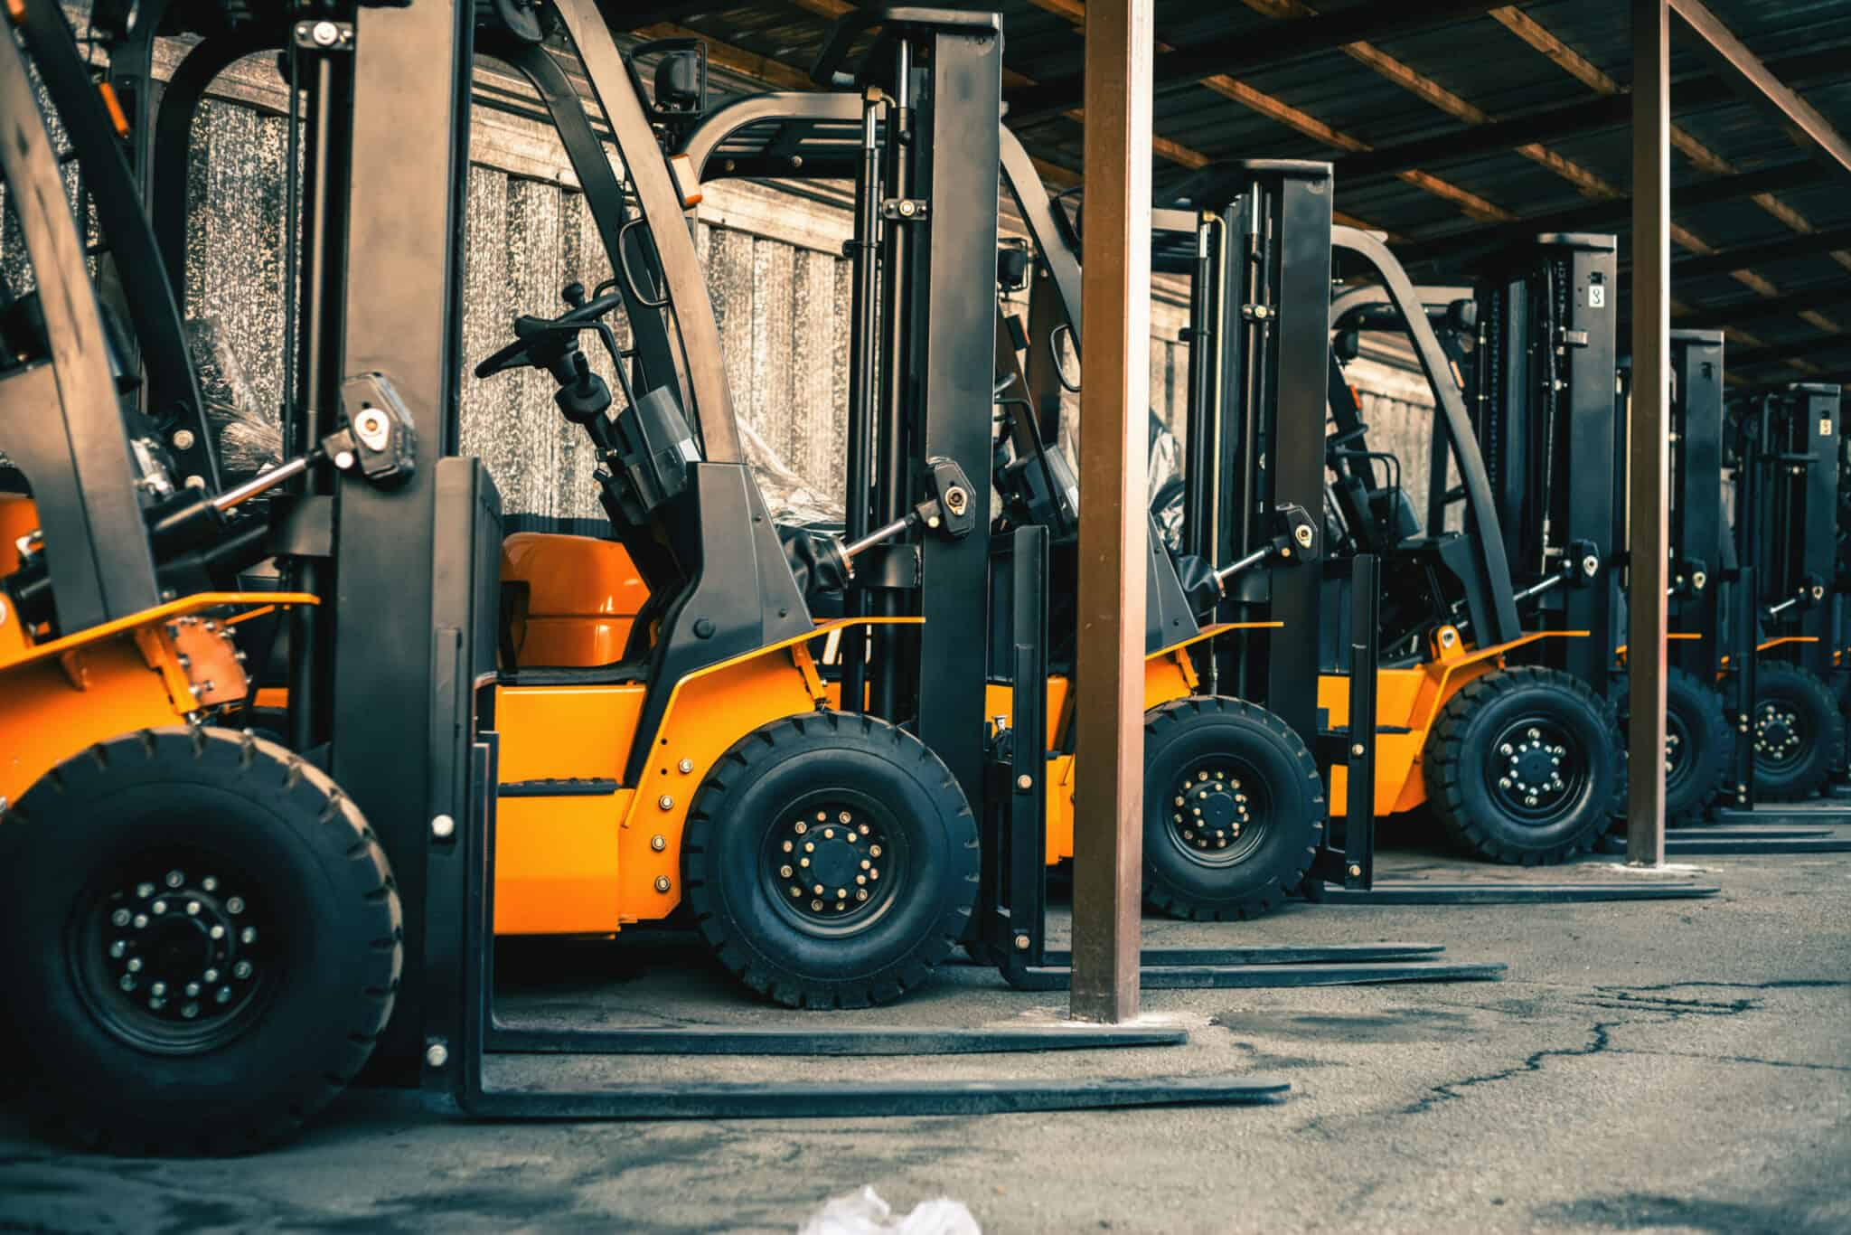
Forklifts
Forklifts are widely used in production plants to move raw materials, intermediate products, or finished goods within the facility. They are essential for loading and unloading materials from storage areas or delivery trucks.

Slide 6
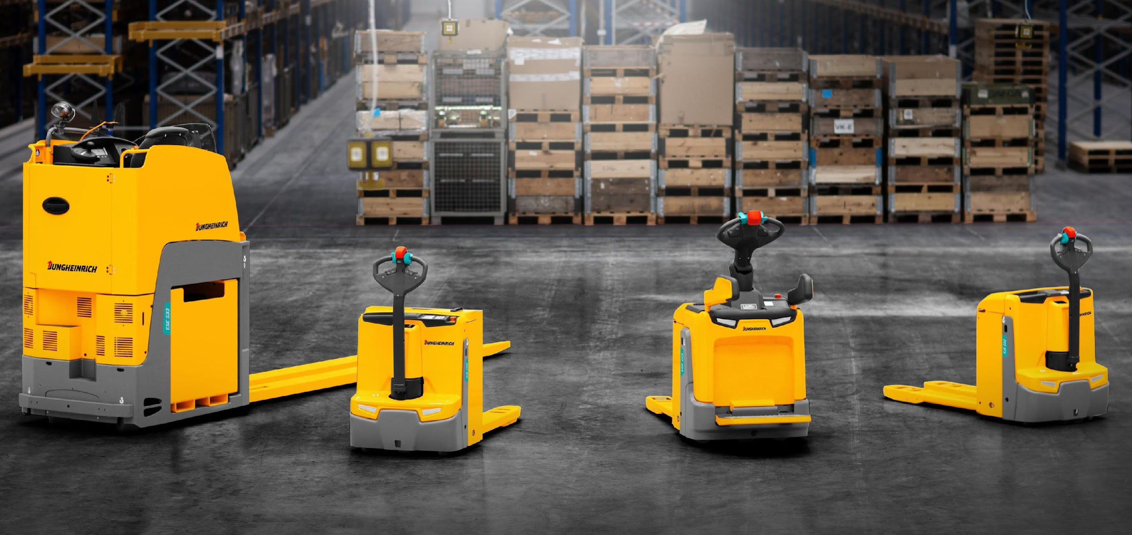
Pallet jacks
Trains are used for transporting large quantities of goods or passengers over long distances. They consist of locomotives that pull a series of interconnected cars or wagons.

Slide 7
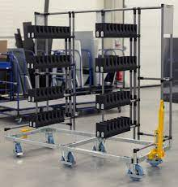
Trolleys and carts
Trolleys and carts with wheels are used in production facilities to transport smaller loads or tools. They can be manually pushed or pulled and are suitable for moving items within a limited area.

Slide 8
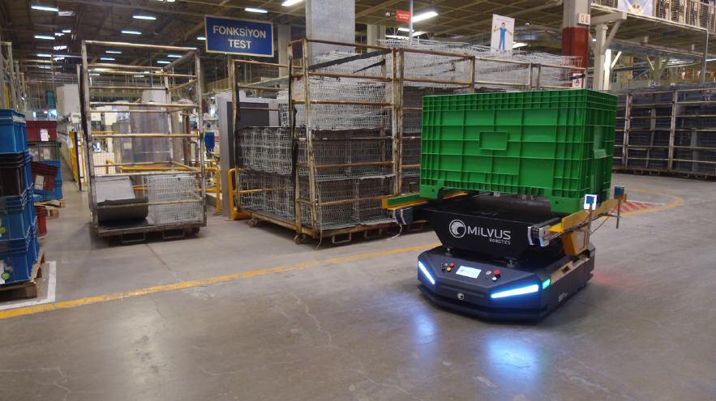
Industrial robots
In automated production lines, industrial robots are used for material handling and transportation tasks. These robots can pick up, transport, and place objects with precision, improving productivity and efficiency.

Slide 9
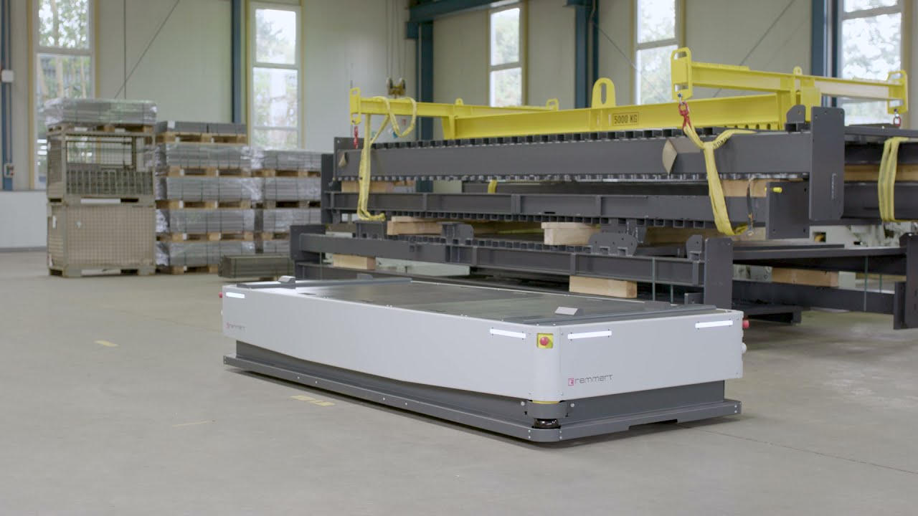
Automated guided vehicles (AGVs)
AGVs are autonomous or semi-autonomous vehicles used to transport materials or products within production facilities. They follow pre-programmed routes and can navigate safely around obstacles.

Slide 10
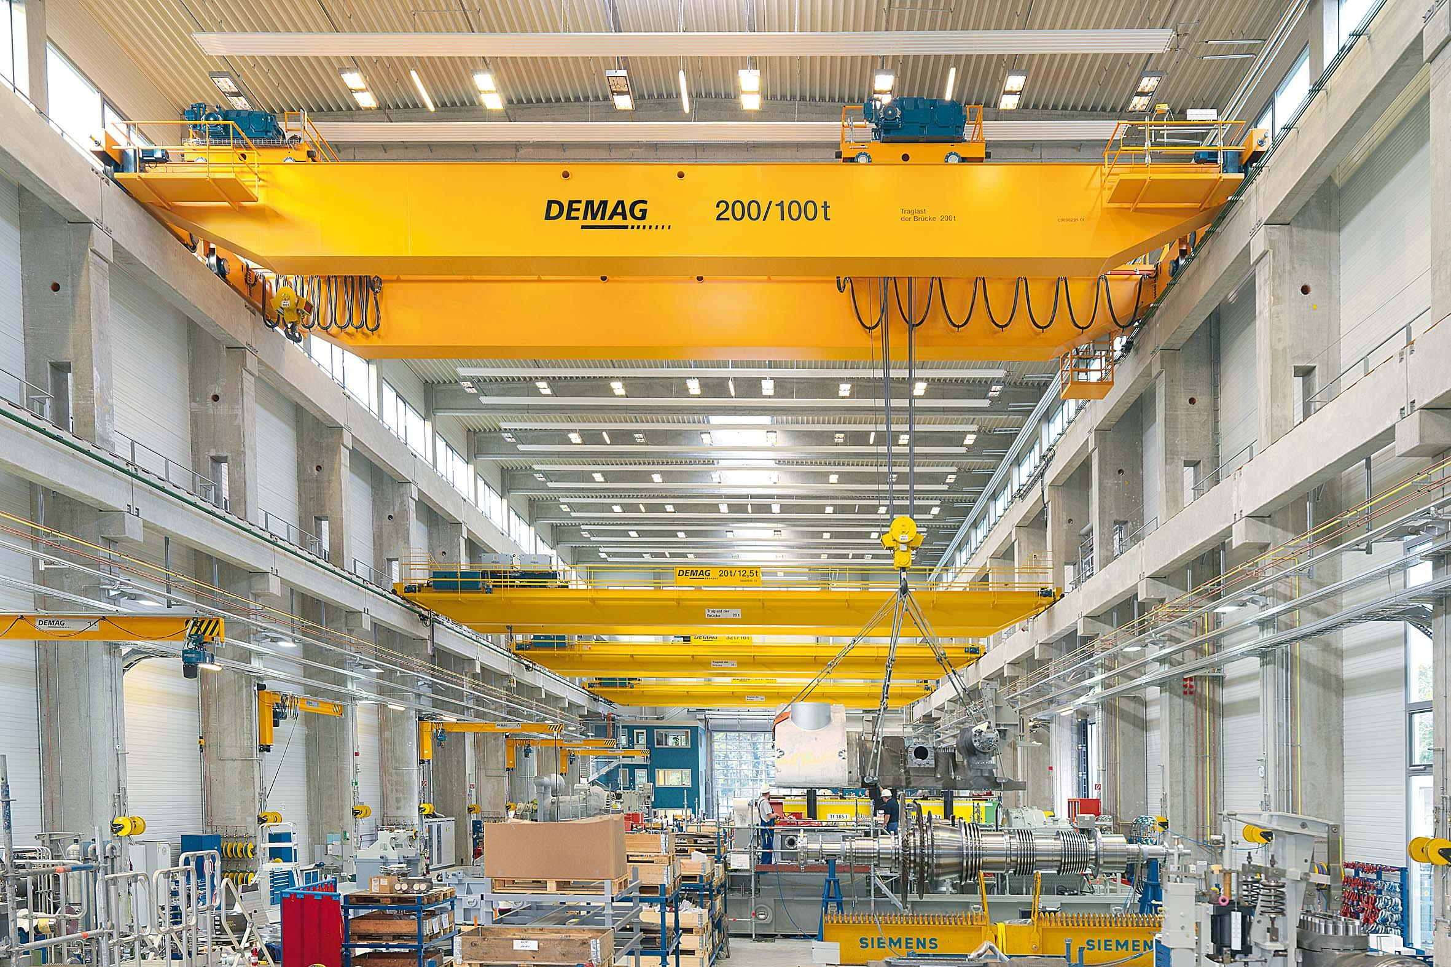
Hoists and lifts
Hoists and lifts are utilized in production facilities for vertical material transport. They are commonly used to lift heavy loads, such as machinery components or finished products, to different levels within the facility.

Slide 11
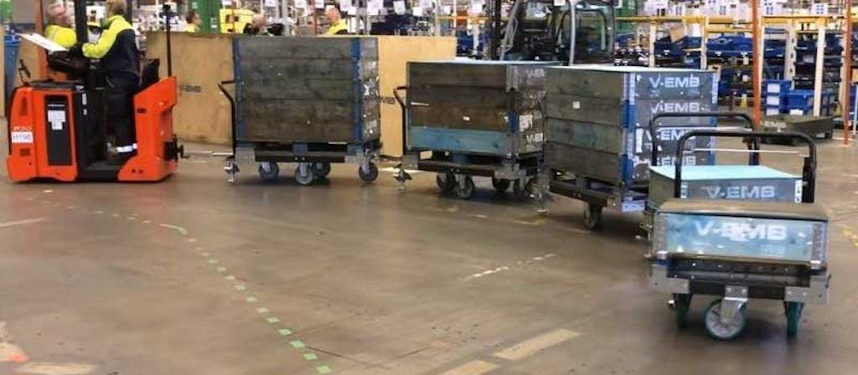
Tugger trains
Tugger trains consist of a powered tugger vehicle that pulls a series of carts or trailers. They are used in production facilities for batch transportation of materials or products between different workstations or assembly areas.

Slide 12
THANKS!
Any questions?

