Slide 1


Field | Automation and robotics
Chapter | Basic characteristics and importance of transport systems
Subtitle | The role of transport systems Division of transport systems

Slide 2
Basic characteristics and importance of transport systems

Slide 3
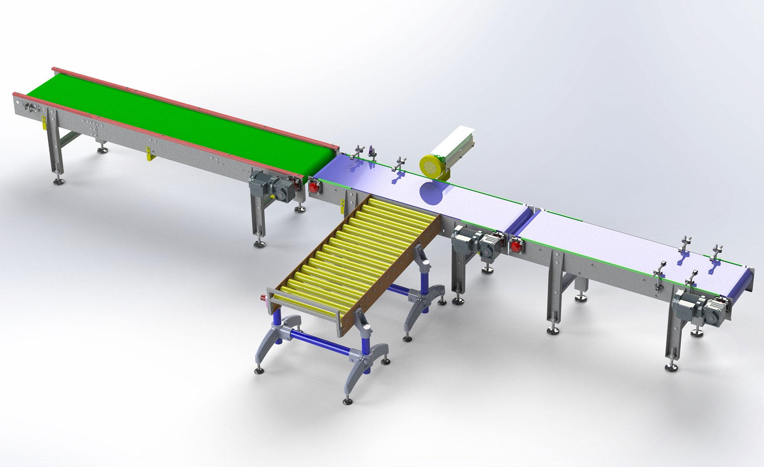
Introduction
Transport systems are vital for the industry, as they enable the movement of products and materials between manufacturing facilities, warehouses, and sales locations. Here, we will explore the fundamental characteristics of transport systems and their significance for the industry.

Slide 4
Characteristics of Transport Systems

Slide 5
Transport systems can vary in terms of size, capacity, and function. Among the most common characteristics of transport systems are speed, reliability, flexibility, efficiency, and safety.

Slide 6
Speed is crucial in industrial processes as it allows for the quick movement of products and materials.

Slide 7
Reliability of transport systems is also key as the industry cannot afford losses due to system failures.

Slide 8
Flexibility of transport systems enables the movement of different products and materials without the need for system changes.

Slide 9
Safety of transport systems is also vital as industrial processes can be hazardous and need protection against injuries and losses.

Slide 10
Types of Transport Systems

Slide 11
Transport systems can be divided into several categories based on the method of moving products and materials. Some of the most common transport systems in the industry are:
Conveyors
Elevators
Trolley-based Transport Systems
Hydraulic Transport Systems
Pneumatic Transport Systems

Slide 12
The Importance of Transport Systems for the Industry
Transport systems are crucial for the industry for several reasons. Firstly, transport systems enable the movement of products and materials between different points in the production process, allowing for faster and more efficient manufacturing. Secondly, transport systems facilitate the storage and transportation of finished products to sales locations, enabling faster and more efficient distribution to customers. Thirdly, transport systems can be used to handle heavy and hazardous materials, reducing the risk of worker injuries.

Slide 13
Conclusion

Slide 14
Transport systems are of vital importance to the industry as they enable the movement of products and materials between different points in the production process. Here, we have explored the fundamental characteristics of transport systems and their significance for the industry. Different types of transport systems are utilized depending on the specific needs of the industry, and speed, reliability, flexibility, efficiency, and safety are some of the key characteristics to consider when choosing a transport system.

Slide 15
THANKS!
Any questions?

