Slide 1


Digital inputs modules PLC

Slide 2
Field | Automation and robotics
Chapter | Digital inputs modules PLC
Subtitle | General

Slide 3
Programmable logic controller ( PLC)
The input module of the PLC controller performs the following two basic tasks:
they accept incoming signals from the outside world
they protect the logical unit from the outside world
The input module converts the logic voltage levels from the outside world into the logic levels required by the logic unit.

Slide 4
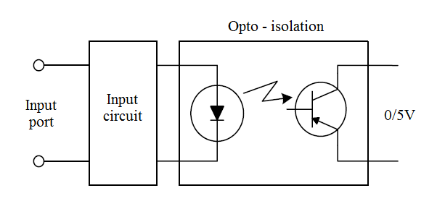
Opto-coupler
Opto-isolation (abbreviated from optical isolation) is most often used to protect the logic unit. The principle of opto-isolation is illustrated in Figure 1. There is no electrical connection between the external connection of the input module and the logic unit.
The signal present at the input of the module is converted into light. The light illuminates the photo-conductor, which turns on under the influence of light. Components that are used for opto-isolation and combine in one sealed housing a photo-transmitter (LED) and a photo-receiver (phototransistor) are called opto-couplers.
Figure 1. Principle of opto-isolation

Slide 5
Flickering contact
Discrete input modules contain built-in circuitry to eliminate input signal flicker. Many input devices are mechanical components and have contacts. When opening or
when the contact is closed, the electrical connection is not broken, that is, it is not established, it is already established a transitional mode occurs during which the connection is established/disconnected a large number of times before establishing a final state. This phenomenon is called contact flicker and can have unwanted effects
consequences if it is not eliminated, given that the logical unit can blink every time
interpret as a new activation of the input signal.
In addition to simple mechanical switches, sensors are often used as input devices.
There are a number of different types of sensors used to:
object presence detection,
product counting,
temperature measurement,
pressure etc.

Slide 6
Inputs - outputs PLC
The PLC controller exchanges simple, digital, on/off signals with other smart devices such as:
robots,
computers,
vision systems, etc.
These signals are used to align the common operation of independent parts of the system. For example, a robot can send a signal to the PLC controller at a moment's notice when he finished some operation. Upon receipt of this signal PLC can activate some other device that continues processing the product. This way of coordination, when devices give each other permission to perform some operations, is called…

Slide 7
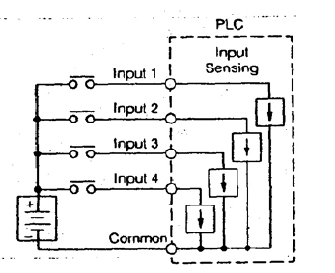
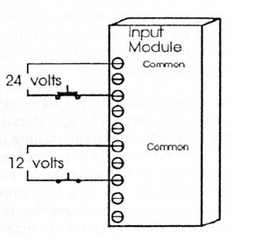
Inputs - outputs PLC
Ways of connecting input modules with external power supply are shown in the picture. Most input modules have a group of inputs that share a common return path - COMMON (or COM).
Some input modules have more than one group with a common power connector
Figure 2. Input module with common connection
Figure 3. Input module with two separate connections

Slide 8
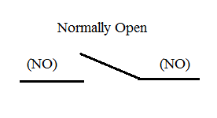
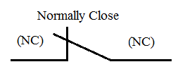
Inputs - outputs PLC
Digital sensors/switches are available in two variants:
with normally-closed
normally-opened output contacts.
The term normal refers to the state of the sensor/switch when it does not detect the presence
of an object, i.e. when it is not pressed.

Slide 9
Inputs - outputs PLC
The terms closed and opened refer to the state of the sensor/switch output.
OFF
The sensor/switch with normally open contacts is in the OFF state for the entire time until the sensor detects the presence of an object, i.e. until the switch is pressed.
ON
A switches to the ON state when the sensor detects an object, i.e. when the switch is pressed.
The opposite is true for sensors/switches with normally-closed contacts.

Slide 10
Inputs - outputs PLC
In addition to sensors with two output connections, (which are less often used and where leakage current must be taken into account), sensors with three connections are also in use. One of the connections is intended for power supply (+V), the other is (GND), while the remaining connection is the output contact of the sensor.
There are two types of sensors with three connections: NPN and PNP.

Slide 11
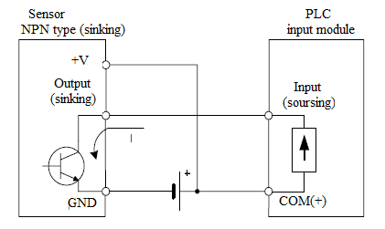
NPN sensor type
An NPN-type sensor can be represented as in Fig. 4. As can be seen, at the sensor NPN type, the current exits from the input port of the PLC module (sourcing type) and enters the sensor through sensor output connection.
Figure 4. Connecting the NPN type sensor to the PLC input module

Slide 12
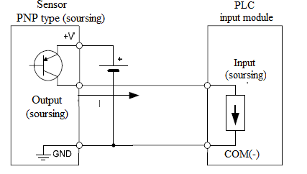
PNP sensor type
The coupling of the PNP type sensor with the PLC module is shown in Fig. 5. In this case, the current flows from the output port of the sensor (that's why it is said that the sensor is of the sourcing type) into the input port of the PLC module
Figure 5. Connecting the PNP type sensor to the PLC input module

Slide 13
THANKS!
Any questions?

