Slide 1


Field | Automation and robotics
Chapter | PLC input/outputs modules
Subtitle | General

Slide 2
PLC input/outputs modules

Slide 3
Programmable logic controller ( PLC)
Discrete sensors and actuators located on a process or plant can have very different technical characteristics, that is, the requirement that is set when connecting them to the controller is always the same.
To ensure the conversion of the digital (binary) signal coming from the sensor into a numerical value of 0 or 1

Slide 4
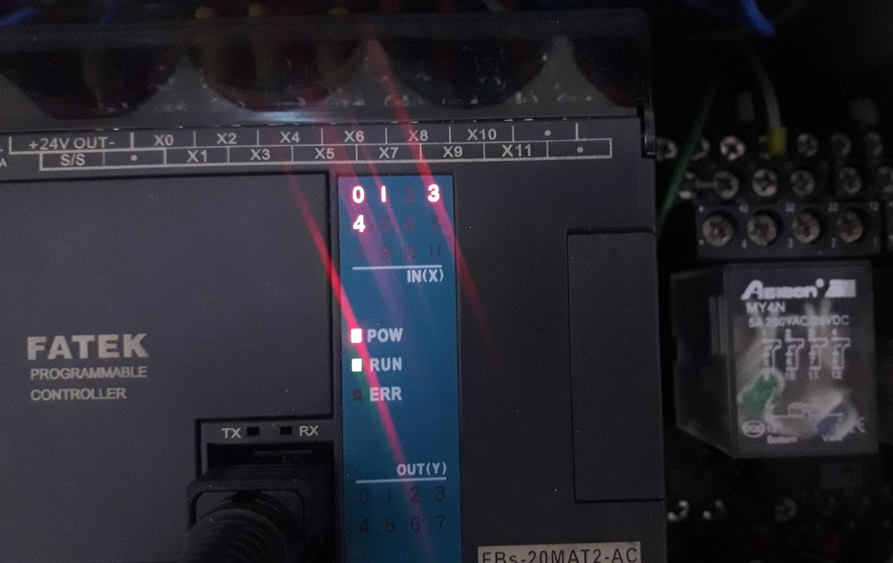
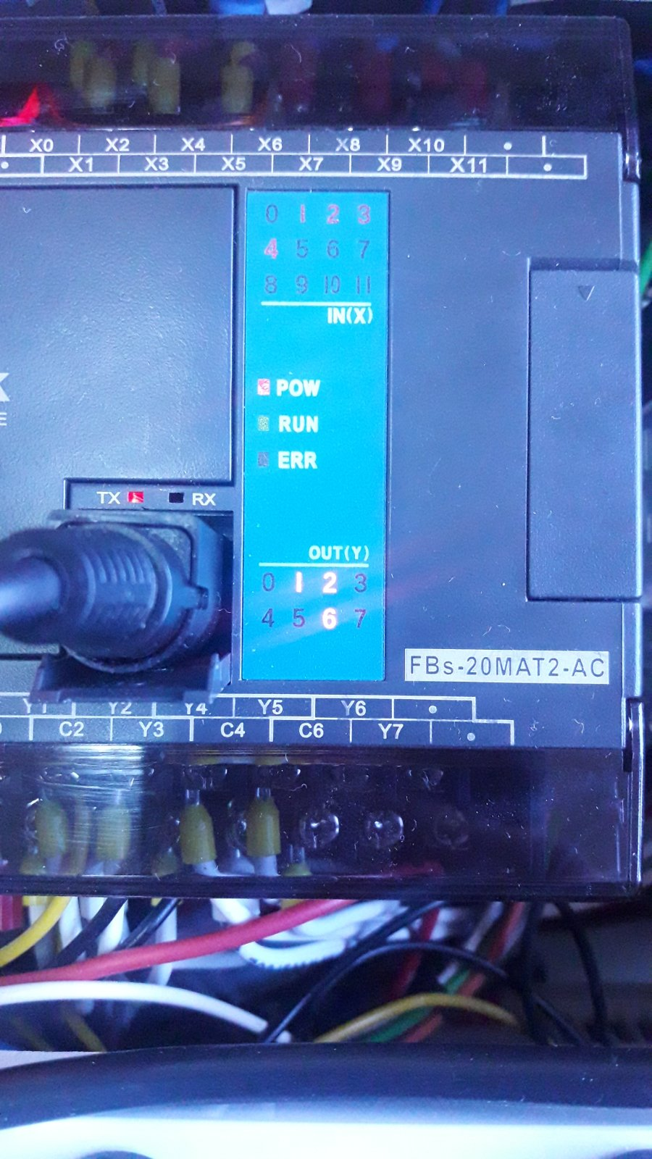
Inputs - outputs PLC
During operation of the I/O module, the state of each pin is displayed on the corresponding LED indicator.
An indicator connected to an input pin lights up if the input signal is in a logic one state.
An indicator connected to an output pin lights up if, as a result of program processing, a logic unit is set on the output pin.

Slide 5
Inputs - outputs PLC
Each pin is actually an input or output point of the corresponding circuit for coupling with the controller. Accordingly, each pin is identified:
by its type (input or output) and
a number that determines the position of the I/O circuit within the module (which actually represents the pin address)

Slide 6
Inputs - outputs PLC
There are three types of I/O modules:
entrance,
output i
combined input/output module
And each of them can be coupled with AC, DC and TTL voltage levels.

Slide 7
THANKS!
Any questions?

